Slide 1
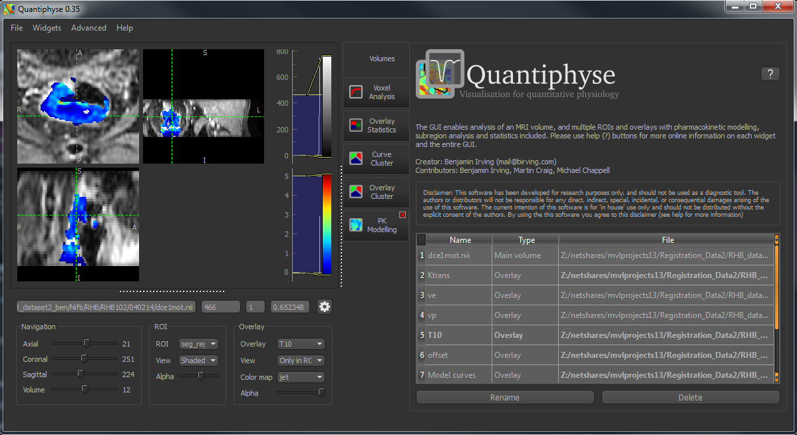
Three viewing windows show Axial, Coronal and Saggital slices. Left click to focus a point, drag to move the image. Right click and drag to zoom. Mouse wheel to move through the slices. Double click to maximise/restore the current view.
Additional widgets can be opened from the menu. They then appear in the tab list
Volumes can be loaded from the File menu, or by drag and drop
Tabs show currently opened widgets. Click to use the tool – currently the volume overview widget is showing.
Current main volume filename
Navigation sliders for the four image dimensions
Choose between loaded regions of interest and how they should be displayed
Choose current displayed overlay and how it should be displayed
Data value, ROI region and overlay data value at current position
View options
List of all loaded volumes

