Slide 1
Minimal Flask
Easy web app building toolkit
Used by a lot of people
Fear Not:
    In a 3 session class, all you should try is a basic understanding.
    More important to recognize than to deeply understand

Slide 2
What runs where?
Client/Server model (simplified overview):
  Server: “Deep thinking” runs on the cloud
    Web server
    Central code
    Database
  Client: “What you see” runs on your machine
    Web browser

Slide 3
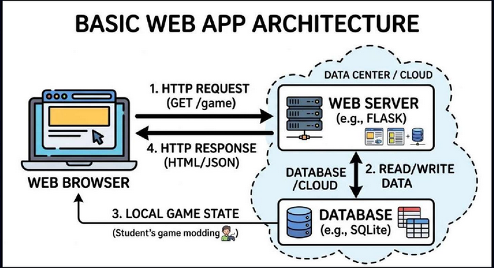
Basic Structure
View from 30,000 feet:

Slide 4
What are the parts?
Browser (Front end)
  User interface (screen, keyboard, graphics…)
  HTTP Request:
    Browser requesting data or page from the server.
    Example: When you request a URL from a server
  HTTP Response:
    A web page
    A bunch of data

Slide 5
What are the parts?
Cloud data center (back end)
    Powerful data center running central code 24/7
  Flask Web Servers
    Accept requests
    Decide what logic to run when request comes in
    Returns result
  Database
    Permanent memory. Keeps all the data
    Imagine a bunch of spreadsheets in memory
    You can save, modify, and retrieve data

Slide 6
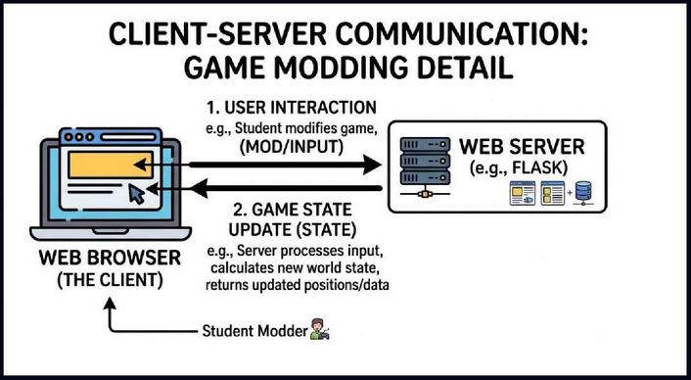
How does it work?
Client Server Game Communications

Slide 7
What are the parts?
User Interaction
    Key and mouse events
    JavaScript packs action into an “http request”
Flask Route Handler
    Matches “http request” to game “specialist” logic
    Returns data packet in JSON format
What you do
    Observe and Modify data and action

Slide 8
Example
  Hello, Goodbye...
from flask import Flask
app = Flask(__name__)
@app.route('/hello', methods=['GET'])
def hello():
return 'hello'
@app.route('/goodbye', methods=['GET'])
def goodbye():
return 'goodbye'
if __name__ == '__main__':
app.run(debug=True)

Slide 9
What are the parts?
From flask import Flask
    “flask” is a library
    Flask is the module you use, lives in the library
Link route to handler
  @: Annotation: Tells flask how to hook up code
    @app.route('/hello', methods=['GET'])
    Whenever /hello gets a ‘GET’, run this”
    def hello():
    return 'hello'
  When browser goes to ../hello, run this code.

Slide 10
Example
  Hello, Goodbye… as a real web page
from flask import Flask
app = Flask(__name__)
@app.route('/hello', methods=['GET'])
def hello():
return '<h1>Hello</h1>'
@app.route('/goodbye', methods=['GET'])
def goodbye():
return '<h1>Goodbye</h1>'
if __name__ == '__main__':
app.run(debug=True)

Slide 11
What are the parts?
Code can return actual web page
    Hint: all the <***>xxx</***> stuff

Slide 12
What are the parts?
Can also return data as Json
from flask import Flask, jsonify, request
app = Flask(__name__)
@app.route('/returnjson', methods=['GET'])
def return_json():
data = {
"object": “magic wand”,
"x": 15,
"y": 23,
"action": "blink"
}
return jsonify(data)
if __name__ == '__main__':
app.run(debug=True)

Slide 13
Looks Complicated!
Don’t worry
    There is NO GRADE in this class!
    We will explain again, and again, and again...
    Just try to recognize the code
    AI will write code for you
    You only need to recognize what it does
      Just watch the game and the debugger messages

Slide 14
NEXT
Show flask console log
  From game demo

