Slide 1
Databases
Simple description of a database:
  A bunch of tables (like spreadsheets)
    Lots of tables
    Lots of rows in the tables
    You can select rows by their contents
      Give me the person whose name is “John Smith”
      Give me all people who live in Pasadena
  Its more then just that, but this is enough for now.

Slide 2
What do you do with it?
For data in tables:
  Get rows of data
  Save rows of data
  Update data
  Delete data

Slide 3
How does this work:
Data managed by a program:
  Program called Database Management System (DBMS)
  You issue commands
    Get data…
    Save data
    Update data
    Delete data
  It returns data and status info (Ok, Error, etc.)

Slide 4








Basic SQL for Flask
1. SQL
Flask Web App
2. Result
MySQL DB
Python Brain
The Storage Vault
Why Do We Need Both?
Why MySQL?
Flask runs in computer memory (RAM). When your game restarts or crashes, normal Python variables vanish into thin air.
MySQL writes records permanently on the hard drive inside organized tables. SQL is the bridge language Flask uses to ask questions.

Slide 5




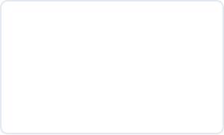


Game Leaderboard: Flask SELECTs Data
MySQL: `leaderboard`
Ask
id | player | score
1 | NovaStar | 2,450
2 | PixelKnight | 1,820
3 | ShadowFox | 1,150
Receive
Flask Server
What Just Happened?
Spreadsheet Analogy
●
A gamer opens mygame.com/leaderboard in their web browser.
Think of a relational table as a super-fast Excel sheet:
●
Columns: The labeled categories (id, player, score).
●
Flask sends a SELECT query across the wire to MySQL.
●
Rows: One record per gamer holding their individual stats.
●
MySQL looks inside the table and sends the player rows right back.

Slide 6
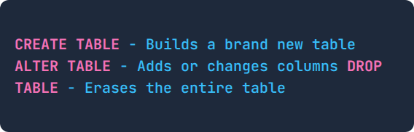
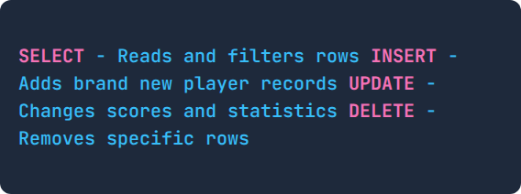
The Two Big Families: DDL vs. DML
DML: Data Manipulation Language
DDL: Data Definition Language
The Architect: Builds and modifies the structure and blueprint of the database.
The Worker: Manages, edits, and reads the live data inside existing tables.
●
Executed only once when first planning or launching the game.
●
Runs thousands of times every second while players play!
●
Defines column names, data types, and safety rules.
●
Does not change the table columns, only the rows inside.
Bookshelf Analogy: DDL is assembling an empty bookshelf with labeled dividers. DML is taking books off the shelf, adding new ones, or rearranging them!

Slide 7






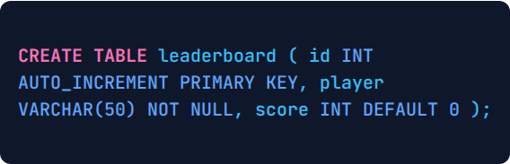
DDL: CREATE TABLE (Building the Blueprint)
Blueprint
Ready
Flask Setup
MySQL Vault
Discussion Prompts
The SQL Blueprint Code
●
PRIMARY KEY: Gives every record a unique ID number so identical names never get mixed up.
●
VARCHAR(50): Text box holding gamer tags up to 50 letters long.
●
INT: Integer bucket for storing numerical point scores.

Slide 8


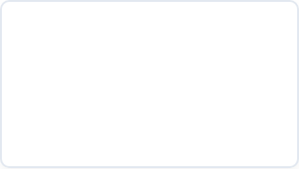


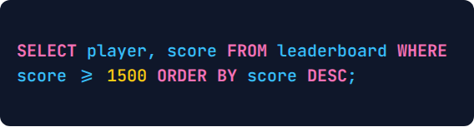
DML: SELECT (Reading Player Records)
Filtered Search
Search
Player | Score | Match?
NovaStar | 2450 | YES
PixelKnight | 1820 | YES
ShadowFox | 1150 | NO
Filtered
Flask Logic
The SQL Query
Key Concept Checklist
●
WHERE clause: Acts like a smart filter. Only scores 1500 and higher get sent back.
●
ORDER BY ... DESC: Ranks scores from top to bottom so #1 is in first place.
●
100% Safe: SELECT reads data without modifying or erasing anything!

Slide 9


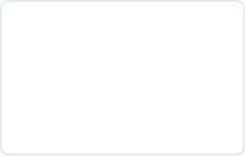


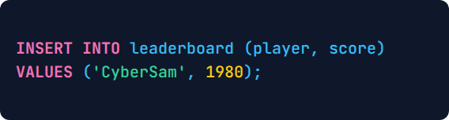
DML: INSERT (Adding a New Challenger)
New Row Added
Add Row
id | player | score
1 | NovaStar | 2450
2 | PixelKnight | 1820
4 | CyberSam | 1980
Inserted
New Player!
The SQL Statement
Notice the Details
●
Auto ID: We never typed the number 4! The database assigned it automatically with AUTO_INCREMENT.
●
Quotes Matter: Text strings go in single quotes ('CyberSam'), while numbers stay unquoted.

Slide 10







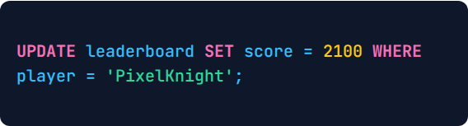
DML: UPDATE (Beating Your High Score)
Updated Score
Update
Player | Old Score | New Score
NovaStar | 2450 | 2450
PixelKnight | 1820 | 2100
CyberSam | 1980 | 1980
Updated
Score Up!
The SQL Statement
The Golden Rule of UPDATE
Danger: If you forget the WHERE clause, EVERY single player in the whole game gets their score changed to 2100!
●
SET: Specifies the exact column to modify and the new value.
●
WHERE: Pinpoints the specific gamer to update.

Slide 11




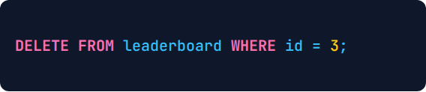
DML: DELETE (Removing a Player Row)
Row Erased
Trash
id | player | score
1 | NovaStar | 2450
2 | PixelKnight | 2100
3 | ShadowFox | 1150
Row Gone
Mod Admin
The SQL Statement
Safety First with DELETE
●
Always use the Primary Key (id): Two gamers might have similar names, but the ID number is always unique.
●
DELETE vs DROP TABLE: DELETE removes rows inside; the table remains. DROP TABLE destroys the entire table itself!

Slide 12

SQL Cheatsheet: What We Learned
Command | Family | What Flask Asks MySQL To Do | Game Example
CREATE TABLE | DDL | Constructs empty columns and column types | Build empty leaderboard layout
SELECT | DML | Queries and reads rows matching a condition | Show Top 10 on the web page
INSERT | DML | Appends brand new player rows to the table | Save score after "Game Over"
UPDATE | DML | Modifies column values in existing rows | Player beats their old high score
DELETE | DML | Erases specific rows matching a filter | Remove an inactive or banned player
The Request-Response Cycle
Remember the Word CRUD
Flask never stores everything in Python memory. It sends a brief SQL command, grabs only the rows it needs, shows them to the player, and closes the connection.
Web developers call these four actions CRUD: Create (INSERT), Read (SELECT), Update (UPDATE), and Delete (DELETE)!

Slide 13
Challenge Time: Test Your SQL Skills!
Scenario 1
Scenario 2
A new gamer signs up for your game on the webpage. Which SQL command does Flask send to the MySQL cylinder?
You want to add a brand new coins column to the leaderboard table. Is that DDL or DML?
> Thinking...
> Thinking...
Scenario 3
Discuss!
What happens if someone runs DELETE FROM leaderboard; without typing a WHERE condition?
Read the scenarios carefully, discuss with the class, and let's flip to the next slide to check the answers!
> Thinking...

Slide 14
NEXT
Show code

