Slide 1
Crowdventure™
By Ben Kern

Slide 2
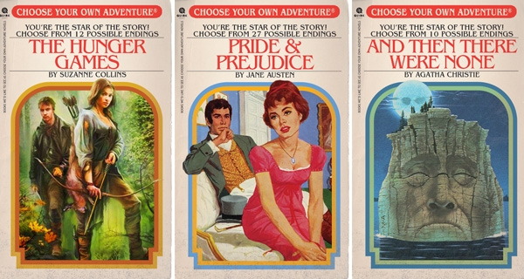
The Problem
Choose Your Own Adventure Games are fun, but have a few problems:
Require a lot of time and effort to make something that isn’t just a linear story
Even when the creators do put in a lot of effort, you still don’t end up with too many options for what you can do
Maybe you don’t like any of the options of a given situation and want to do something different!

Slide 3
The Solution: Crowdsourcing!
It solves all of our problems.
By allowing people to suggest and add upon other’s games, people can be as creative as they want to create truly complicated and fun to play Choose Your Own Adventure Games
Theoretically, the number of different endings will expand exponentially as more people add more options to the game!

Slide 4
BK
You awake on an the beach of an island, with no memory of how you got there. There is no sign of any humans being anywhere around you, and there is a forest behind you. What do you do?
Restart Game
Restart Game
Explore Beach
Explore Forest
BK
BK
As you explore a bit, you find a wooden canoe resting on the beach! Do you use the canoe to try to escape the island?
Searching through the forest, you find some delicious looking red berries in a bush. Do you eat them?
Yes!
Yes!
BK
BK
You try to use the canoe to escape, and it topples over and you die! Game over!
You try one berry and instantly topple over and die! Game over!

Slide 5
You awake on an the beach of an island, with no memory of how you got there. There is no sign of any humans being anywhere around you, and there is a forest behind you. What do you do?
BK
Restart Game
Restart Game
Explore Beach
Explore Forest
BK
BK
As you explore a bit, you find a wooden canoe resting on the beach! Do you use the canoe to try to escape the island?
Searching through the forest, you find some delicious looking red berries in a bush. Do you eat them?
Examine Canoe
Look up pictures of berries online
Yes!
Yes!
BK
BK
You try to use the canoe to escape, and it topples over and you die! Game over!
You try one berry and instantly topple over and die! Game over!
RT
AF
As you examine the canoe, you find a small hole in the hull that would have led to you toppling over and dying!
You find on your trusty iPhone 11C++ that if you had eaten them, you would have had a BERRY bad time!

Slide 6
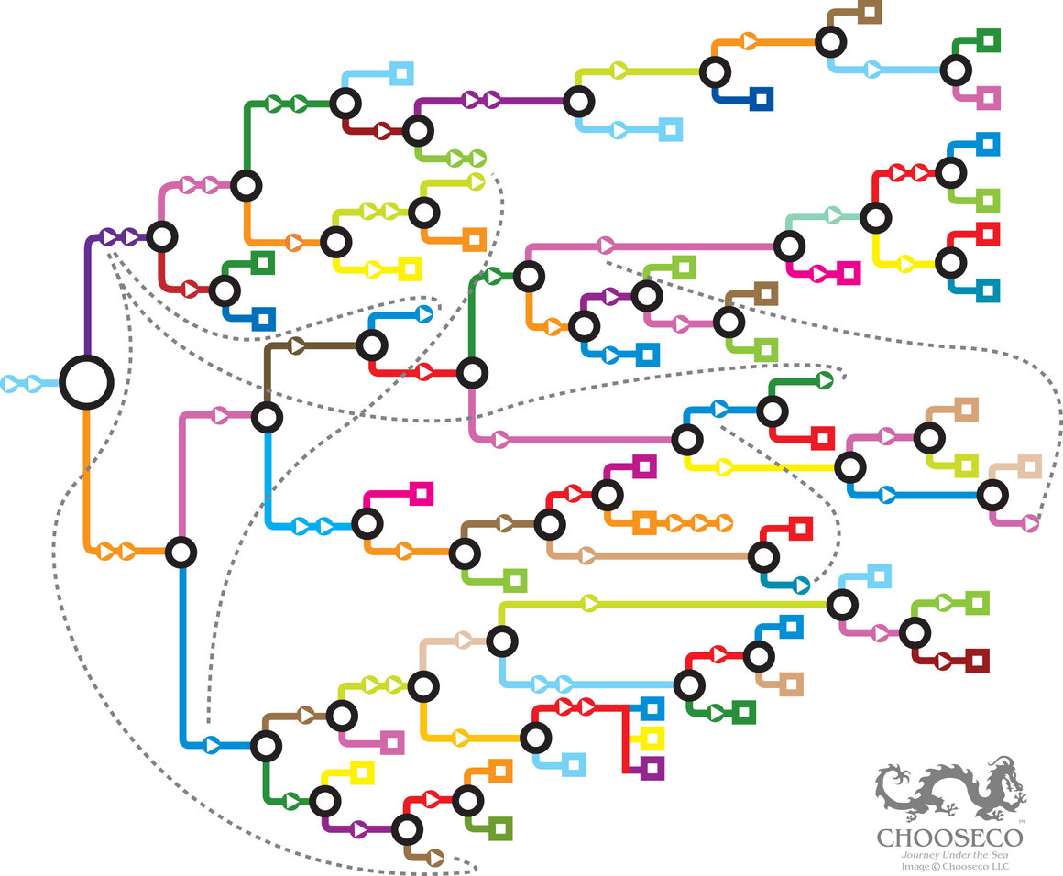
Justification
I don’t have a lot of frontend experience!
Nothing else like it exists!
Seems like a fun project!

Slide 7
Questions?

Slide 8

Thank you!

