Slide 1
Drillcreator
Automatic Marching Band Show Builder
Mason Davy, Andy Greer, Matthew Kuhr, Benjamin Middleton
Advised by Mehdi Norouzi

Slide 2
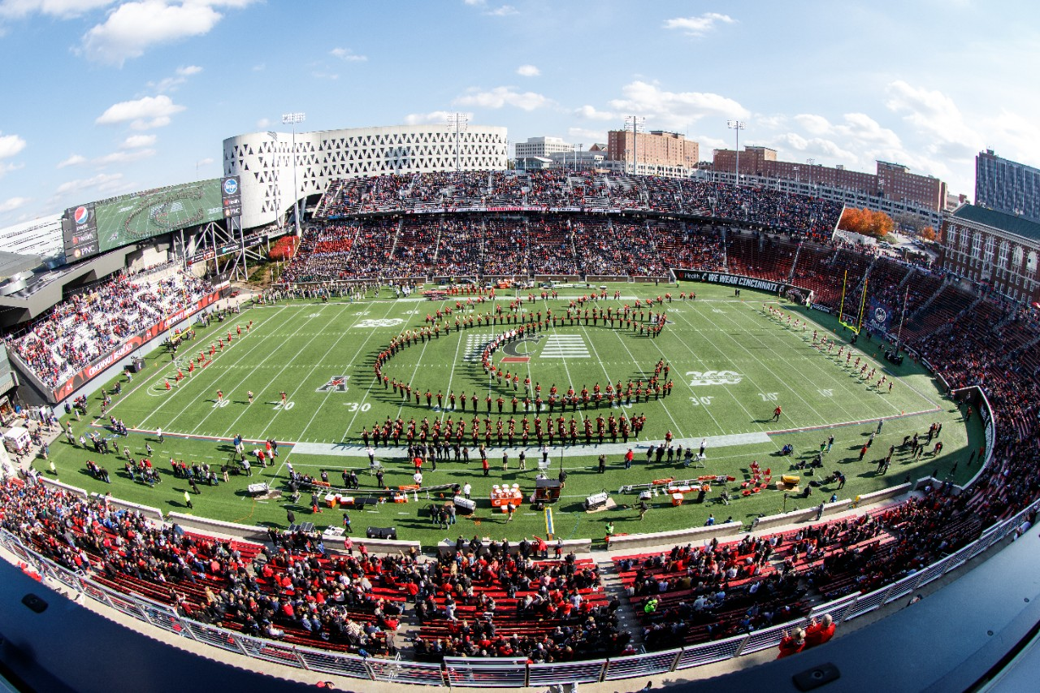
Goals and Background
Creating marching drill sets can be difficult
Sometimes marchers collide with each other
Sometimes marchers are forced to move quickly to keep up
Make it easy for band directors to create drillsets
Sets can be created from arbitrary images
Ensure that marchers don’t collide with each other & can move at comfortable speeds

Slide 3
Intellectual Merits
Learning to create an image interpreter and develop a GUI application from the ground-up was beneficial to each of us as students and developing professionals.
Perhaps the most novel and mathematically complex part of the project is the drill solver algorithm, which includes a complex allocation problem.
The allocation problem is made difficult because each marcher not only wants to travel in an efficient manner, but also is a member of a group (sorted by instrument) and may have a different effective size to take into account when checking for colliding performers.

Slide 4


Broader Impacts
Industry standard Drill writing software is cumbersome and unintuitive
Simplifying the drill writing process will make it more accessible
Allows band directors to write more interesting shows
Allows amateurs to contribute more to band
Similar to Musescore

Slide 5
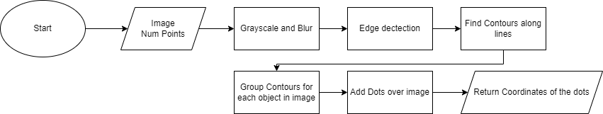
Design Specifications - Image Interpreter
Given:
An image
Number of dots to add
The program will:
Convert the image to grayscale
Apply a Gaussian Blur on the Image
Use Canny Edge Detection to find the lines inside the Image
Split the lines into contours
Group contours near each other to find each object
Add dots equally spaced along contours
Output:
An array of coordinates for each dot generated

Slide 6
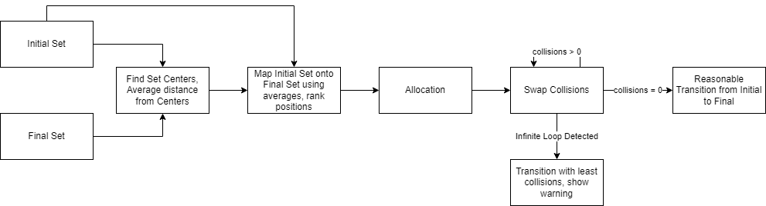
Design Specification - Drill Solver
Given:
The specific placement of marchers in Set 1
The unassigned placement of marchers in Set 2
The number of counts between the the Sets
The algorithm should assign spots such that:
No marcher needs to march an unnecessarily long distance
As few as possible marchers collide during the transition

Slide 7
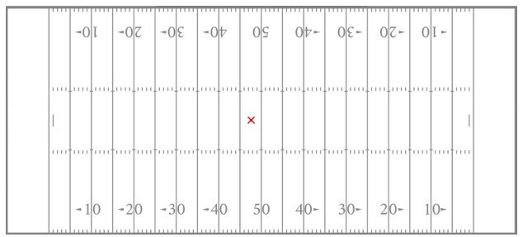
Design Specifications - GUI
The program will:
Allow users to create new shows
Allow users to save and load shows they were working on
Integrate the drill solver and image interpreter to allow automatic creation of drillsets
Visualize drillsets and allow the user to step through the show they have loaded
The field view used for displaying drillsets

Slide 8

Technologies
All components of our project were built in python.
Our algorithm was developed mainly using standard python libraries, and our image interpreter made use of OpenCV, Shapely, and numpy.
For the GUI component, a combination of PyQt5, a GUI development suite, and matplotlib were used to display our drillsets.
We used Git for version control (Github.com)
VSCode was our primary editor/IDE

Slide 9
Milestones
Transition solver gives outputs that work at a basic level (11/1/22)
The transition solver is the heart of our application. It determines who should move where. Getting a basic version on the algorithm working is critical to our success.
Image interpreter developed, tested, and working well (2/14/22)
One of the main draws to our software is the idea of turning images into a marchable set of marching band dots. It should be simple to add in to the rest of the project, but is of high importance.
Finish Qt GUI atop interpreter and transition solver (2/28/22)
We need to put significant effort into the GUI and user experience portion of the software so that our algorithms can be used by the average joe (such as a band director).
Finish Transition solver and drill editor UI (3/25/22)
Polishing the transition solver algorithm and the UI will be one of the last milestones in development. At this stage, we should be focusing on ironing out bugs and UI inefficiencies.

Slide 10
Results
So far, we have implemented a solid image interpreter and drill solver, as well as the beginnings of our application layer
By the demo, we will attempt to add grouping to the drill solver to keep similar instrument performers together on the field
We will fine-tune the image interpreter and see if we can allow it to accept increasingly complex images
We will have completed our GUI application, allowing users to create complete marching band shows from images and step through them visually.

Slide 11
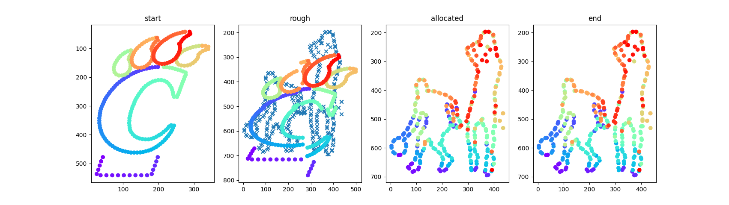
Results - Visualization
Here, the image interpreter has outputted two sets (start, allocated).
The algorithm allocates marchers’ locations from the “C” paw to the basketball players in several steps.

Slide 12
Challenges
Algorithm optimization
Try every combination? -> Factorial ❌
Prune and test combinations? -> Exponential ❌
Estimate and Allocate? -> Polynomial ✅
GUI Challenges
Visualizing information was difficult with pure Qt, especially PyQt – would need to build a large portion of the graphics library
Without Qt, GUI QOL features similarly need to be largely built by us.
Luckily, matplotlib has support for Qt integration in the way of FigureCanvasQtAgg
Concurrency with issues with event handling
Eliminating race conditions
Ensuring proper variable locking
Solved through a lot debugging

