Slide 1
Quarantine Gang
Marching Band Drill Creator
Mason Davy, Andy Greer, Matthew Kuhr, Benjamin Middleton
Advised by Mehdi Norouzi

Slide 2
Contact Information
Mason Davy - davymp@mail.uc.edu
Andy Greer - greeraw@mail.uc.edu
Matthew Kuhr - kuhrmw@mail.uc.edu
Benjamin Midleton - middlebo@mail.uc.edu

Slide 3
Project Abstract
The visual portion of marching band that accompanies the music is called drill. Industry-standard tools such Pyware are used to design and create drill for bands across the country. These softwares provide tools so that users are not manually placing each marcher, but the software could stand to be smarter. We want to create an intuitive drill creation software that uses image recognition to create sets of marching band coordinates (sets) and provides intelligent feedback as the user edits and creates drill to make the entire process easier, faster, and more musically successful. This will involve evaluating marching transitions between pictures and the pictures themselves.

Slide 4
User Stories
As a drill writer, I want to be able to set band size and instrumentation so that it does not need to be set each time.
As a drill writer, I want to be able to convert between high school, college, and professional field markings so that the drill is applicable to all field types.
As a drill writer, I want to create a new drill set from an image so that I can added new sets.
As a drill writer, I want to be able to edit drill sets so that I can improve them.
As a drill writer, I want to be able to duplicate a previous drill set so that I can set up basic transitions such as expansions and rotations.
As a drill writer, I want to find the optimal routing between two drill sets so that the band can transition from one set to another.
As a drill writer, I want to be able to edit the automatically generated routing so that I can create more dynamic and engaging shows.
As a drill writer, I want to see potential collision points and unreasonable step sizes so that they may be mitigated before the drill is put to the field.
As a drill writer, I want to be able to convert moves between floats, flanks, and follow the leader drill moves so that I can make more dynamic and engaging shows.
As a drill writer, I want to be able to convert moves between halftime, singletime, and doubletime steps, as well as scatters so that I can make more dynamic and engaging shows.
As a drill writer, I want to be able to import and export the completed drill into a format which can be distributed to marchers so that drill can be more easily learned.

Slide 5
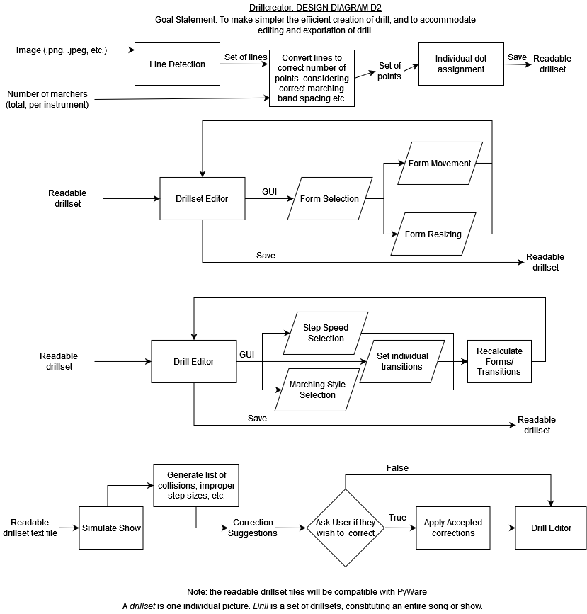
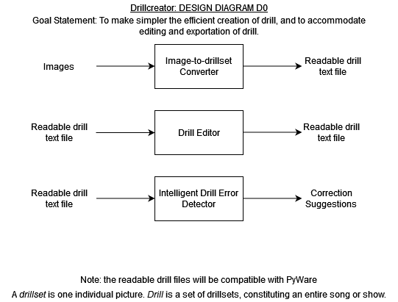
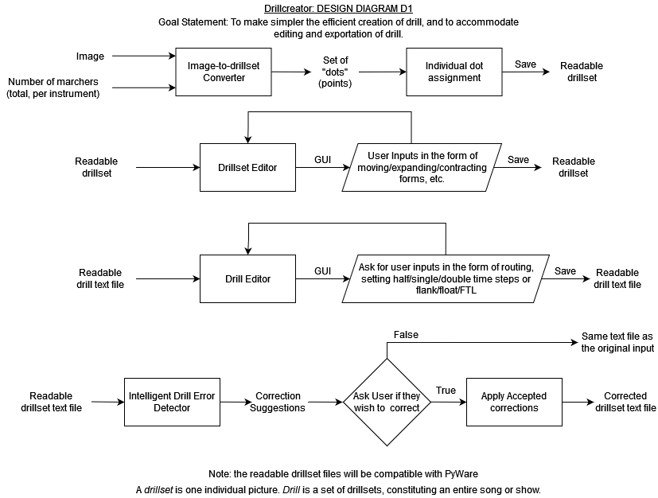
Design Diagrams
Diagrams D0, D1, and D2 show increasingly complex designs for our application.

Slide 6
Major Project Constraints
Time: With a limited amount of time both due to our full course loads and due to the project deadline, we will need to carefully balance our project wishlist with what we will have time for.
Scope: Tying into time, we will need to limit the number of features we implement based on what is most important and potentially on the number of development hours each feature may need.
Technical Expertise: Multiple complex algorithms will need to be efficiently and accurately implemented for the core of our project to work. Also, in order to make the application presentable to an end user, a fair amount of UI knowledge will be needed.

Slide 7
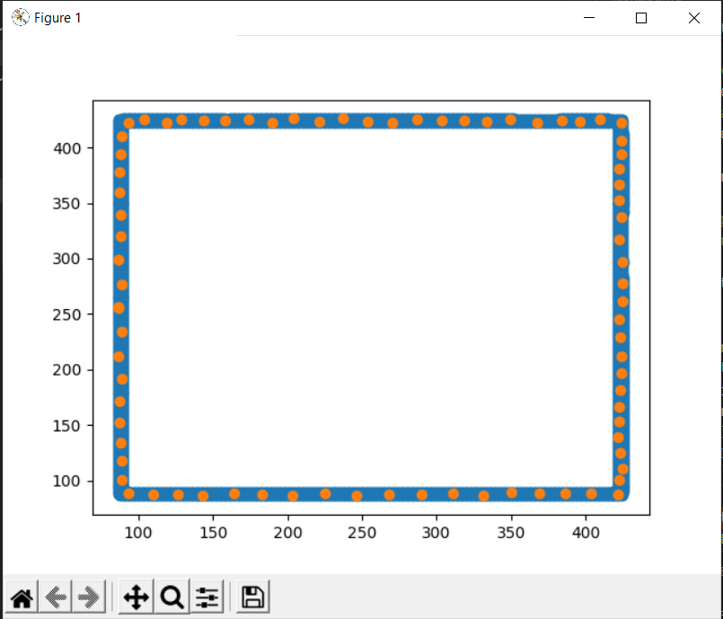
Project Progress
As of now, our project has begun to get rolling in a few areas:
Our image-to-drillset converter is able to recognize very basic shapes and plot rough coordinates for those shapes, as shown in the image.
Our Individual Dot Assignment algorithm, which is to be implemented in the image-to-drillset converter and the Intelligent Error Detector, is working for basic transitions and images, and is in the process of being optimized for large bands.

Slide 8
Goals for the Term
By the end of winter break, we intend on having major components working and in the testing/iterative development stage, including:
Drillset transition solver/individual dot assigner
Image interpreter
Drill Editor
Furthermore, we expect the UI design to be complete and the GUI to be in development.

Slide 9
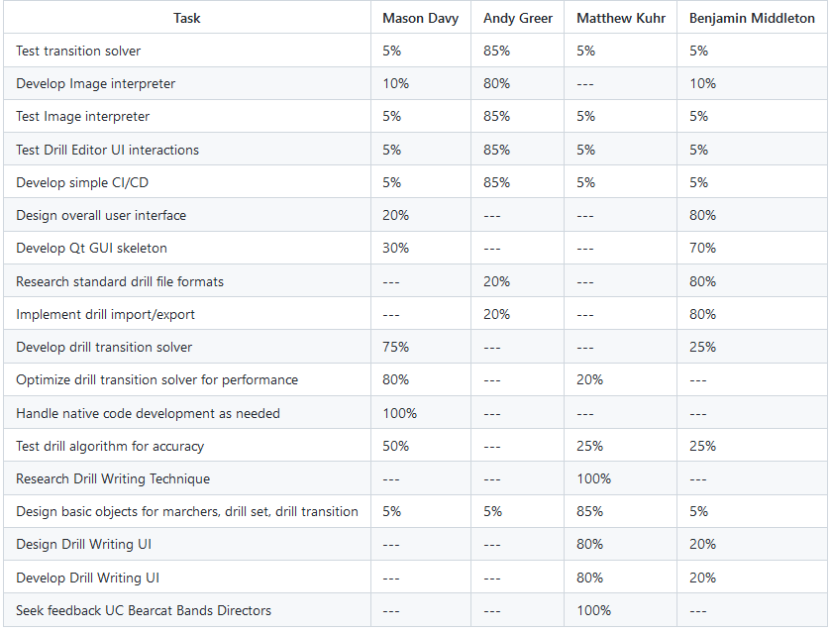
Division of Work
To the right is our effort matrix, but to summarize each member’s role:
Mason Davy: optimizations, testing, native code development, transition solver
Andy Greer: image interpreter, testing, CI/CD
Matthew Kuhr: design, research. our marching band expert.
Benjamin Middleton: Qt GUI and UI design, testing, file import/export
All members will assist in any unexpected issues/development that may arise.

Slide 10
Expected Demo at Expo
At the exposition, we expect to include a demonstration of all parts of the project: the image-to-drillset converter, the drill editor, and the intelligent drill error detector. We expect to have test examples set up for each component, and viewers may be able to use their own images/ideas to further explore the software. Seeing as this is a fully software project, there should not be anything we have done that we can not show off at the exposition.

