Slide 1
Using lockdowns as a natural experiment to fix transmission parameters in mechanistic models: WIP
Ben Singer
Postdoc
Joe Lewnard group
University of California, Berkeley

Slide 2
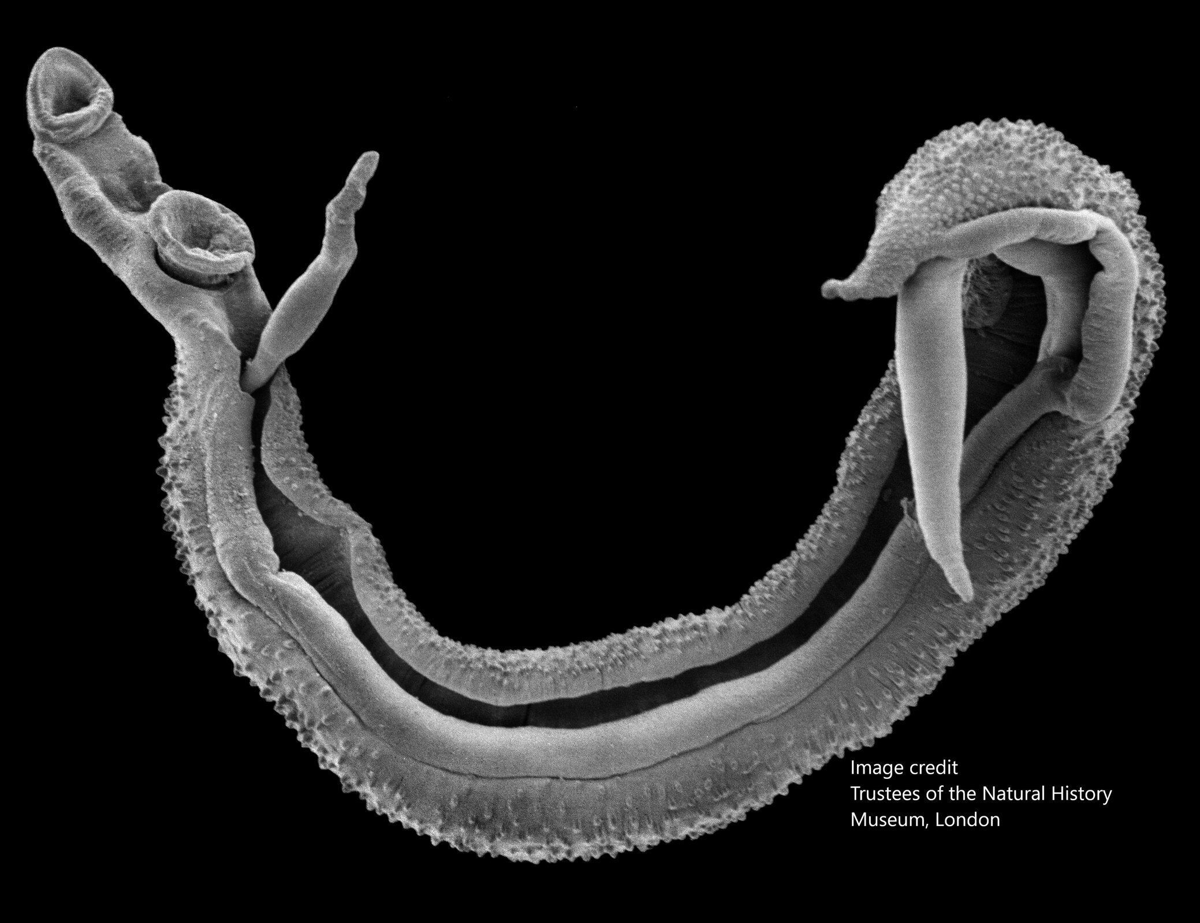
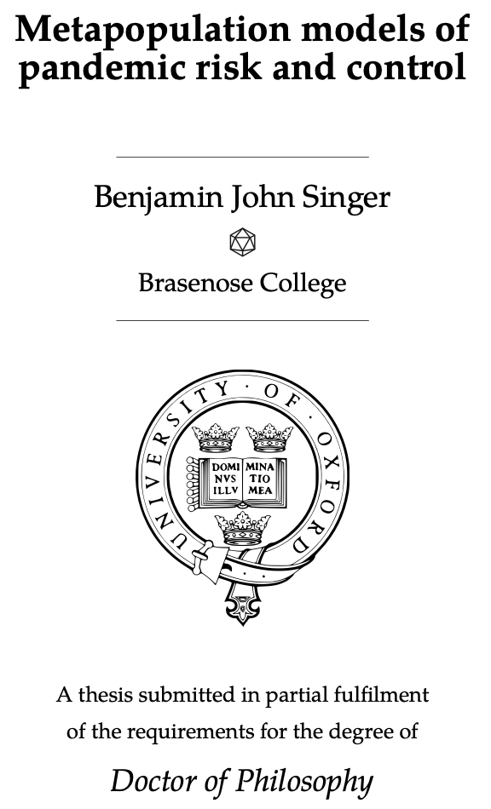







Slide 3
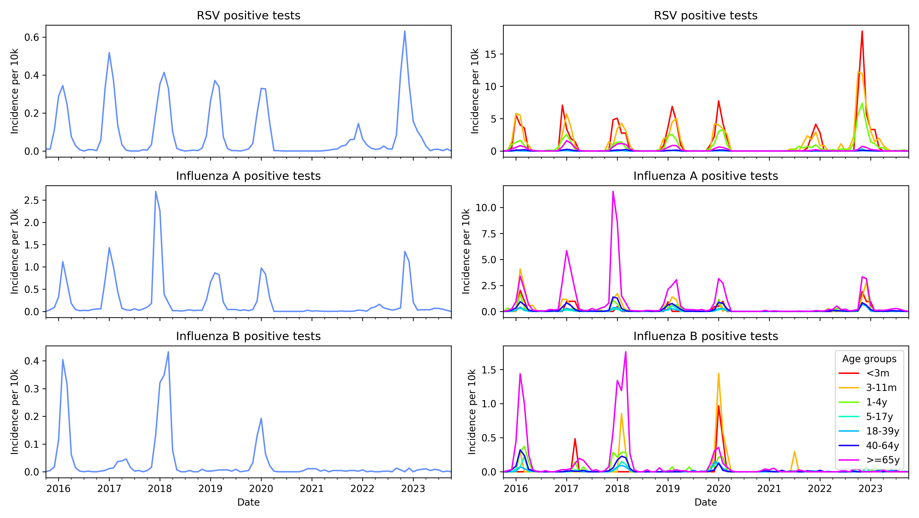
Notes:
Kaiser data on range of pathogens shows different recoveries after covid restrictions lifted
Influenza B did come back in the US for 2023 (normal size outbreak), and this year is having a small outbreak
This has some relationship too to how the infections spread through age groups
RSV – seasonal forcing vs immune decay – Stefan Flasche LSHTM
Flu B has a lot of US-internal structure, Flu A less so, essentially panmictic bc it comes from the southern hemisphere - latin america seasonality affects flu A a lot
2017-18 early outbreak in kids and elderly? why?

Slide 4
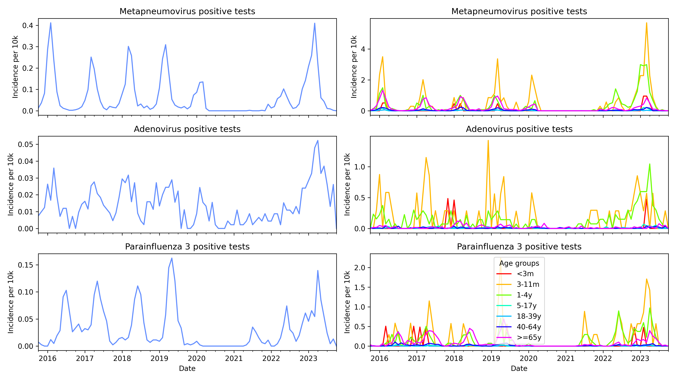
Notes:
Kaiser data is great and includes interesting time series on pathogens outside the normal superstar

Slide 5
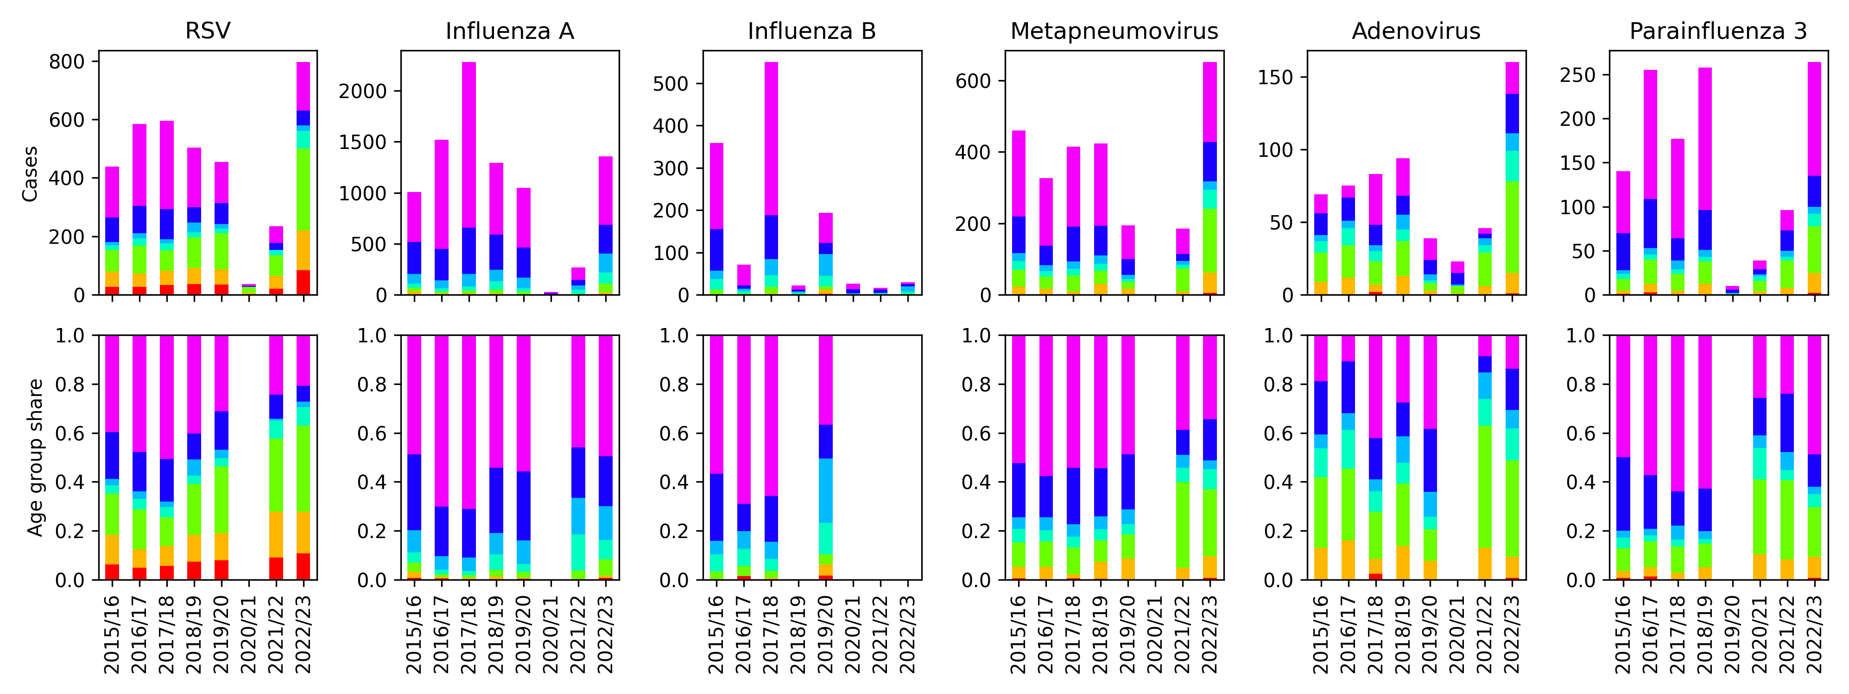
Notes:
Walk through figures
Our hypothesis is that this differences in rebound and age structure can be best explained by differences in dynamics of susceptible recruitment
We need a model that can account for different ways of recruiting susceptibles:
Birth
Waning
Immune escape
No evidence for a strong immunity debt hypothesis – rebounds never reach size of missed seasons

Slide 6
S₁
Infection
I₁
Simple but flexible model which captures multiple infections with varying immunity over an individual’s lifetime, with waning immunity
S₁ experiences higher infection rate than S₂, which experiences higher infection rate than S₃
Each compartment split into 7 age groups
Infection spreads between age groups based on contact matrix from Prem et al.
Recovery
S₂
I₂
Waning
immunity
S₃
I₃
Notes:
Explain model
For now, hoping that waning and immune escape can be treated as equivalent
We can show theoretically that this model explains dynamics of the types seen in the data

Slide 7
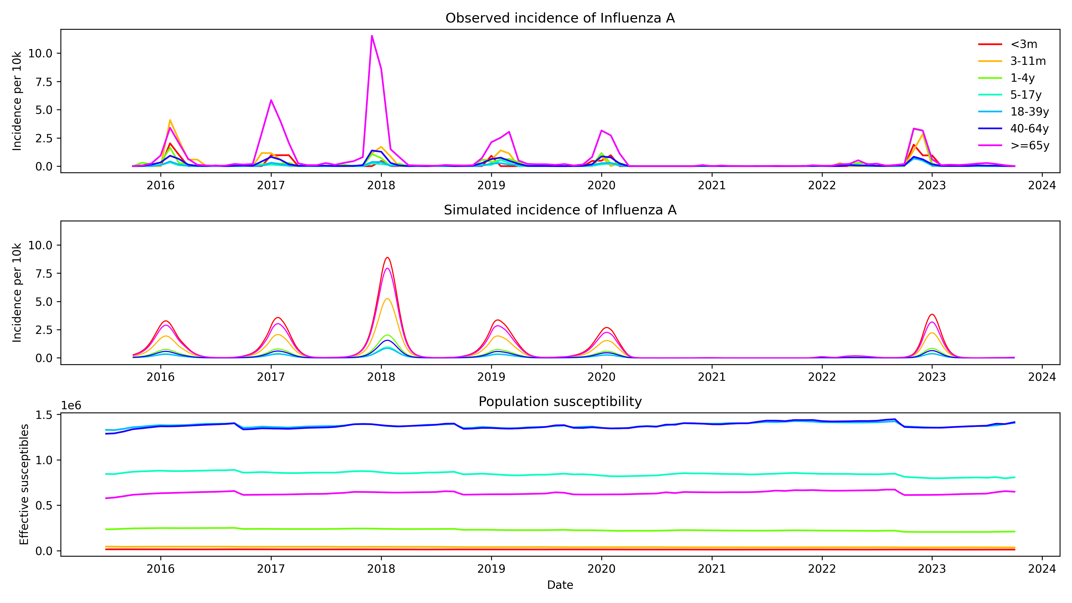

Slide 8
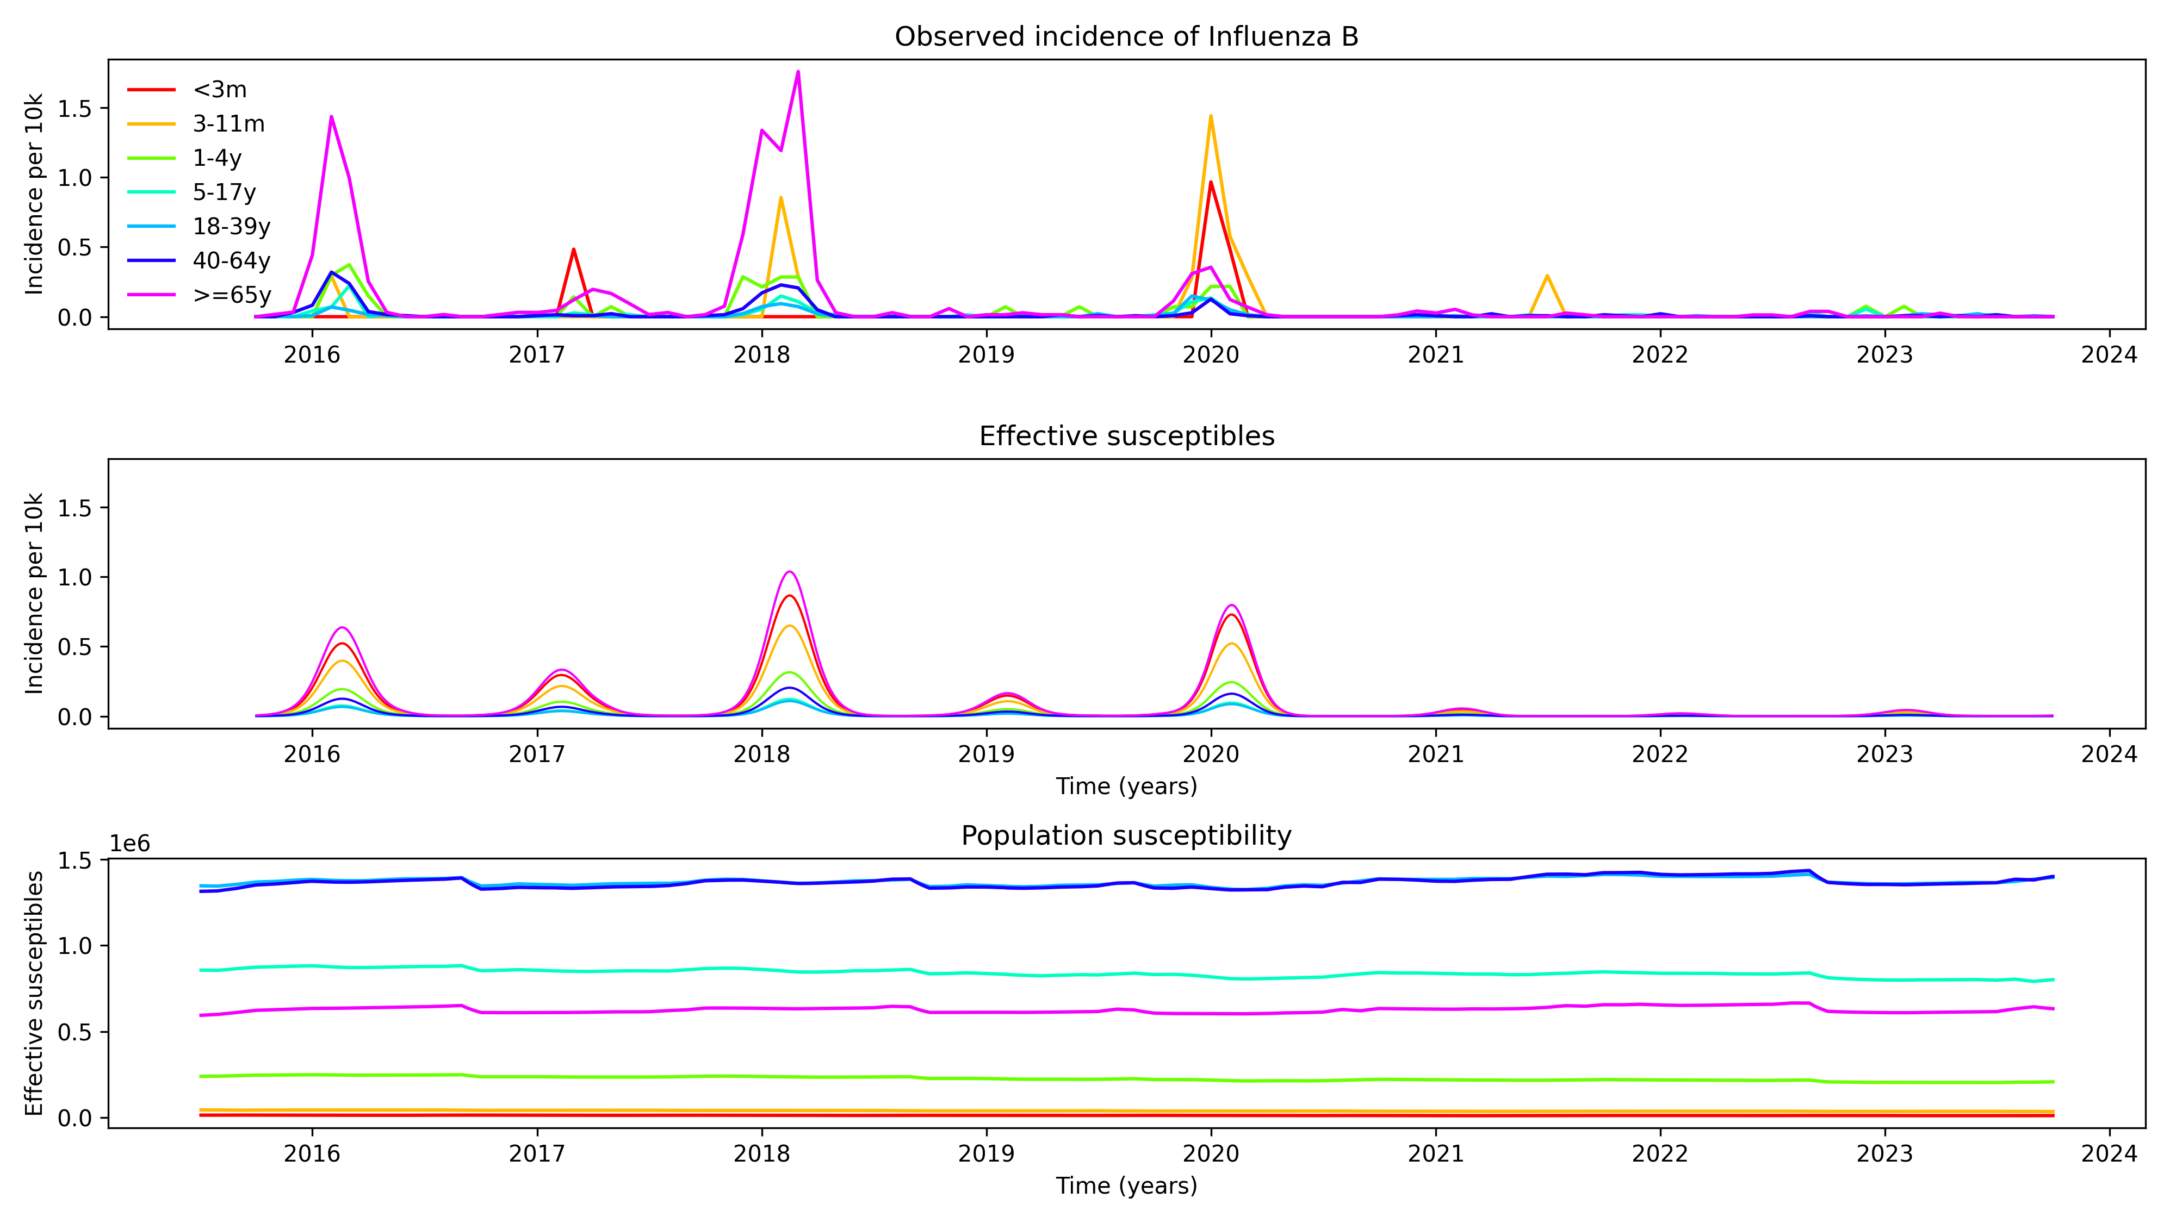

Slide 9
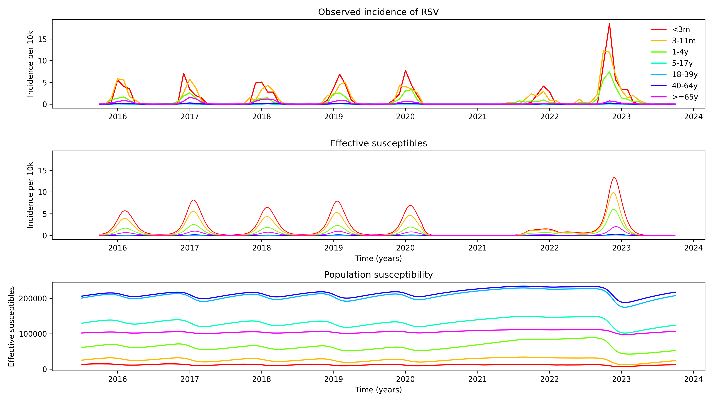
Notes:
Good fit to RSV – rebound is explained by build-up of susceptibles during the pandemic

Slide 10
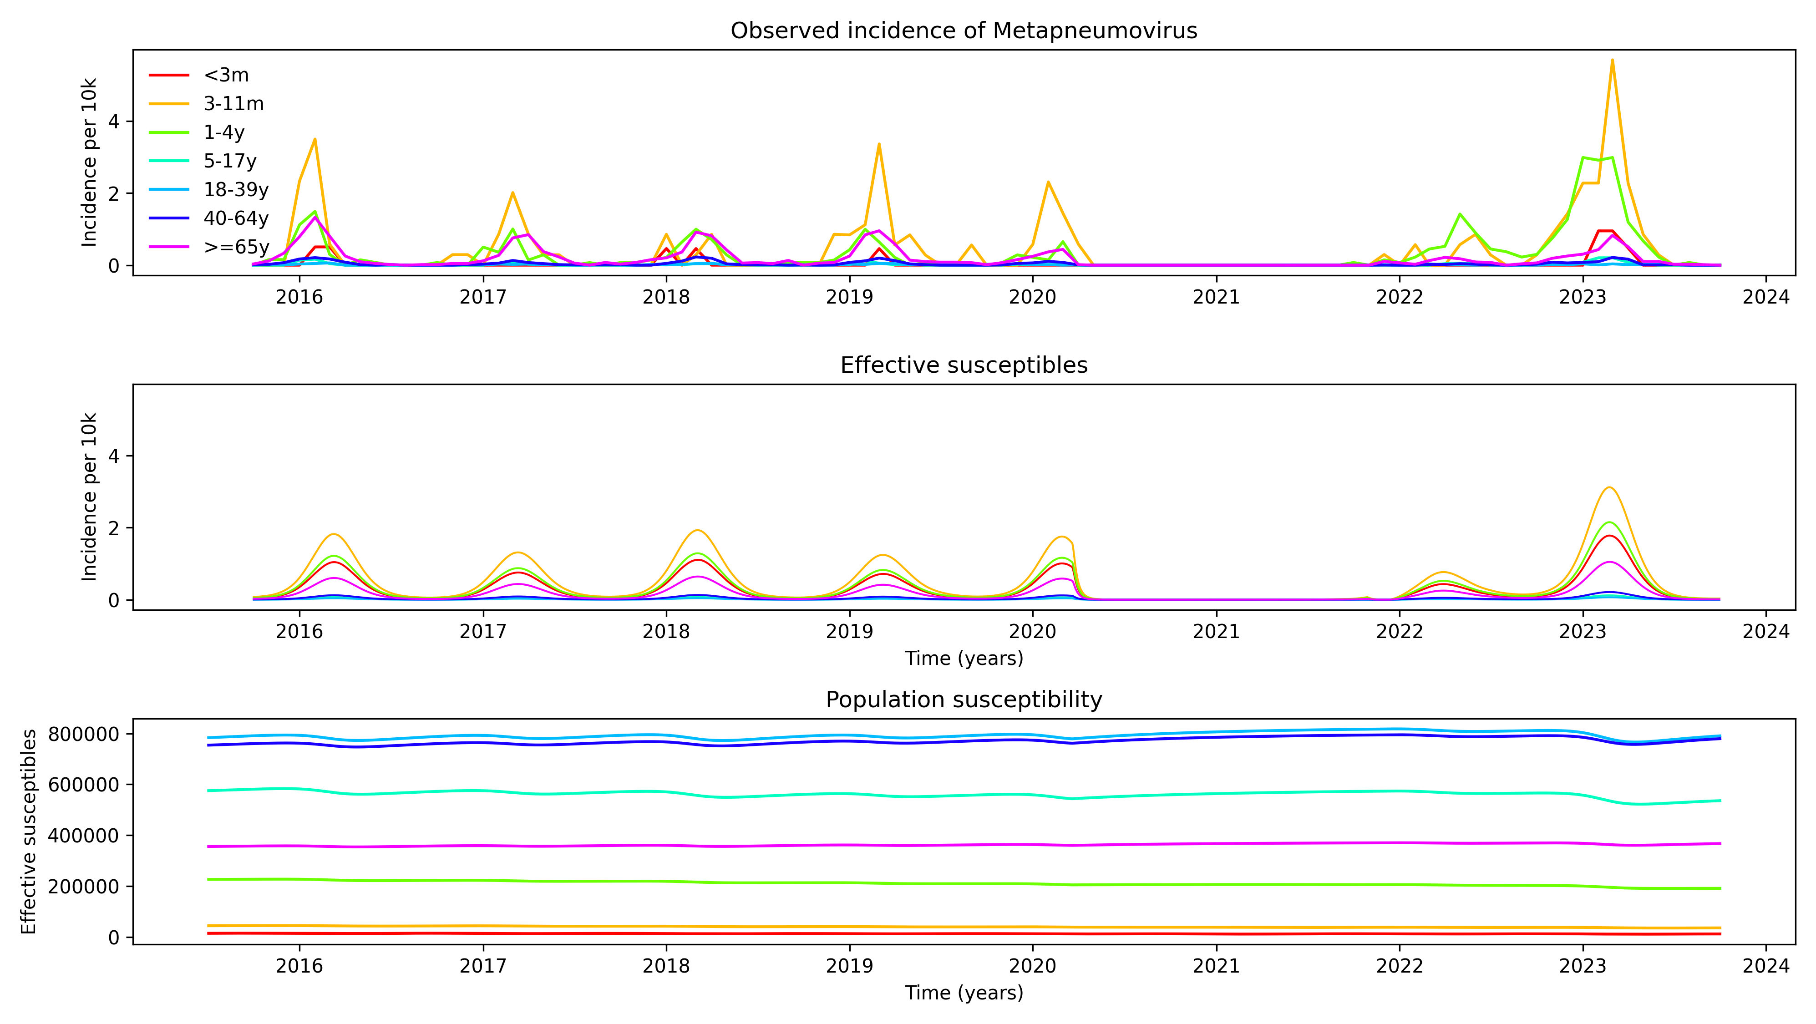

Slide 11
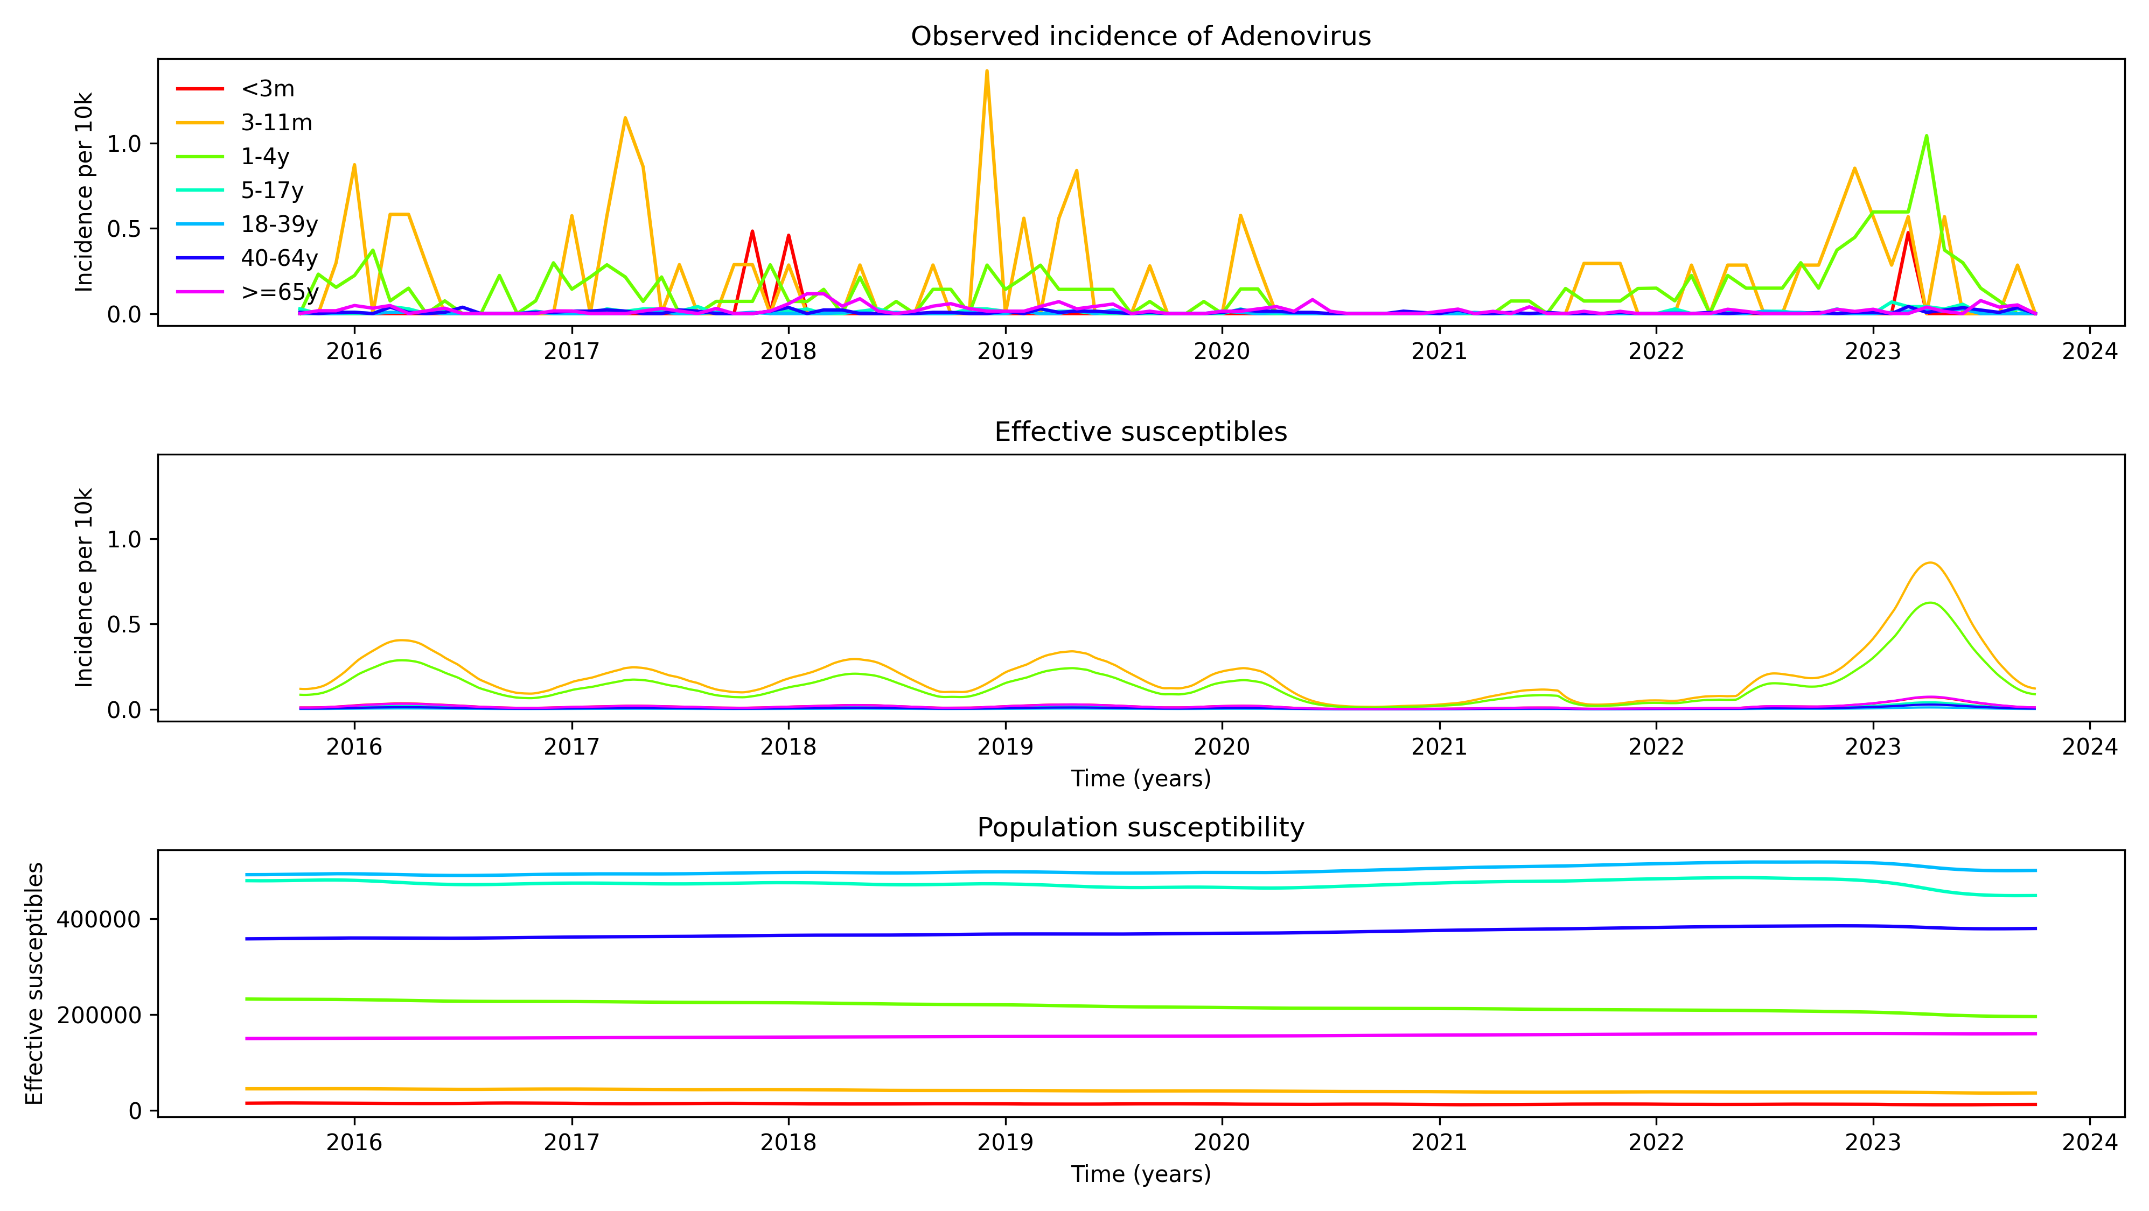

Slide 12
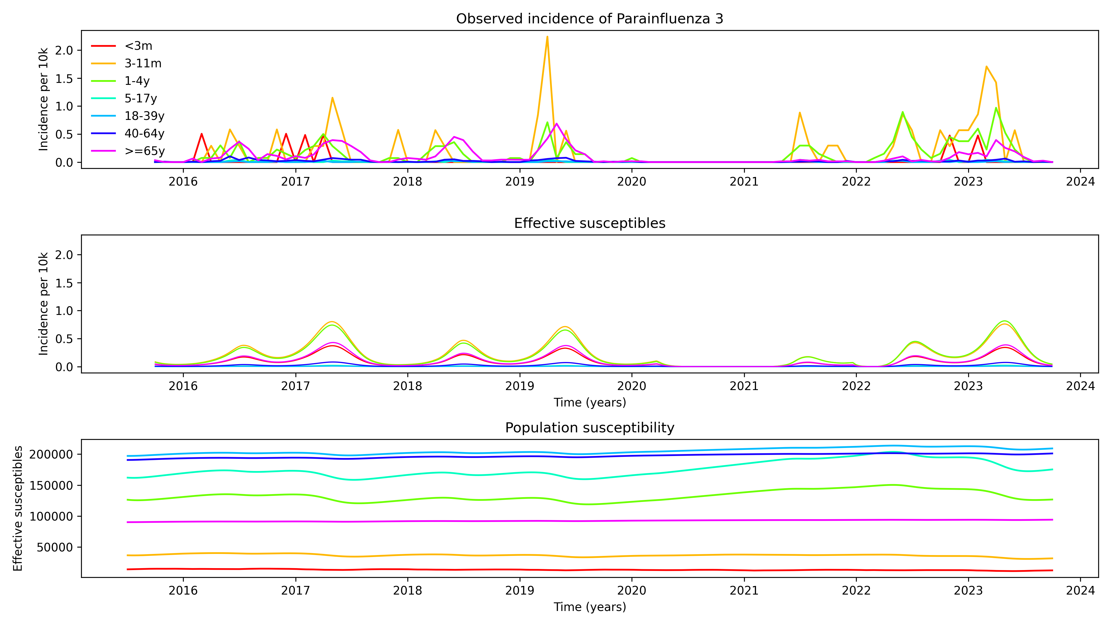

Slide 13
Next steps
More interpretation of rebound causes
Quantification of uncertainty

Slide 14
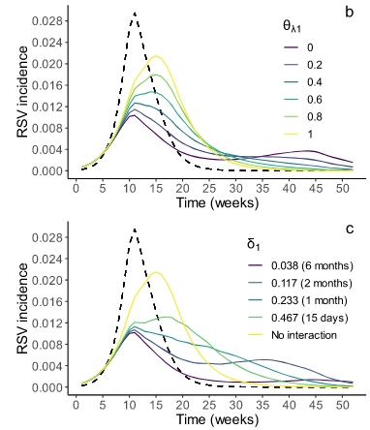
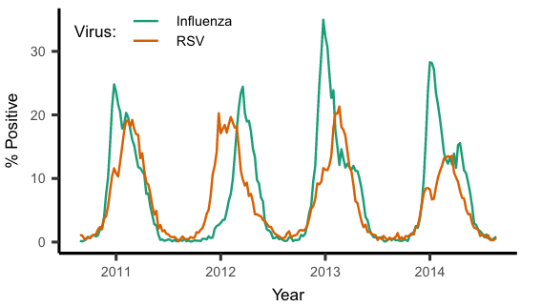
Viral interference
Sarah C Kramer, Sarah Pirikahu, Jean-Sébastien Casalegno & Matthieu Domenech de Cellès
Nature Communications, 2024

Slide 15
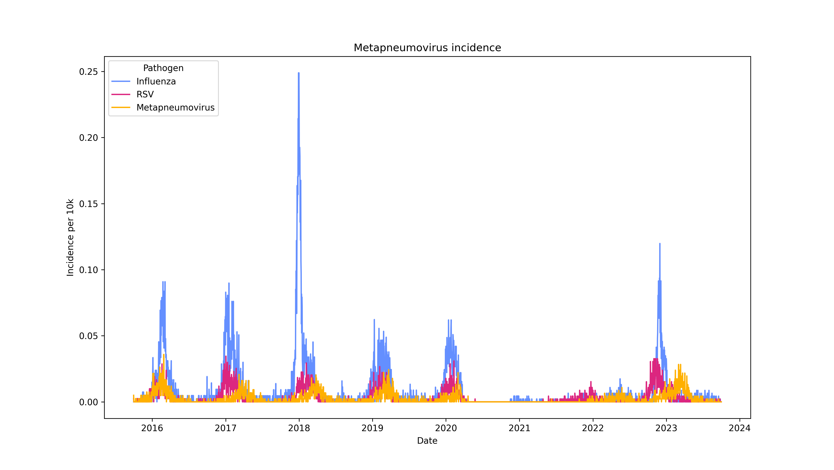

Slide 17
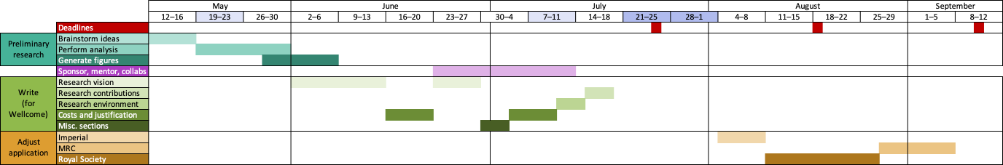

Slide 18
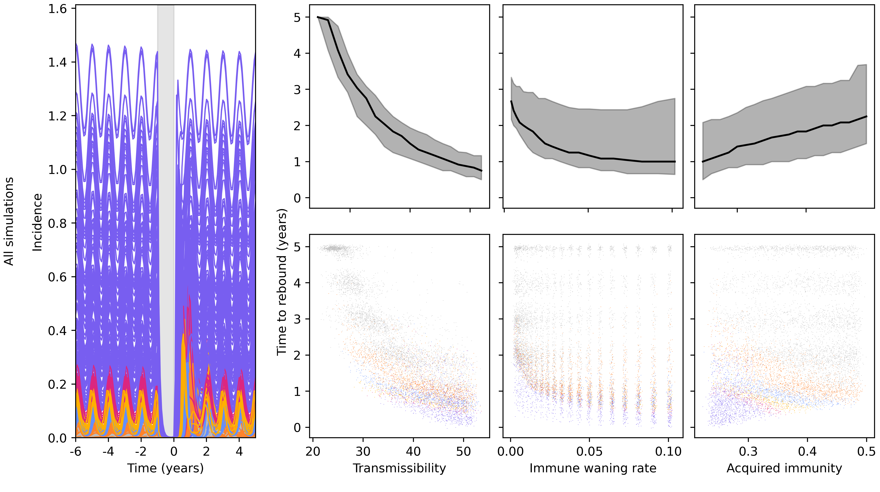
Notes:
Comparing lots of hypothetical diseases with different transmissibility, waning, and acquired immunity
Behaviour of time to rebound overall is fairly intuitive
However, we can cluster based on before-lockdown behaviour – what we might know about a pathogen before a disruptive event
If we do this, immunity has opposite effect
Zoom in on a few clusters to make this clearer

Slide 19
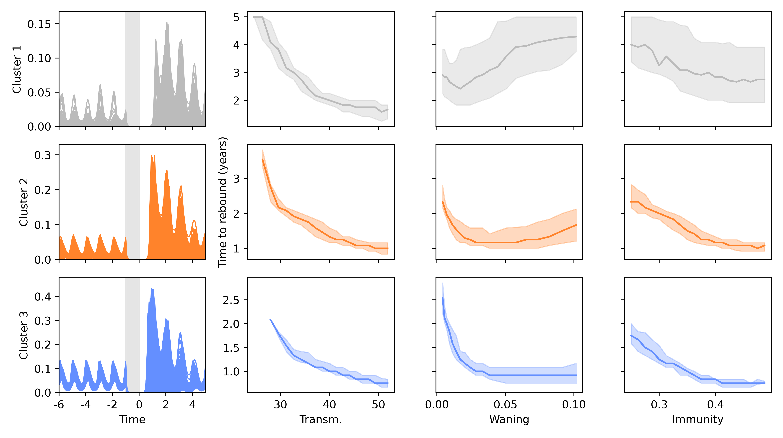
Notes:
Matching for pre-lockdown behaviour, increased immunity means smaller time to rebound
This helps us understand why, when we compare major respiratory diseases, infections of children come back faster
- Next step is to make this all work in a highly realistic scenario, and to get a good fit to data

Slide 20
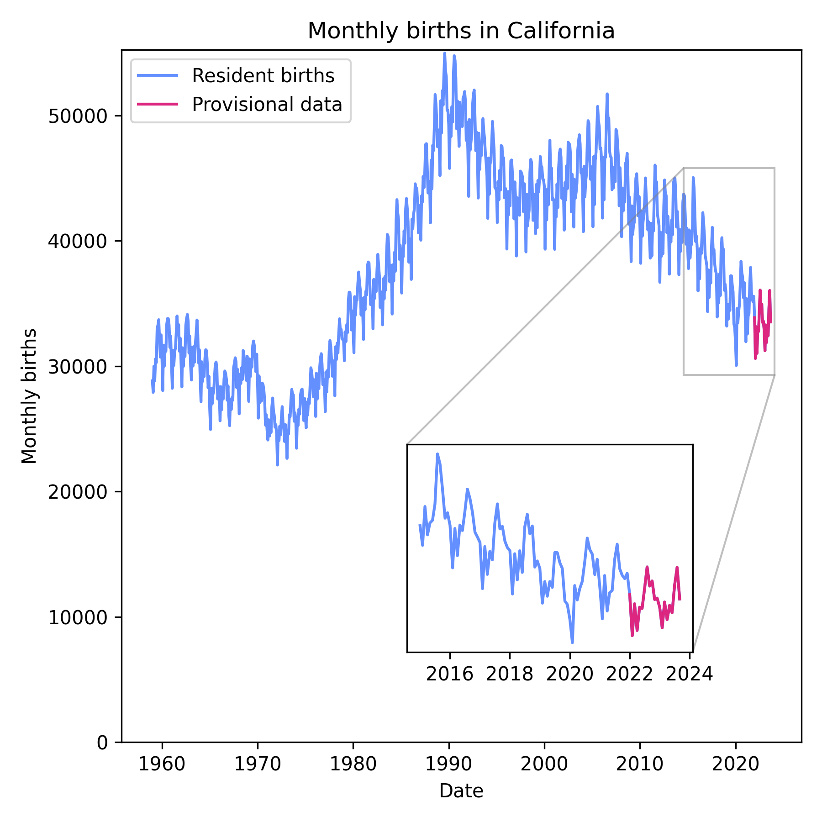
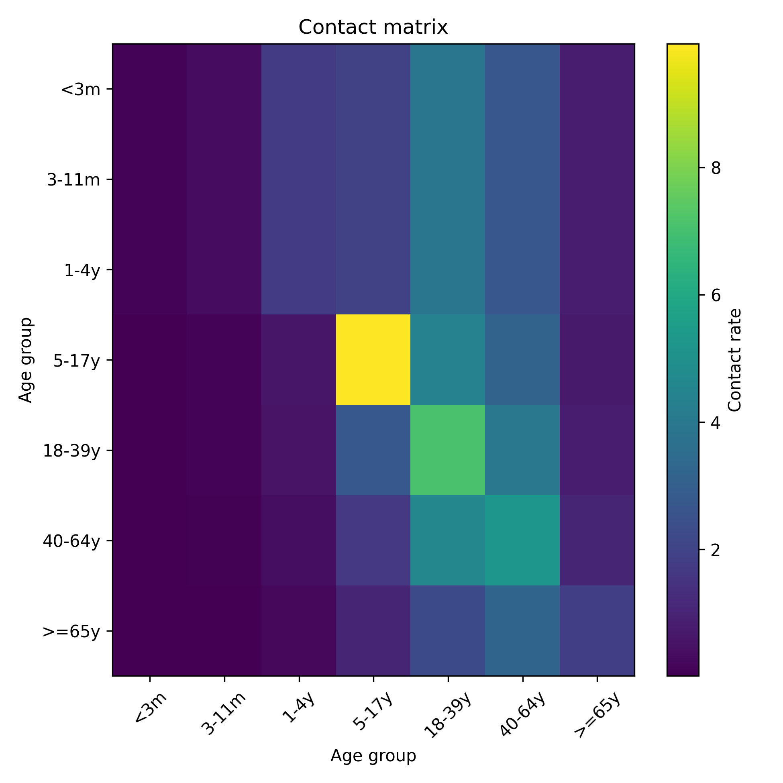
Notes:
- Some extra data needed to do fit real incidence time series

Slide 21
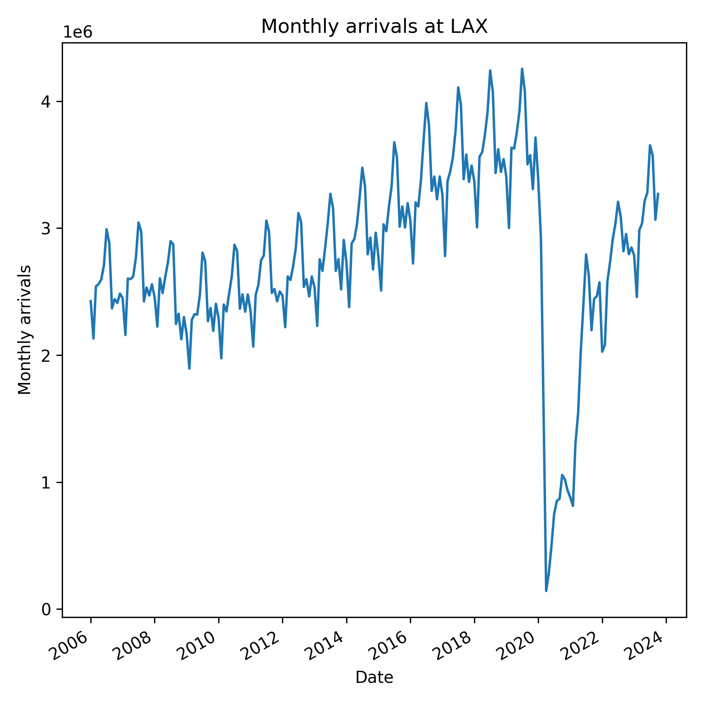
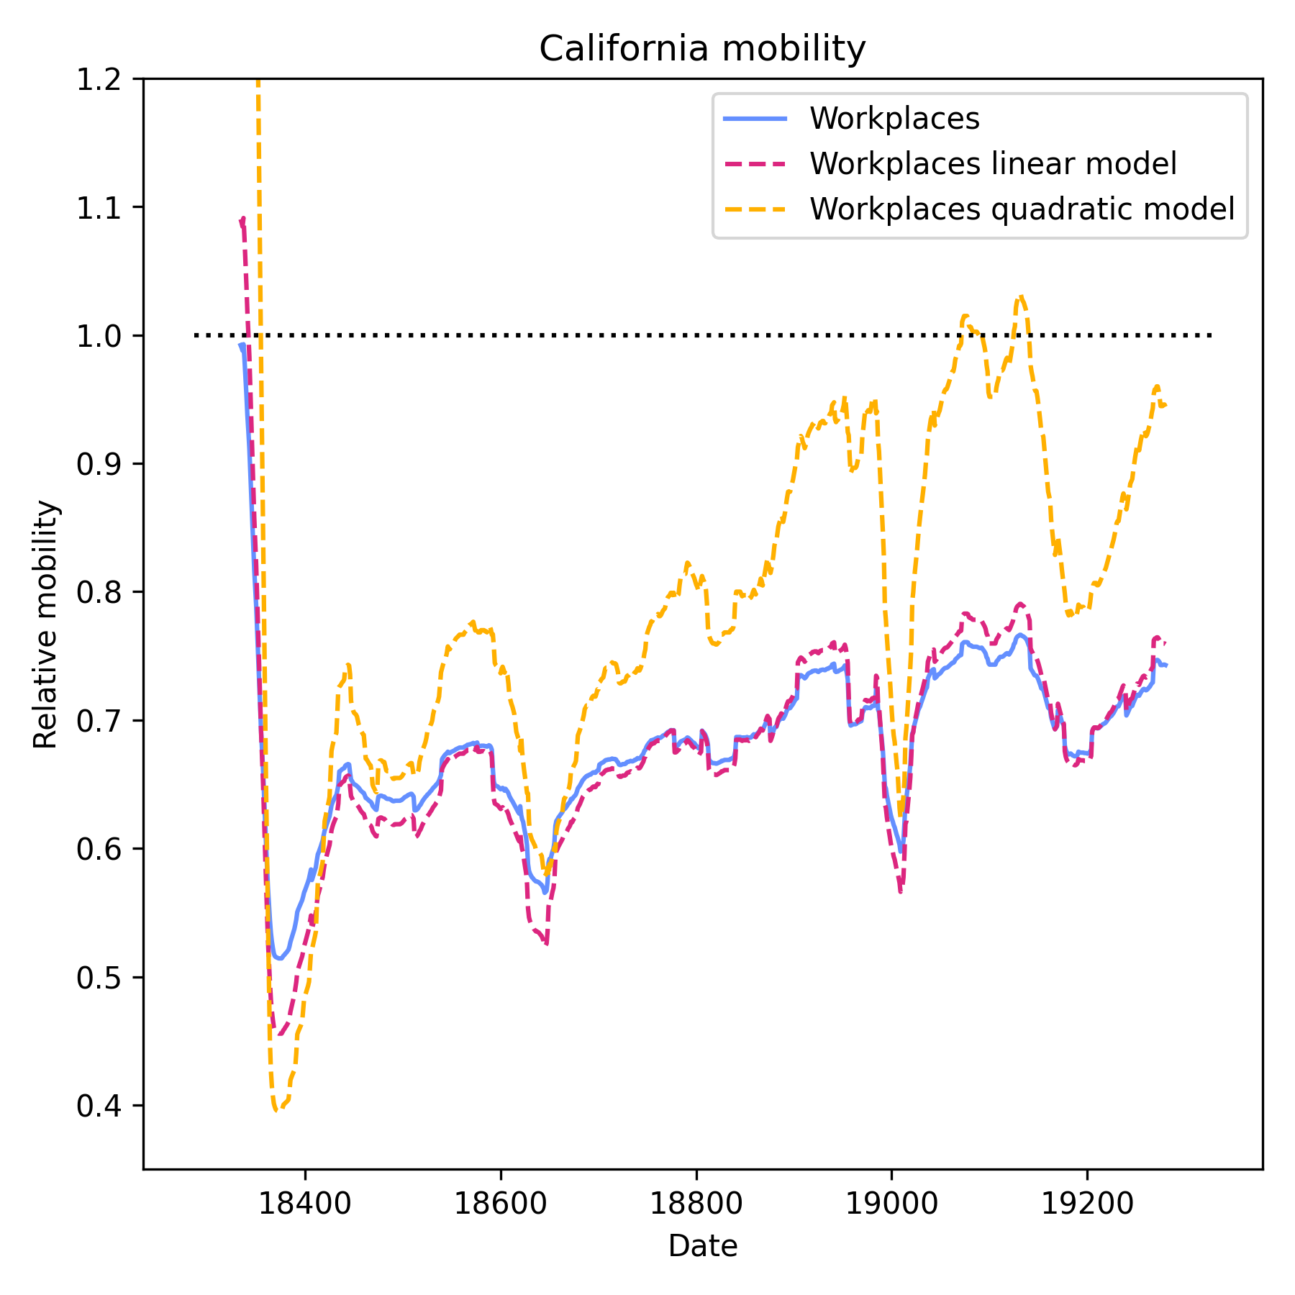
Key dates:
2020.03.19—California stay-at-home order
2021.04.27—CDC relaxes mask advice
2021.12.15—CDC reinstates mask advice
2022.03.01—California cancels mask mandate
Notes:
Travel and contact changes have a big effect on how we estimate other parameters, so important to get as realistic as possible
Different approaches – based on mobility, or based on key dates
In the end, we found a fitting method powerful enough to support a stepwise contact model with two periods of suppression with a break inbetween – though it’s important to compare this to other data sources as a sanity check

Slide 22
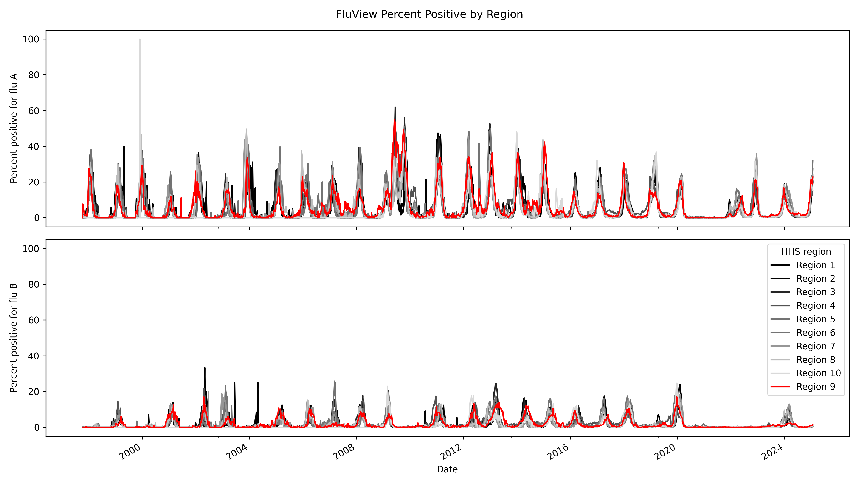
Notes:
The final ingredient is to take account of how the dynamics in California are forced by the dynamics in other parts of the US

Slide 23
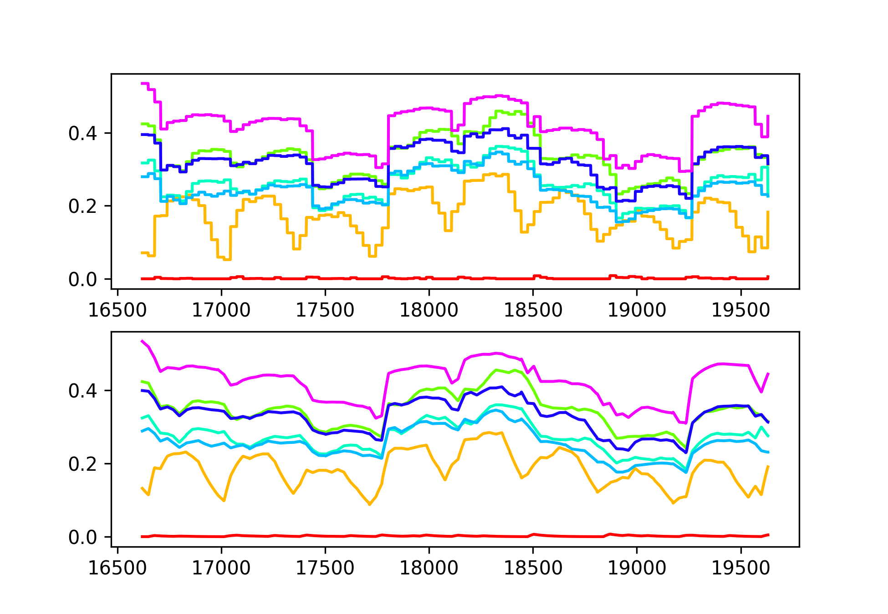
Flu vaccines
Vaccine effectiveness data could help capture variation over time
Vaccine literature puts constraints on immunity
Disease-preventing immunity vs infection-preventing immunity
Adult and child vaccine effectiveness provide additional constraints

