Slide 1
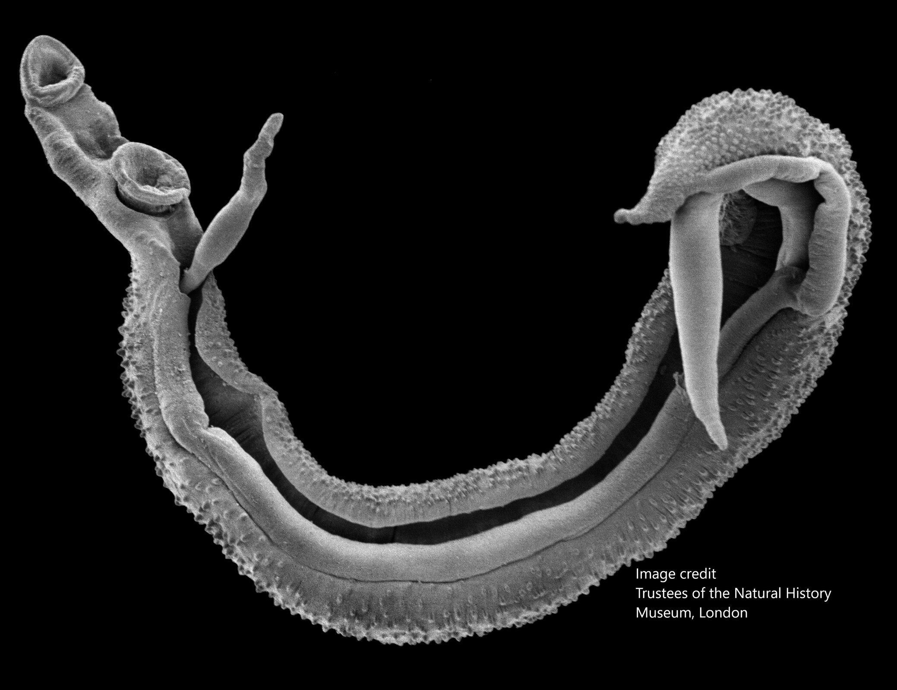
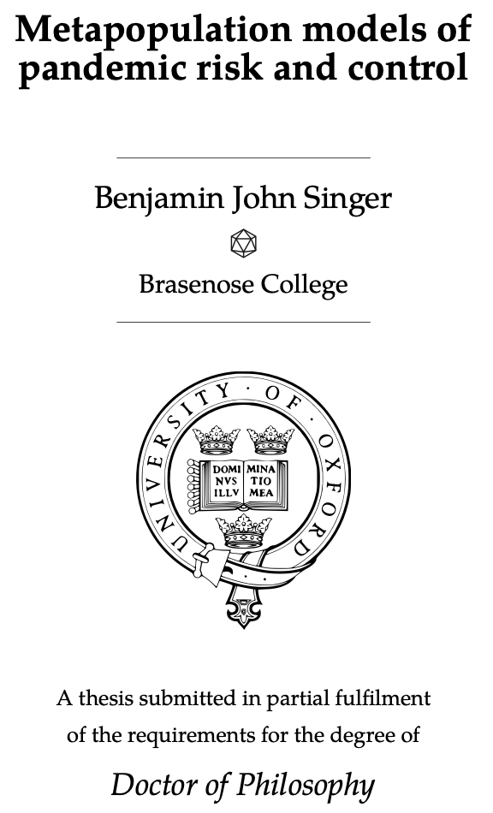
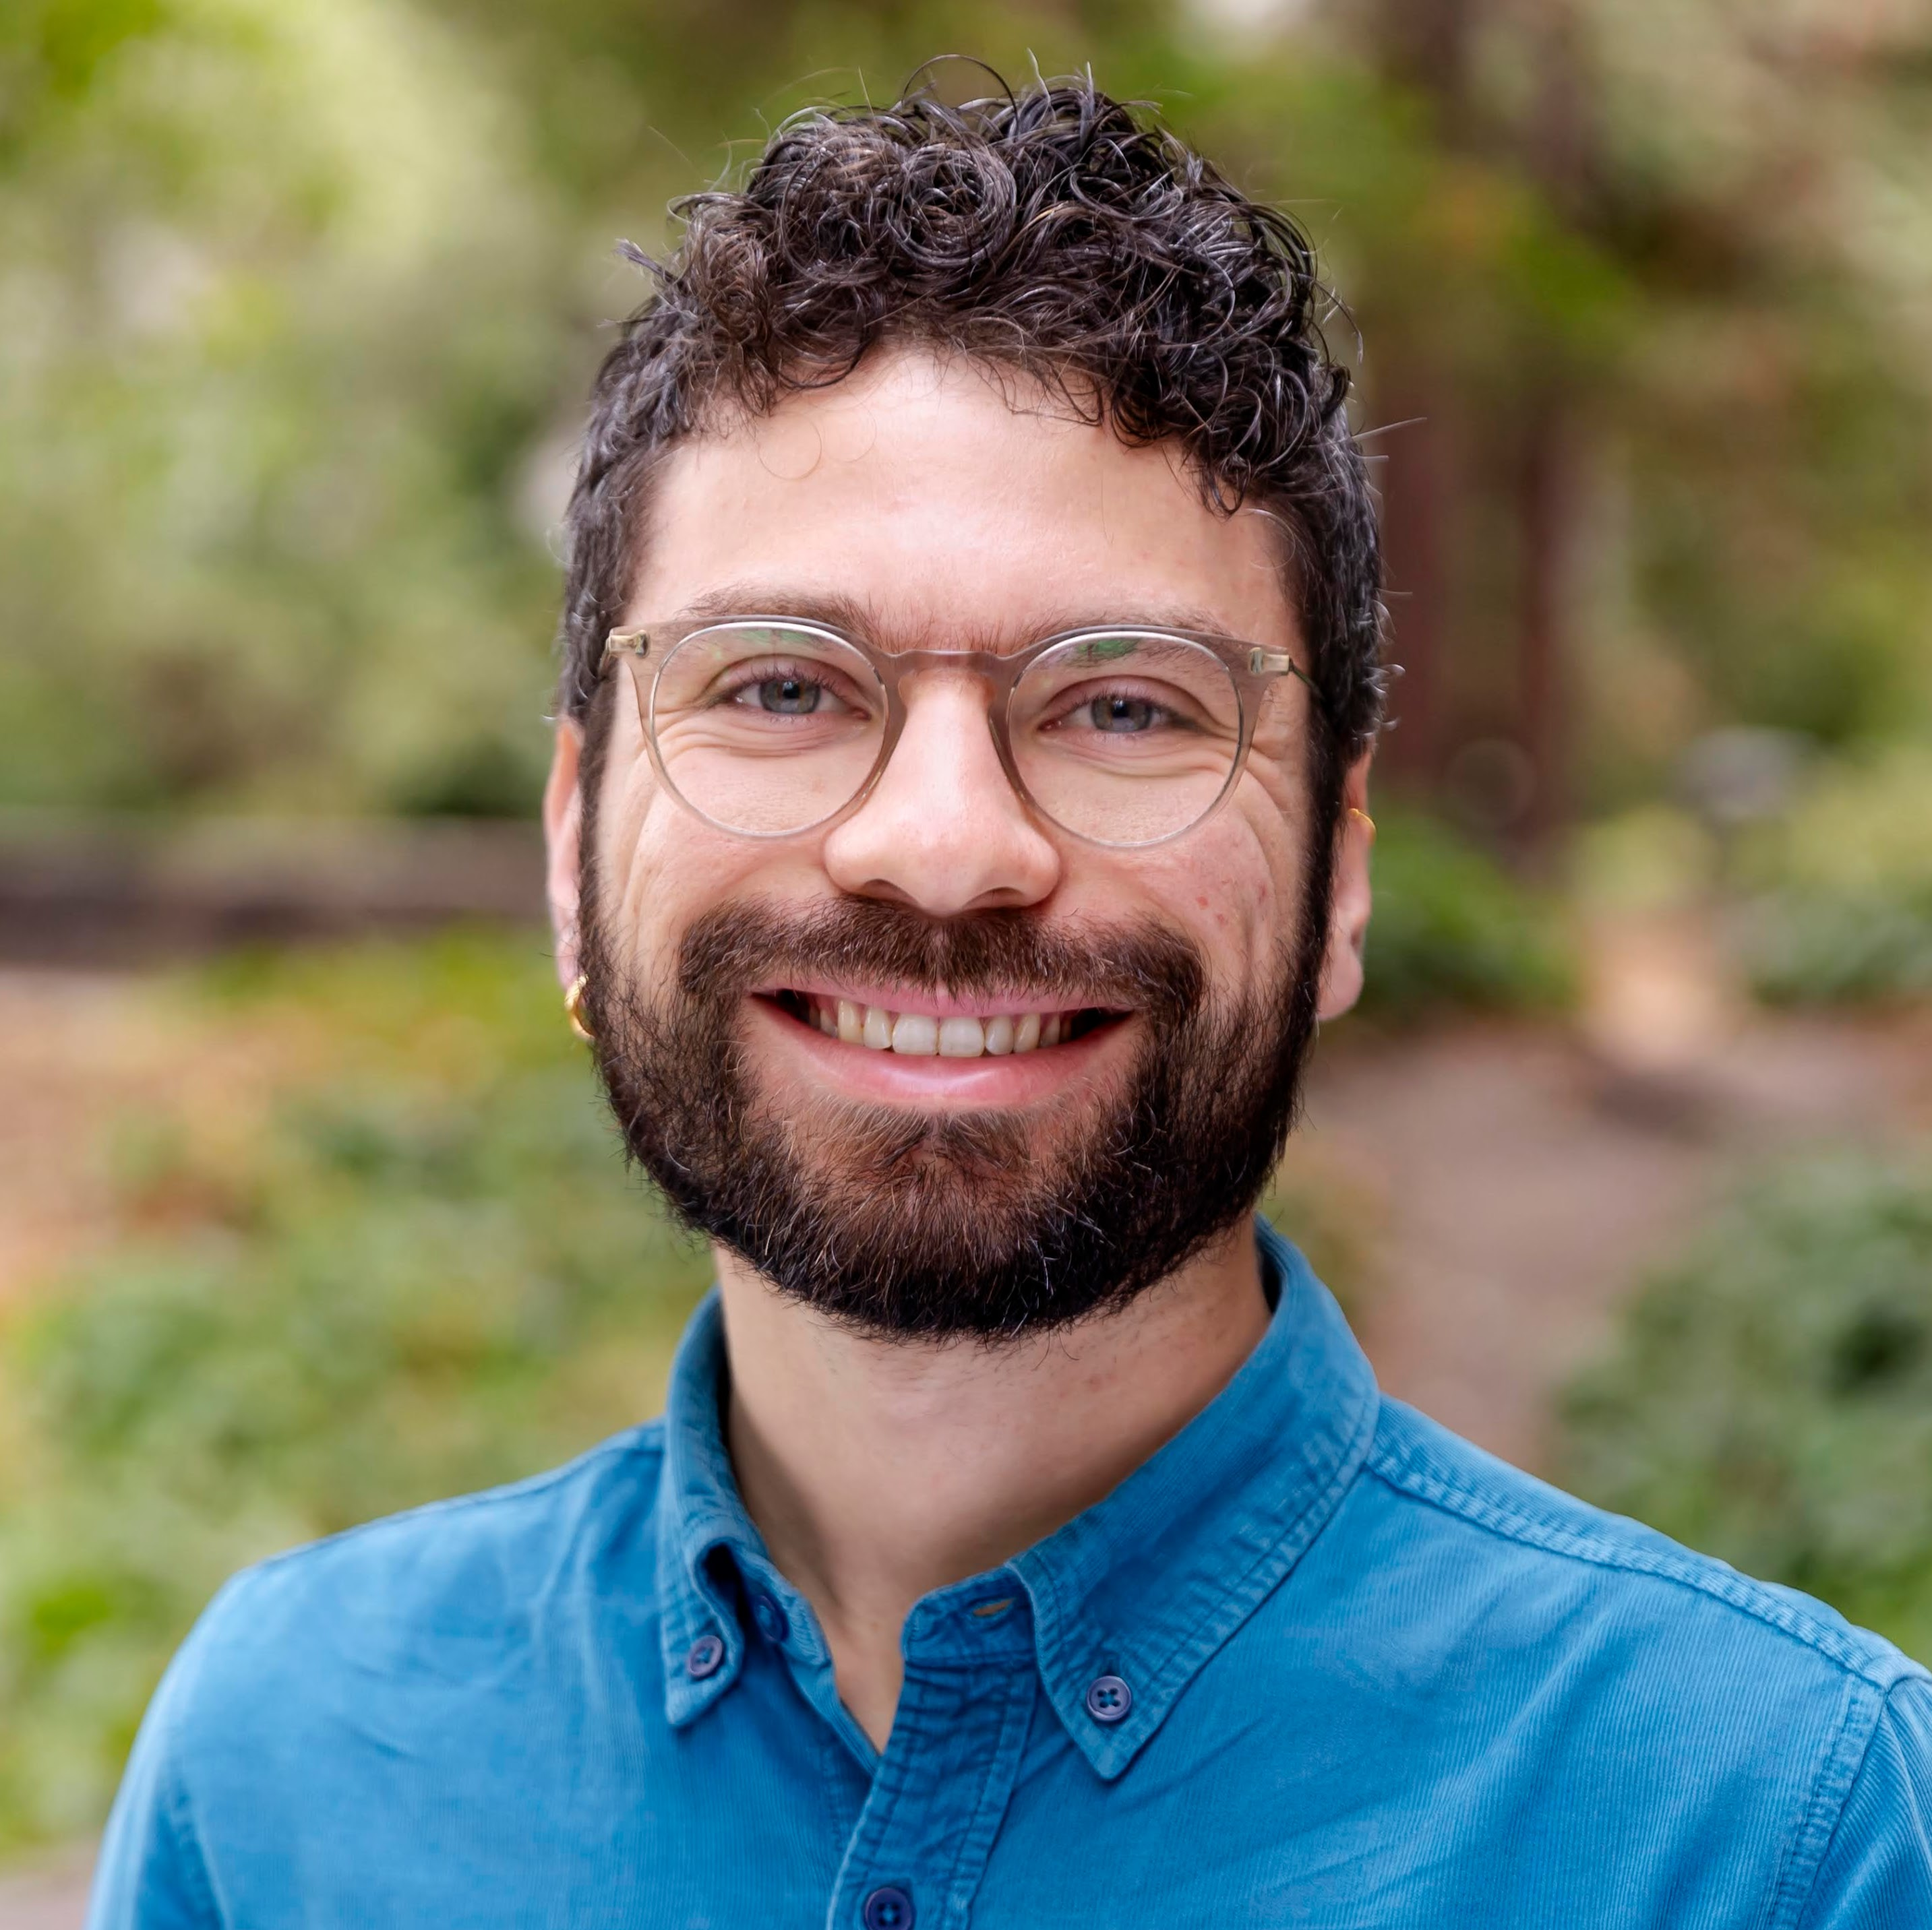






Slide 2
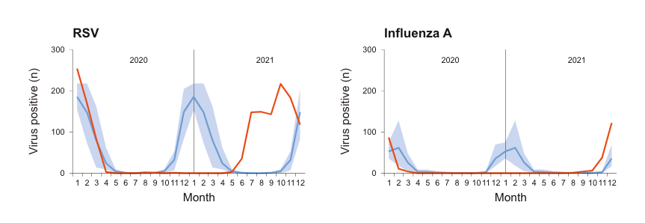
Pathogens recovered differently after suppression during the pandemic
Dagan et al. eBioMedicine, 2023

Slide 3
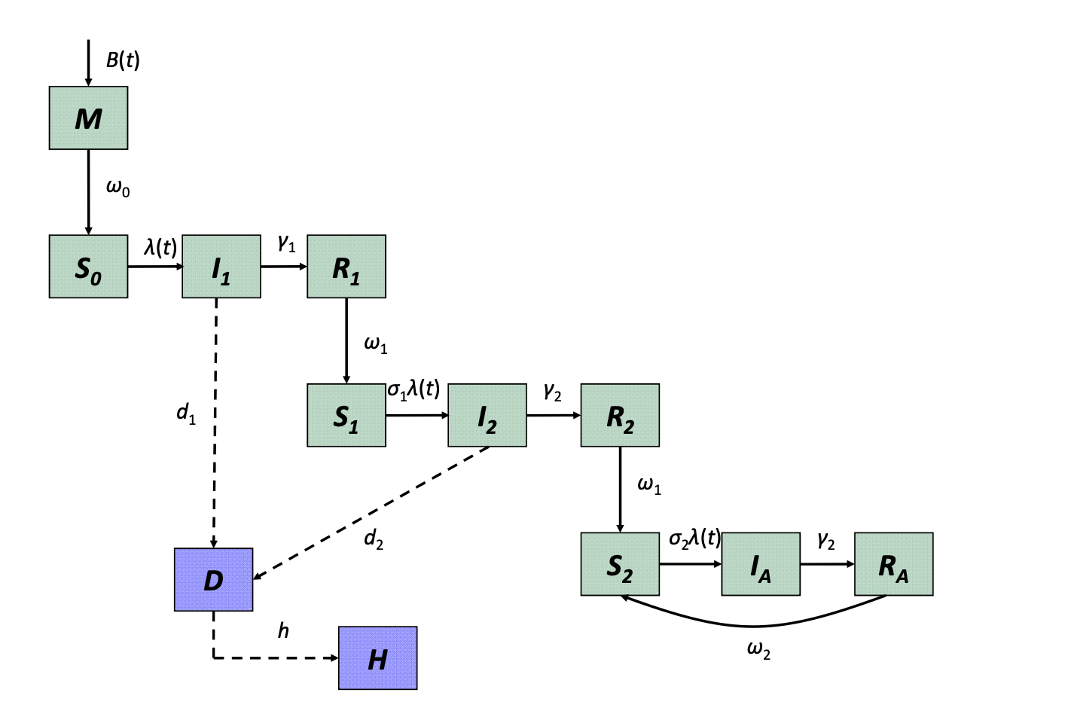
Hypothesis: growth rate and susceptibility drive recovery
Pitzer et al. Science, 2009

Slide 4
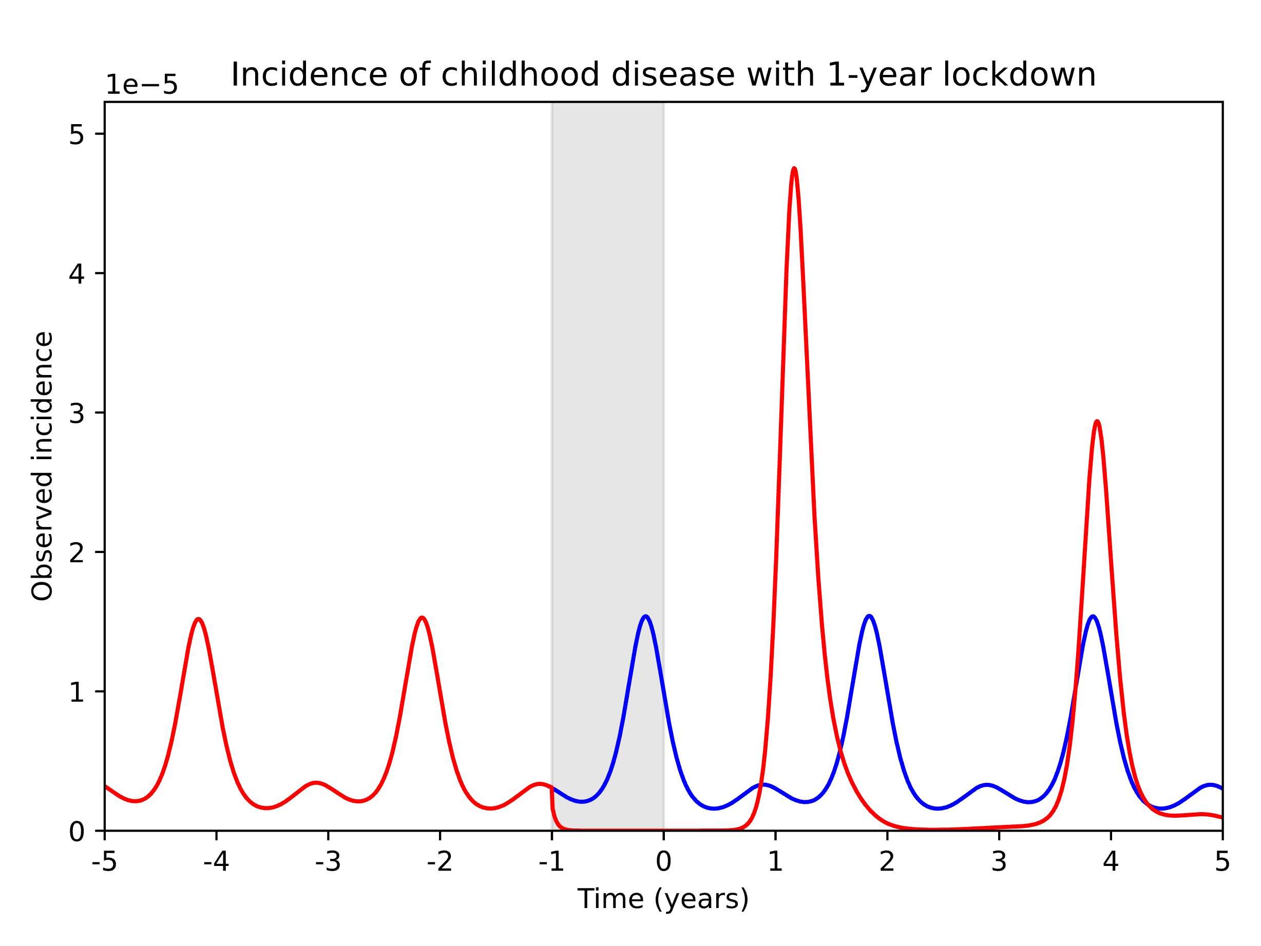
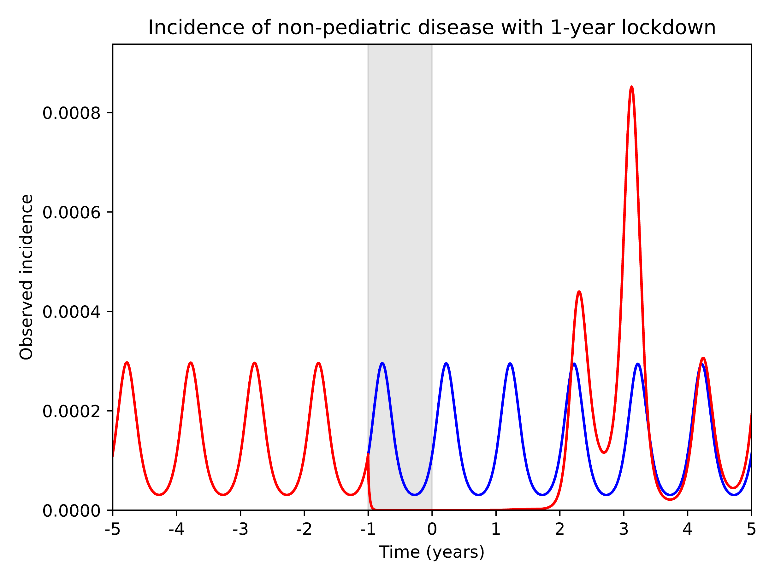
Our model can capture dynamics of differential recovery

Slide 5
Next steps
Characterize epi parameters that lead to differential recovery
Fit model to observed incidence for viral disease
Understand role of different age groups
Future applications of the model: eg, RSV vaccine modelling

Slide 6
