Slide 1
S₁
Infection
I₁
Simple but flexible model which captures multiple infections with varying immunity over an individual’s lifetime, with waning immunity
S₁ experiences higher infection rate than S₂, which experiences higher infection rate than S₃
Each compartment split into 7 age groups
Infection spreads between age groups based on contact matrix from Prem et al.
Recovery
S₂
I₂
Waning
immunity
S₃
I₃

Slide 2
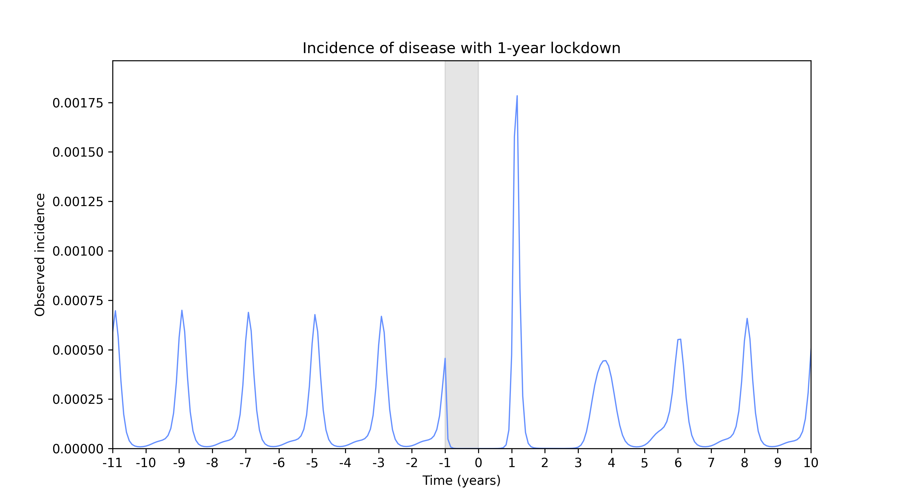

Slide 3
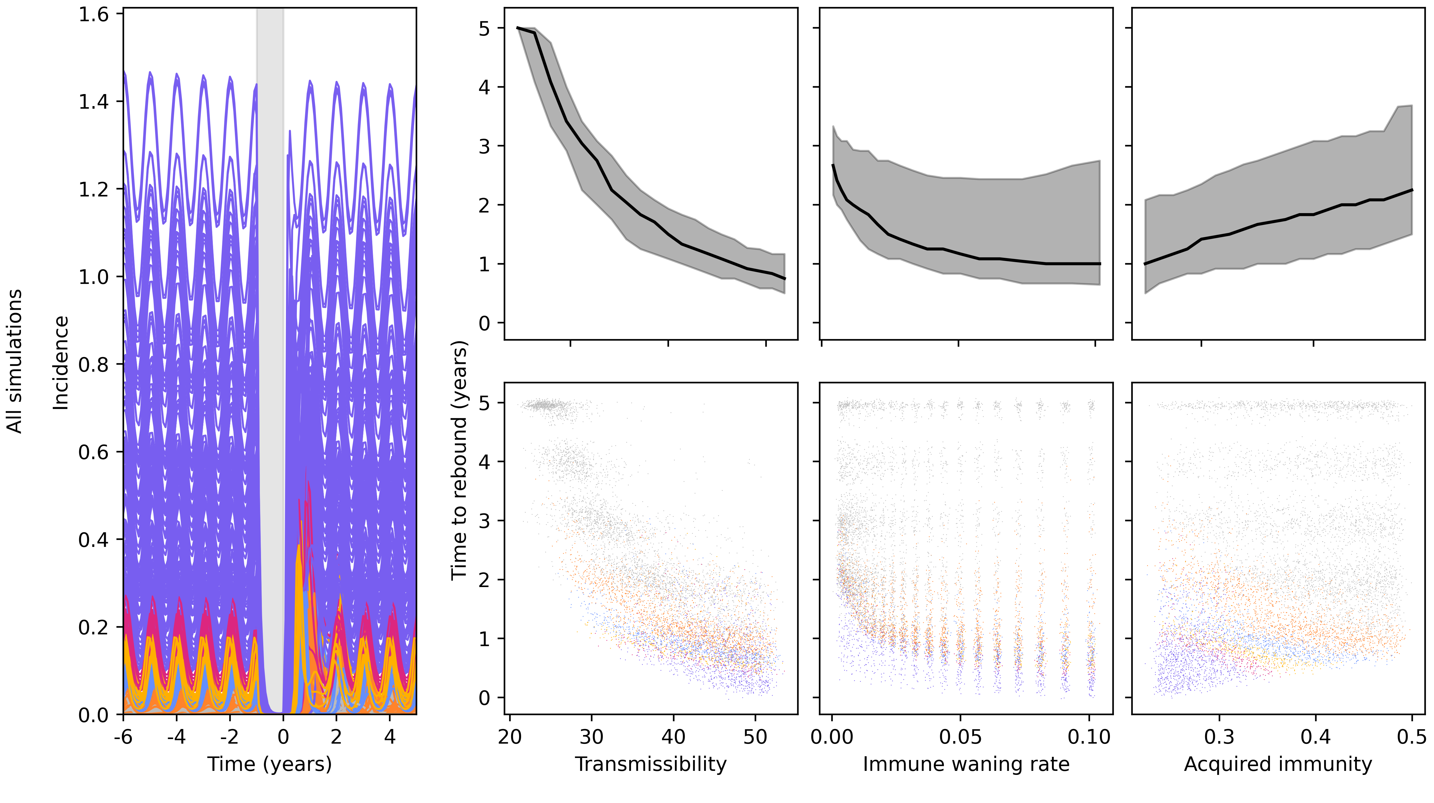

Slide 4
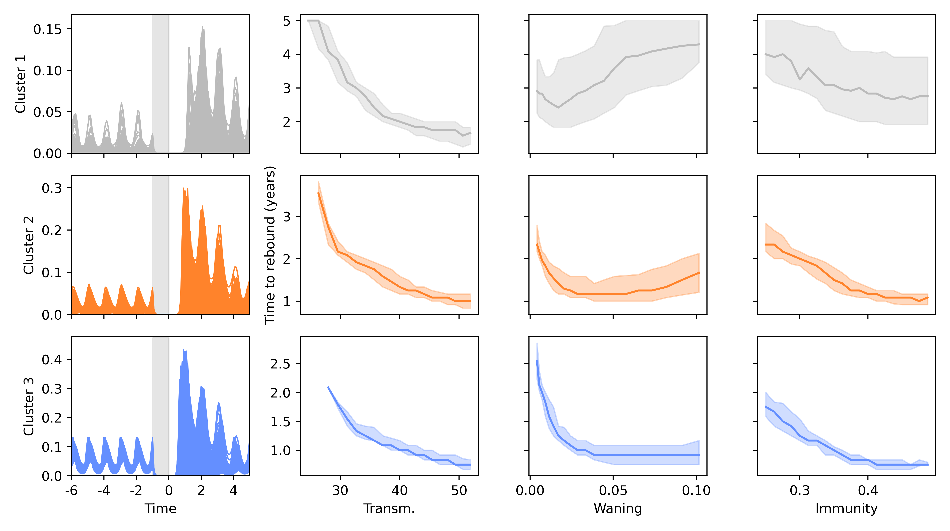

Slide 5
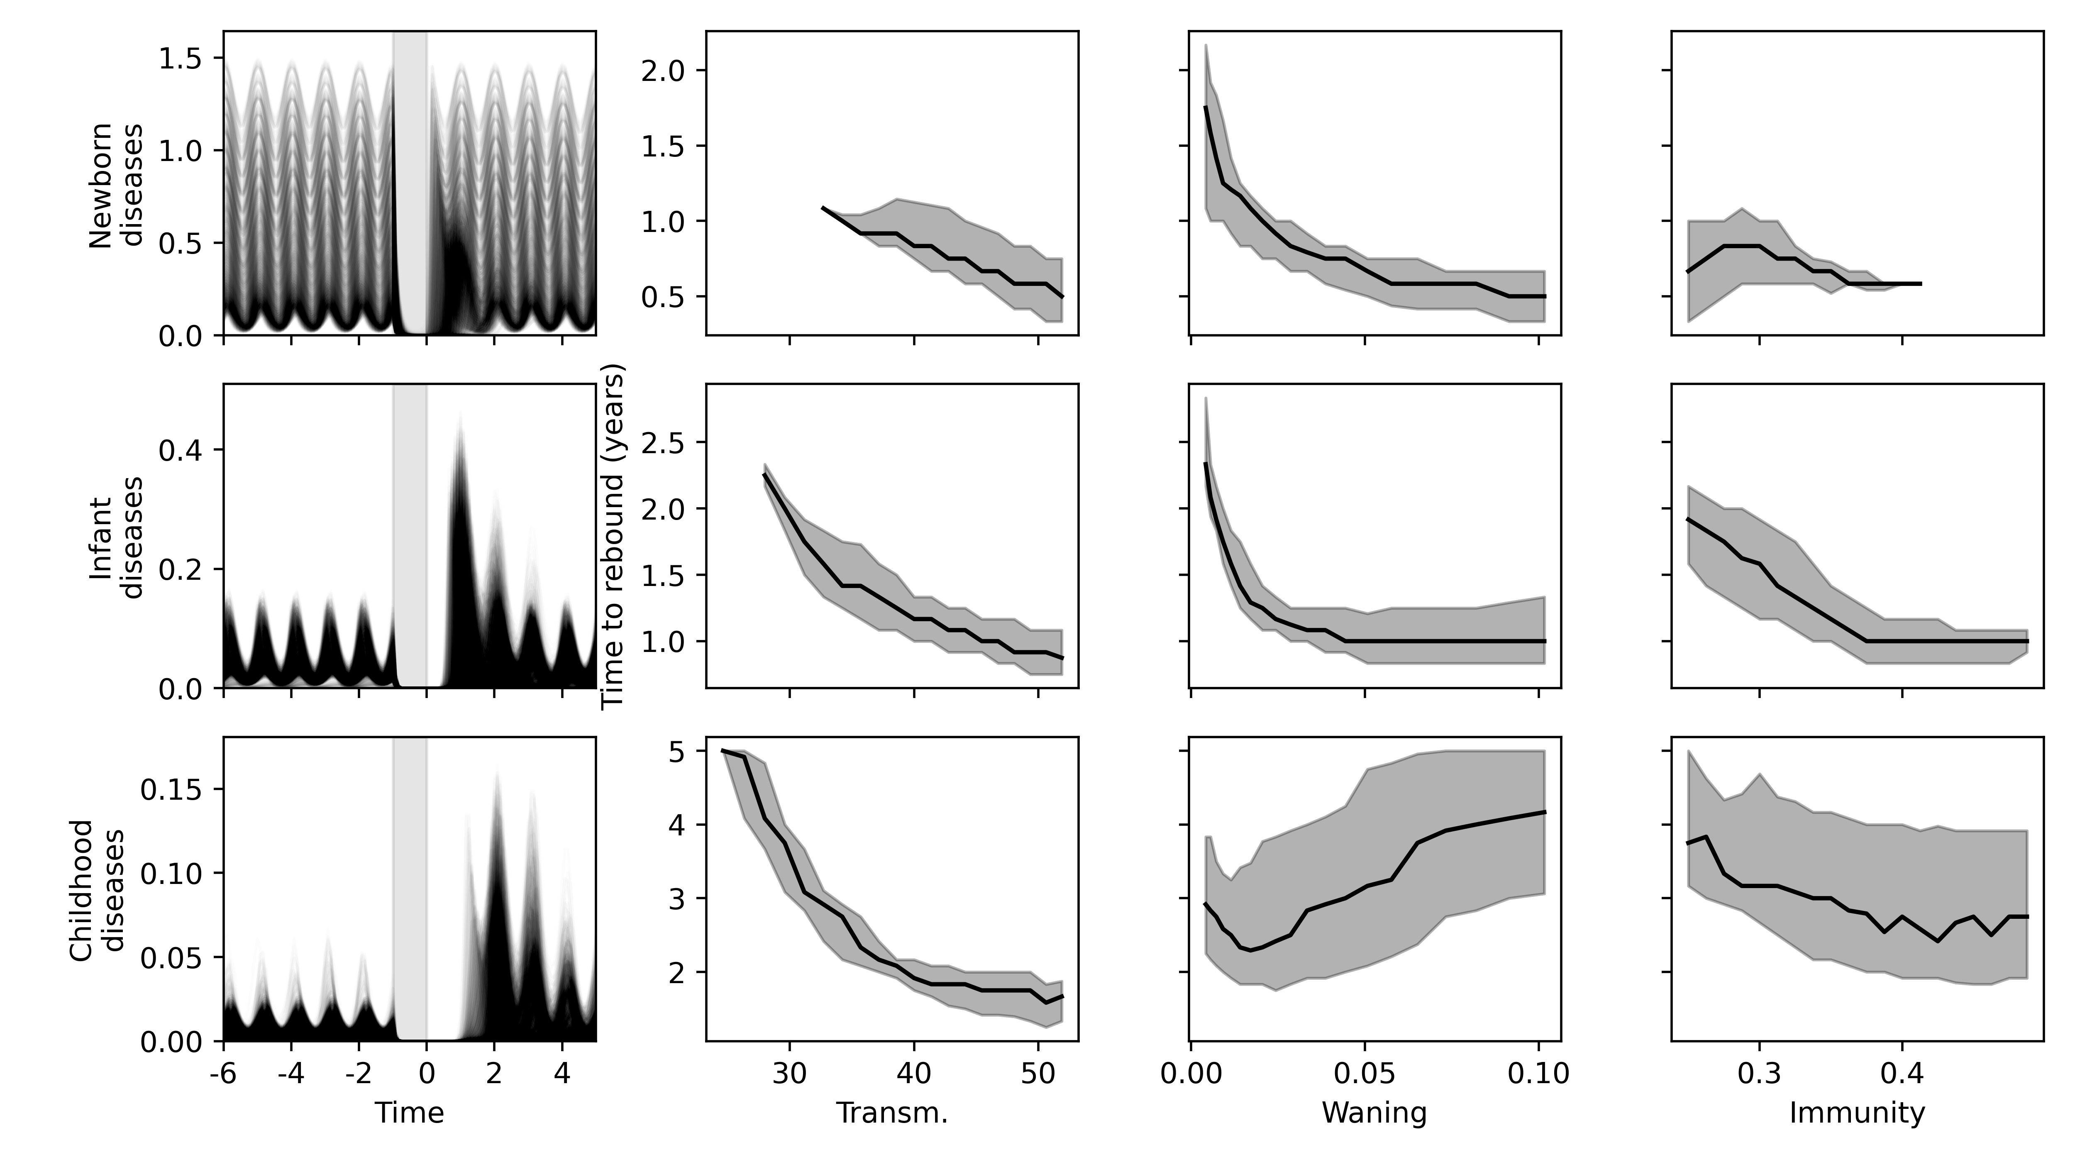

Slide 6
