Slide 1
Fellowship project: Modelling viral interference
Ben Singer
29 May 2025

Slide 2
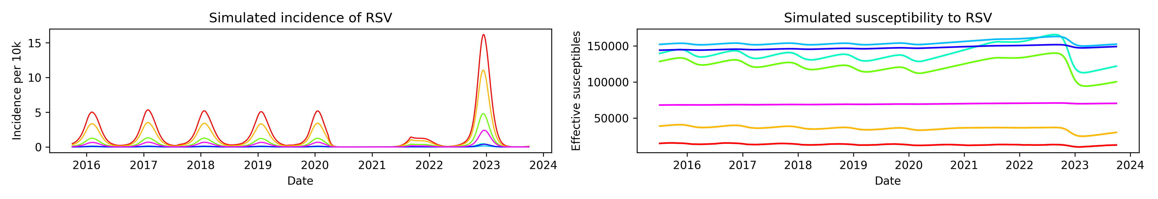
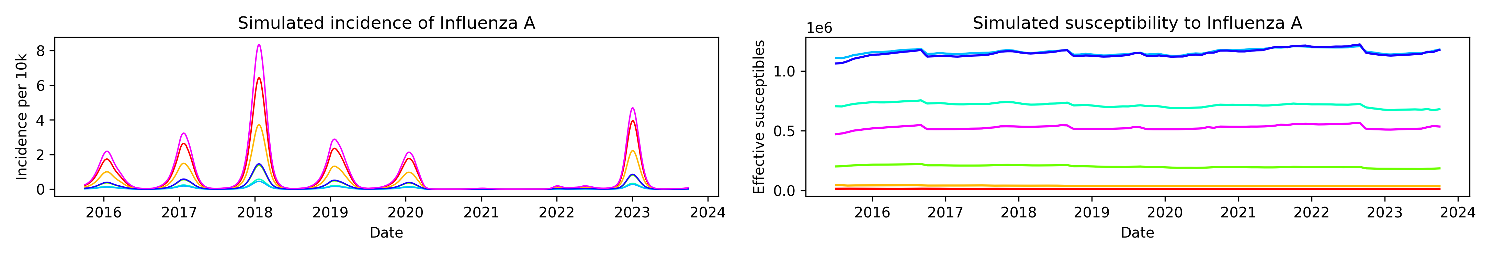
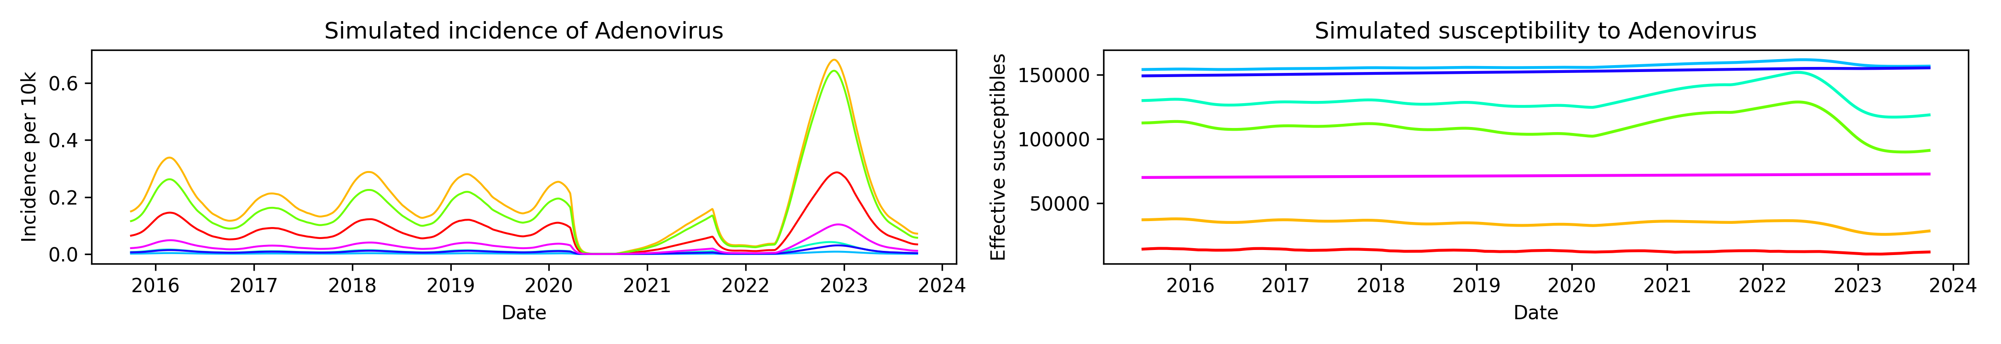
Current work
Simulating multiple respiratory viruses
S₁
Infection
I₁
Recovery
S₂
I₂
Waning
immunity
S₃
I₃

Slide 3
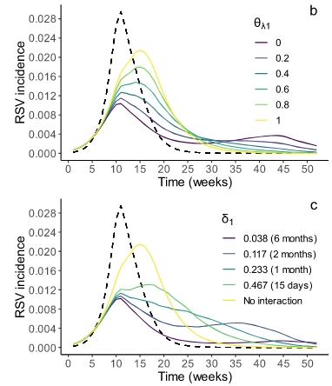
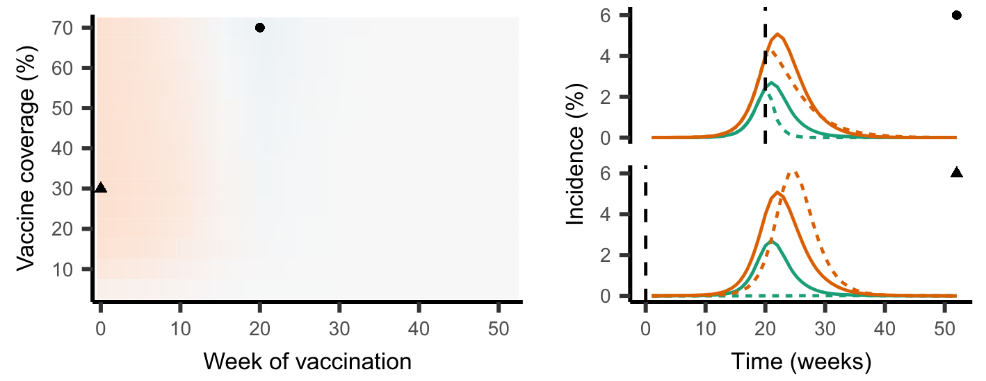
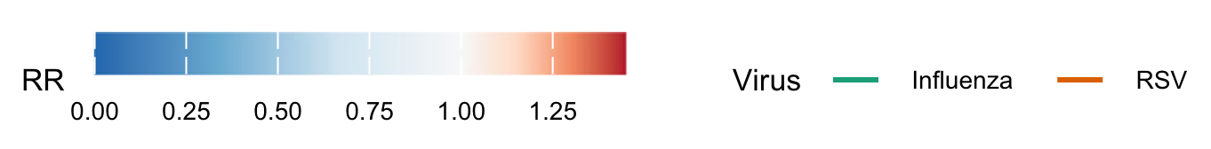
Background
Viral interference has been demonstrated in biological studies
There are few population-level modelling studies
Sarah C Kramer, Sarah Pirikahu, Jean-Sébastien Casalegno & Matthieu Domenech de Cellès
Nature Communications, 2024

Slide 4
Aims
Aim 1
  Build and calibrate a dynamical model of multiple respiratory infections, incorporating viral interference.
Aim 2
  Simulate how interference affects vaccination campaigns’ impact on outbreak timing, and the effects of timing on vaccine campaigns’ efficacy.
Aim 3
  Develop a framework for surveillance through viral interference.

Slide 5
Data
Kaiser
  Viral panel testing data with linked hospital admissions data
  2015–2023
  Demographic and SES information
NHS
  Can take a long time to acquire
  Aiming for similar variables to Kaiser—if linking can work

Slide 6
Preliminary results
Calibrated unified model of multiple respiratory pathogens
Statistical analysis of simultaneous infection in Kaiser data
  2-way contingency tables stratified by NDI and race/ethnicity
  CMH test for odds ratios and p-values
  Bias introduced by symptomatic testing, adjusted based on proportion of symptomatic infections

Slide 7
