Slide 1
Using lockdowns as a natural experiment to fix transmission parameters in mechanistic models: WIP
Ben Singer
Postdoc
Joe Lewnard group
University of California, Berkeley

Slide 2

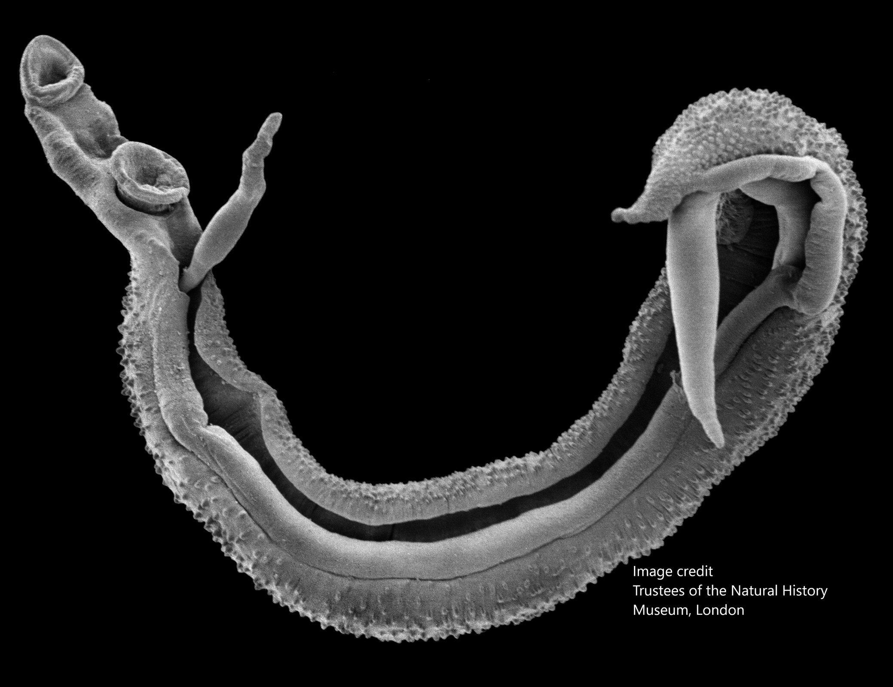
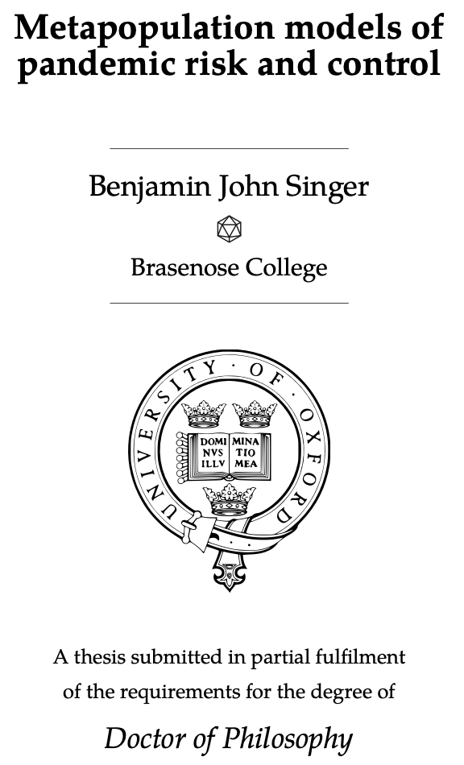








Slide 3
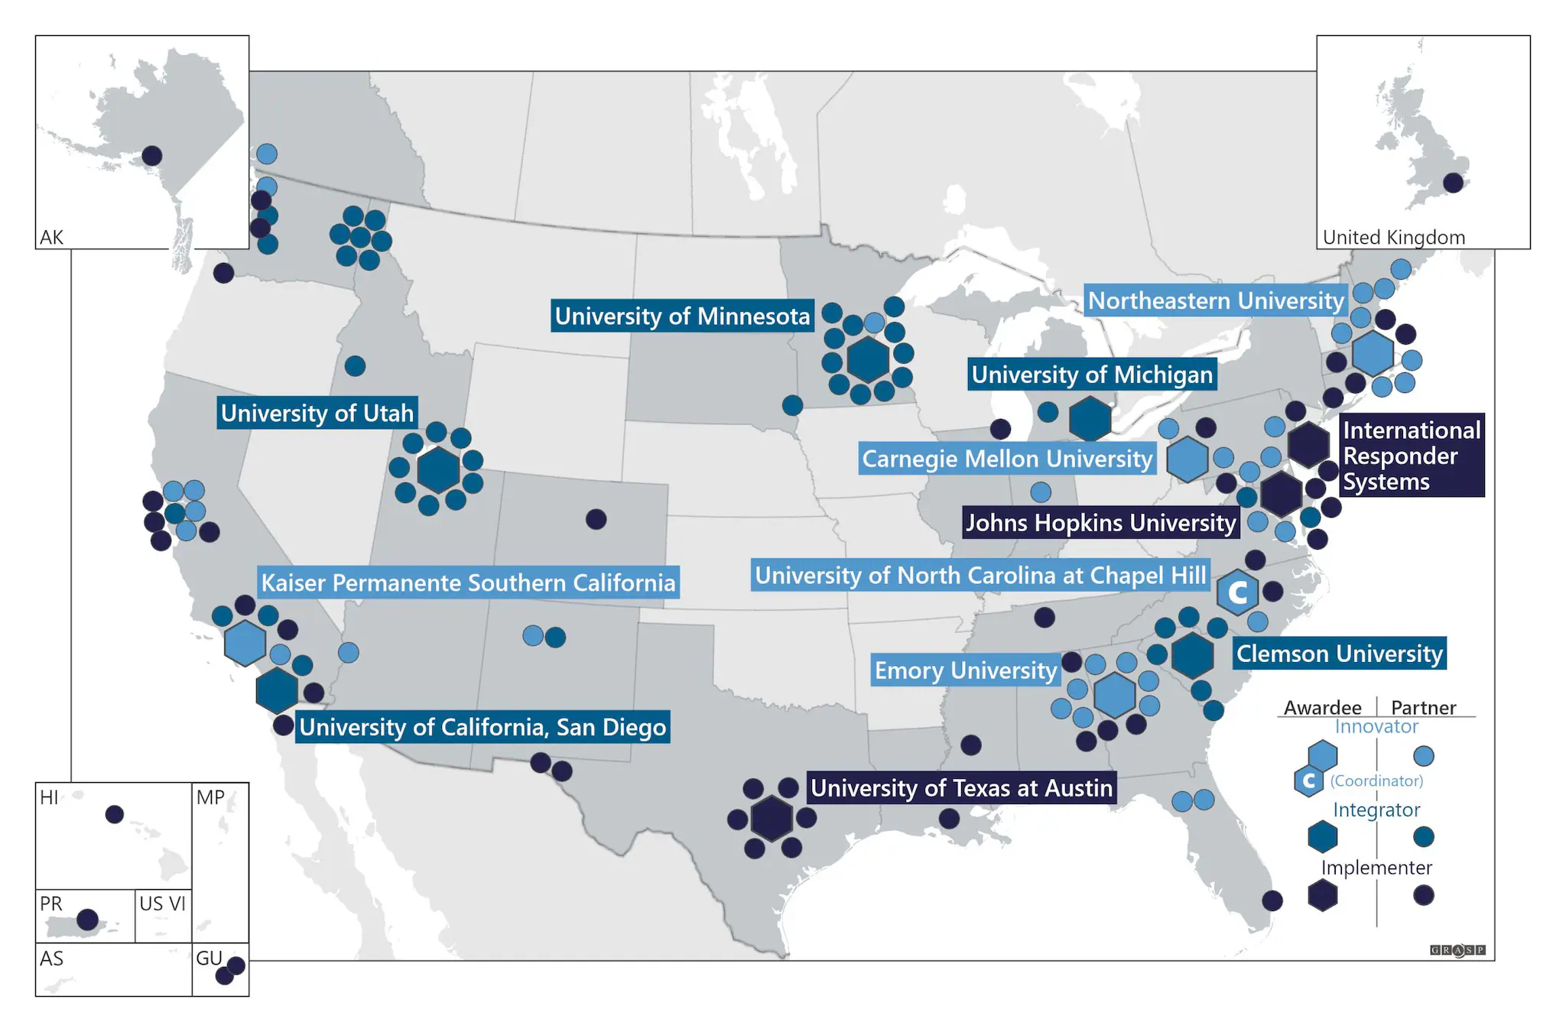

Center for Outbreak Analytics—Insight Net
Kaiser Permanente Southern California Innovator grant
Partnering to analyze data
Broad pandemic preparedness remit
Notes:
Working as part of the CDC Center for Outbreak Analytics Insight Net project
Kaiser Permanente is leading the grant, we’re providing analysis for their data
My remit in particular is to produce models of respiratory infectious diseases, and come up with pandemic preparedness insights
The data I’m working with is hospital admissions and testing data from across the KPSC system
Our aim is to build models that can explain disease transmission, and in particular use post-covid rebound data to uncover dynamics of infectious diseases
"Los Angeles":10081570,"Kern":887641,"Orange":3168044,"San Diego":3316073,"San Bernardino":2149031,"Riverside":2411439,"Ventura":847263

Slide 4
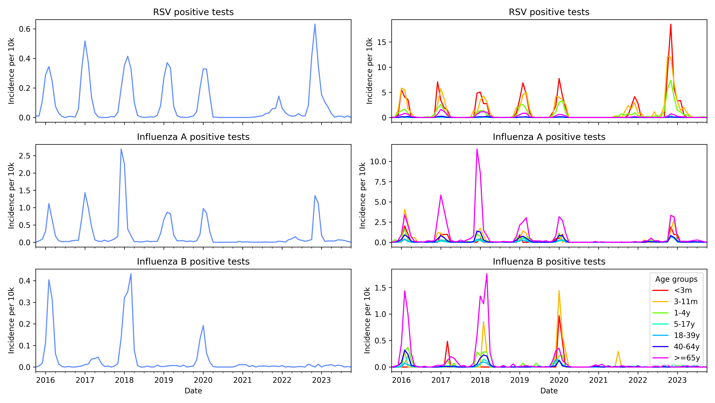
Notes:
Kaiser data on range of pathogens shows different recoveries after covid restrictions lifted
Influenza B did come back in the US for 2023 (normal size outbreak), and this year is having a small outbreak
This has some relationship too to how the infections spread through age groups
RSV – seasonal forcing vs immune decay – Stefan Flasche LSHTM
Flu B has a lot of US-internal structure, Flu A less so, essentially panmictic bc it comes from the southern hemisphere - latin america seasonality affects flu A a lot

Slide 5
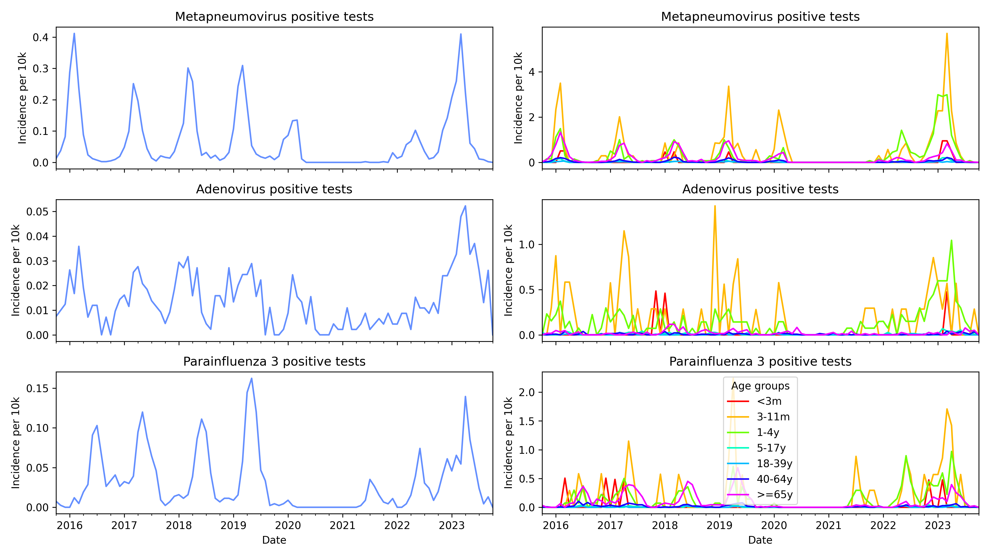
Notes:
- Kaiser data is great and includes interesting time series on pathogens outside the normal superstars
Our hypothesis is that this differences in rebound and age structure can be best explained by differences in dynamics of susceptible recruitment
We need a model that can account for different ways of recruiting susceptibles:
Birth
Waning
Immune escape
Older children might get severe infection because of less exposure to other pathogens?
vs immunity maturation which pushes the other way
Immunity works differently <2yo
Interesting plot: For each wave separately, what's the age distribution?

Slide 6
S₁
Infection
I₁
Simple but flexible model which captures multiple infections with varying immunity over an individual’s lifetime, with waning immunity
S₁ experiences higher infection rate than S₂, which experiences higher infection rate than S₃
Each compartment split into 7 age groups
Infection spreads between age groups based on contact matrix from Prem et al.
Recovery
S₂
I₂
Waning
immunity
S₃
I₃
Notes:
Explain model
For now, hoping that waning and immune escape can be treated as equivalent
Next step is to fit to data, for which we have to understand the impact of covid restrictions

Slide 7
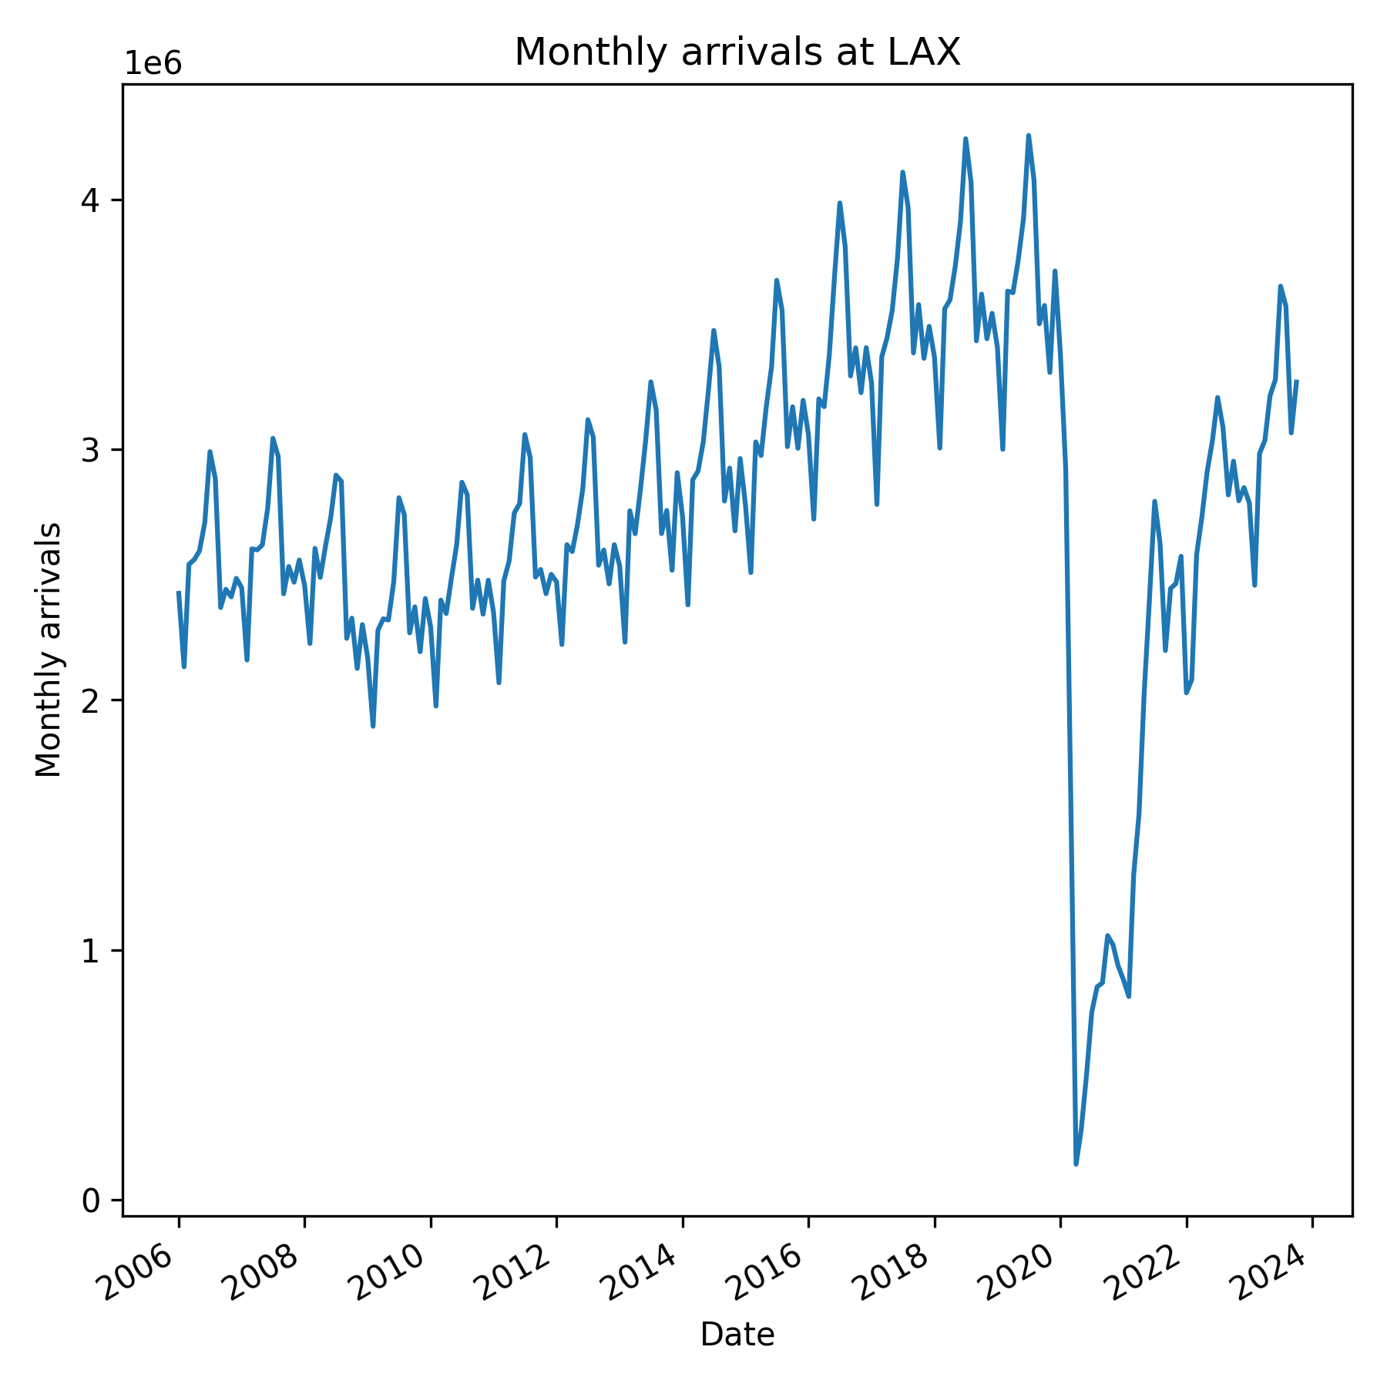
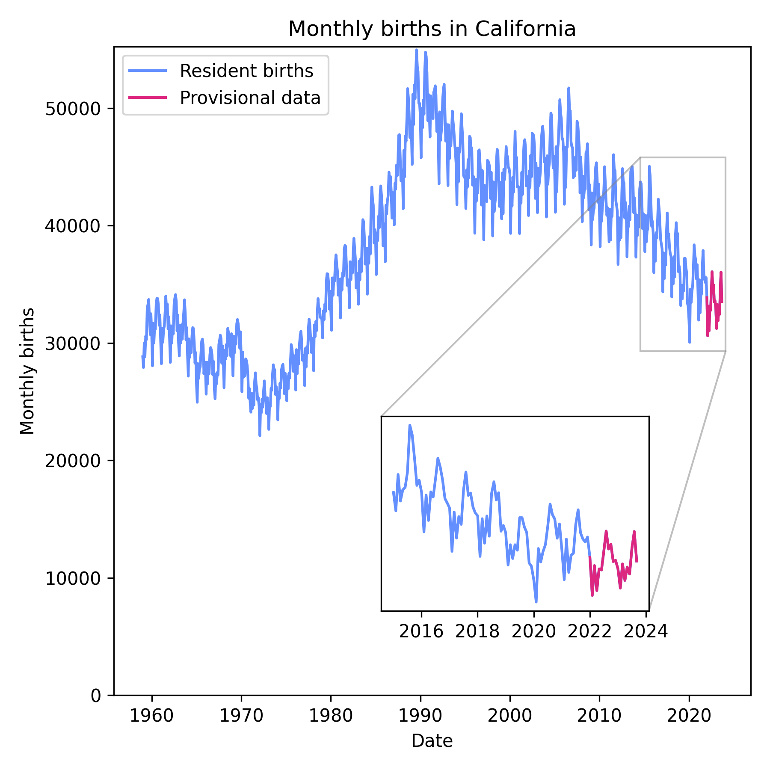

Slide 8
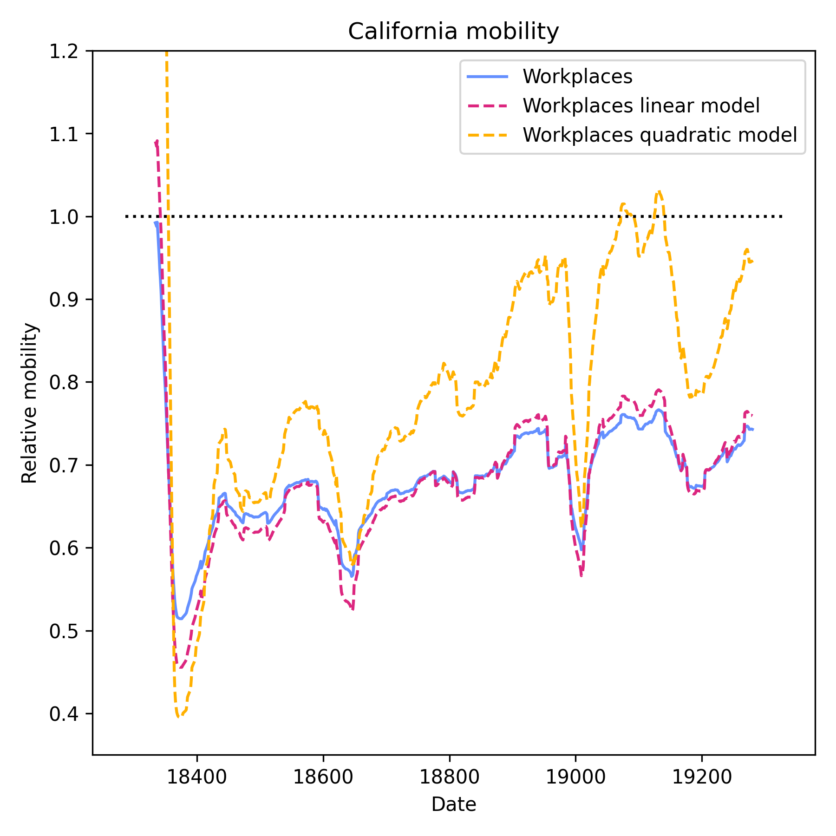
Key dates:
2020.03.19—California stay-at-home order
2021.04.27—CDC relaxes mask advice
2021.12.15—CDC reinstates mask advice
2022.03.01—California cancels mask mandate
COMIX vs POLYMOD mean daily contacts
Age group | Min. contacts | Max. contacts
0–4y | 32% | 98%
4–17y | 20% | 94%
18–59y | 20% | 43%
60+y | 19% | 38%
Notes:
Contact rates will have a big effect on how we estimate other parameters, so important to get as realistic as possible
Different approaches – based on mobility, or based on key dates
Determining change in contact rates is challenge, especially in relaxed period—COMIX data from UK, which provides a starting point but not the whole story

Slide 9
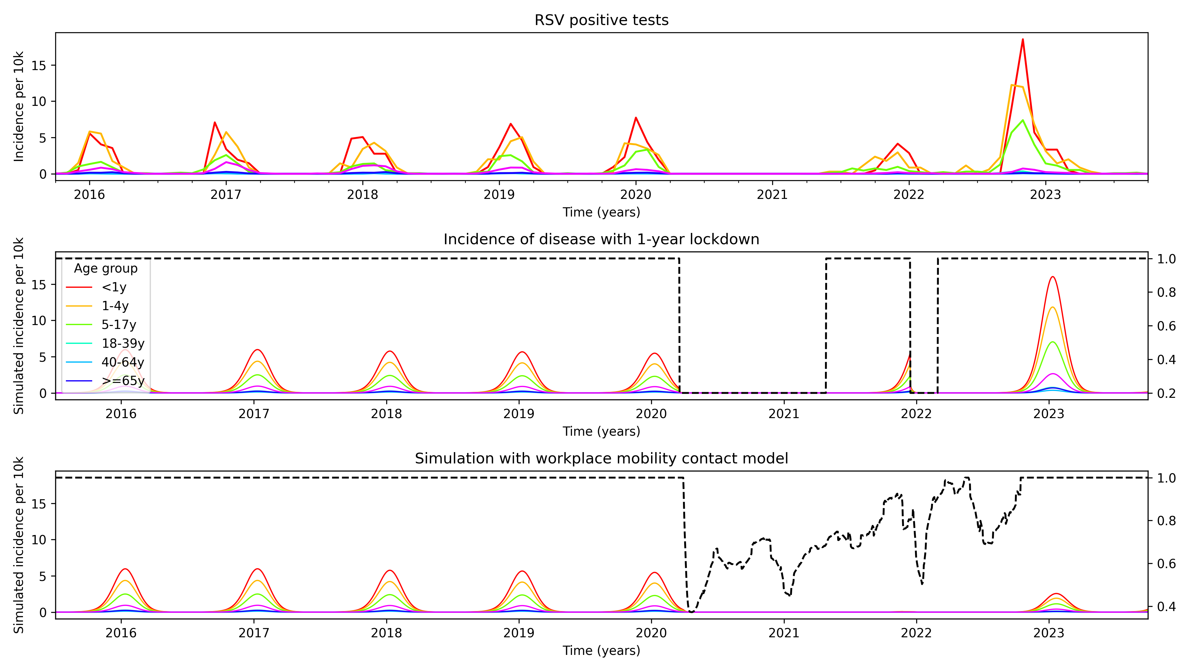
Notes:
- Key dates model more successful than mobility model

Slide 10
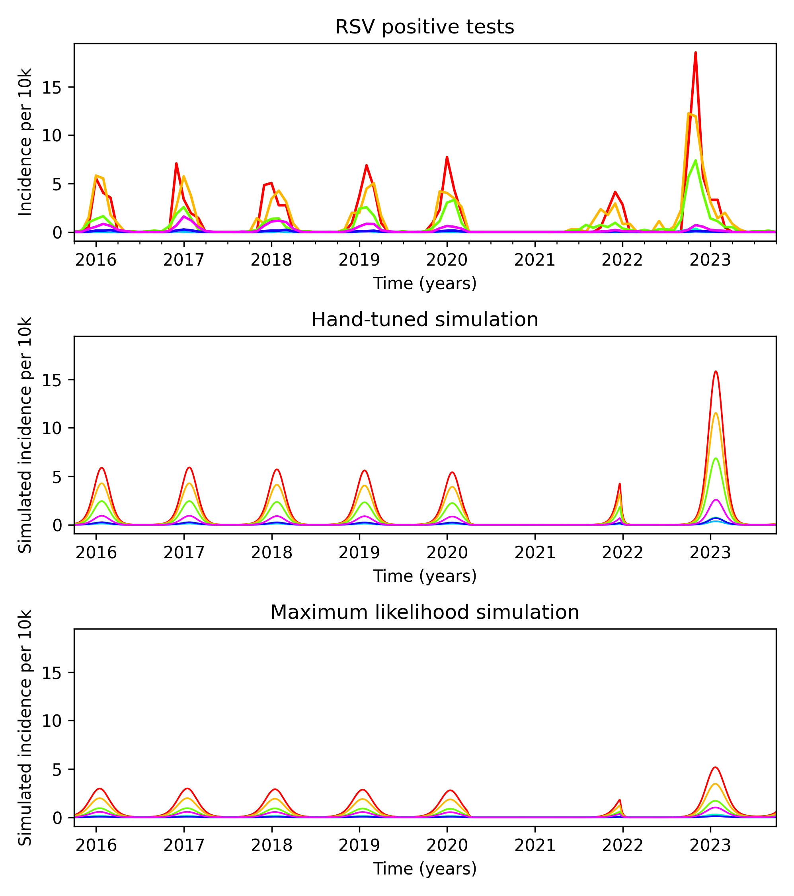
Fitting the model
Starting with RSV
Maximum likelihood assuming Poisson distribution
Difficult to match timing of rebound
Key elements to explore are contact changes, immunity, and seasonal forcing
Notes:
This model can produce time series similar to what we observe in the data
However, there are important elements that I can’t capture yet, as demonstrated by the miserable maximum likelihood fit
While I’m working on developing a good fit, I’ve also done some theoretical work showing what kind of thing we can expect to learn from these fits
Cumulative infections?

Slide 11
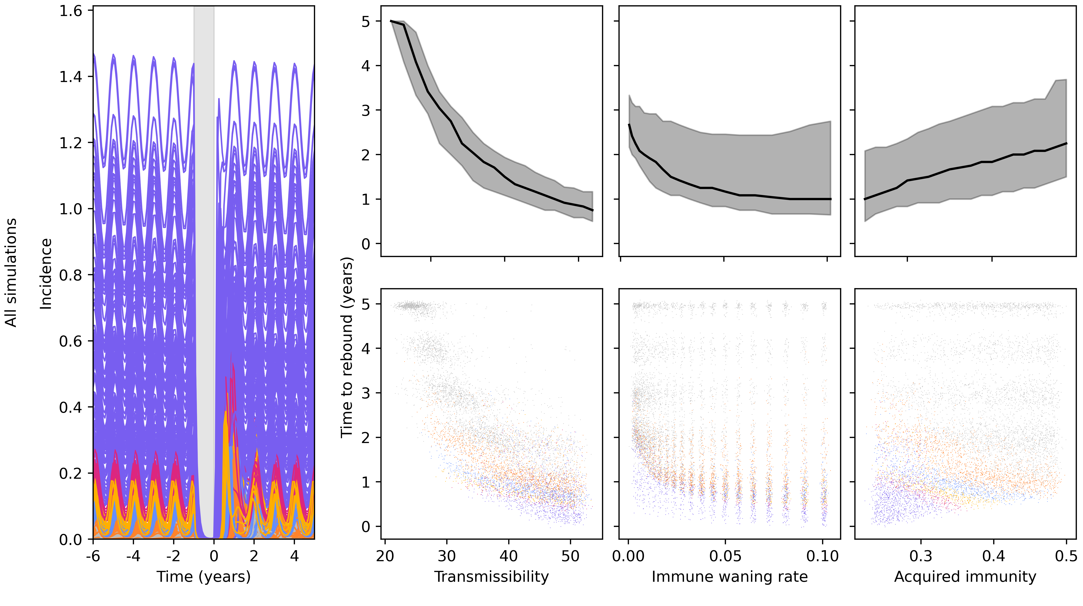
Notes:
Comparing lots of hypothetical diseases with different transmissibility, waning, and acquired immunity
Behaviour of time to rebound overall is fairly intuitive
However, we can cluster based on before-lockdown behaviour – what we might know about a pathogen before a disruptive event
If we do this, immunity has opposite effect
Zoom in on a few clusters to make this clearer

Slide 12
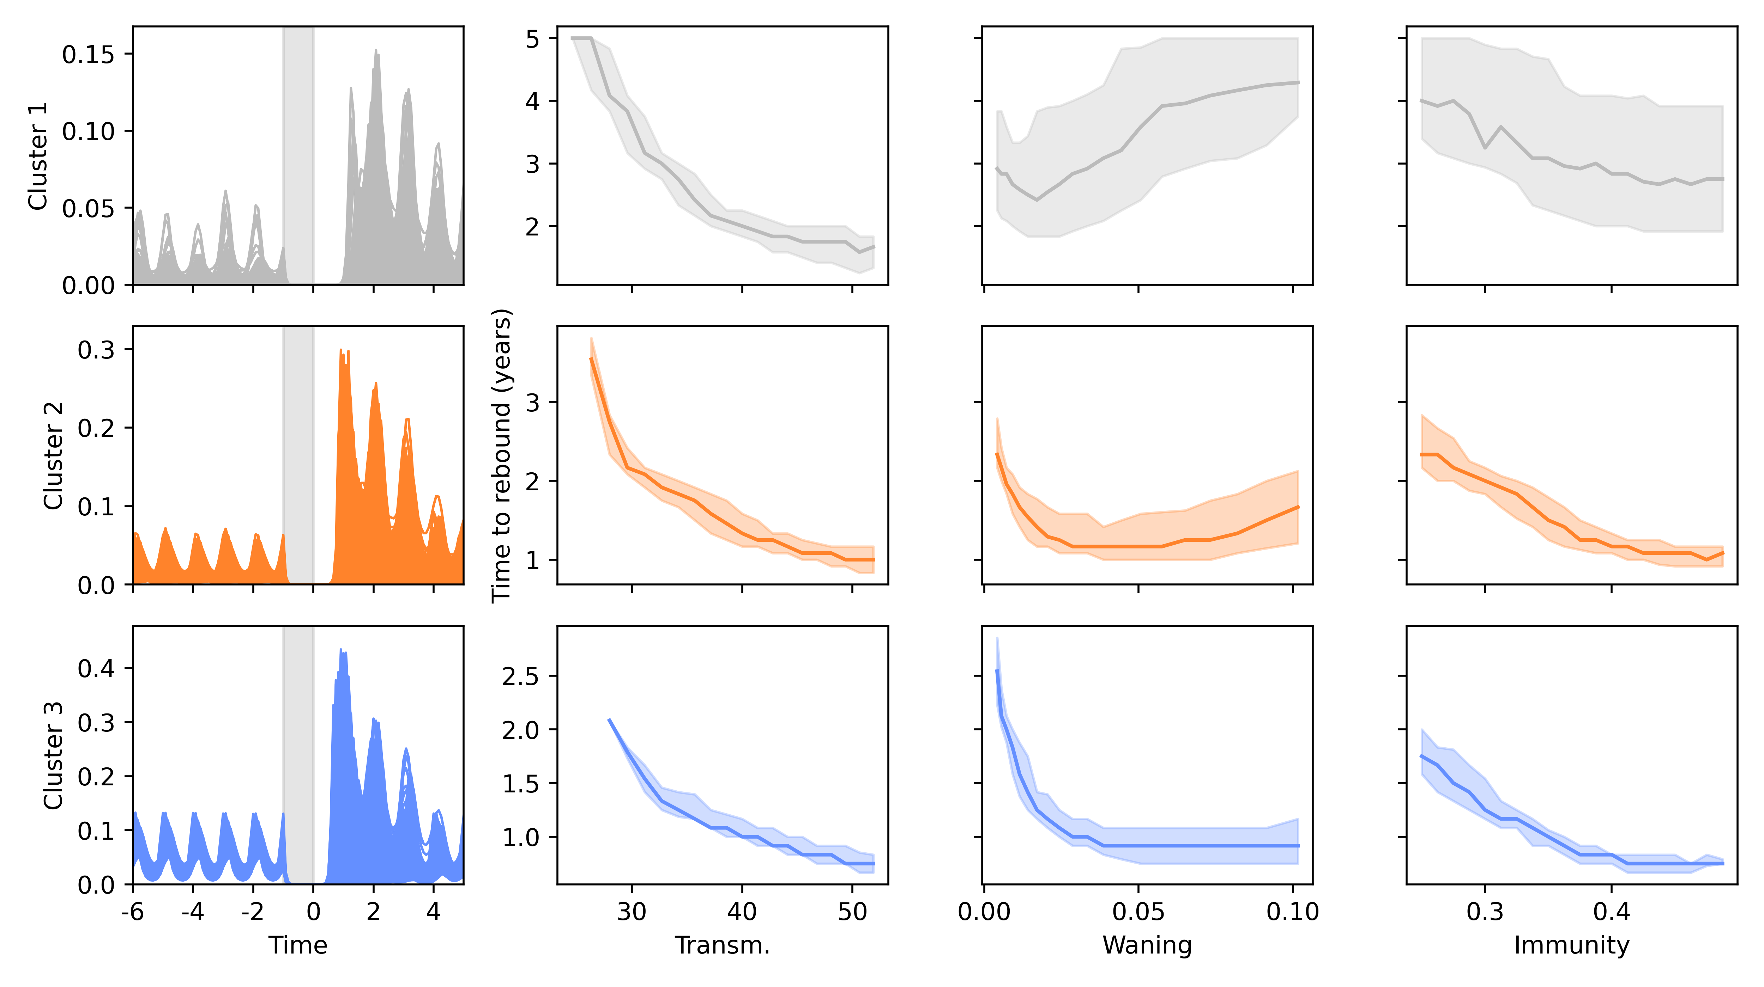
Notes:
Matching for pre-lockdown behaviour, increased immunity means smaller time to rebound
This helps us understand why, when we compare major respiratory diseases, infections of children come back faster
- Next step is to make this all work in a highly realistic scenario, and to get a good fit to data

Slide 13
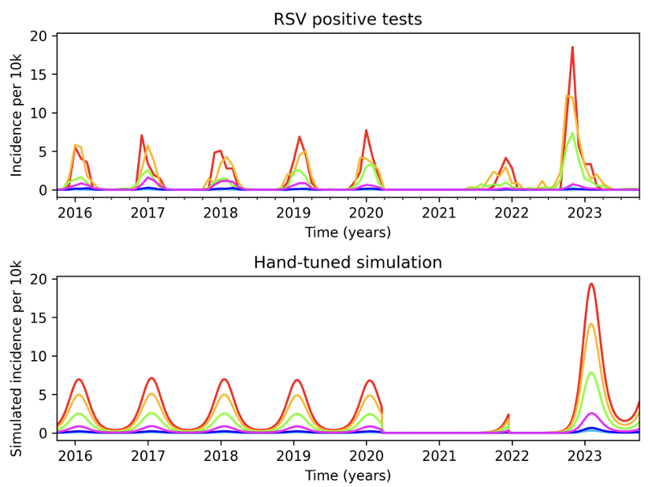
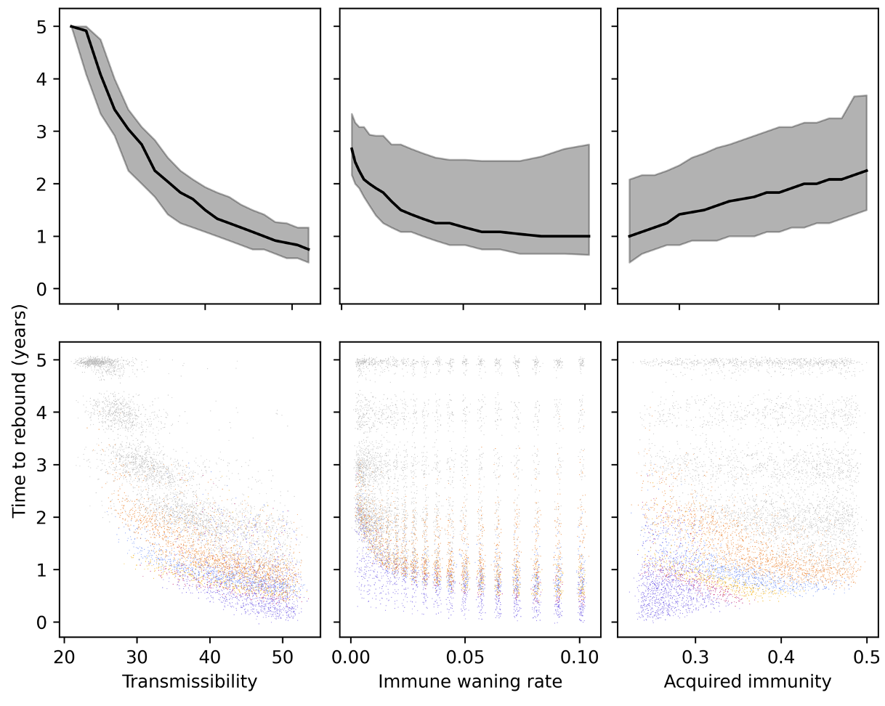
Thanks for listening

Slide 14
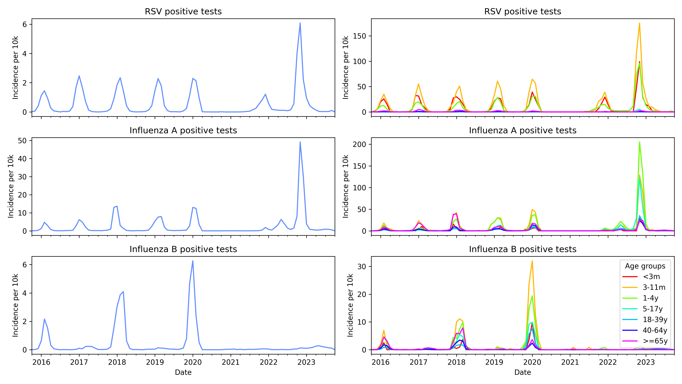

Slide 15
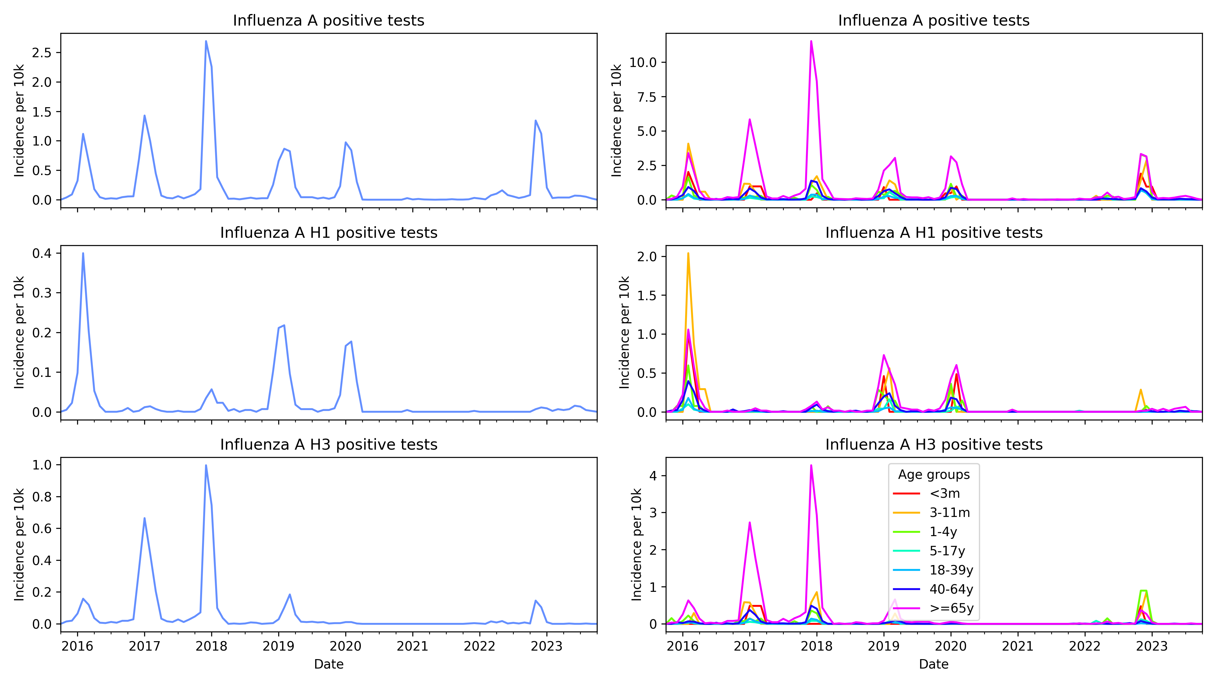

Slide 16
