Slide 1
Work in progress:
COVID-19 related suppression of infectious diseases as a natural experiment to understand susceptibility dynamics
Ben Singer
Postdoc
Lewnard group
UC Berkeley

Slide 2
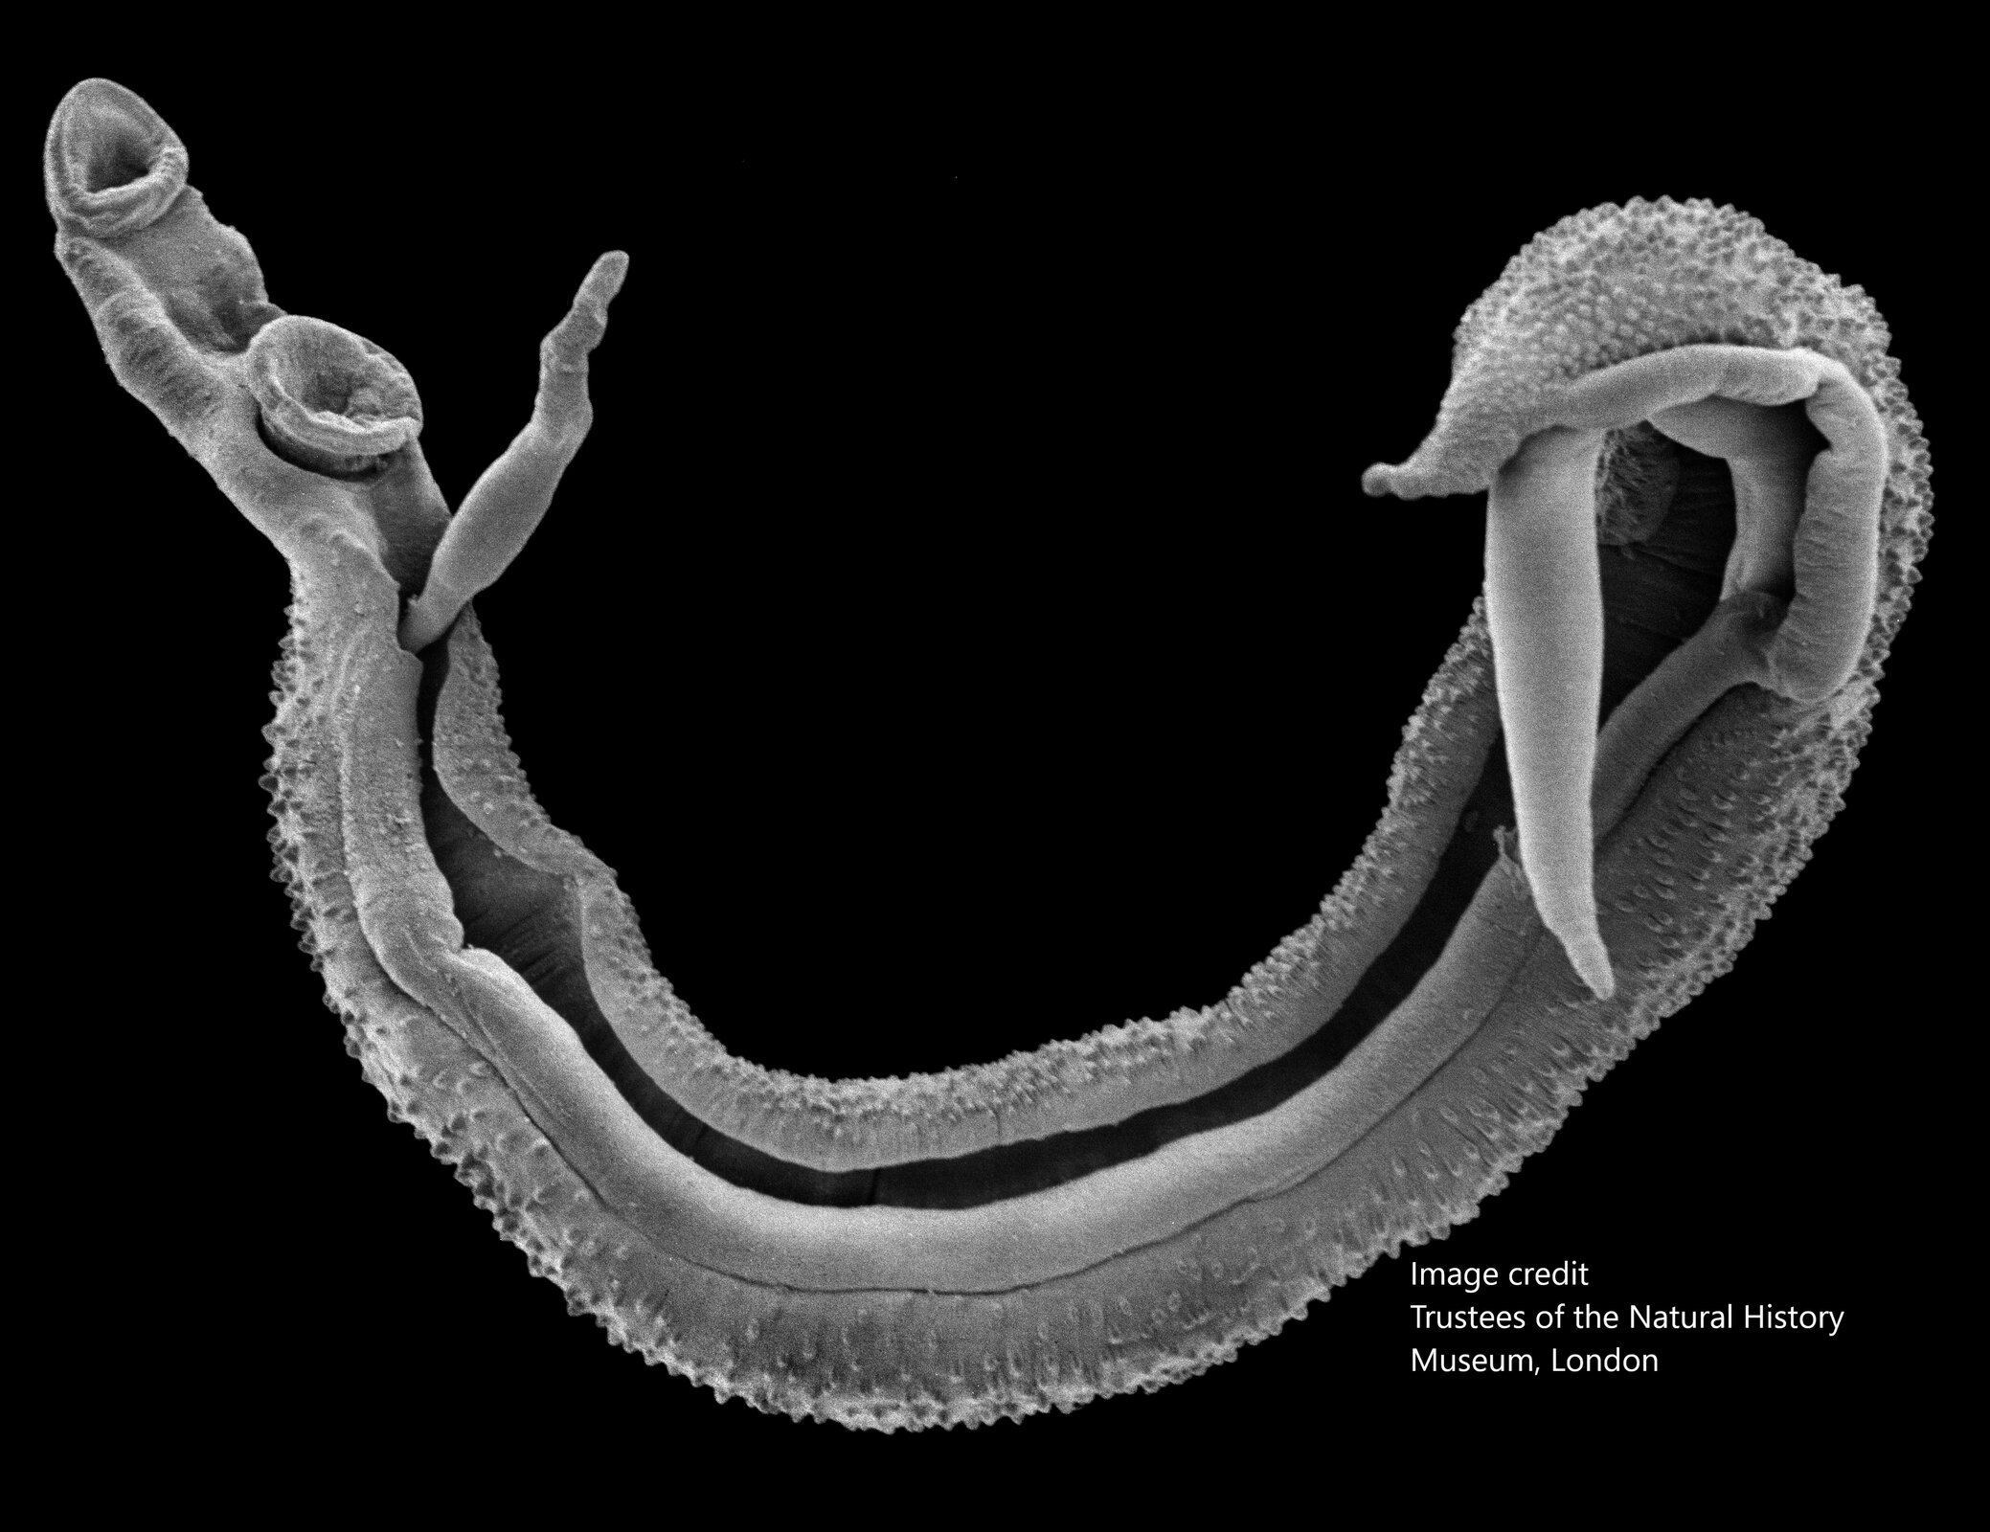
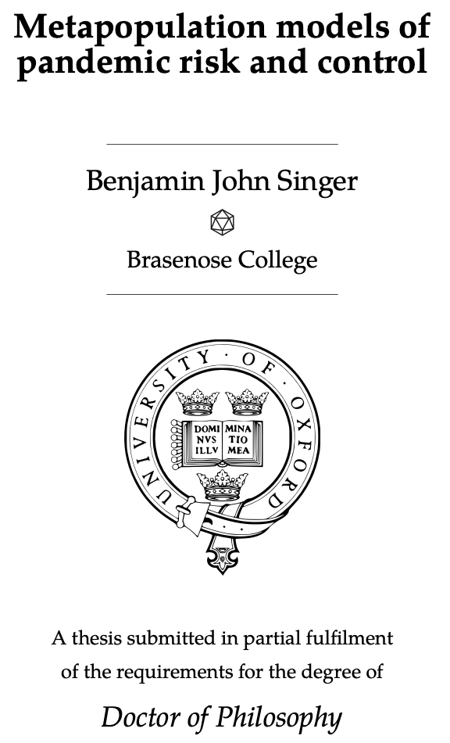







Slide 3
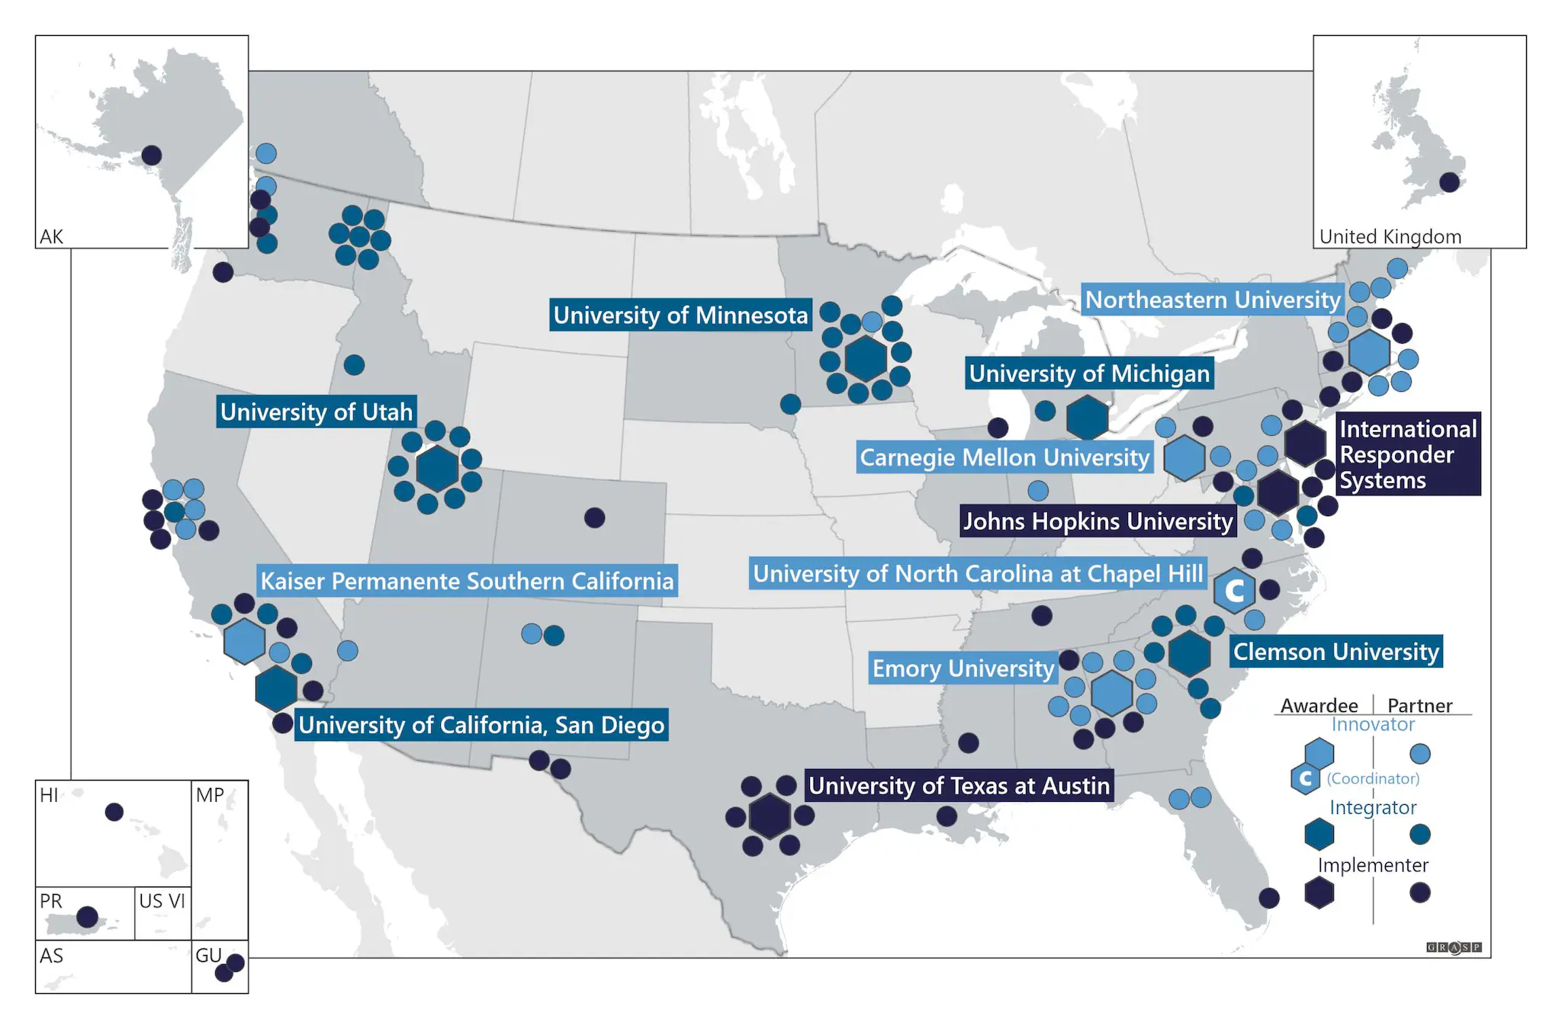

Center for Outbreak Analytics—Insight Net
Kaiser Permanente Southern California Innovator grant
Partnering to analyze data
Broad pandemic preparedness remit
Notes:
Working as part of the CDC Center for Outbreak Analytics Insight Net project
Kaiser Permanente is leading the grant, we’re providing analysis for their data
My remit in particular is to produce models of respiratory infectious diseases, and come up with pandemic preparedness insights
The data I’m working with is hospital admissions and testing data from across the KPSC system
We just got this data last week, and when we plot it we can see some interesting patterns
"Los Angeles":10081570,"Kern":887641,"Orange":3168044,"San Diego":3316073,"San Bernardino":2149031,"Riverside":2411439,"Ventura":847263

Slide 4
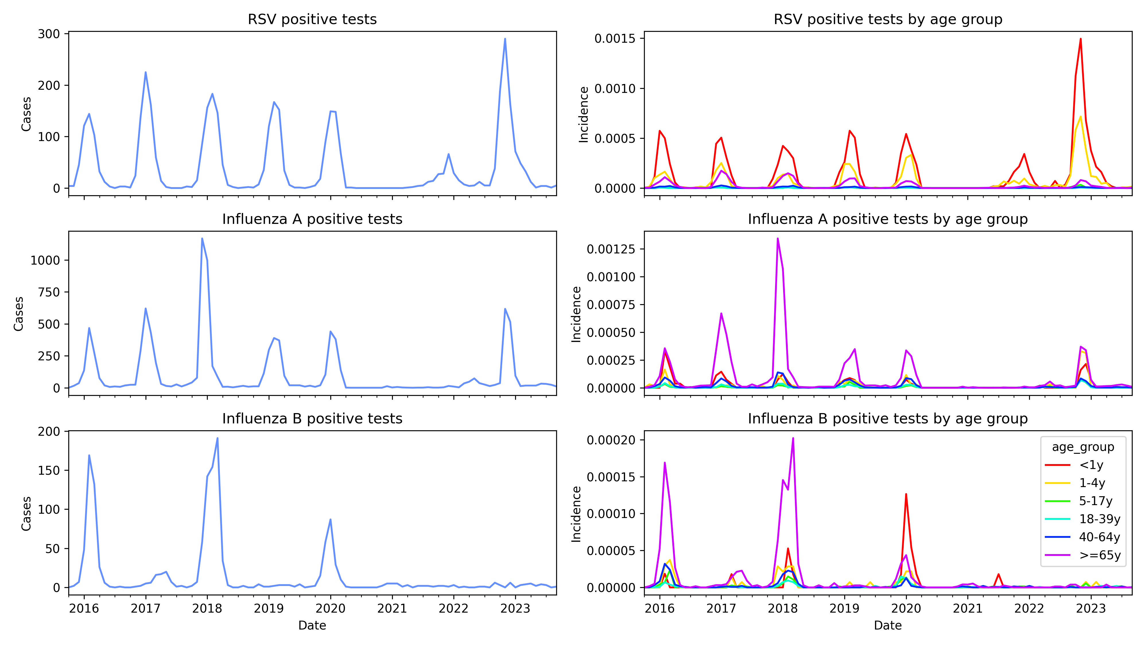
Notes:
Kaiser data on range of pathogens shows different recoveries after covid restrictions lifted
This has some relationship too to how the infections spread through age groups
Our hypothesis is that this can be best explained by differences in dynamics of susceptible recruitment
We need a model that can account for different ways of recruiting susceptibles:
Birth
Waning
Immune escape

Slide 5
S₁
Infection
I₁
Simple but flexible model which captures multiple infections with varying immunity over an individual’s lifetime, with waning immunity
S₁ experiences higher infection rate than S₂, which experiences higher infection rate than S₃
Each compartment split into 7 age groups
Infection spreads between age groups based on contact matrix from Prem et al.
Recovery
S₂
I₂
Waning
immunity
S₃
I₃
Notes:
Explain model

Slide 6
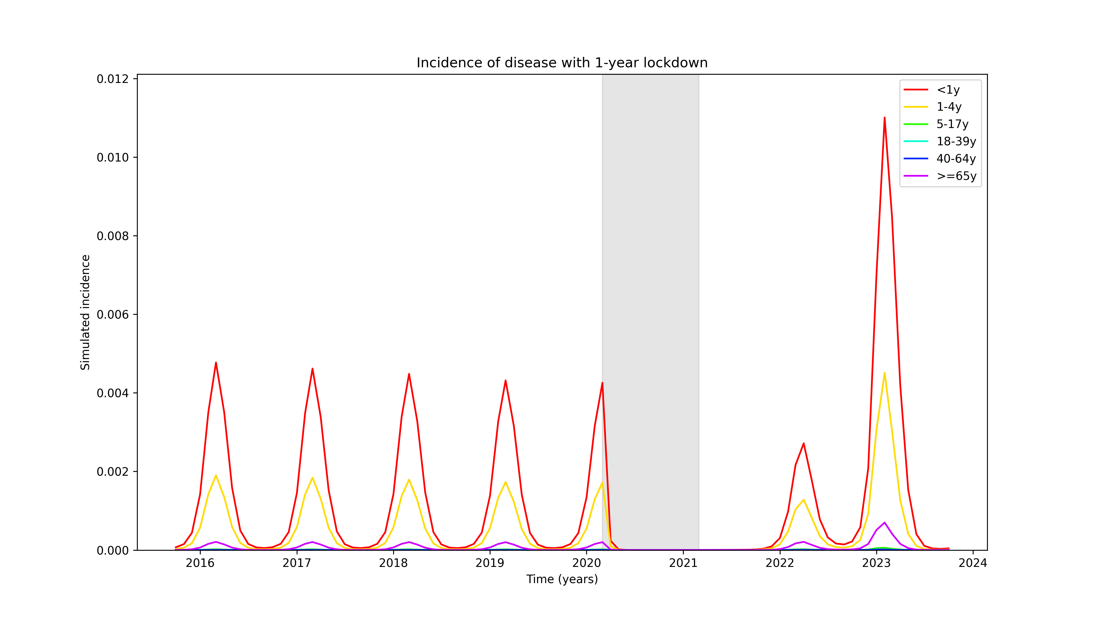
Notes:
This model can produce time series similar to what we observe in the data
This is not a fully fit model, just playing around with parameters, but it’s a proof of principle that we can capture these dynamics
Still working on flu a and b but they’re within the behaviours I’ve observed in this model
To properly understand impact of susceptible recruitment parameters on rebound, however, we need to compare a lot of possible diseases in parameter space

Slide 7
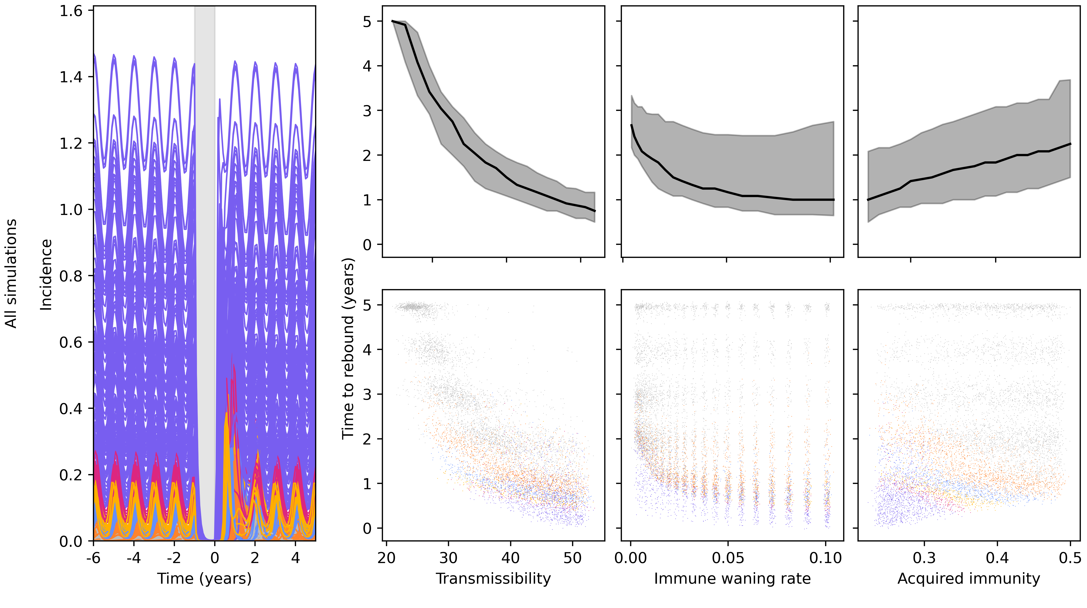
Notes:
Comparing lots of hypothetical diseases with different transmissibility, waning, and acquired immunity
Behaviour of time to rebound overall is fairly intuitive
However, we can cluster based on before-lockdown behaviour – what we might know about a pathogen before a disruptive event
If we do this, immunity has opposite effect
Zoom in on a few clusters to make this clearer

Slide 8
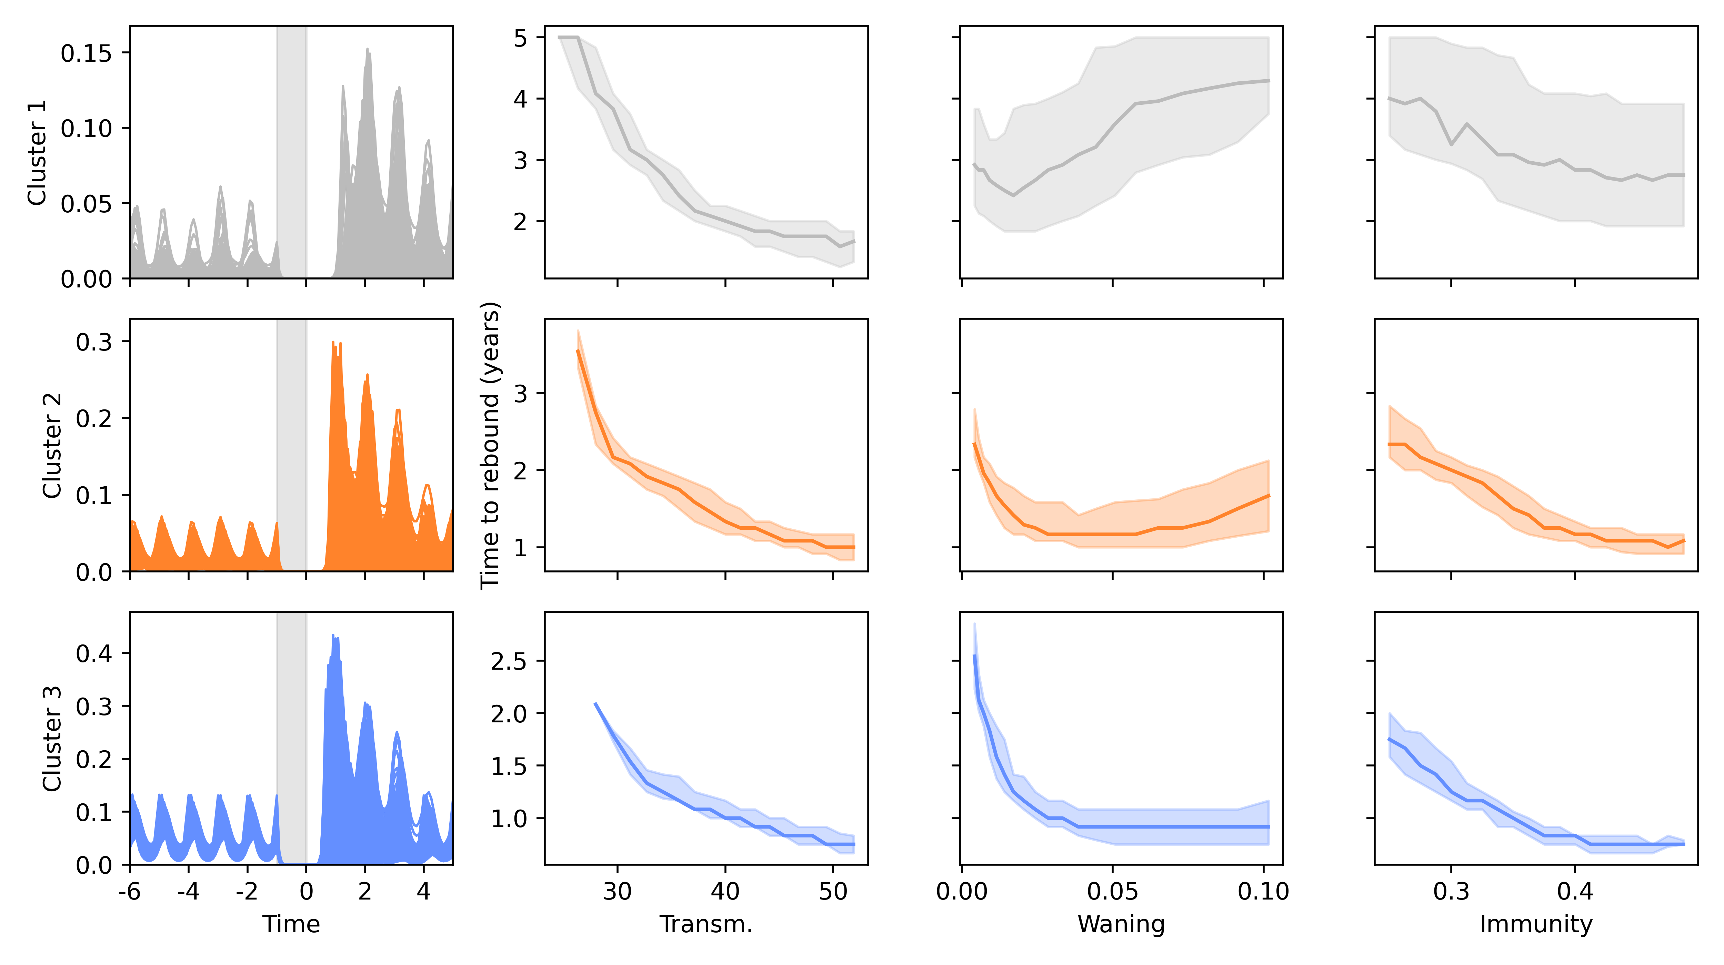
Notes:
Matching for pre-lockdown behaviour, increased immunity means smaller time to rebound
This helps us understand why, when we compare major respiratory diseases, infections of children come back faster
- Next step is to make this all work in a highly realistic scenario, and to get a good fit to data

Slide 9
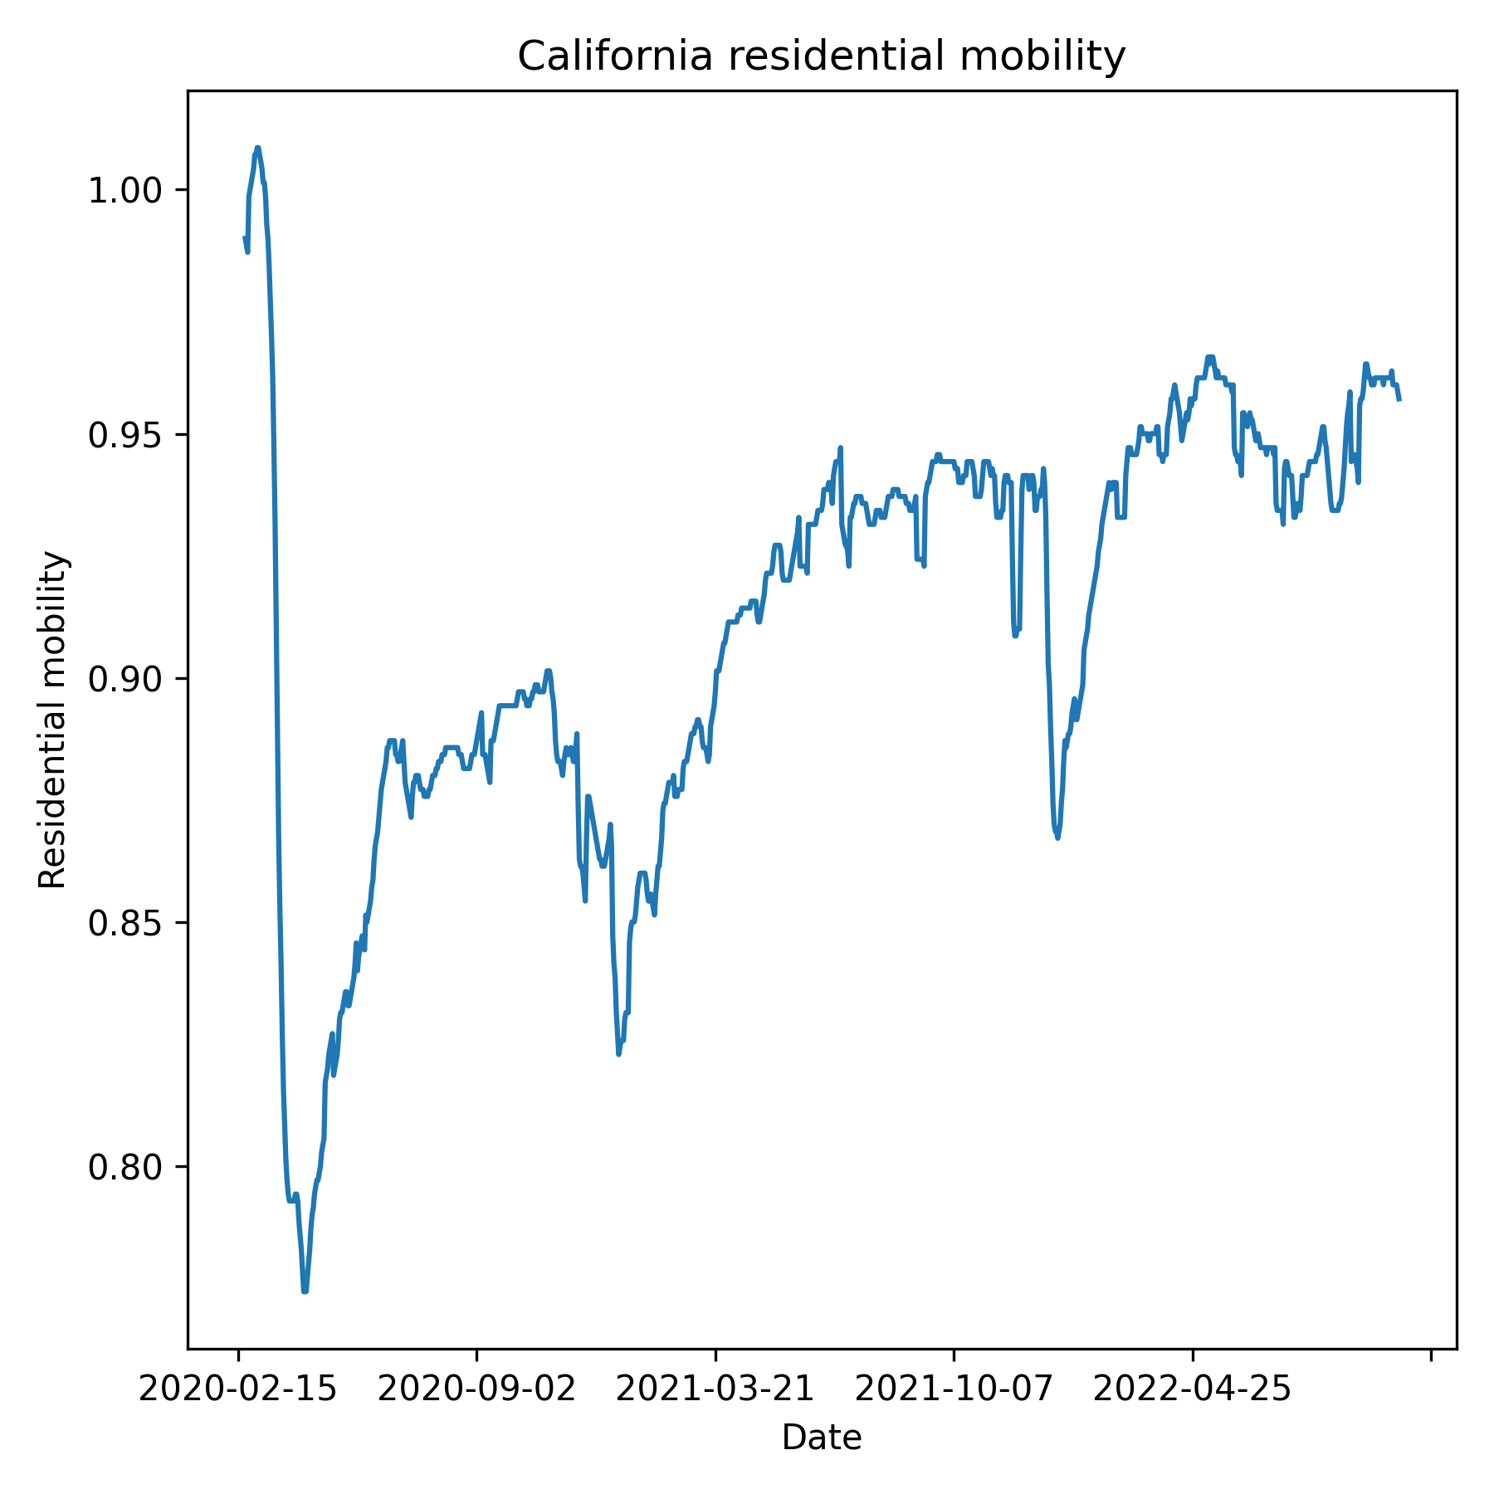
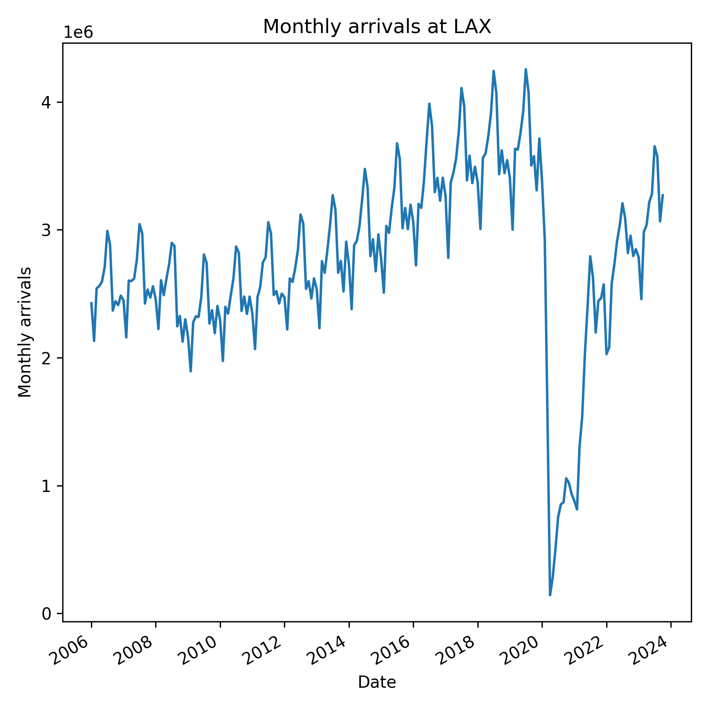
Notes:
First step is to figure out how to simulate lockdowns more realistically
flu immune escape kind of froze in time during lockdowns
joe found study showing no rsv flu interference (rsv actually boosting flu risk)

Slide 10
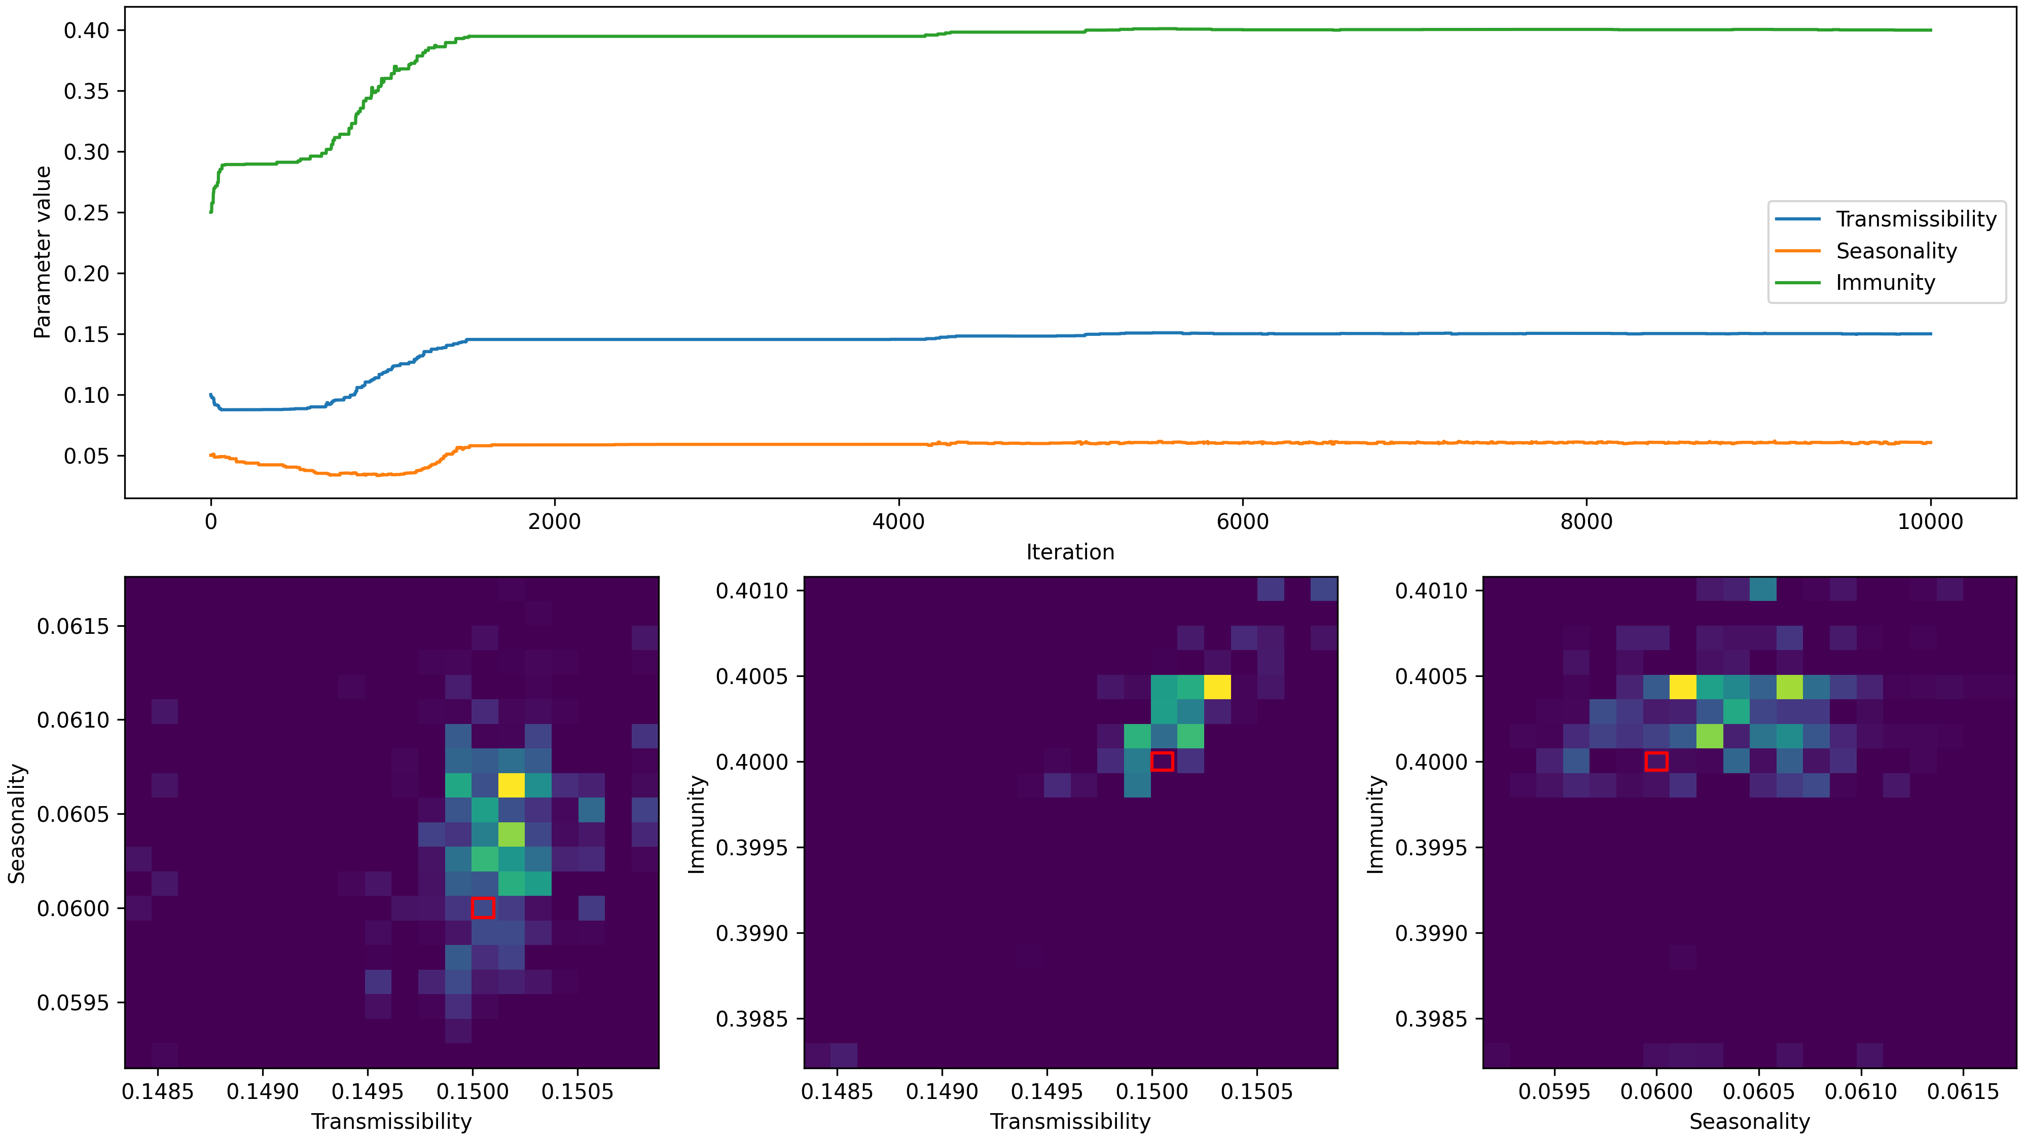
Notes:
Then I need to develop a good MCMC algorithm
Anyone experienced with mcmc who could give me some pointers? Particularly useful to have recs on multi-dimensional proposal distribution and mapping reals to interval
odin dust package imperial
public health: identifiability of phenomena

