Slide 1
Respiratory virus modelling project
Benjamin J Singer
Lewnard Group
School of Public Health
University of California, Berkeley

Slide 2
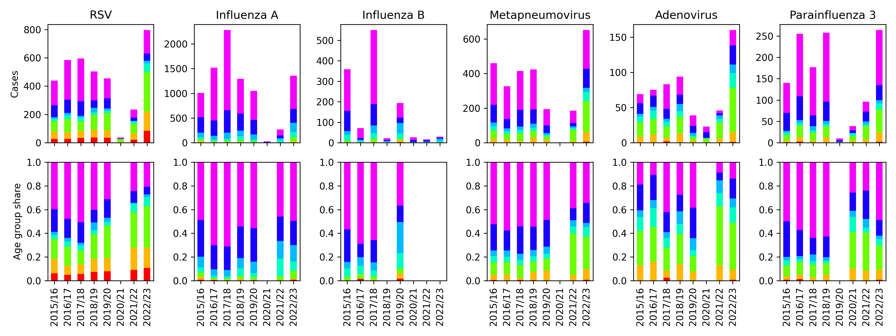
Simultaneous data on viral infections provides modelling opportunities

Slide 3
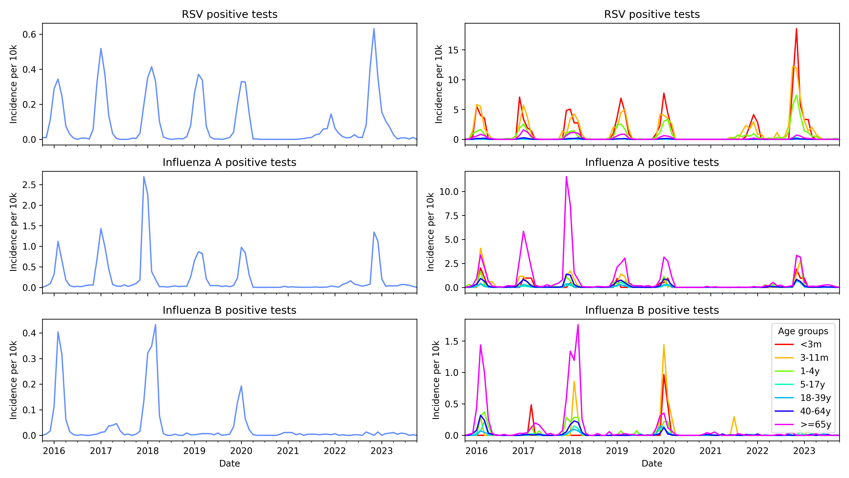

Slide 4
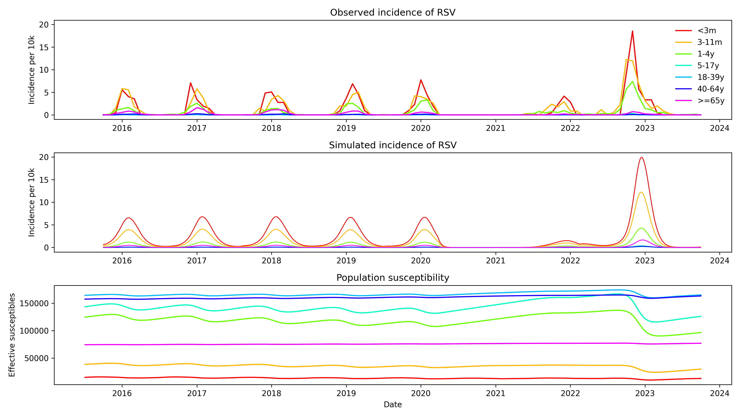

Slide 5
More data could power bigger questions
KPSC data has limited geographic and SES coverage
NHS data could open up more research
  Comparison between regions with different climate could reveal seasonality drivers
  Larger data set allows more questions to be asked
Particularly interesting question: viral interference

Slide 6
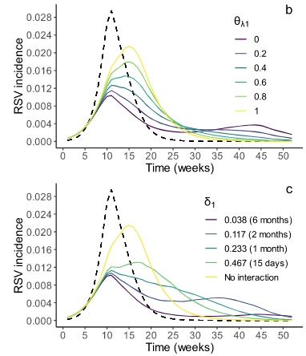
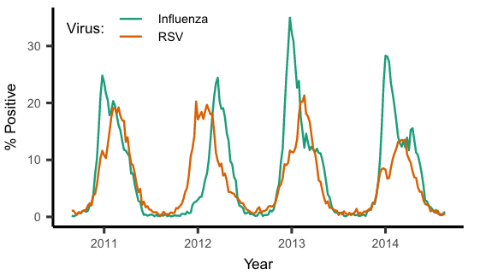
Existing study: Kramer et al. 2024
Sarah C Kramer, Sarah Pirikahu, Jean-Sébastien Casalegno & Matthieu Domenech de Cellès
Nature Communications, 2024

Slide 7
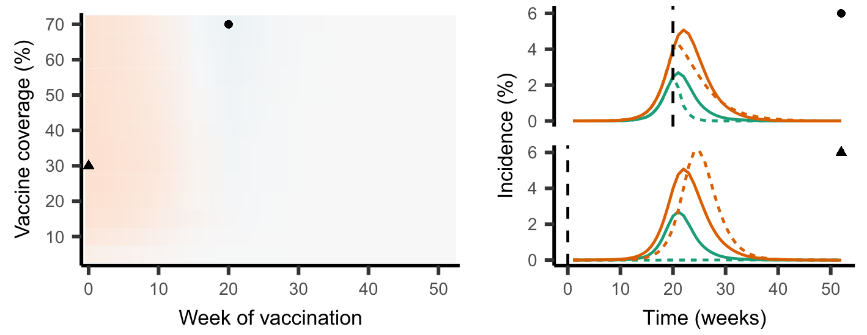
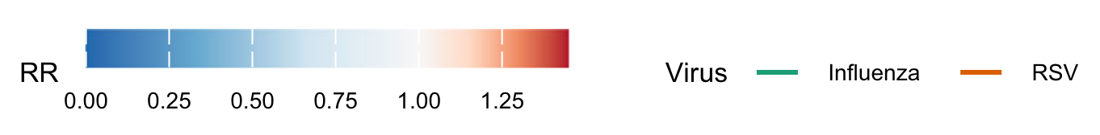
Impact: vaccination timing
Notes:
Rate Ratio of RSV in presence of vaccination relative to absence, minimum and maximum plotted
Dotted lines are in presence of vaccination, solid lines absence

Slide 8
Objectives of a future study
Replicate existing findings
Extend to additional pathogens
Understand the impact on surveillance and emerging diseases
Understand interactions with seasonality

