Slide 1
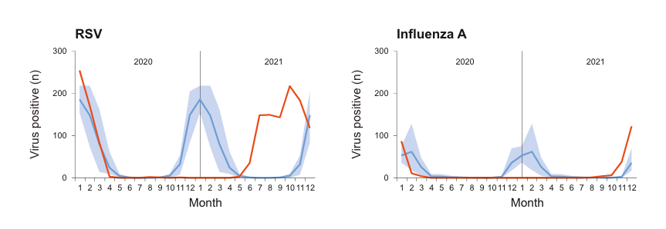
Pathogens recovered differently after suppression during the pandemic
Dagan et al. eBioMedicine, 2023
Notes:
Pathogens recovered differently after suppression during the pandemic – why?
Hypothesis: different recovery of susceptibles
Different ways to recover susceptibles – classing immune escape and waning together
So we need an age-structured model with waning immunity
SIR model, multiple susceptibility classes needed to fit certain infections
Sketch out compartments, write down equations
In absence of Kaiser data to fit to, running with Pitzer rota data and a guess at a flu-like pathogen

Slide 2
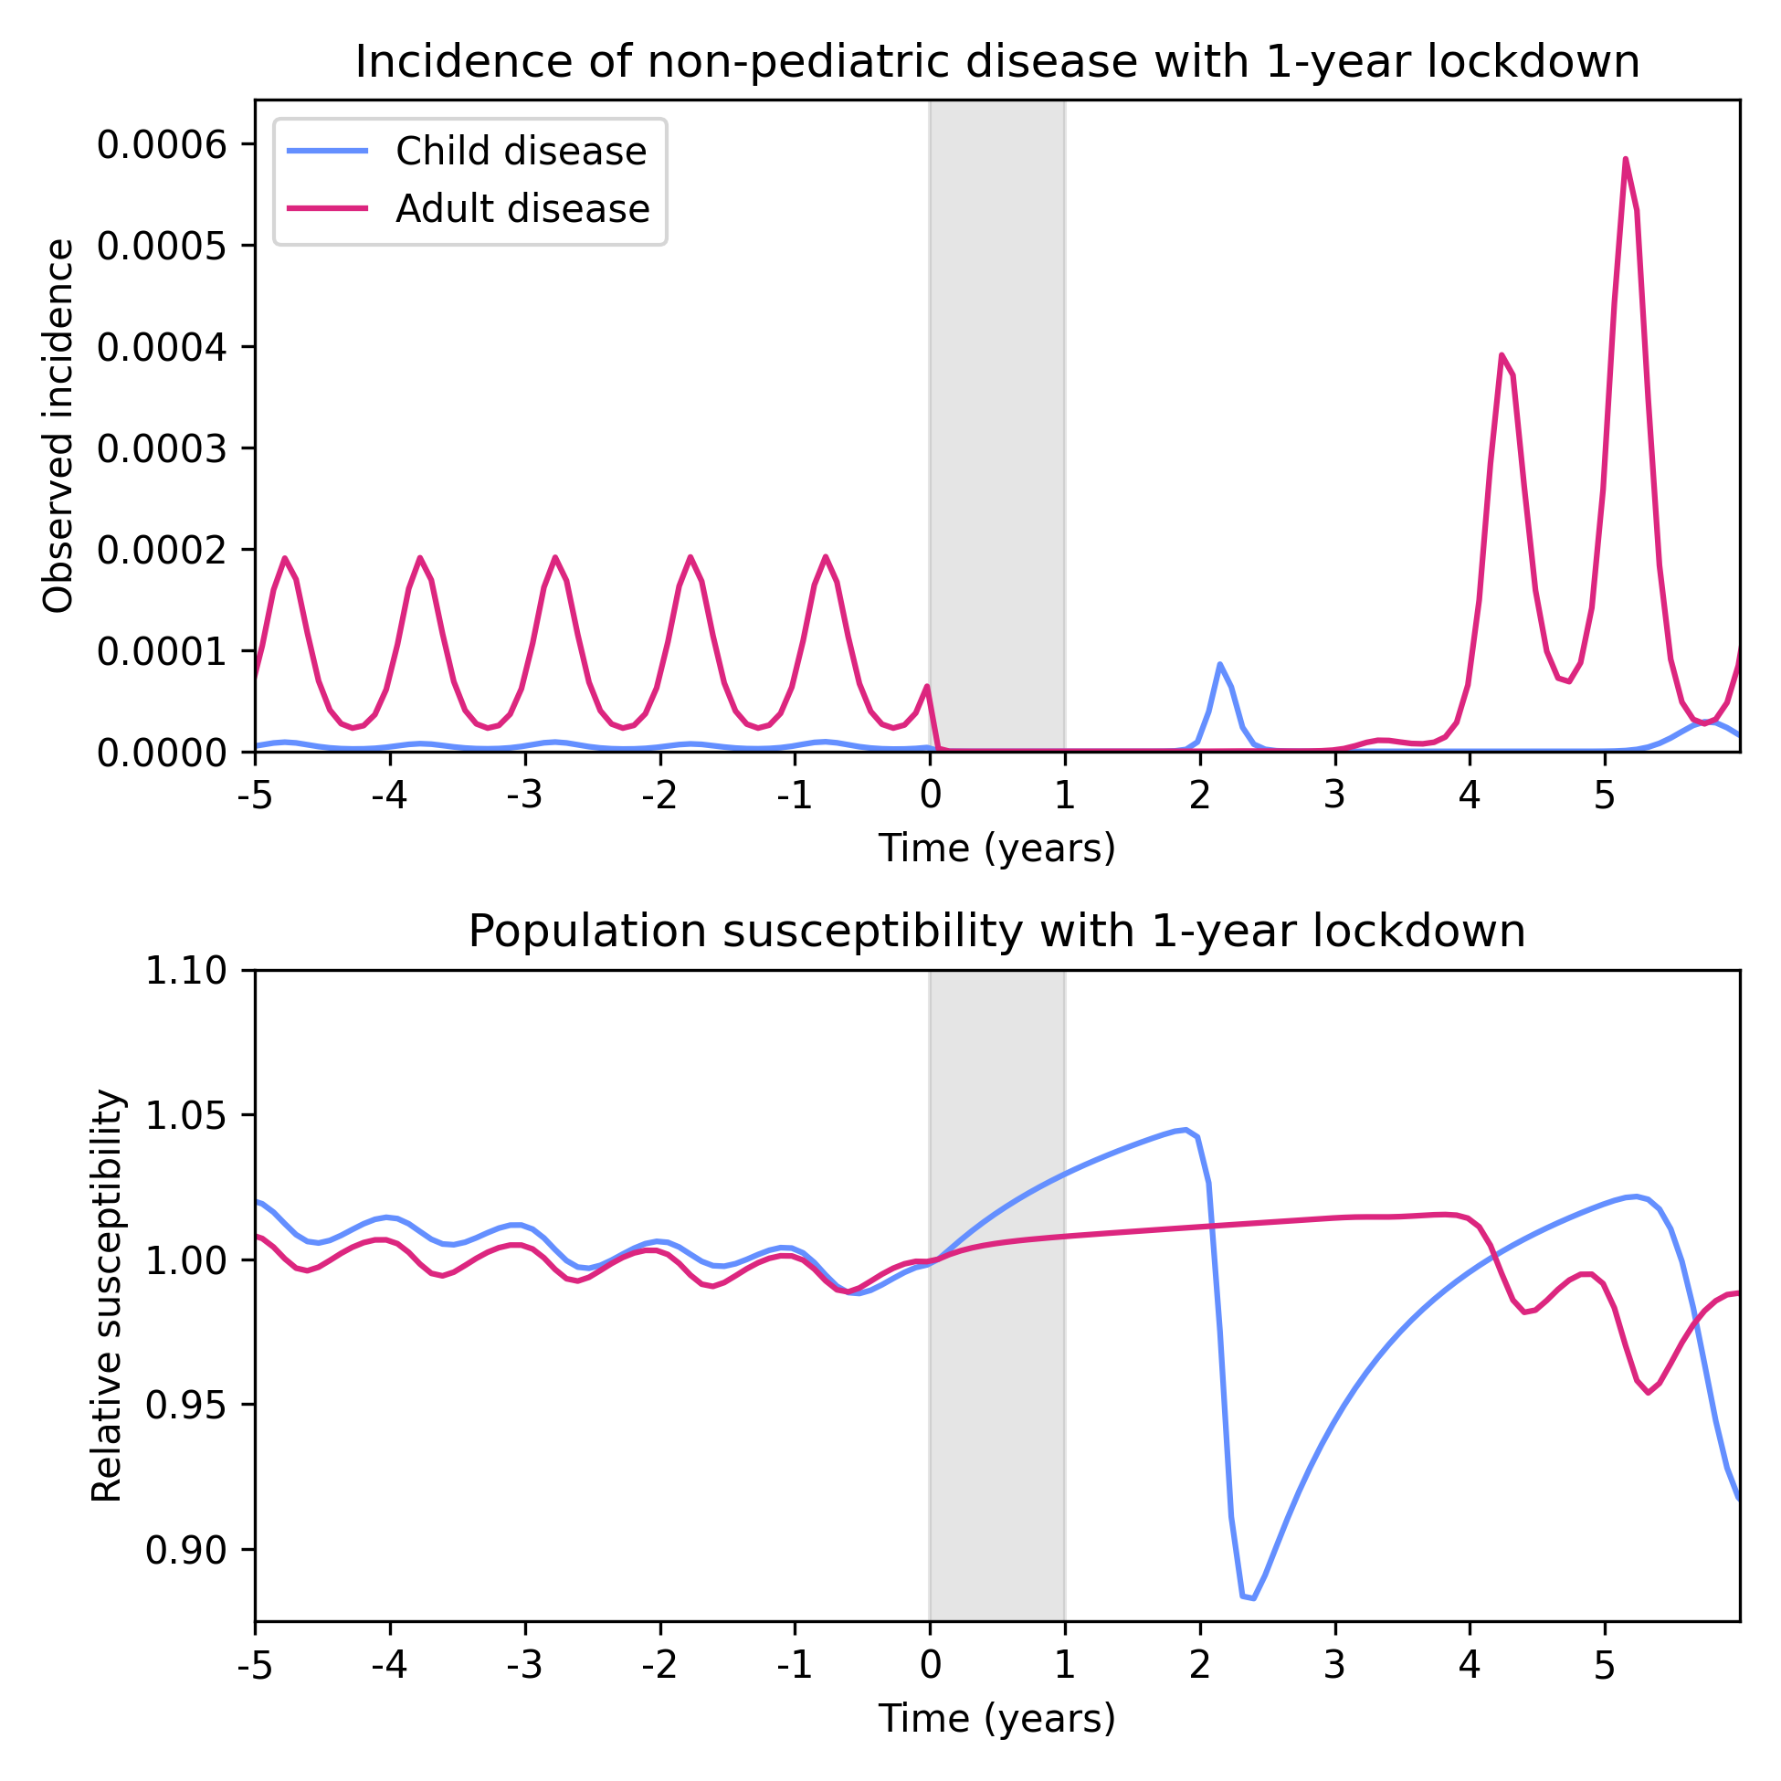
Notes:
“Child disease” characterized by high growth rate but low population susceptibiilty (slow waning) and heterogeneity between susceptibility classes, relies on new susceptibles being born
“Adult disease” characterized by low growth rate but high population susceptibility and homogeneity between susceptibility classes, relies on waning immunity

Slide 3
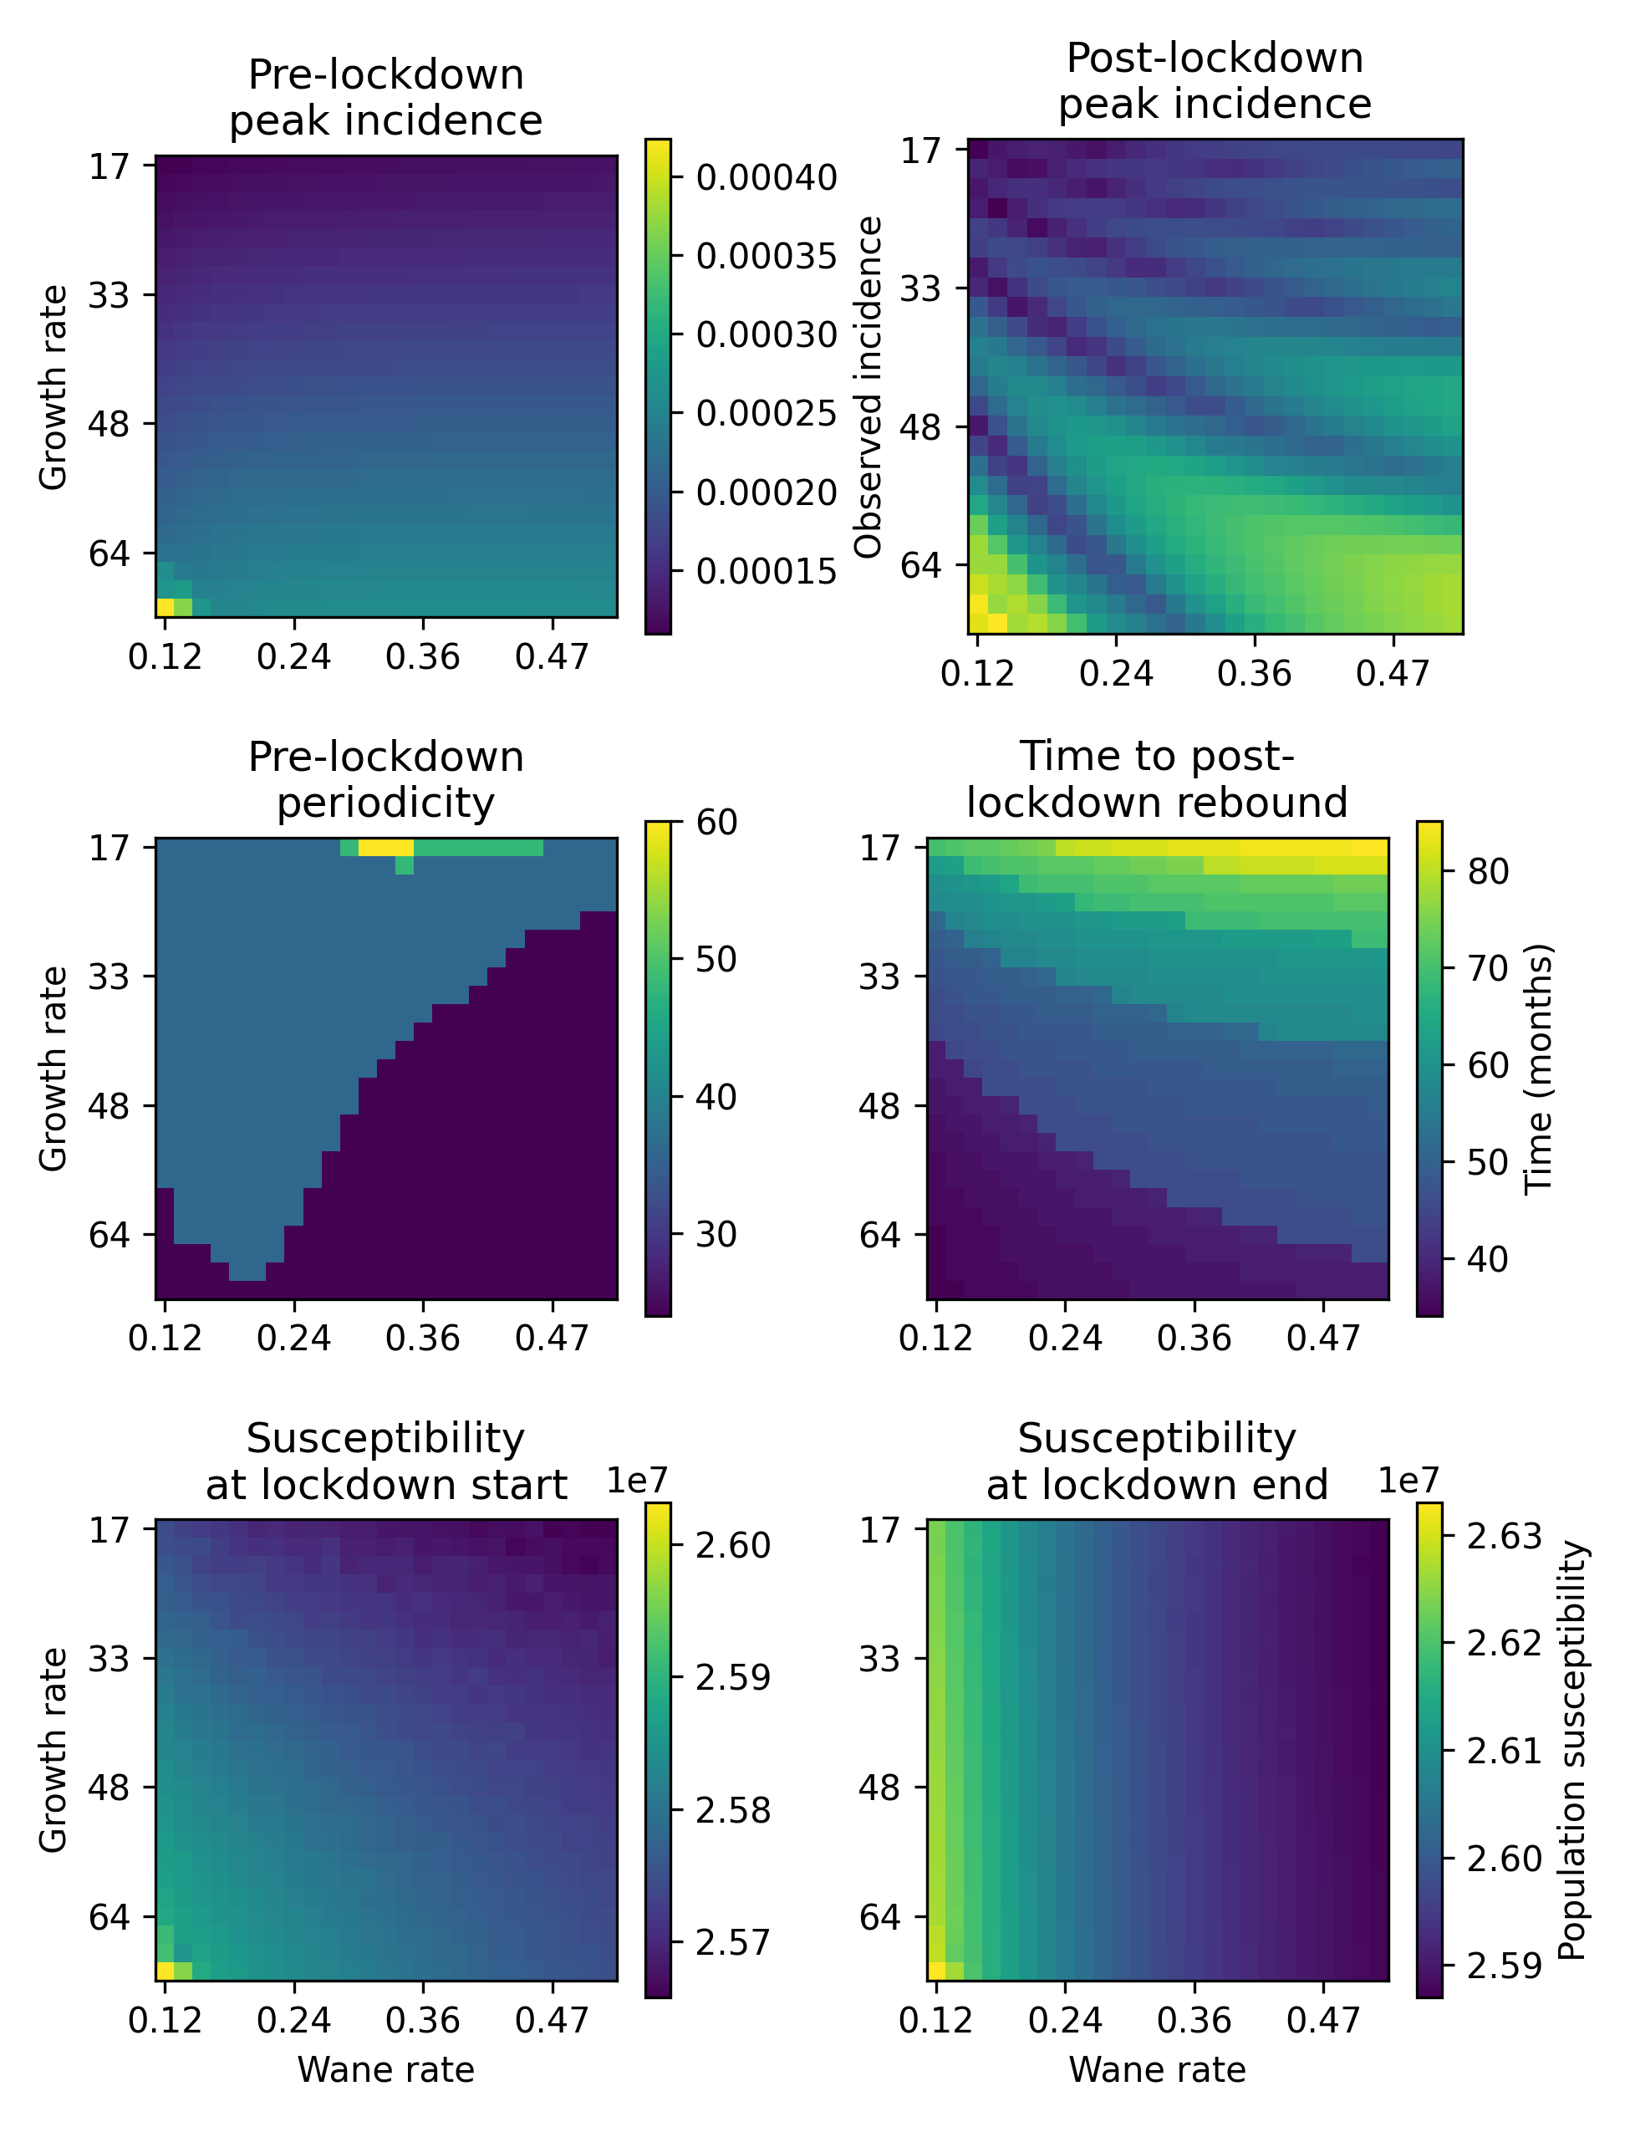
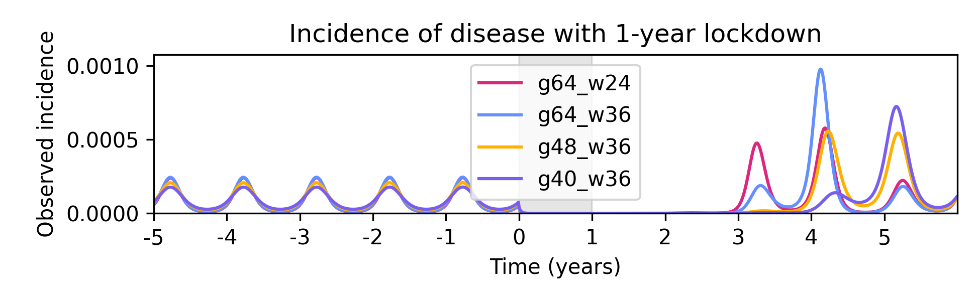
Notes:
Susceptibility along with growth rate affects time to post-lockdown rebound
At thresholds peak is largest since between thresholds the rebound is more staged out

Slide 4
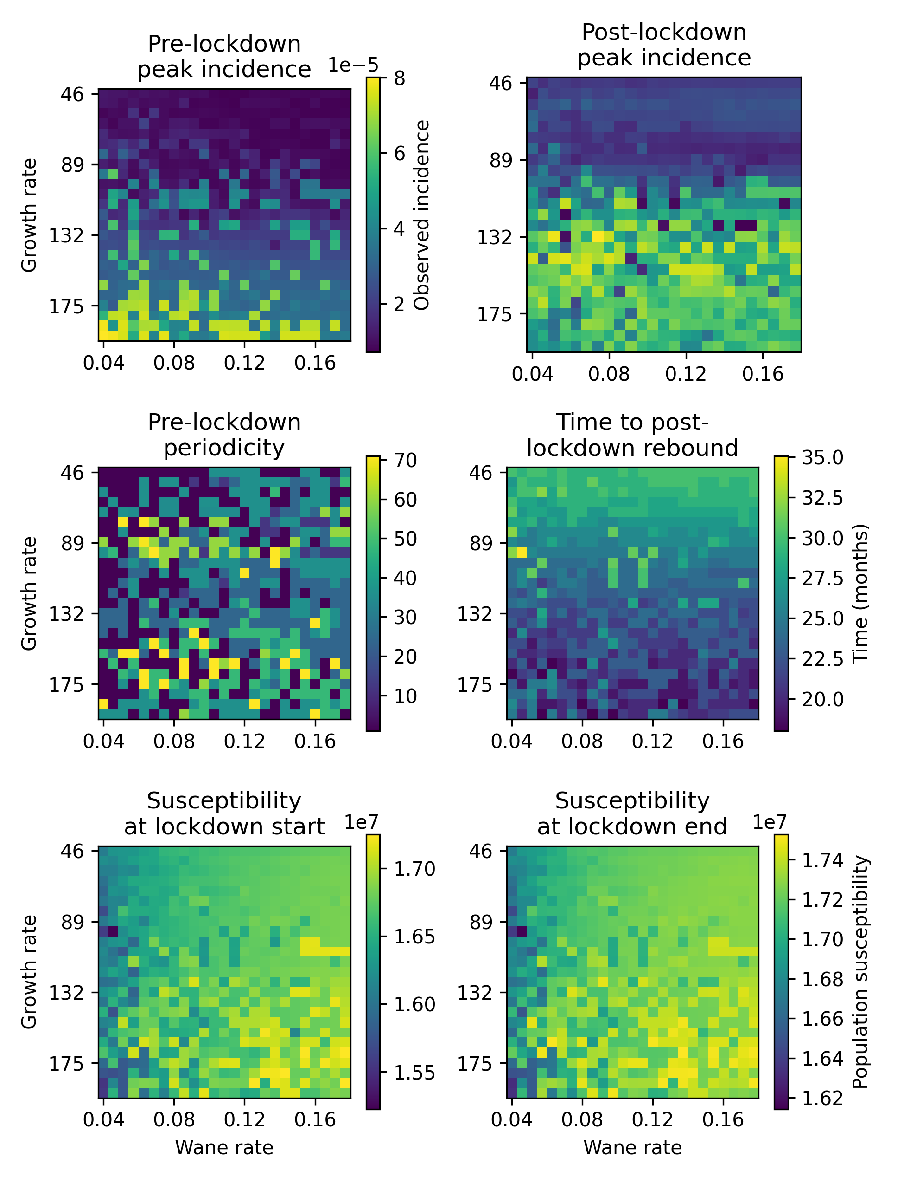
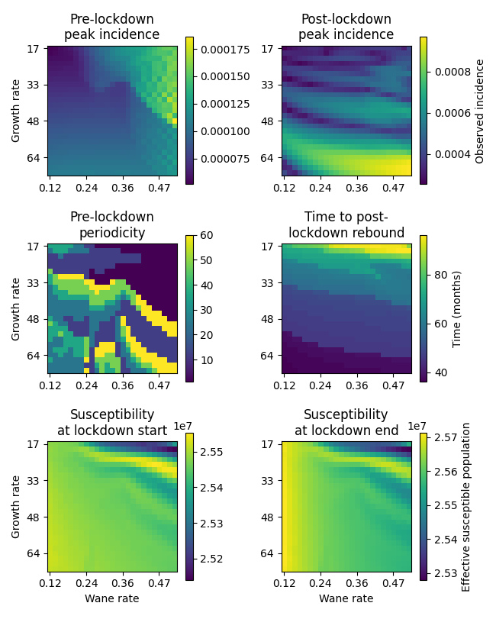
Notes:
I’ve shown simple relationships so far, but this is just a bit of a mess of figures to show that the relationship can be more complicated – but the broad patterns are still there

