Slide 1
Correctly Identifying Anti-Racist Comments from Hate Speech in Social Media using Bag of Words and BERT
Ben Schmidt and Armand Heydarian

Slide 2
Background
With the prevalence of hate based ideologies, there is a growing effort to detect hateful content on social media, one platform in particular is Twitter.
Twitter serves as a real time blogging network that allows for the mass dissemination of information and it’s limitation of characters to short and concise messages lends itself to mass usage, especially during the surge of events like the global protests after the death of George Floyd.
Notes:
AH

Slide 3
Hate Speech
According to the United Nations, the distinction between hate speech and free speech should fall into three different categories of:
Expression that constitutes a criminal offence
Expression that is not criminally punishable, but may justify a civil suit or administrative sanctions
Expression that does not give rise to criminal, civil or administrative sanctions, but still raises concern in terms of tolerance, civility and respect for the rights of others
Racist Speech in Data:
Comparisons of protestors to thugs or terrorists
Denial or victim blaming for George Floyd’s death
Delegitimizing Black Lives Matter by associations with crime/wrong doing
Notes:
AH

Slide 4
Anti-Racist Speech
Using Social Feed Manager, we collected approximately 200K Tweets regarding the events surrounding the George Floyd from June 1st to 12th using hashtags: #blm, #bluelivesmatter, #blacklivesmatter,#georgefloyd, #defundthepolice, and #police.
Through manual inspection of each Tweet, we have identified and sampled 2K anti-racist tweets to test against our model.
These Tweets were selected on the basis of being explicitly anti-racist and critical of systemic racism in media, culture and government.
Notes:
AH

Slide 5
Problem Statement
One of the key challenges of hate speech detection (and by extension, racist speech) is the differentiation between offensive language, hate speech, and anti-racist speech.
Is there a notable difference for either BERT or Bag of Words models to avoid misclassification of anti-racist speech

Slide 6
Literature Review
Prior research on hate speech and racist speech have focused on building classification, focusing on using relevant Twitter data and labeled data to create classifiers.
Prior research has attempted to address false positives of anti-hate speech and interventions to hate-filed conversations.
No prior studies take into account the manner in which the training data is labeled, presenting possible bias in the training data for hate speech.

Slide 7
Datasets
"Automated Hate Speech Detection and the Problem of Offensive Language." (Davidson, et al. 2017). This dataset contains ~25000 multiclassed labeled offensive comments and Tweets from social media. This data is labeled as offensive but not racist, racist, and not offensive. These Tweets were searched on the basis of the lexicon, yielding tweets from over 33,000 unique Twitter users and the timeline of each user was extracted, allowing us to create a sample of over 25,000 Tweets.

Slide 8
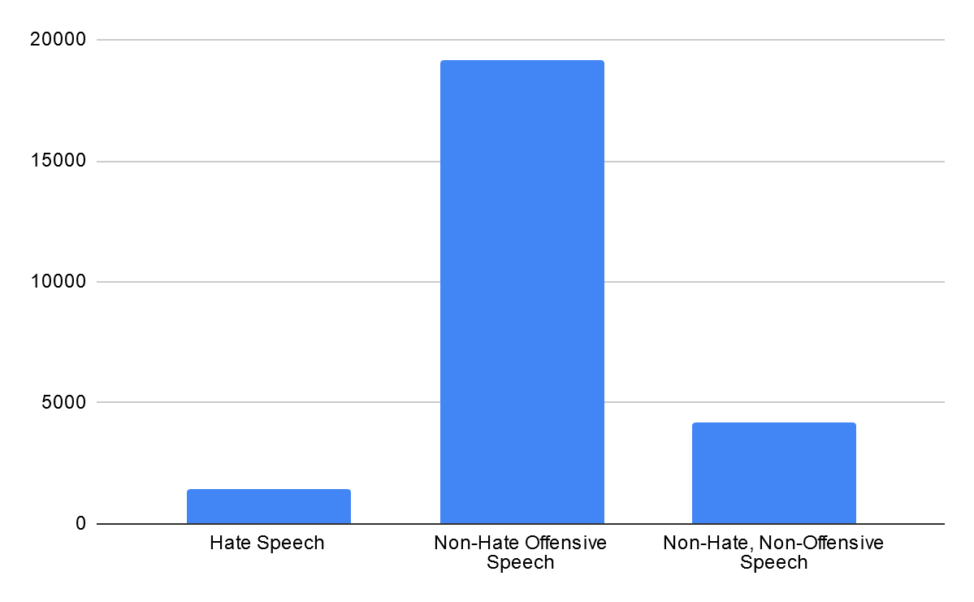
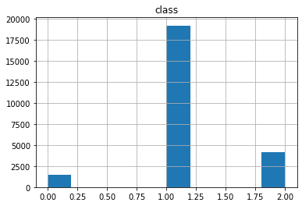
Dataset EDA
class = 0 - hate speech 1 - offensive language 2 - neither

Slide 9
Methodology
Bag of Words and BERT models were developed with the training data for a benchmark.
This model will be trained to an acceptable level of benchmarking to be evaluated against the anti-racist Tweets gathered separately.
To limit experimental bias, anti-racist Tweet collection is prepared by one team member and evaluation of anti-racist Tweets by another team member.
Notes:
AH

Slide 10
Bag of Words
Utilizes text as a representation of a bag of words along with disposing/ignoring the word order/grammar while maintaining multiplicity.
Sentences are represented as a string of numbers though the process of vectorization.
Based on similarity between the set of tokenized words of item to be reviewed and training data.
Notes:
AH

Slide 11
Bag of Words P2
Gaussian Naive Bayes
Known for promising results with textual data, the classifier produces competitive classification accuracy
Data point-class label association probability estimates could be inaccurate due to how the Naive Bayes classifier calculates the probabilities
SVC Model
Effective in use cases where the number of dimensions are greater than the number of samples
The fit time for the model scales quadratically with the number of samples, may be impractical beyond sample sizes larger than tens of thousands.
Random Forest
Works well with categorical or numerical data, used for statistical inference making, feature selection and clustering
Robust method against overfitting, tends to produce better results with increased size in number of data points
Notes:
AH

Slide 12
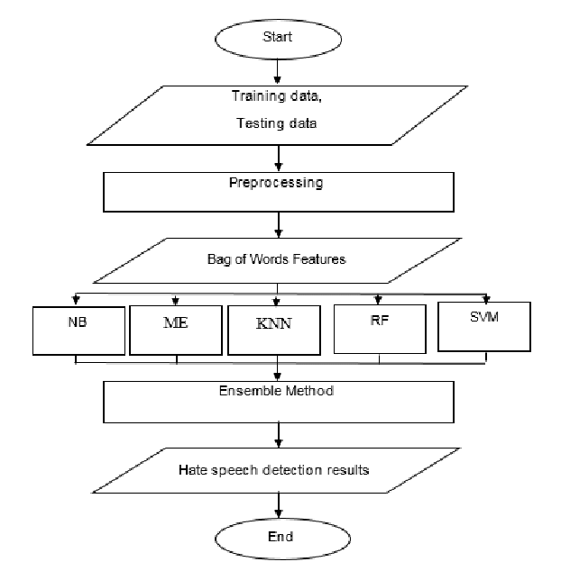
Notes:
AH

Slide 13
BERT
Relatively new pre-trained deep learning model for transfer learning for classification of NLP corpus
Uses Bidirectional n-grams trained on enormous corpus of English text.
Largely unexplored for this application but offers significant opportunities to expand.
Anti-racist test data labeled as Category 2 for purposes of evaluation.

Slide 14
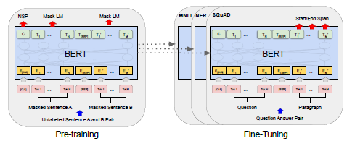

Slide 15
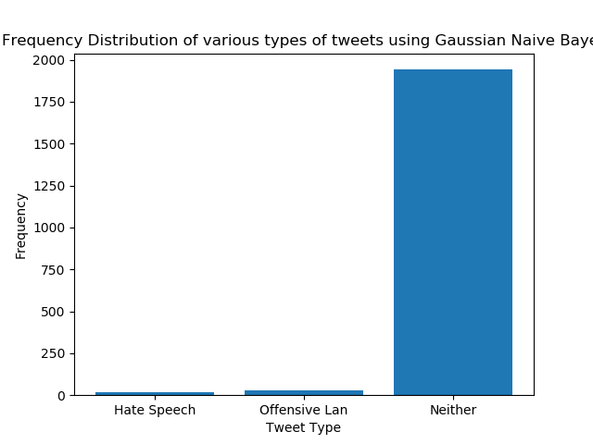
BOW Results-Gaussian Naive Bayes
Accuracy | 74.7226
Precision | 52.1692
Recall | 61.4151
F1 | 0.5331
Confusion Matrix | [[ 35 65 190] [ 246 2853 733] [ 1 18 816]]
Notes:
AH

Slide 16
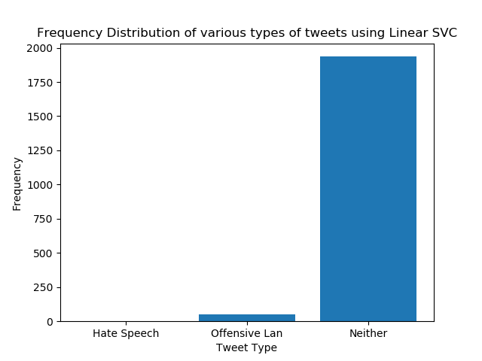
BOW Results-Linear SVC
Accuracy | 82.9130
Precision | 49.7440
Recall | 61.0097
F1 | 0.5314
Confusion Matrix | [[ 0 105 185] [ 0 3301 531] [ 0 26 809]]
Notes:
AH

Slide 17
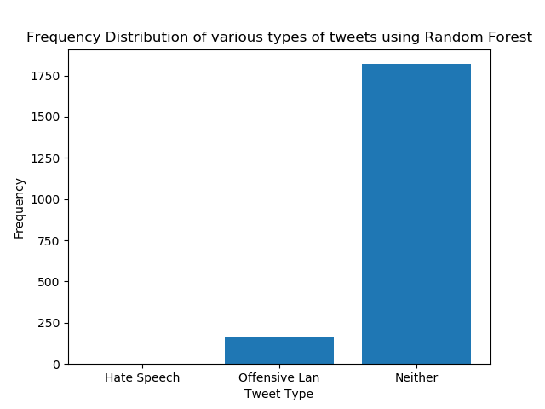
BOW Results -Random Forest
Accuracy | 82.9332
Precision | 56.5017
Recall | 59.2392
F1 | 0.5385
Confusion Matrix | [[ 5 122 163] [ 19 3371 442] [ 0 100 735]]
Notes:
AH

Slide 18
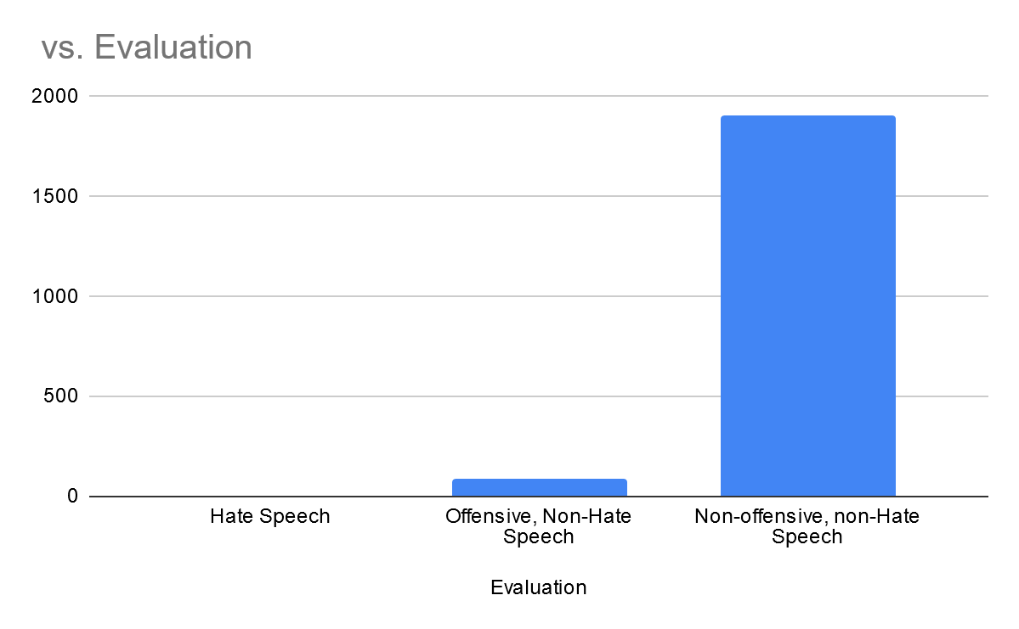
BERT Results
Accuracy | 92.95
Precision | 90.85
Recall | 95.51
F1 | .9220
Confusion Matrix | [204, 95, 14], [105, 3009, 64], [20, 84, 1208]

Slide 19
Comparisons
Model | Accuracy | Precision | Recall | F1 | Confusion Matrix
GaussianNB | 74.7226 | 52.1692 | 61.4151 | 0.5331 | [[ 35 65 190] [ 246 2853 733] [ 1 18 816]]
SVC Model | 82.9130 | 49.7440 | 61.0097 | 0.5314 | [[ 0 105 185] [ 0 3301 531] [ 0 26 809]]
Random Forest | 82.9332 | 56.5017 | 59.2392 | 0.5385 | [[ 5 122 163] [ 19 3371 442] [ 0 100 735]]
BERT | 92.95 | 90.85 | 95.51 | .9220 | [204, 95, 14], [105, 3009, 64], [20, 84, 1208]]

Slide 20
Conclusions
Accuracy between the four models is comparable, however other metrics for Bag of Words models generally fall short of usability for real world implementation.
Confusion Matrices for all four models suggests modeling would not succeed with edge-cases and false positive may still be too high
Multi-label datasets for speech may allow for more effective and accurate classification for transfer learning.
Datasets should be assembled by a broad and diverse group of labelers, confirming prior research.

