Slide 1
Table Clear
Hardware Production CENG317
N01216688 Hoang Long Le

Slide 2
Introduction
Introduction
Table Clear is a wait-list, reservations and seating management system that turns smartphones into pagers, revolutionizing the way restaurants connect with customers.
Benefits
Table Clear allows restaurants to see reservations and wait lists in real-time database, sends notifications to customers when their table is ready, seats them efficiently, and confirms the booking by sending notification messages.

Slide 3
Introduction
Hardware:
Pressure sensor: set under customer’s seats to confirm that specific table is occupied.
Weight sensor: set under a cup holder to notify waiter/waitresses whenever the customers finish their drink and require a refill without asking.
GPS sensor: In case of the customers leave their seats to go to the bathroom while they are still occupying the table, the pressure sensor will be useless. Therefore, the GPS sensor under the form of a token will be given to the customer and will be set on the table to confirm that they are still occupying that table.

Slide 4
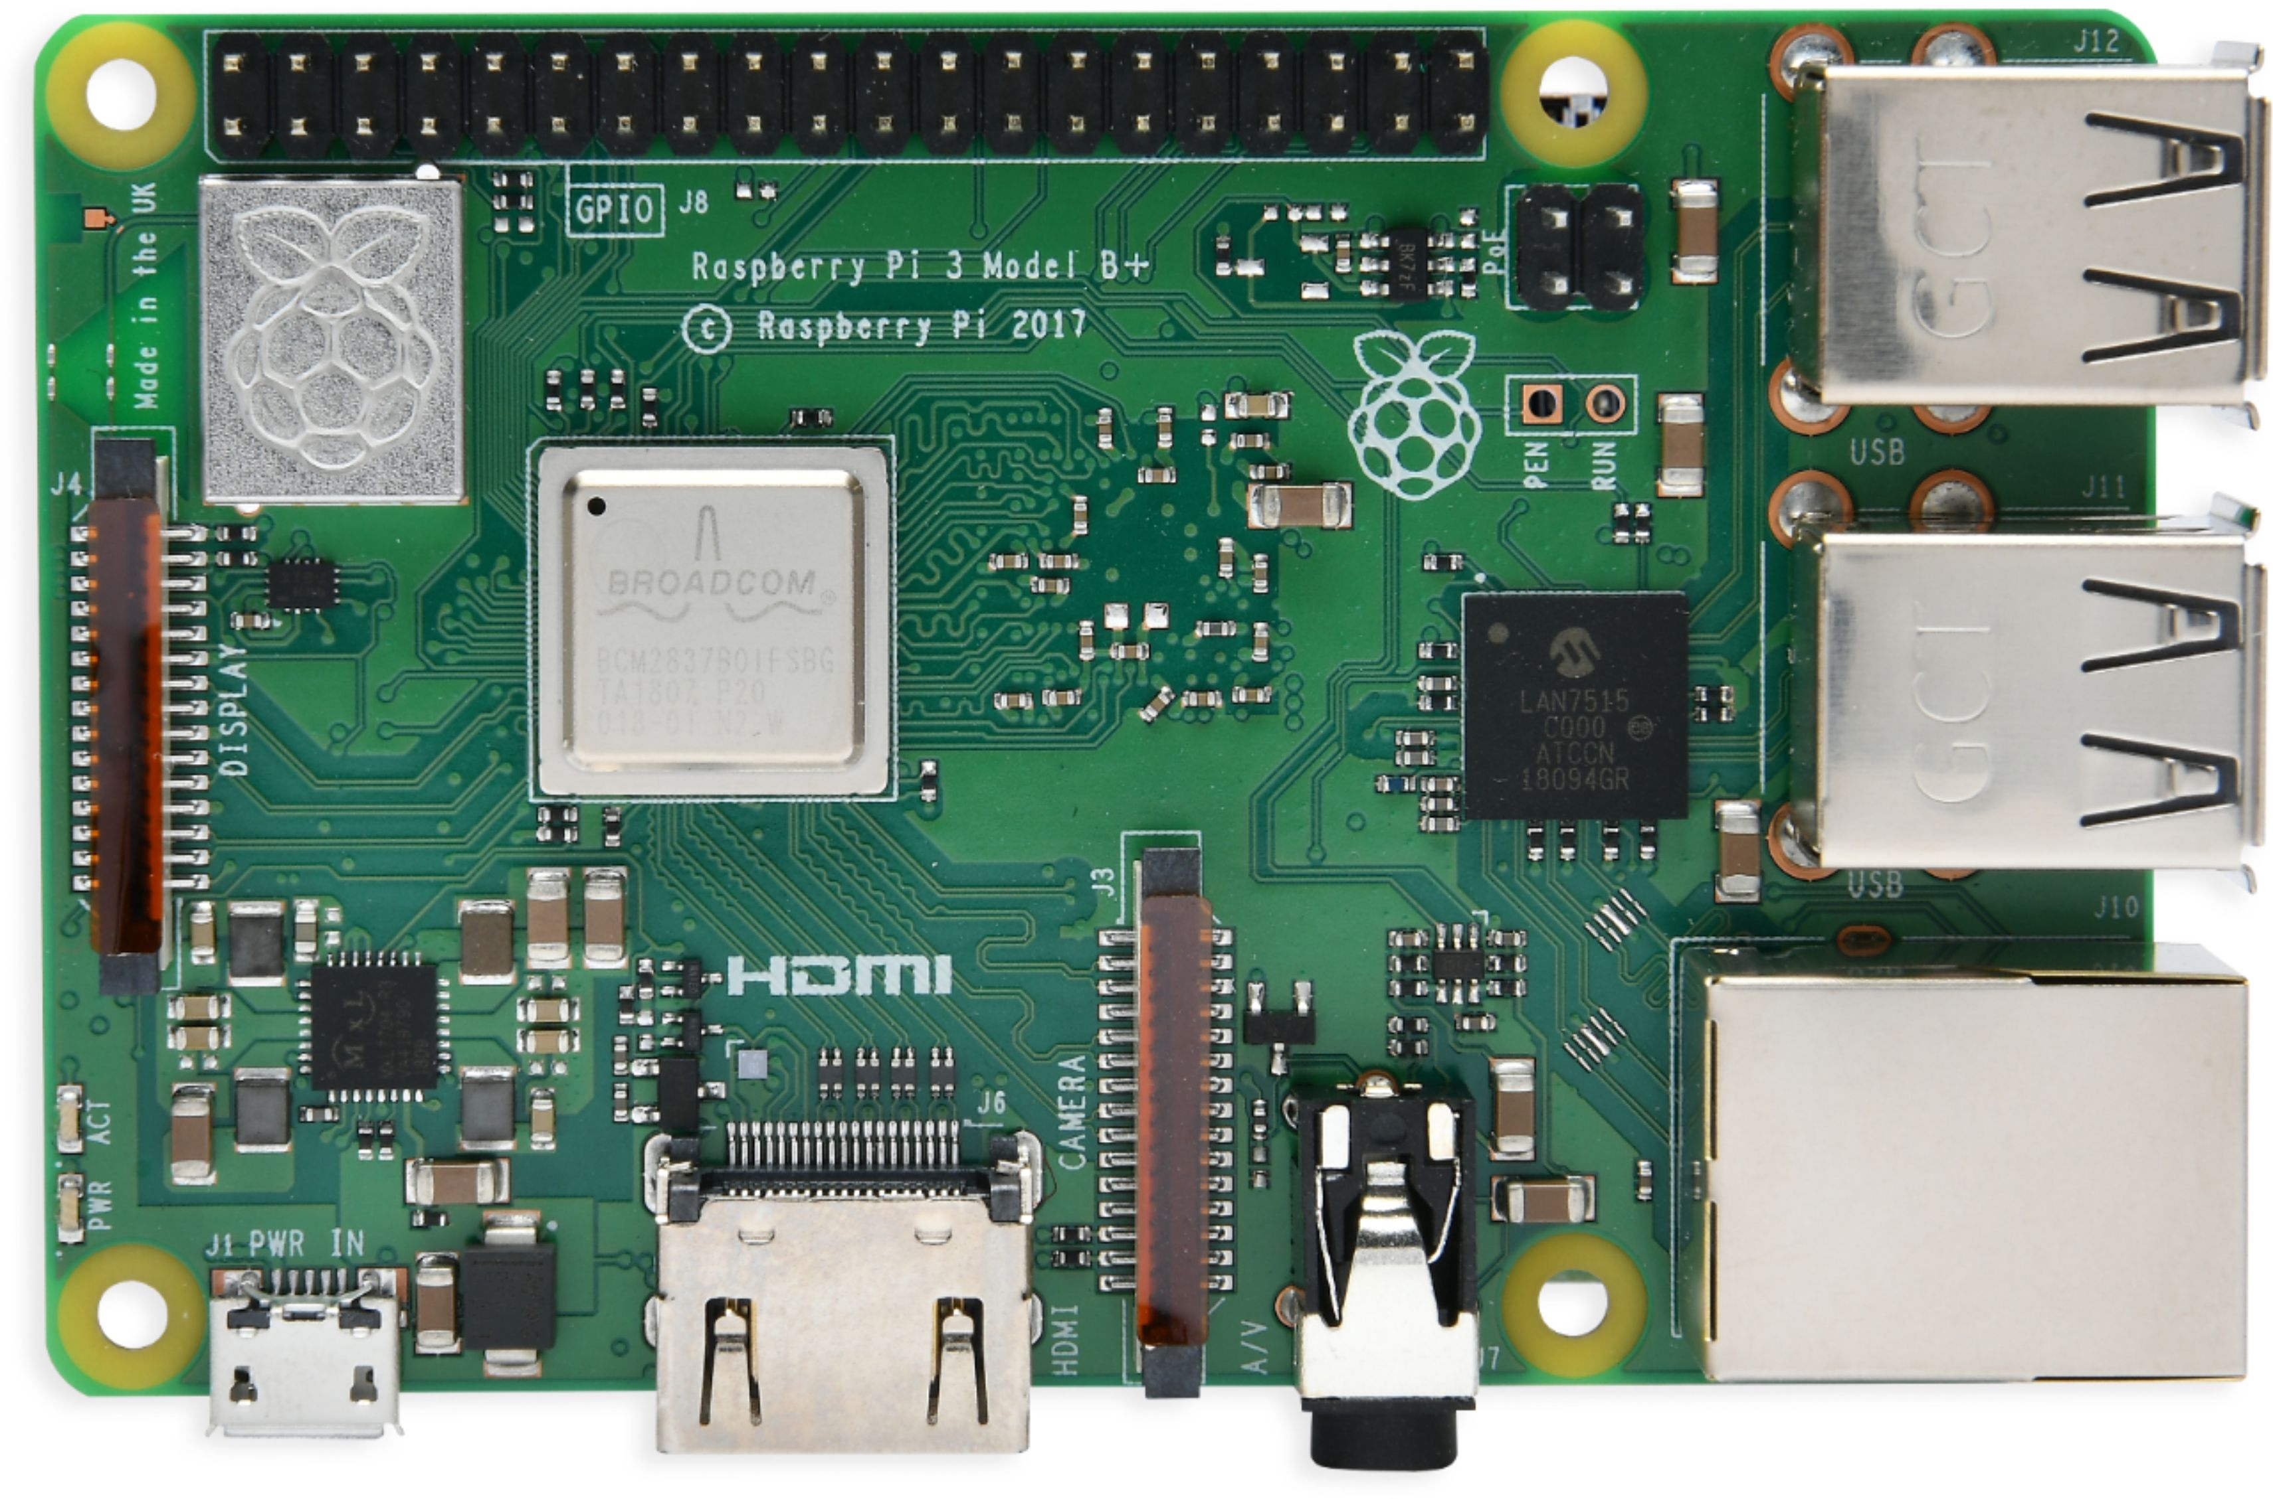
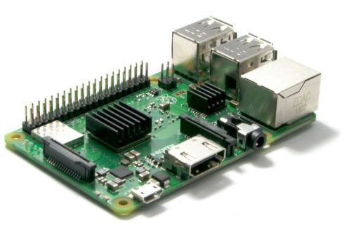
Budget for implementing the GPS Sensor
Raspberry Pi any version (Preferred 3B, 3B+ or 4) $56.00

Slide 5
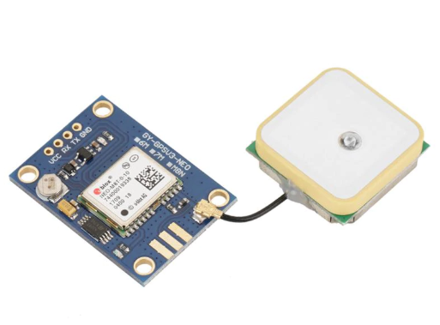
Budget for implementing the GPS Sensor
GPS V3 NEO with Antenna Module $75.00

Slide 6
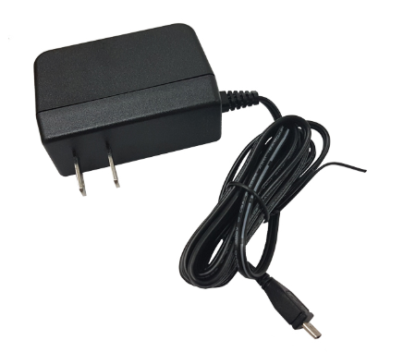
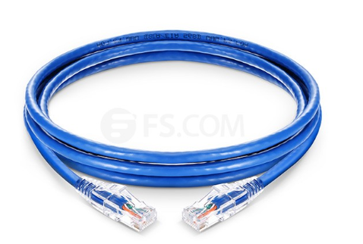
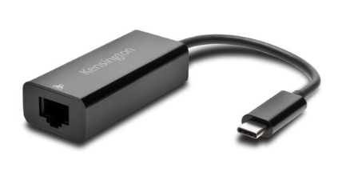
Budget for Implementing the GPS Sensor
Cables (Power cable for RPi, Ethernet cable, Ethernet adapter) $40.00

Slide 7
Budget for Implementing the GPS Sensor
Monitor, Keyboard, Mouse, HDMI Cable, VGA to HDMI Cable (Optional – In case you do not have a laptop to work on).

Slide 8
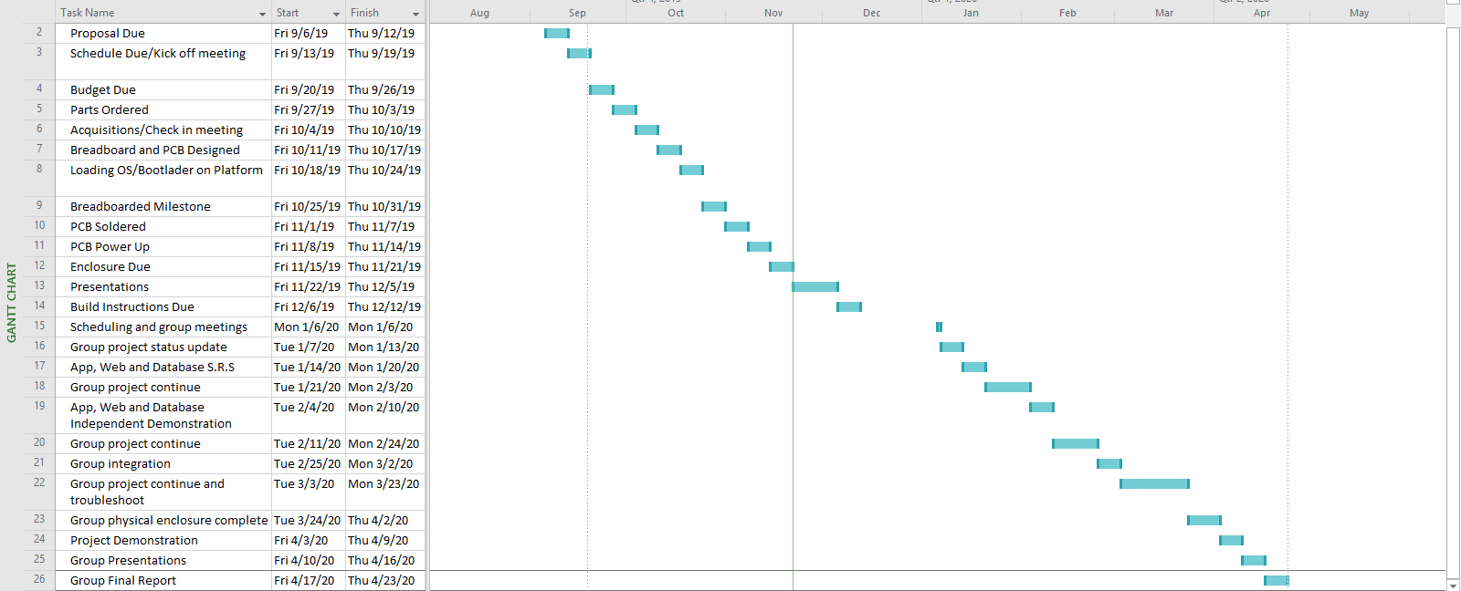
Schedule

Slide 9
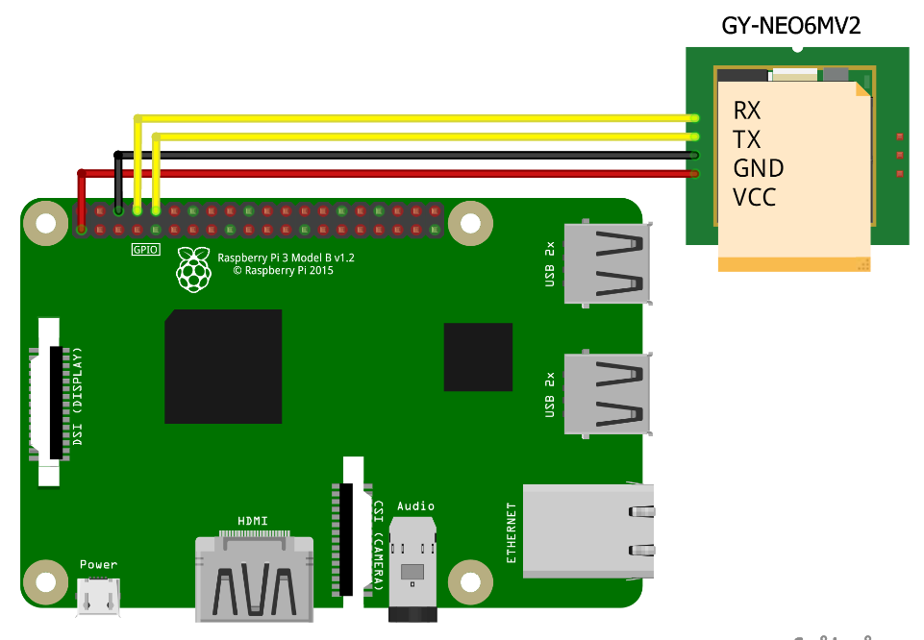
Breadboard Design

Slide 10
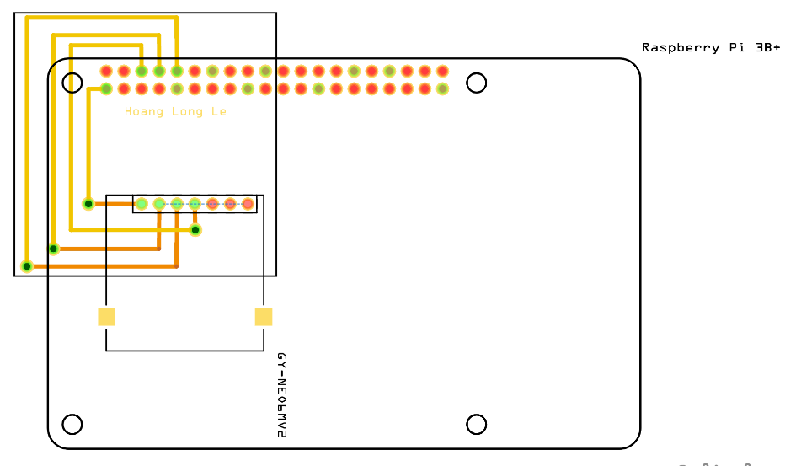
PCB Design

Slide 11
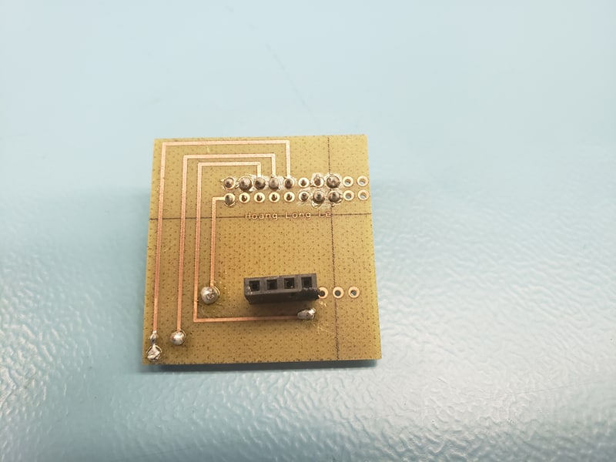
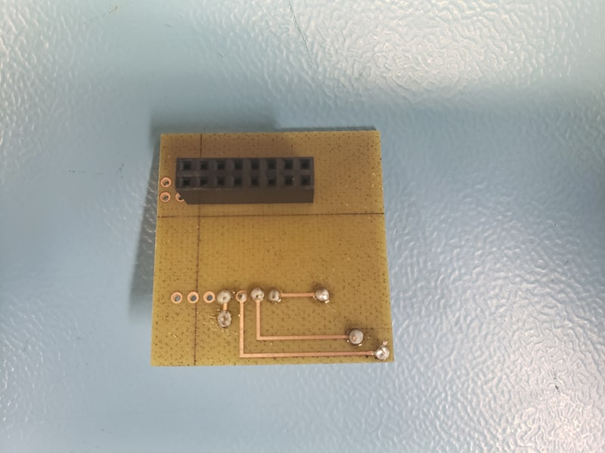
PCB Soldered

Slide 12
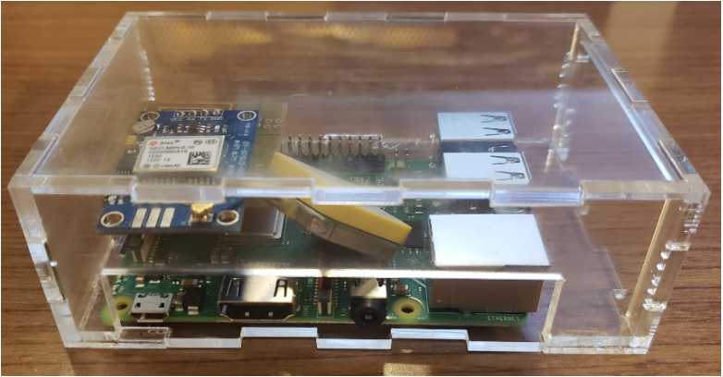
Enclosed Hardware

Slide 13
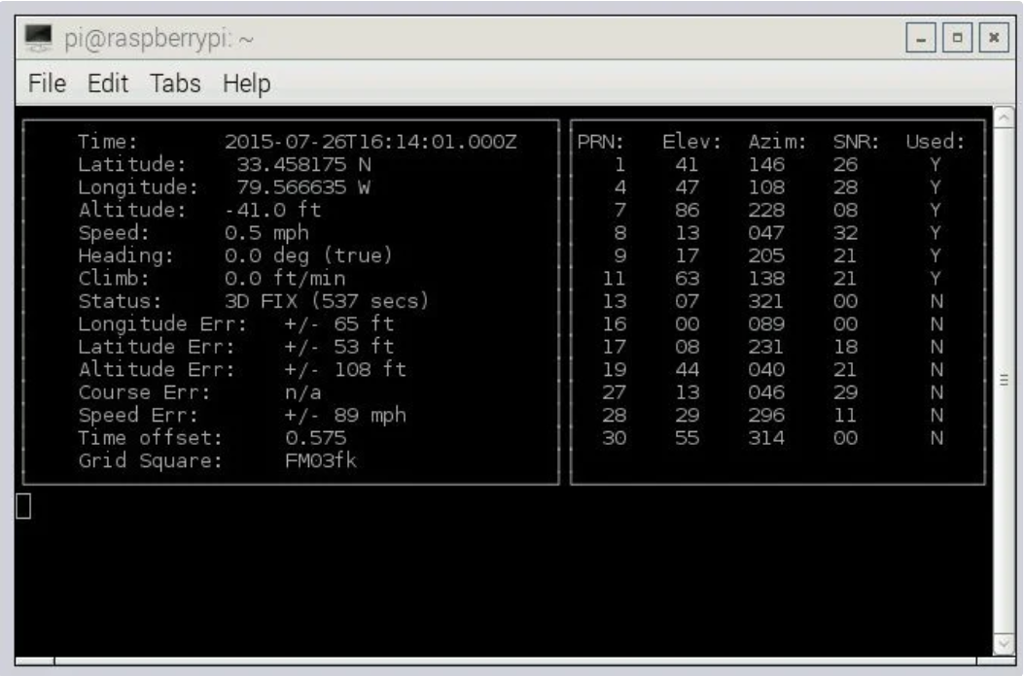
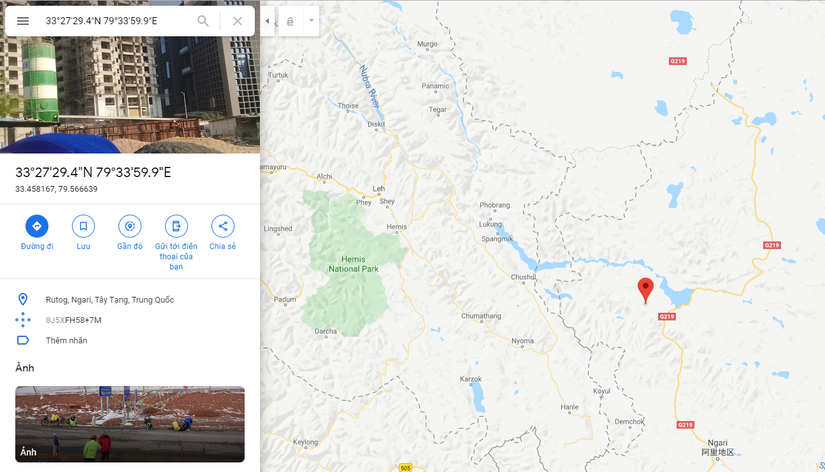
Expected output readings

Slide 14
Course knowledge used from previous classes
TECH153 – Technical C
Setting up Raspberry Pi and Connecting to a laptop/PC.
CENG252 – Embedded System
Communicating with Raspberry Pi through a Remoted Desktop.
CENG251 – UNIX Internals
Writing C Program to extract readings from the GPS Sensor on Raspberry Pi.

