Slide 1
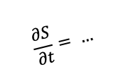
$$\frac{∂S}{∂t}= …$$
data pre-processing
modeling & simulation
post-processing
comparison & assessment
EDA

