Slide 1
Investment thesis 1: Asia controls AI's hardware bottlenecks
The theme: structural demand for Asian chips, memory and tools, traded in markets that are concentrated, fully priced and violent
1a Demand is structural, and it runs through Asia
1b A strong theme on a violent path
Demand is structural
Hyperscaler capex ~US$725bn in 2026 (+77%); the chip market nearly doubles to ~US$1.5trn.
The moat runs through Asia
8 of the world's 10 largest companies depend on TSMC (J.P. Morgan).
…but the cycle is maturing
DRAM price gains slowing: +48% in Q2, ~+13% expected in Q4 2026.
Growth is structural…
TAIEX and KOSPI are 2–3× their end-2022 levels on AI demand.
…but the path is violent
Down 10–25% in 2022; records in June 2026, then sharp falls within weeks.
~70%
Taiwan makes the chips: TSMC's share of global foundry revenue; TSMC is >40% of TAIEX.
→ Taiwan is the single largest AI chokepoint
−25%
Round trips happen fast: KOSPI went from 9,000+ in June to 6,789 on 28 Aug 2026, in about ten weeks.
→ Entry timing is hard; drawdowns are deep and quick
83%
Korea makes the memory: SK hynix + Samsung share of HBM, the memory every AI accelerator needs.
→ No AI accelerator ships without Korean memory
>40%
Returns hinge on a few names: TSMC >40% of TAIEX; Samsung + SK hynix ~48% of KOSPI; ~92% of advanced chips from Taiwan.
→ Single-name risk is high
~55%
Japan makes the tools: Advantest's share of chip test equipment; with Tokyo Electron ≈ 20% of the Nikkei.
→ Every new fab needs Japanese tools
38.6×
Valuations price in a lot: Nikkei CAPE 38.6×; Taiwan among the most expensive markets; DRAM gains slowing.
→ Upside from here is less certain than the theme
Whichever AI company wins, it needs Asia's chips, memory and tools, but the path to owning them is violent.
Sources: WSTS; company capex guidance; Counterpoint (foundry, HBM); TrendForce (DRAM); industry research (test equipment); J.P. Morgan AWM 2026 Outlook; TWSE, KRX, Nikkei (index levels); FN News, BIT Research (KOSPI); Siblis (CAPE). Full list: deck/thesis_sources.md.
ANALYSIS
STRATEGY
APPENDIX
Notes:
Thesis 1, the theme. AI spending is a hardware boom and Asia holds the three bottlenecks: Taiwan's foundries, Korea's high-bandwidth memory, Japan's chip-making tools. The demand is structural, but the memory cycle is maturing and the indices that hold the theme move violently: KOSPI lost about a quarter between June and August. Returns are concentrated in a few names and valuations are full.

Slide 2
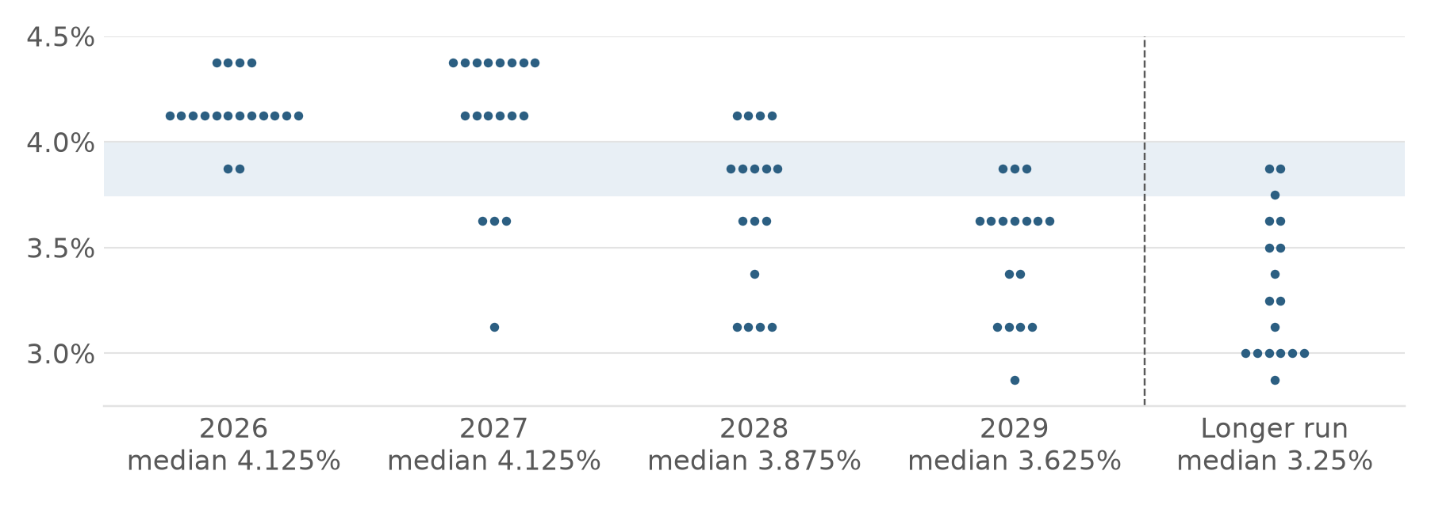
Investment thesis 2: Rates stay high and volatility is at records
The backdrop for the next five years: the Fed holds rates high, bonds carry rate risk, and Asian equities swing harder than ever
2a The Fed holds rates high for longer
2b Bonds carry rate risk, equities swing hard
Yields are high…
5Y USD at 5.69%: high income on offer.
…but prices are exposed
With hikes back on the table, a fixed rate locked in today loses value if rates rise further.
FOMC dot plot, 16 Sep 2026 (shaded: today's 3.75–4.00%). Dots read from the Fed's chart.
4.125%
FOMC median to end-2027, cuts deferred to 2028: 12 of 18 dots at 4.125% for 2026; 4.375% seen by 4 for 2026 and 8 for 2027.
→ Rate risk is structural, not a one-off
−4.0%
Long bonds carry rate risk: a 5-year bond loses ~4.0% per 1% rise in rates.
→ Duration is a risk, not a hedge, in this cycle
+0.25%
The Fed is hiking again: 16 Sep 2026: to 3.75–4.00%, the first hike since 2023.
→ The easing cycle is over for now
91.2
Volatility is at records: VKOSPI closed at an all-time high of 91.2 (9 Jun 2026), above the 2008 peak.
→ Option-implied risk in Asian equities is extreme
~87%
Markets price more: probability of at least one further hike priced by fed funds futures.
→ Risk to rates is still to the upside
−8.95%
Single days move markets: KOSPI's one-day fall on 13 Jul 2026; J.P. Morgan expects a 10–15% correction in 2026.
→ Buy-and-hold must sit through deep drawdowns
Rates stay high for longer and Asian equity volatility is at records: neither bonds nor buy-and-hold are a comfortable place to sit.
Sources: Federal Reserve SEP (16 Sep 2026, dots read from chart); Federal Reserve via Advisor Perspectives; fed funds futures; case USD funding grid (5Y 5.69%); standard bond maths; Herald / SBS (VKOSPI); FN News, BIT Research (KOSPI); J.P. Morgan AWM 2026 Outlook.
ANALYSIS
STRATEGY
APPENDIX
Notes:
Thesis 2, the backdrop. The Fed's dot plot keeps the median at 4.125% to end-2027 with cuts only from 2028; it has just hiked and futures price more. Yields are high, but a long bond loses about 4.0% per 1% rise, so duration is a risk. Asian equity volatility is at records: VKOSPI hit 91.2 and KOSPI fell nearly 9% in one day. Both bonds and buy-and-hold carry more risk than usual.

