Slide 1
Investment thesis now: the AI-hardware story is intact, the entry point is volatile
Eight factors behind 3119 HK, 2644 JP, 00878 TT, EWY and EWT at the 17 Sep 2026 trade date (market data to 8 Oct 2026)
Factor | Signal | Reading now (evidence) | What it means
AI demand | Positive | TSMC Aug-26 revenue +53% y/y (Jan–Aug +39%); hyperscaler capex ≈US$725bn in 2026 (+77%); chip market ≈US$1.5trn (WSTS) | Five years of structural growth: own the theme, not a bond
Memory cycle | Mixed | Samsung Q3-26 operating profit seen at ≈₩100trn+ (₩12trn a year ago); but DRAM contract gains slow: +45–50% Q2, +13–18% Q3, +10–15% Q4e | Earnings near a cyclical peak: Korea (EWY) and 3119 most exposed
Momentum | Mixed | Portfolio +87% in 1 year, +36% a year over 3 years; but −14% in 3 months and −16% from its high (2644 JP −26%) | Entry after a pullback, but the trend is fragile
Volatility | Negative | Realised vol 48% vs 25% 5-year average (97th percentile); VKOSPI record 91 (Jun-26); KOSPI −8.95% in one day (13 Jul) | Holding naked is costly; high vol makes option-based protection and coupons rich
Valuation | Mixed | KOSPI forward P/E ≈7.8×; Nikkei 17.2× forward, CAPE 38.6; Taiwan among the most expensive markets | Korea cheap, Japan and Taiwan full: no margin of safety in price
Rates & FX | Mixed | Fed hiked to 3.75–4.00% (16 Sep), ≈1-in-3 odds of another on 28 Oct; BoJ 1.25% (18 Sep); USD/JPY ≈158; 5Y USD funding 5.69% | Strong USD drags USD returns; high rates make a capital floor cheap (5Y zero-coupon 75.8)
Geopolitics | Negative | Taiwan makes ≈92% of advanced chips and is 'the most blockade-sensitive advanced economy' (J.P. Morgan); US Section 232 chip tariff 25% | A tail risk no diversification removes: needs a contractual floor
Income & ESG | Positive | 00878 (ESG high dividend) pays ≈7.6% a year, lowest vol (17%), −0.1% from its high | Ballast and ESG credentials inside the basket
Thesis: stay invested in Asian AI hardware for five years, but at 2× normal volatility and with tail risk, hold it with a floor
Sources: Bloomberg USD prices 2021–26 (team calculations); TSMC 6-K (10 Sep 2026); Hana/IBK Securities previews; TrendForce; Siblis Research; Federal Reserve; BoJ; J.P. Morgan AWM 2026 Outlook; WSTS. Full list in the appendix. Forecasts marked ≈ are consensus or approximate: verify before submission.
ANALYSIS
STRATEGY
APPENDIX

Slide 2
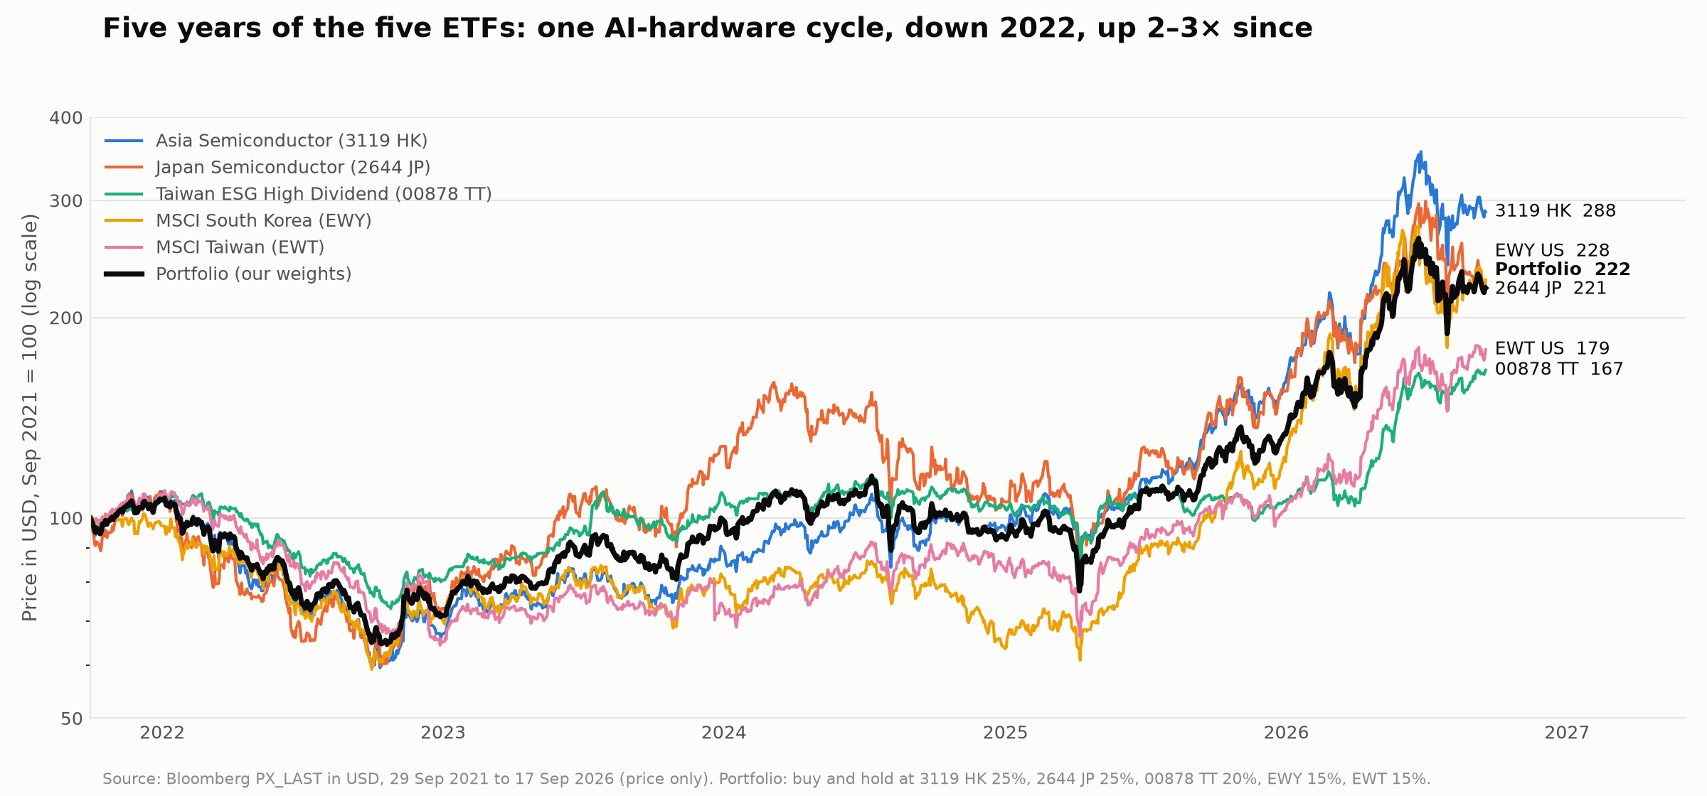
Where we are now: one AI cycle in five years, +87% in the last twelve months
+87%
Portfolio, last 12 months
−14%
Last 3 months: the pullback
−16%
Below the 52-week high
−40%
Worst fall in 5 years (2022)
Strong long-term trend, but we are buying after a 12-month surge and a sharp summer correction: timing risk is high
Source: Bloomberg PX_LAST in USD, 29 Sep 2021 to 17 Sep 2026; buy-and-hold portfolio at our weights (3119 HK 25%, 2644 JP 25%, 00878 TT 20%, EWY 15%, EWT 15%). Price only.
ANALYSIS
STRATEGY
APPENDIX

Slide 3
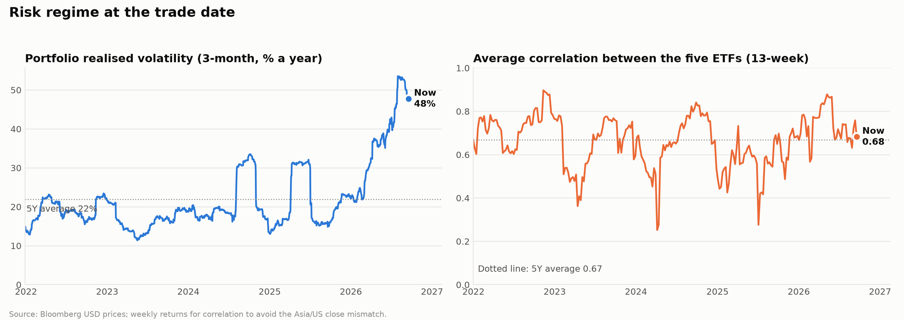
Risk regime: volatility is at a 5-year extreme, and diversification is not helping
Volatility 2× normal
Correlation stays high
So: protect, don't dilute
Realised 48% vs 25% on average. In our 5-year simulation the unhedged worst 1% is USD 33mn of 100.
The five ETFs move together (0.68 now, 0.67 on average): they share TSMC, Samsung and SK hynix, so a shock hits all five.
A zero-cost collar (buy the 70% put, sell a ≈248% call) lifts the worst 1% to USD 70mn and keeps the median at 113.
Realised vol: 63-day daily returns of the buy-and-hold portfolio; 5-year average of that series 22% (weekly-return vol 24.5%). Correlation: 13-week weekly returns. Collar priced in the team Monte Carlo without volatility skew (real quotes will be dearer).
ANALYSIS
STRATEGY
APPENDIX

Slide 4
Appendix: sources for the factor thesis
Fact | Source
Prices, returns, volatility, correlation, drawdowns | Bloomberg PX_LAST (USD), 3119 HK, 2644 JP, EWY US, EWT US, 00878 TT, 2021-09 to 2026-09; simulation/factor_snapshot.py
TSMC Aug-26 revenue NT$514.8bn, +53.3% y/y; Jan–Aug +39.3%; Q3 guide US$44.6–45.8bn | TSMC monthly revenue report / Form 6-K, 10 Sep 2026 (sec.gov); Focus Taiwan, 10 Sep 2026
Samsung Q3-26 operating profit forecasts ₩101.7trn (IBK) to ₩108trn (Hana); Q3-25 ₩12.17trn | Broker previews via StockHub (Oct 2026); Korea JoongAng Daily (Q3 2025 actual). Verify against the preliminary release
DRAM contract prices +45–50% Q2, +13–18% Q3, +10–15% Q4e | TrendForce via iConnect007 / TechNews (2026)
Hyperscaler capex ≈US$725bn 2026; chip market ≈US$1.5trn | Company guidance via AI Weekly / Yahoo Finance; WSTS Spring 2026 forecast
KOSPI fwd P/E 7.82; Nikkei fwd 17.18, CAPE 38.59 | Siblis Research (1 Jul 2026)
VKOSPI record 91.23 (9 Jun 2026); KOSPI −8.95% (13 Jul 2026) | SBS; Herald Corp; Asiae
Fed 3.75–4.00% (16 Sep 2026); BoJ 1.25% (18 Sep 2026); USD/JPY ≈158; Oct meeting odds | Federal Reserve; TMGM / Oxford Economics market notes (Oct 2026). Verify on federalreserve.gov and boj.or.jp
Taiwan ≈92% of advanced chips; blockade sensitivity; 10–15% correction base case | J.P. Morgan AWM, Eye on the Market 2026 Outlook 'Smothering Heights' (1 Jan 2026)
US Section 232 25% tariff on advanced logic chips | Proclamation 11002 via Perkins Coie (Jan 2026)
Collar and simulation outcomes | Team Monte Carlo: simulation/portfolio_mc.py, simulation/collar_overlay.py
ANALYSIS
STRATEGY
APPENDIX

