Slide 1
The Macro Regime Shift: Traditional Portfolios Left Exposed
Long bonds face rising rates; buy-and-hold equity faces record volatility, concentration and stretched valuations
Rates have been rising again
Equity paths are violent
Implications
Market proof: Taiwan structured-note issuance +81% in 2025, snowball autocalls the favourite payoff (SRP)
1
Early exit beats duration: Bonds lose ~4.0% per 1% rate rise; autocalls can redeem from year 1
2
Paid on recovery, not timing: −25% in ten weeks (KOSPI 2026): autocall coupons pay once the basket is back at its start
Fed funds upper bound: hikes 2022–23, cuts 2024–25, a hike again on 16 Sep 2026 (median dot 4.1% for end-2026).
Index levels, end-2021 = 100: −10–25% in 2022, then 2–3×. KOSPI fell ~25% from June to late August 2026.
Long bonds carry rate risk
Valuations already price in a lot
3
Diversify the basket: TSMC >40% of TAIEX, ~92% of advanced chips from Taiwan: use a diversified ETF basket, not worst-of
4
Volatility funds the coupon: VKOSPI at a record 91.2: richer option premium means higher autocall coupons
5
Protection is affordable: USD 100 in 5 years costs USD 75.8 at 5.69%: a buffer and a 70% floor fit inside an autocall
Value change of a 5-year USD bond (5.69% coupon) for parallel rate moves of −2% to +2%.
Siblis Research, 1 Jul 2026. Korea's gap assumes earnings roughly triple; Nikkei CAPE 38.6×; Taiwan among the most expensive markets.
Plain bonds and equities leave investors exposed; a buffered autocall with a 70% floor keeps the theme and manages the risks.
Sources: Federal Reserve via Advisor Perspectives; TWSE, KRX/press, Nikkei (index levels); Siblis Research (P/E); Herald / SBS (VKOSPI); TrendForce; J.P. Morgan 2026 Outlook; StructuredRetailProducts.com; case funding grid with standard bond maths.
ANALYSIS
STRATEGY
APPENDIX
Notes:
One-slide thesis 2, modelled on the 'traditional strategies fall short' format, using market evidence only: rising rates (bond duration risk), violent equity paths, concentration, record volatility and a late, richly priced cycle. Implications link each market fact to why an autocallable structure fits; our specific note and its numbers come in the product section.

Slide 2
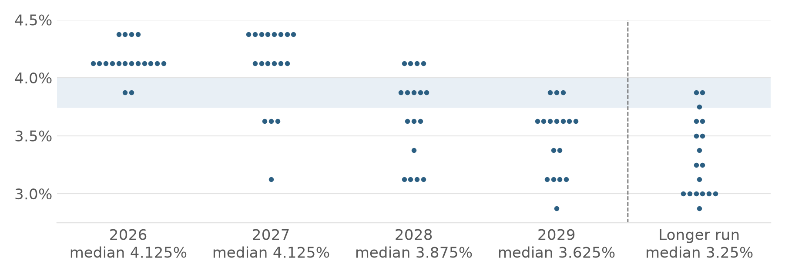
Investment thesis: Monopolizing the AI Supply Chain via Structured Overlays
What we own and why we wrap it: structural demand for Asian chips, memory and tools, held through a market of high rates, record volatility and concentrated, full prices
1 Asia controls AI's hardware bottlenecks
2 2026 punishes bonds and buy-and-hold
Demand is structural
Hyperscaler capex ~US$725bn in 2026 (+77%); the chip market nearly doubles to ~US$1.5trn.
The moat runs through Asia
8 of the world's 10 largest companies depend on TSMC (J.P. Morgan).
…but the cycle is maturing
DRAM price gains slowing: +48% in Q2, ~+13% expected in Q4 2026.
Rates stay high
Fed median 4.125% to end-2027, cuts only from 2028; 12 dots see 4.375%.
FOMC dot plot, 16 Sep 2026 (shaded: today's 3.75–4.00%)
−4.0%
Long bonds carry rate risk: a 5-year bond loses ~4.0% per 1% rise.
→ Redeems from year 1; USD 75.8 today buys USD 100 in 5 years, so a 70% floor fits
~70%
Taiwan makes the chips: TSMC share of global foundry revenue; TSMC >40% of TAIEX
91.2
Volatility is at records: VKOSPI's all-time high; KOSPI fell ~25% from June to August 2026.
→ Coupons pay on recovery, no timing needed; rich option premium funds them
83%
Korea makes the memory: SK hynix + Samsung share of HBM, the memory every AI accelerator needs
~92%
Concentrated and fully priced: of advanced chips come from Taiwan; Nikkei CAPE 38.6×.
→ Diversified five-ETF basket; capping upside at the coupon costs little
~55%
Japan makes the tools: Advantest share of chip test equipment; with Tokyo Electron ≈ 20% of the Nikkei
Whichever AI company wins, it needs Asia's chips, memory and tools. In 2026's market, the way to own them is an autocall with a 30% buffer and a 70% floor.
Sources: WSTS; company capex guidance; Counterpoint (foundry, HBM); TrendForce (DRAM); industry research (test equipment); J.P. Morgan AWM 2026 Outlook; Federal Reserve SEP (16 Sep 2026, dots read from chart); Herald / SBS (VKOSPI); FN News, BIT Research (KOSPI); Siblis (CAPE); case USD funding grid. Full list: deck/thesis_sources.md.
ANALYSIS
STRATEGY
APPENDIX
Notes:
One-page thesis. Left: what we own. AI spending is a hardware boom and Asia holds the three bottlenecks: Taiwan's foundries, Korea's high-bandwidth memory, Japan's chip-making tools. Demand is structural, though the memory cycle is maturing. Right: why we hold it through an autocall now. The Fed's dot plot keeps rates high until 2028, so long bonds carry rate risk and a capital floor is cheap; volatility is at records, so buy-and-hold must sit through violent swings while autocall coupons pay on recovery and are funded by option premium; the theme is concentrated and fully priced, so a diversified basket and a capped upside cost little.

Slide 3
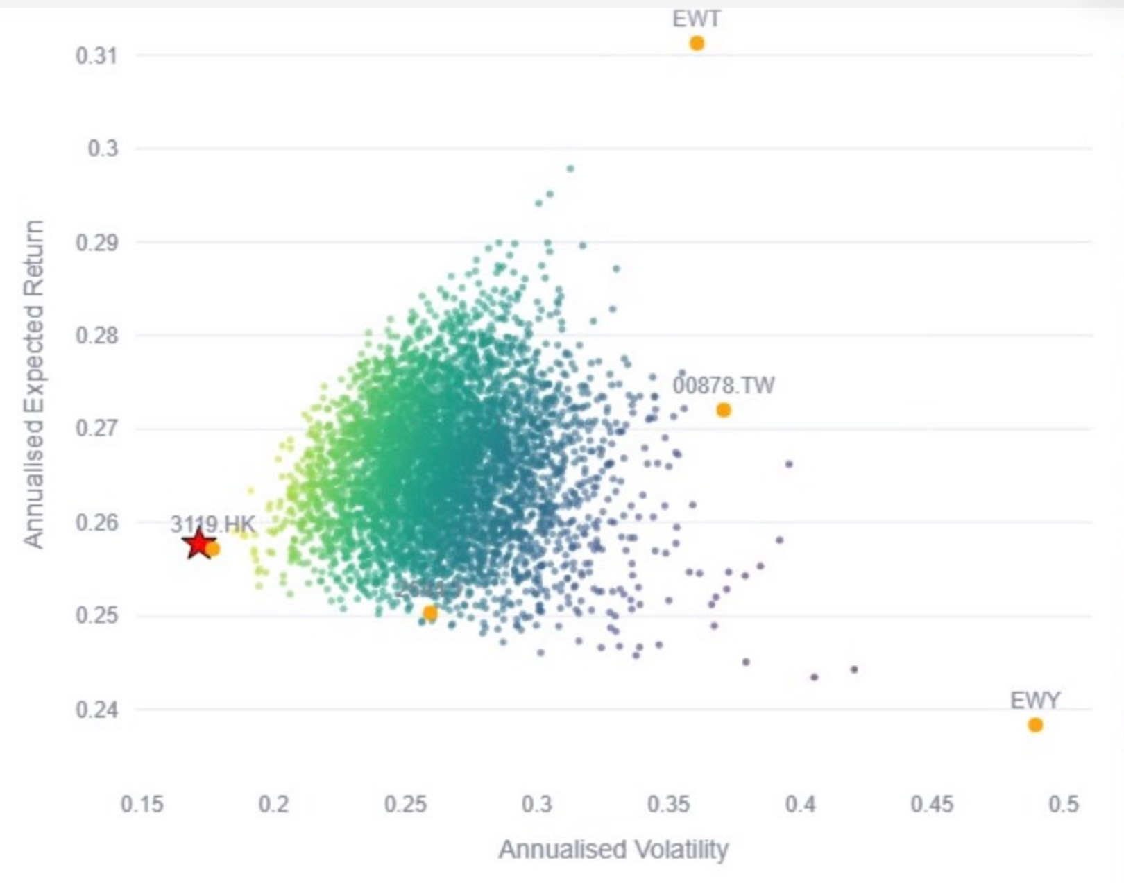
Strategy: our five-ETF basket sits at the low-risk edge of every possible mix
USD 100mn across five Bloomberg-listed ETFs; our weights (red star) deliver ~26% expected return for only ~17% volatility
Allocation
Risk vs return: single ETFs and random mixes
How to read it
Orange dots: each ETF on its own (2644 is the dot near 0.26, 0.25).
Red star: our basket (35 / 20 / 15 / 15 / 15).
Small dots: thousands of random weightings of the five ETFs; lighter = more return per unit of risk.
Axes: annualised volatility (risk) and expected return.
Half in the semiconductor core
3119 HK + 2644 JP = 50%; Korea adds memory, Taiwan the foundry, 00878 the ESG income.
USD
100mn
Takeaways
Our basket (red star): ~26% return at ~17% volatility, the lowest risk of all the mixes shown.
Most random mixes need 22–32% volatility for the same 25–28% return: our weights get it with less risk.
Less risk than any single ETF, about a third of EWY's (~49%), while giving up only a few points versus EWT's ~31%.
Why: 3119 HK (35%) anchors the basket; the other four move differently enough to pull risk down.
■ | 3119 HK | Pan-Asian chip leaders | 35%
■ | EWY US | Korea: memory for AI | 20%
■ | EWT US | Taiwan: the AI foundry | 15%
■ | 2644 JP | Japan: chip-making tools | 15%
■ | 00878 TT | ESG dividend anchor | 15%
Our basket (red star): ~26% return for ~17% volatility, less risk than any single ETF or random mix
Risk/return chart: team analysis app (annualised from historical data; red star = our basket at 35/20/15/15/15; values read from the chart). Liquidity: 3119 HK is borderline against the USD 5M/day rule, verify on Bloomberg.
ANALYSIS
STRATEGY
APPENDIX

