Slide 1
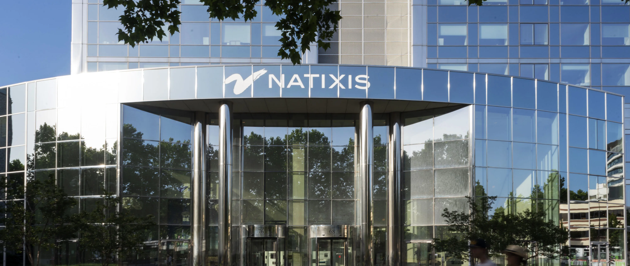


Slide 2




Our client: NKE Private Wealth
Client profile
Goals
Risk tolerance:
Moderate
1
Capital for the next generations
Assumption
Grow the USD 100mn ticket while keeping a defined capital barrier so the legacy sleeve is not an open-ended equity drawdown.
Family is open to structured notes / OTC, provided barriers and issuer credit are explicit.
Provider: NKE Private Wealth
1
Prestigious single-family office for the Chak family
Third-generation business dynasty
Ops across Japan and Greater China
Sectors: tech infrastructure, renewables, real estate
Family net worth > USD 2Bn
2
Digital transformation in Asia
Horizon of 5 years. Trade date 17 Sep 2026. Secondary liquidity is accepted as limited (issuer bid, not an exchange).
Meaningful exposure to the compute –power–platform stack that sits next to the family’s own tech-infrastructure and renewable plants.
2
Client: The Chak Family
Patriarch has handed operations to G3 and is now focused on strategic asset allocation and legacy planning in a volatile market.
3
Bridge old Asia and new tech
3
NKE / Natixis can design, price and book a bespoke note. Underlyings must be Bloomberg-searchable large caps; no OFAC names.
Prefer underlyings that connect Japan and Greater China real-economy franchises with emerging technology
Client Mandate
Allocate USD 100 Mn in a product that compounds capital for future generations and captures Asia’s digital transformation
The family owns Asian infrastructure, renewables and property. We should give them AI hardware layer and exclude what they originally own

Slide 3




Our client should consider macro, geopolitical, and AI market factors
Geopolitics
AI pivots
Why hardware products ?
US midterms (Nov 2026) and the 2028 race keep trade policy uncertain
US–China tech restrictions and tariffs hit cross-border families
Capital rotates to supply-chain security and reshoring
US elections
Software
Cycle faced a valuation rationalization
Most of the money is not in models
Worldwide AI spend is about USD 2.7tn in 2026. Infrastructure takes roughly half.
High-multiple AI software de-rates on higher discount rates
Middle East, oil, inflation
Hardware
Building ahead of demand
Many projects are still pilots. The cycle only pays off if AI creates new real-economy revenue (factories, grids, science)
AI performance is no longer driven by coding apps, but by hardware, localized grid/power infrastructure etc.
Capex shifts decisively to chips, HBM memory, equipment, servers
US , Iran conflict and Strait of Hormuz risk drive oil volatility
Sticky core inflation keeps long-end yields high
Rewards real pricing power; penalises cash-burning growth
Client already owns plants and infrastructure in Asia sits closer to the scarce part of the market
The client should own Asia's AI hardware, with protection for the legacy and income while we wait
1. The market is huge — and most of the money is not in models.
Worldwide AI spend is about USD 2.7tn in 2026. Infrastructure takes roughly half. Services and software follow. Models and agents are still small.
2. The bottleneck is no longer “can we train a model?”
It is power, grid connections, sites, cooling, networks and packaging. Chips still matter; you cannot plug them in fast enough. Inference (using AI every day) is overtaking training as the demand that has to be built for.
3. Cash has moved faster than proven profit.
Hyperscalers are building ahead of demand. Adoption is wide; many projects are still pilots. The cycle only pays off if AI creates new real-economy revenue (factories, grids, science) — which is why a family that already owns plants and infrastructure in Asia sits closer to the scarce part of the market than a software multiple does.

Slide 4
Investment thesis 1: Asia controls AI's hardware bottlenecks
1a Demand is structural, and it runs through Asia
1b A strong theme on a violent path
Demand is structural
Hyperscaler capex ~US$725bn in 2026 (+77%); the chip market nearly doubles to ~US$1.5trn.
The moat runs through Asia
8 of the world's 10 largest companies depend on TSMC (J.P. Morgan).
…but the cycle is maturing
DRAM price gains slowing: +48% in Q2, ~+13% expected in Q4 2026.
Growth is structural…
TAIEX and KOSPI are 2–3× their end-2022 levels on AI demand.
…but the path is violent
Down 10–25% in 2022; records in June 2026, then sharp falls within weeks.
~70%
Taiwan makes the chips: TSMC's share of global foundry revenue; TSMC is >40% of TAIEX.
→ Taiwan is the single largest AI chokepoint
−25%
Round trips happen fast: KOSPI went from 9,000+ in June to 6,789 on 28 Aug 2026, in about ten weeks.
→ Entry timing is hard; drawdowns are deep and quick
83%
Korea makes the memory: SK hynix + Samsung share of HBM, the memory every AI accelerator needs.
→ No AI accelerator ships without Korean memory
>40%
Returns hinge on a few names: TSMC >40% of TAIEX; Samsung + SK hynix ~48% of KOSPI; ~92% of advanced chips from Taiwan.
→ Single-name risk is high
~55%
Japan makes the tools: Advantest's share of chip test equipment; with Tokyo Electron ≈ 20% of the Nikkei.
→ Every new fab needs Japanese tools
38.6×
Valuations price in a lot: Nikkei CAPE 38.6×; Taiwan among the most expensive markets; DRAM gains slowing.
→ Upside from here is less certain than the theme
Whichever AI company wins, it needs Asia's chips, memory and tools, but the path to owning them is violent.
Notes:
Thesis 1, the theme. AI spending is a hardware boom and Asia holds the three bottlenecks: Taiwan's foundries, Korea's high-bandwidth memory, Japan's chip-making tools. The demand is structural, but the memory cycle is maturing and the indices that hold the theme move violently: KOSPI lost about a quarter between June and August. Returns are concentrated in a few names and valuations are full.

Slide 5
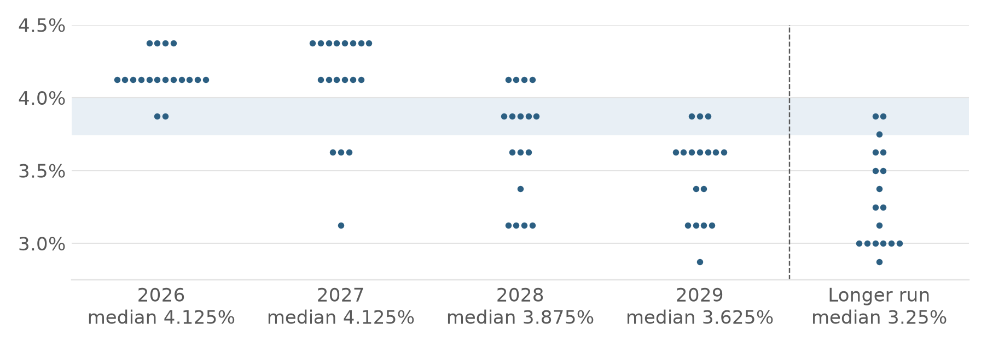
Investment thesis 2: Rates stay high and volatility is at records
The backdrop for the next five years: the Fed holds rates high, bonds carry rate risk, and Asian equities swing harder than ever
2a The Fed holds rates high for longer
2b Bonds carry rate risk, equities swing hard
Yields are high…
5Y USD at 5.69%: high income on offer.
…but prices are exposed
With hikes back on the table, a fixed rate locked in today loses value if rates rise further.
FOMC dot plot, 16 Sep 2026 (shaded: today's 3.75–4.00%). Dots read from the Fed's chart.
4.125%
FOMC median to end-2027, cuts deferred to 2028: 12 of 18 dots at 4.125% for 2026; 4.375% seen by 4 for 2026 and 8 for 2027.
→ Rate risk is structural, not a one-off
−4.0%
Long bonds carry rate risk: a 5-year bond loses ~4.0% per 1% rise in rates.
→ Duration is a risk, not a hedge, in this cycle
+0.25%
The Fed is hiking again: 16 Sep 2026: to 3.75–4.00%, the first hike since 2023.
→ The easing cycle is over for now
91.2
Volatility is at records: VKOSPI closed at an all-time high of 91.2 (9 Jun 2026), above the 2008 peak.
→ Option-implied risk in Asian equities is extreme
~87%
Markets price more: probability of at least one further hike priced by fed funds futures.
→ Risk to rates is still to the upside
−8.95%
Single days move markets: KOSPI's one-day fall on 13 Jul 2026; J.P. Morgan expects a 10–15% correction in 2026.
→ Buy-and-hold must sit through deep drawdowns
Rates stay high for longer and Asian equity volatility is at records: neither bonds nor buy-and-hold are a comfortable place to sit.
Notes:
Thesis 2, the backdrop. The Fed's dot plot keeps the median at 4.125% to end-2027 with cuts only from 2028; it has just hiked and futures price more. Yields are high, but a long bond loses about 4.0% per 1% rise, so duration is a risk. Asian equity volatility is at records: VKOSPI hit 91.2 and KOSPI fell nearly 9% in one day. Both bonds and buy-and-hold carry more risk than usual.

Slide 6
Our Product : 12.75% p.a. 5-Year Asia Mixed Technology Autocallable Note
Why this design: the highest coupon on the basket, with capital usually back early
Issuer | Natixis SA (BPCE Group)
Notional / currency | USD 100,000,000
Trade / maturity | 17 Sep 2026 / 17 Sep 2031 (5Y)
Underlying | Weighted basket of 5 Asian ETFs
Observation | Yearly, 5 dates; autocall from Year 1
Coupon | 12.75% p.a. (3.19% per quarter), paid if basket ≥ 100%
Autocall | Called when Basket ≥ 102.5% - 2.5% x time , return function : 100% + coupon x time
Kick in Level | 70%, if underlying asset has ever fall below the kick in level, Strike price of 100% will be activated.
Issue price / fair value | 100% / 96.5%
ETF (Bloomberg) | Wt | Role in the basket
Asia Semiconductor (3119 HK) | 35% | Pan-Asian chip leaders (40 names; TSMC, Samsung, SK Hynix the largest): the core AI-hardware exposure
iShares MSCI South Korea (EWY) | 20% | Korea large caps (Samsung + SK hynix ~44%): high-bandwidth memory for AI
iShares MSCI Taiwan (EWT) | 15% | Taiwan large caps (TSMC, MediaTek, Delta): AI foundry and server chain in the family's Greater China region
Japan Semiconductor (2644 JP) | 15% | Japanese semiconductor stocks (FactSet Japan Semiconductor Index, e.g. Tokyo Electron, Advantest): the family's home market
Taiwan ESG High Dividend (00878 TT) | 15% | ESG-screened Taiwan high-dividend leaders (Quanta, UMC, MediaTek): ESG sleeve and lower-volatility anchor
Structure: Autocallable Note.
Asset Allocation: Applied Modern Portfolio Theory (MPT) and Relative Value (RV) analysis to optimize weights for a 5-ETF underlying basket (details on next slide).
Pricing & Valuation: Combined Implied Volatility (IV) with Monte Carlo simulations to derive the fair coupon price (methodology in Appendix E & F).
7
Notes:
The table is the key design argument. Full protection is safe but pays under 8%. Removing all protection pays more but exposes the family to the whole drawdown in a crash. We choose the classic autocall: no barrier and no floor, so the family takes the basket's fall if the note is never called, in exchange for the highest coupon. Diversification and the memory coupon keep that outcome to about one path in five.

Slide 7
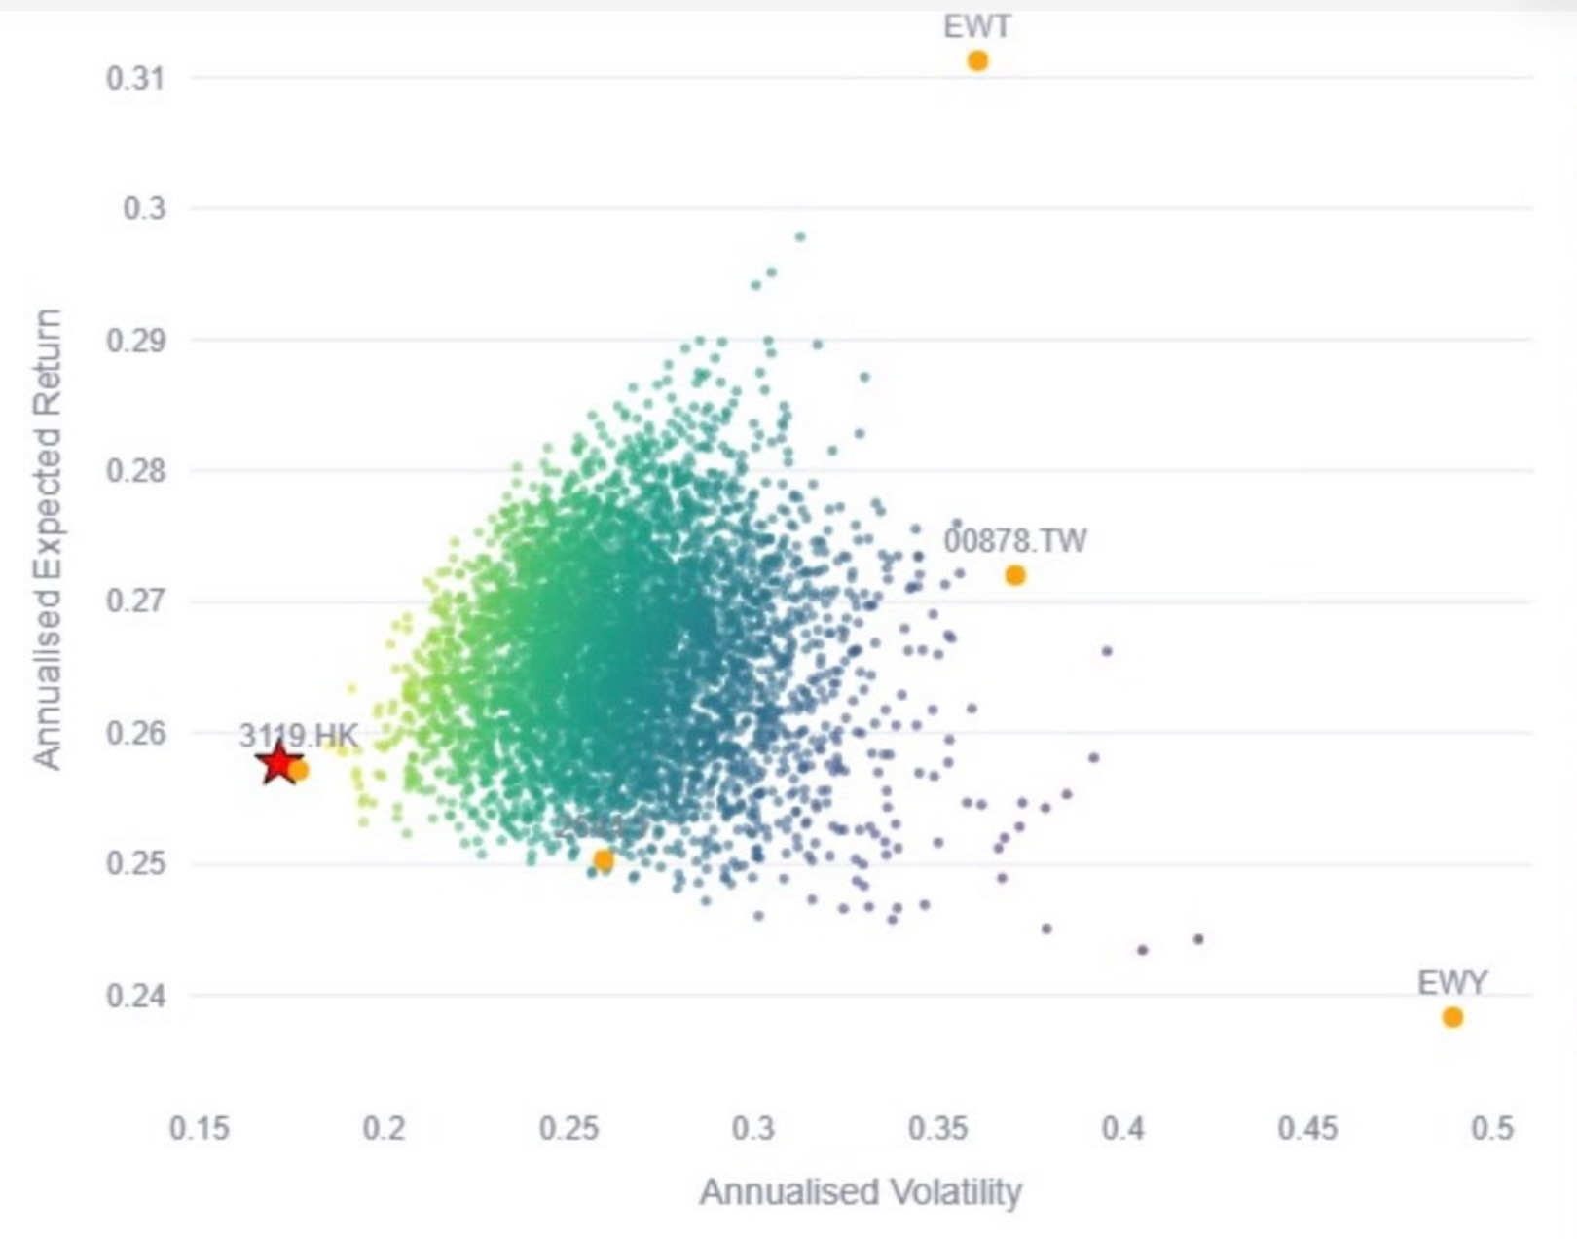
Strategy: our five-ETF basket sits at the low-risk edge of every possible mix
USD 100mn across five Bloomberg-listed ETFs; our weights (red star) deliver ~26% expected return for only ~17% Realized Volatility
Allocation
Modern Portfolio Theory : Risk vs return: single ETFs and random mixes
How to read it
Orange dots: each ETF on its own (2644 is the dot near 0.26, 0.25).
Red star: our basket (35 / 20 / 15 / 15 / 15).
Small dots: thousands of random weightings of the five ETFs; lighter = more return per unit of risk.
Axes: annualised volatility (risk) and expected return.
Half in the semiconductor core
3119 HK + 2644 JP = 50%; Korea adds memory, Taiwan the foundry, 00878 the ESG income.
Basket :
100M
Takeaways
Our basket (red star): ~26% return at ~17% volatility, the lowest risk of all the mixes shown.
Most random mixes need 22–32% volatility for the same 25–28% return: our weights get it with less risk.
Less risk than any single ETF, about a third of EWY's (~49%), while giving up only a few points versus EWT's ~31%.
Why: 3119 HK (35%) anchors the basket; the other four move differently enough to pull risk down.
■ | 3119 HK | Pan-Asian chip leaders | 35%
■ | EWY US | Korea: memory for AI | 20%
■ | EWT US | Taiwan: the AI foundry | 15%
■ | 2644 JP | Japan: chip-making tools | 15%
■ | 00878 TT | ESG dividend anchor | 15%
Our basket (red star): ~26% return for ~17% volatility, less risk than any single ETF or random mix
4

Slide 8
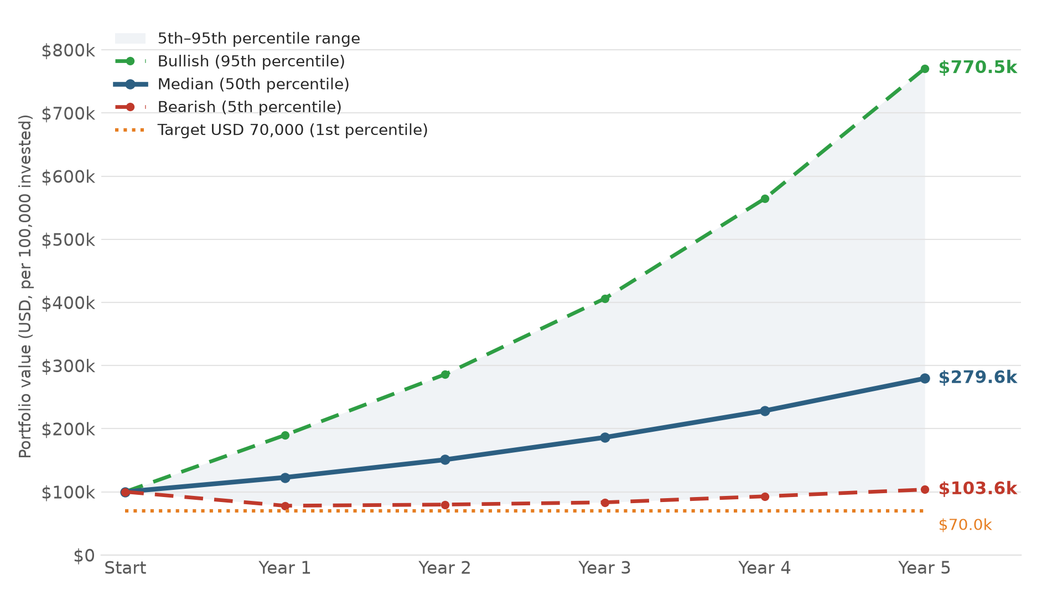
Monte Carlo: the median portfolio grows 2.8× in five years
5-year simulation of the five-ETF portfolio, per USD 100,000 invested (×1,000 for the USD 100mn mandate)
$279.6k
Median at Year 5: 2.8× the start, +22.8% a year
$103.6k
Bearish (5th percentile): still above the start, +0.7% a year
$770.5k
Bullish (95th percentile): 7.7× the start
99.0%
Chance of ending at or above the USD 70,000 target
Even the bearish path ends above the start ($103.6k); the USD 70,000 target is the 1st percentile
5

Slide 9
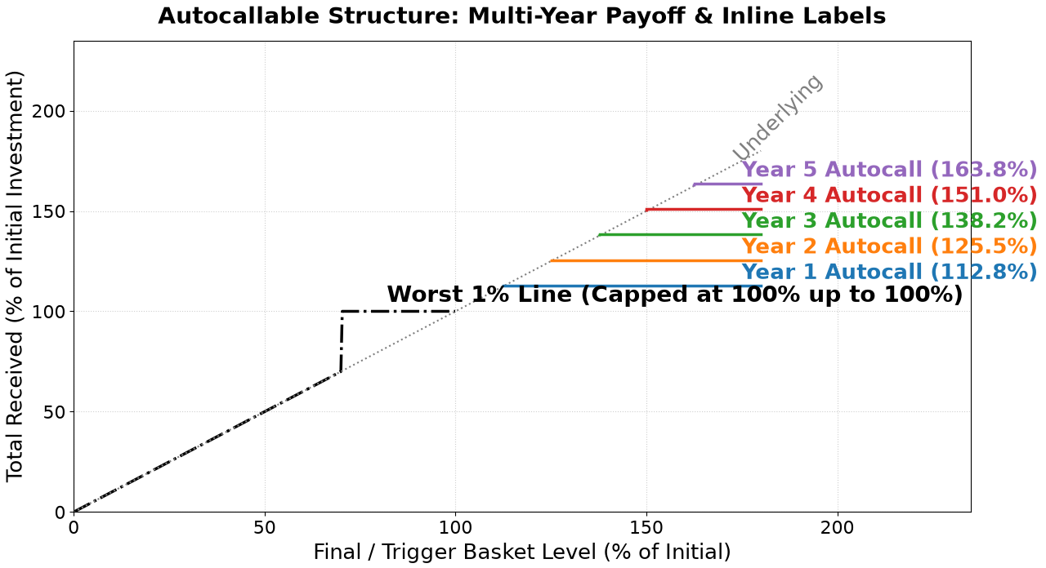
How it pays: one question every quarter, three outcomes
Is the basket at or above 100% of its starting level? (checked quarterly; one date per year shown)
Q1–Q3: coupon only (3.19% if basket ≥ 100%). From Q4: coupon plus autocall. Missed coupons are always caught up.
0
Y1
Y2
Y3
Y4
Y5
Trade date
17 Sep 2026
If ≥ 102.5%:
CALLED,
Receive 112.8% total,
Otherwise, refer to B,C
If ≥ 100% & y1 not
called: CALLED,
Receive 125.5% total
Otherwise, refer to B,C
If ≥ 97.5% & y1-2 not called: CALLED,
Receive 138.3% total
Otherwise, refer to B,C
If ≥ 95% & y1-3 not
called: CALLED
Receive 151.0% total;
Otherwise, refer to B,C
If ≥ 92.5% & y1-4 not called: CALLED,
Receive 163.8% total;
Otherwise refer to B,C
P(called by Y1) 78%
P(called by Y2) 93%
P(called by Y3) 97%
P(called by Y4) 99%
P(called by Y5) 99%
A
Autocalled
99.3% called
in any year
Basket ≥ 100% on any date from Q4: 100% plus every coupon to date. The note ends.
Not called, basket 70–By yearly target %
0.5% uncalled while being above 70% in year 5
B
Year 1-4 : Continue holding
Year 5: Repaid at 100% of the basket level
C
Not called, basket < 70%
0.2% repaid due to below 70% at check date
Repaid immediately at the basket level: the family bears the full fall.
Expected Portfolio Value : 114.1754% (+14.1754%)​
Notes:
Explain the note as one question asked every quarter: is the basket at or above where it started? If yes, the family is paid 3.19% for that quarter plus any coupons missed before, and from Year 1 the note also ends with 100% back. If the note is never called, the payoff chart shows the two zones at Year 5: at or above 100% the family receives 163.8%; below 100% it is repaid at the basket level.

Slide 10
Risks for the family, and how Natixis hedges its side
Risk | What could happen | Mitigant
Capital loss | Never called: repaid at the basket level (0.8% on the team outlook; 33% if markets go nowhere) | Diversified basket, memory coupon; only 5% of wealth
Capped upside | Team median is 2.8× in 5 years; the note pays 12.75% p.a. and is usually called by Y1 | Coupons lock in gains if the rally stalls; rest of family wealth keeps direct equity exposure
ETF structure | 00878 pays ~7.6% a year out, lowering its price path; 3119 trading is thin; ETF tracking error | 00878 held at 15%; verify volumes; Natixis can reference total-return versions
Issuer credit | Coupons and repayment depend on Natixis / BPCE | BPCE senior rating; optional collateralised wrapper
Liquidity / MTM | Sold before maturity, the price can be below 100% | Natixis daily indicative price; hold to call or maturity
Coupon digitals
Natixis owes basket digitals struck at 100%: replicated with tight basket call spreads, delta-hedged with ETF units, constituent stocks and index futures as proxies; listed options on EWY/EWT
Vol & correlation
Coupon value moves with basket vol and correlation (fair 12.9% –15.6% for 𝜎_{𝑡} ± 300bps): managed with listed index options and correlation trades
Quanto FX
EWT and EWY already trade in USD; 3119 (HKD, pegged), 2644 (JPY) and 00878 (TWD) need FX forwards and a quanto adjustment
Pricing sensitivity (fair coupon):
Base Case Baseline: 𝐶_{𝑓𝑎𝑖𝑟} = 14.1%
Volatility Shift: 𝜎_{𝑡} ± 300bps ⟹ 𝐶_{𝑓𝑎𝑖𝑟} ∈ [12.9%,15.5%], 𝜕𝐶_{𝑓𝑎𝑖𝑟} /𝜕𝜎_{𝑡} > 0
Correlation shift: 𝜌_{𝑖,j} ± 0.15 ⟹ 𝐶_{𝑓𝑎𝑖𝑟} ∈ [13.2%,15.0%], 𝜕𝐶_{𝑓𝑎𝑖𝑟} /𝜕𝜌_{𝑖,j} > 0
Equity drift: Δ𝜇 = -1.0 to -2.0% ⟹ 𝐶_{𝑓𝑎𝑖𝑟} = 15.6% − 17.3%
The 12.75% offer stays fundable in every case.
Short put & funding
Natixis is long the client's put at 100% (live only if never called), hedged with basket put spreads and delta. Principal funded at 5.69%
10
Notes:
Investor risks on the left, desk hedges on the right. The capital-loss line is explicit: if the note is never called, the family bears the basket's fall. The other honest risks are capped upside and Natixis credit. The 12.75% coupon sits below the 14.1% fair level in every sensitivity we ran, so the offer is robust to market moves before the trade date.

Slide 11
Appendix A: pricing assumptions and methodology
Vols and expected returns from the team risk/return app (slides 4–5); correlations and dividends to refresh on Bloomberg
ETF | Weight | Vol | Div | 3119 HK | EWY US | EWT US | 2644 JP | 00878 TT
3119 HK | 35% | 18% | 1.0% | 1.00 | 0.80 | 0.85 | 0.70 | 0.60
EWY US | 20% | 49% | 1.2% | 0.80 | 1.00 | 0.70 | 0.55 | 0.55
EWT US | 15% | 36% | 2.6% | 0.85 | 0.70 | 1.00 | 0.60 | 0.75
2644 JP | 15% | 26% | 0.8% | 0.70 | 0.55 | 0.60 | 1.00 | 0.45
00878 TT | 15% | 37% | 7.6% | 0.60 | 0.55 | 0.75 | 0.45 | 1.00
Variant of our note | Fair cpn
Coupon barrier 100% (base) | 14.1%
Coupon barrier 95% | 12.9%
Coupon barrier 90% | 11.9%
First autocall at Y2 | 13.3%
Equity drift −1% | 15.6%
Equity drift −2% | 17.4%
Vol +3pts / −3pts | 15.6% / 12.9%
Model. Correlated GBM for each ETF, 200,000 paths, quarterly steps. Risk-neutral drift = USD funding (linear interpolation of case grid) − dividend yield. Quanto adjustment ignored (assumed hedged by the desk; to be added with FX-equity correlations).
Discounting. USD funding grid from the case rules; 5Y discount factor 0.758.
Coupon solve. Bisection on coupon so that PV = 98% (2% hedging cost and margin).
Historical back-test (to run). Monthly Bloomberg history since 2021 for all five ETFs (00878 and 3119 launched in 2020–21). Launch a hypothetical note every month, apply the same coupon, memory and autocall rules, and record coupons, life and IRR by launch year.
All variants priced at 98% with the same basket and inputs. Code: pricing/scenario2_autocall_mc.py

Slide 12
Appendix B: scenario analysis, five paths for Asian markets
Hypothetical quarterly basket paths and what the USD 100mn note returns in each
Scenario | Outcome | Coupons | USD mn | IRR | Basket
AI capex boom | Called Q4 (1y) | 12.8% | 112.8 | 13.4% | –
Range-bound Asia | Called Q6 (1.5y) | 19.1% | 119.1 | 12.4% | –
2022-style tech drawdown, slow recovery | Called Q15 (3.75y) | 47.8% | 147.8 | 11.0% | –
Lost decade (sideways below par) | 88% back at Y5 | 0.0% | 88.0 | -2.5% | -12%
Geopolitical shock, no recovery | 55% back at Y5 | 0.0% | 55.0 | -11.3% | -45%
Reading: the note earns ~11.0%–13.4% a year whenever the basket gets back to 100%, even after a 30% drawdown: memory pays all 15 missed coupons at Q15. If the basket never recovers (lost decade, lasting shock) the note repays the basket's level, 88% or 55%.
Paths are illustrative and not forecasts. 'Basket' = direct basket return at Y5 when the note is not called. Historical back-test to run on Bloomberg history (appendix).
Notes:
Walk the five scenarios. The 2022-style path is the key one: a 30% drawdown in the first year that would scare a direct investor, yet the note pays all 15 quarterly coupons at once when the basket recovers at Q15. The two bad paths are the honest cost: if the basket never gets back to 100%, the family is repaid the basket's level (88% and 55%).

Slide 13
Appendix C: how Natixis replicates the note
Replication used by the Natixis desk to price and hedge (values in % of notional, at trade date)
Principal
Coupon digitals
Autocall (Natixis)
Short put (client)
100% repaid at autocall or maturity. Worth 89.3%
3.19% plus missed coupons on each date ≥ 100%. Worth 14.1% (net of autocall)
From Q4, basket ≥ 100%: remaining coupons cancelled, note ends. Keeps the coupon affordable
If never called, the client bears the basket's fall below 100% at Y5. Worth −6.8%
+
−
−
Fair value 96.5% = principal 89.3% + coupons 14.1% − short put 6.8%. Issued at 100%, leaving 3.5% for hedging and margin. The short put funds the double-digit coupon.
Notes:
Mini-charts show each leg's payoff against the basket level (the autocall leg is illustrative: it shows the remaining coupon stream switching off). The short put is the key: the client sells Natixis a put on the basket at 100%, live only if the note is never called, and its premium funds the double-digit coupon.

Slide 14
Appendix D: alternatives for the investment committee
Same basket: full protection, a higher-risk snowball, and a pure participation note
Option | Return | Loss risk
Classic autocallable (ours) | 12.75% p.a. memory coupon | 0.8% (team outlook)
100% protected autocallable | ~7.9% fair coupon | 0%
Snowball, 65% barrier | 13.6% fair, paid at call | 14.0% (pricing)
Principal-protected note | 85% of basket gain at Y5 | 0%
Trade-off: The snowball's fair coupon is 13.6%, but it loses capital in ~14% of paths (pricing measure). Full protection pays only ~8%. The PPN pays nothing unless the basket ends above 100% after 5 years. Our note pays 12.75%, with money usually back within ~1 year on the team outlook, but takes the basket's fall if never called.
Monte Carlo, 200k paths. Vols, dividends and correlations are assumptions to refresh with Bloomberg data as of the 17 Sep 2026 trade date; discounting uses the USD funding grid.

Slide 15




Appendix E: how we priced the note, and why the fair coupon is 14.09%
Monte Carlo simulation of the five-ETF basket (1,000,000 paths); the fair coupon makes the note worth exactly its issue price
Term structure & discount factors
Annual rates are converted to continuous rates; each cash flow is discounted at its own tenor
$$r_{j}=\ln\left(1+R_{j}\right)$$
(1)
Product priced
A
$D_{j}=\exp{​_{​}^{\left(−r_{j}⋅t_{j}\right)}​}$ (2)
Basket weights | 3119.HK 35% · EWY 20% · EWT 15% · 2644.T 15% · 00878.TW 15%
Autocall barrier H | Y1 102.5% · Y2 100% · Y3 97.5% · Y4 95% · Y5 92.5%
Called in year k | 100 × (1 + k × y)
Never called | R₅ as in (7)
Simulation | 1,000,000 paths, annual steps
Asset paths (correlated geometric Brownian motion)
Each ETF moves one year at a time with its own interval variance ΔV; shocks are correlated through the Cholesky factor L of ρ
X$​_{i,j}^{​}=X_{i,j−1}⋅e^{\left(\left(r_{j}−q_{i,j}−\frac{1}{2}ΔV_{i,j}\right)+\sqrt{ΔV_{i,j}}⋅Z_{i,j}\right)}$(3)
B
Z = ε · L^{T}, ρ = L · L^{T} (4)
C
Basket & autocall trigger
The basket is the weighted sum of normalised ETF prices; the note ends at the first year it reaches that year's barrier
B_{j} = Σ_{i=1..5} w_{i} X_{i,j} (5)
call at first k with B_{k} ≥ H_{k} (6)
Pricing results (Case A)
Maturity payout (never called)
A 70% barrier observed only at Year 5
R₅ = 1.0 if B₅ ≥ 0.70; R₅ = B₅ if B₅ < 0.70 (7)
Fair coupon |  | 14.092219%
Standard error |  | 2.236 bp
Approx. 95% CI |  | [14.018397%, 14.166041%]
D
E
Fair coupon
a = discounted principal repaid, b = discounted years of coupon (Case A: no coupon on never-called paths)
1.0 = E[a + y · b] (8)
14.092219% = 12.75% coupon to the client + 1.34% kept by Natixis
$y=\frac{\left(1.0−E\left[a\right]\right)}{E\left[b\right]}$(9)
We are collecting 3.752219% from the customer and give them a 10% coupon
Source: team write-up 'Derivation of Fair Coupon Rate for Autocallable Structured Product' (8 Oct 2026), sections 2–3. Excludes issuer credit, fees and hedging costs.
Notes:
How we priced the note. A: annual rates from the case grid are turned into continuous rates and discount factors. B: we simulate each ETF one year at a time with correlated geometric Brownian motion, using the implied-volatility term structure through interval variances and the correlation matrix through its Cholesky factor. C: the basket is the weighted sum of the five ETFs; the note is called at the first year the basket reaches that year's barrier, which steps down from 102.5% to 92.5%. D: if never called, the family gets 100% back unless the basket is below 70% at Year 5. E: the fair coupon is the value of y that makes the expected discounted payoff equal 1. Result: 13.752219% with a standard error of 2.236 basis points. We pay the client a 10% coupon and collect the remaining 3.752219%.

Slide 16
Appendix F: pricing inputs, grids and matrices
Every input used in the Monte Carlo simulation (team write-up, section 4)
4.1 Term structure of interest rates
4.2 Correlation matrix (ρ)
Year (t) | Risk-free rate (R) | Continuous rate r = ln(1 + R) | Discount factor (D)
1 | 4.78% | 4.671% | 0.9544
2 | 5.30% | 5.166% | 0.9015
3 | 5.52% | 5.375% | 0.8466
4 (interpolated) | 5.605% | 5.454% | 0.7981
5 | 5.69% | 5.534% | 0.7510
Asset | 3119.HK | EWY | EWT | 2644.T | 00878.TW
3119.HK | 1.000 | 0.534 | 0.741 | 0.863 | 0.562
EWY | 0.534 | 1.000 | 0.787 | 0.691 | 0.438
EWT | 0.741 | 0.787 | 1.000 | 0.614 | 0.689
2644.T | 0.863 | 0.691 | 0.614 | 1.000 | 0.517
00878.TW | 0.562 | 0.438 | 0.689 | 0.517 | 1.000
4.3 Implied volatility grid (σ), annualised
4.4 Interval variances (ΔV), drive each year's diffusion step
Asset / Year | Year 1 | Year 2 | Year 3 | Year 4 | Year 5
3119.HK | 30.45% | 32.34% | 33.50% | 36.70% | 37.50%
EWY | 41.50% | 42.70% | 44.50% | 44.50% | 44.50%
EWT | 32.40% | 35.80% | 36.30% | 36.30% | 36.30%
2644.T | 23.00% | 24.90% | 25.60% | 25.60% | 25.90%
00878.TW | 7.00% | 9.00% | 12.00% | 12.00% | 12.00%
Asset / Interval | Year 1 | Year 2 | Year 3 | Year 4 | Year 5
3119.HK | 0.0927 | 0.1126 | 0.1177 | 0.1633 | 0.1744
EWY | 0.1722 | 0.1868 | 0.2078 | 0.2078 | 0.2078
EWT | 0.1050 | 0.1340 | 0.1384 | 0.1384 | 0.1406
2644.T | 0.0529 | 0.0620 | 0.0655 | 0.0655 | 0.0689
00878.TW | 0.0049 | 0.0081 | 0.0162 | 0.0162 | 0.0162
Basket weights 3119.HK 35% · EWY 20% · EWT 15% · 2644.T 15% · 00878.TW 15% | Autocall barriers 102.5% / 100% / 97.5% / 95% / 92.5% | Maturity barrier 70%
Source: team write-up, section 4. Rates: case USD funding grid (Year 4 interpolated). Correlation matrix checked positive definite before the Cholesky decomposition.
Notes:
All inputs to the simulation. Term structure: the case USD grid, with Year 4 interpolated between 3 and 5 years, converted to continuous rates and discount factors. Correlations: pairwise correlations between the five ETFs. Implied volatilities: a term structure for each ETF over five years. Interval variances: the variance used for each one-year step in the simulation.

Slide 17
Summary: Asia's AI hardware, held through an autocall that pays while markets swing
From the family's mandate to the note: what we recommend, why now, and what the family can expect
1 The client
2 The thesis
3 The product
4 The outcome
USD 100mn, 5 years, moderate risk
Chak family office (NKE Private Wealth); ~5% of family wealth.
Asia controls AI's hardware
~70% of foundry (Taiwan), 83% of HBM (Korea), ~55% of chip test (Japan).
12.75% a year, 5Y autocallable note
Natixis-issued, USD 100mn, five Asian ETFs: 3119 HK 35%, EWY 20%, EWT 15%, 2644 JP 15%, 00878 TT 15%.
Capital usually back early
78% called in year 1 (112.75%); 99.3% called within five years.
Two goals
Compound capital for the next generation, and own Asia's digital transformation.
But the path is violent
KOSPI −25% in ten weeks; VKOSPI at a record 91.2.
Step-down call, yearly
Called if the basket ≥ 102.5% in Y1, falling 2.5% a year to 92.5% in Y5; pays 100% + 12.75% × years.
Loss is rare
0.2% of paths end below 70%, where the family takes the basket's fall.
One constraint
A defined capital barrier, not an open-ended equity drawdown.
And rates stay high
FOMC median 4.125% to end-2027; long bonds lose ~4% per 1% rise.
70% barrier at maturity only
If never called, 100% back unless the basket ends below 70%.
Priced with room
Fair coupon 14.09%: Natixis keeps 1.34% a year for hedging and margin.
Why it fits the family
12.75%
Growth: a double-digit coupon from the AI-hardware theme, without having to time entry
70%
Protection: a defined barrier, checked only at maturity, for the legacy sleeve
~1.3 yrs
Flexibility: expected life is short, so capital returns early to reinvest at higher rates
Own the scarce part of AI, Asia's chips, memory and tools, and get paid while the market swings.
Call and loss probabilities on the team outlook (slide 9); fair coupon from the Monte Carlo pricing (Appendix E). Not a guarantee of future returns; capital at risk below the 70% barrier and to Natixis credit.
Notes:
Close on one page. The family wants to grow capital for the next generation and own Asia's digital transformation, with a defined barrier. Our thesis: Asia holds AI's hardware bottlenecks, but the path is violent and rates stay high. So we hold a five-ETF Asian basket through a five-year autocallable note paying 12.75% a year, with a step-down call and a 70% barrier at maturity only. On our outlook the note is usually called in year one and loses capital in very few paths.

