Slide 1



Investment thesis 1: AI is a hardware boom, and Asia owns the chokepoints
Taiwan, Korea and Japan each control a bottleneck
Demand is surging, but the cycle is maturing
Taiwan: makes the chips
~70%
HPC/AI 58% of TSMC revenue (2025); 3nm sold out through 2026
TAIEX record 48,476 (2 Oct 2026), ~+67% YTD; TSMC >40% of the index
TSMC share of global
foundry revenue (Q1 2026)
Korea: makes the memory
83%
DRAM contract prices +45–50% q/q in Q2 2026; server DRAM still undersupplied
KOSPI forward P/E 7.8× vs 23× trailing: earnings, not just multiples
SK hynix (50%) + Samsung (33%)
share of HBM revenue (Q2 2026)
Cycle check
Memory prices still rising, but gains slowing (midpoints of TrendForce ranges)
US 25% tariff on some advanced chips since Jan 2026 (Section 232)
Structural demand, cyclical prices: own it through a structure built for volatility (thesis 2)
Japan: makes the tools
~55%
Test equipment +31% and DRAM equipment +39% in 2026 (SEMI)
Advantest + Tokyo Electron ≈ 20% of the Nikkei 225; forward P/E 17.2×
Advantest share of chip
test equipment
Sources: Counterpoint (foundry, HBM); TSMC; Trading Economics / TWSE; TrendForce (DRAM, range midpoints); Siblis (P/E, 1 Jul 2026); SEMI (14 Jul 2026); WSTS (2025 actual $795.6bn; 2024 implied; 2026–27 Spring 2026 forecast); company reports and guidance midpoints (capex; Microsoft 2025 calendar-year estimate); White House Proclamation 11002.
Whichever AI model or company wins, it needs Taiwan's chips, Korea's memory and Japan's tools.
ANALYSIS
STRATEGY
APPENDIX
Notes:
Thesis 1. AI is a hardware story and Taiwan, Korea and Japan each own a bottleneck. The boom is visible in earnings, not just prices: KOSPI's forward P/E of 7.8x against 23x trailing means analysts expect earnings to roughly triple. But the cycle is maturing: memory price increases are decelerating and US tariffs are a live risk. That tension, a great theme on a risky path, is thesis 2.

Slide 2
J.P. Morgan's 2026 Outlook: the AI moat is real, and so are its cracks
"Smothering Heights: is the largest moat in market history indestructible?" (M. Cembalest, J.P. Morgan Asset & Wealth Management, 1 Jan 2026)
The theme is the market
…but the moat has cracks
$3trn → $18trn
Market cap of 4 hyperscalers + NVIDIA, TSMC, ASML, AMD in ~7 years: ~20% of MSCI World
10–11 days
Taiwan's gas storage; LNG is 40% of its power and 90% of energy is imported: "the most blockade-sensitive advanced economy"
65–75%
Share of S&P 500 returns, profits and capex since Nov 2022 from 42 AI-linked stocks
$1.3trn
Hyperscaler capex + R&D since 2022: risk of a "Metaverse moment" (Mag 7 fell 50% in 2022)
8 of 10
Of the world's 10 largest companies depend heavily on TSMC supply
−10–15%
JPM's base case: a correction at some point in 2026, then markets end the year higher
Source: J.P. Morgan Asset & Wealth Management, Eye on the Market, 2026 Outlook "Smothering Heights" (M. Cembalest, 1 Jan 2026), pp. 1–2, 7, 33–35, 46; underlying data Bloomberg, USITC, BP, ROC Taiwan, Global Guardian. Reliance values read from JPM's chart (approximate).
J.P. Morgan's key risks (concentration, Taiwan, a 10–15% correction) are what an autocall with a 30% buffer and a 70% floor is built to absorb.
ANALYSIS
STRATEGY
APPENDIX
Notes:
Third-party validation from J.P. Morgan's 2026 Outlook. Left: the AI theme has driven most of the equity market's returns and earnings since ChatGPT, and the moat runs through TSMC (8 of the 10 largest companies depend on it). Right: JPM's own 'what could go wrong' list highlights: Taiwan dependence (~92% of advanced chips) and blockade vulnerability, a possible 'Metaverse moment' for hyperscaler capex, and a 10–15% correction in its 2026 base case. These are the risks any investor in the theme has to manage. Note: the outlook is dated 1 Jan 2026, before this year's moves.

Slide 3
Investment thesis 2: Volatile markets and high rates favour autocallables
Economic aspect: a strong theme on a volatile path
Finance aspect: today's rates and volatility suit autocalls
Structural growth, but a violent, concentrated and late-cycle equity market
Rates are high and rising again; volatility is at records
Growth is structural…
Capex +77% and chip market +90% in 2026 (thesis 1).
…but the path is violent
Down 10–25% in 2022, then 2–3× since. KOSPI fell 8.95% in a single day (13 Jul 2026).
The Fed is hiking again
16 Sep 2026: +0.25% to 3.75–4.00%, the first hike since 2023; median dot 4.1% for end-2026.
Markets price more
~87% probability of at least one further move priced by futures.
−25%
Round trips happen fast: KOSPI went from 9,000+ in June to 6,789 on 28 Aug; J.P. Morgan expects a 10–15% correction in 2026.
→ Autocall coupons are paid when the basket gets back to its start: no need to time the bottom
−4.0%
Long bonds carry rate risk: A 5-year bond loses ~4.0% per 1% rate rise, as the Fed hikes again.
→ Autocalls can redeem from year 1: short duration, and cash to reinvest at higher rates
1
1
>40%
Returns hinge on a few names: TSMC >40% of TAIEX; Samsung + SK hynix ~48% of KOSPI; ~92% of advanced chips from Taiwan.
→ Use a diversified ETF basket, not a worst-of on single names
91.2
Volatility is at records: VKOSPI closed at an all-time high of 91.2 (9 Jun 2026), above the 2008 peak.
→ Rich option premium funds higher autocall coupons
2
2
38.6×
Valuations price in a lot: Nikkei CAPE 38.6×; Taiwan among the most expensive markets; DRAM price gains slowing.
→ Capping upside at the coupon costs little when the good news is already priced
75.8%
High rates make guarantees cheap: At 5.69% 5Y USD funding, USD 100 payable in 5 years costs only USD 75.8 today.
→ A capital floor is affordable inside an autocall
3
3
Sources: TWSE, KRX/press, Nikkei (index levels; 2021–23 KOSPI/Nikkei to verify); Asiae, FN News, BIT Research (KOSPI); J.P. Morgan 2026 Outlook; Trading Economics, Siblis (valuations); TrendForce; Federal Reserve via Advisor Perspectives; Herald / SBS (VKOSPI); case funding grid; standard bond maths.
ANALYSIS
STRATEGY
APPENDIX
Notes:
Thesis 2, market evidence only. Economic: AI-hardware demand is structural, but the equity path is violent (2022 falls, 2026 round trips), concentrated in a handful of names, and valuations already assume a lot while memory price momentum slows. Finance: the Fed is hiking again, so long bonds carry real rate risk; volatility is at record highs; and high rates make a capital floor unusually cheap. Each point ends with the autocall link: coupons paid on recovery (not timing), a diversified basket, capped upside that costs little, short duration, coupons funded by volatility, and a floor funded by high rates.

Slide 4
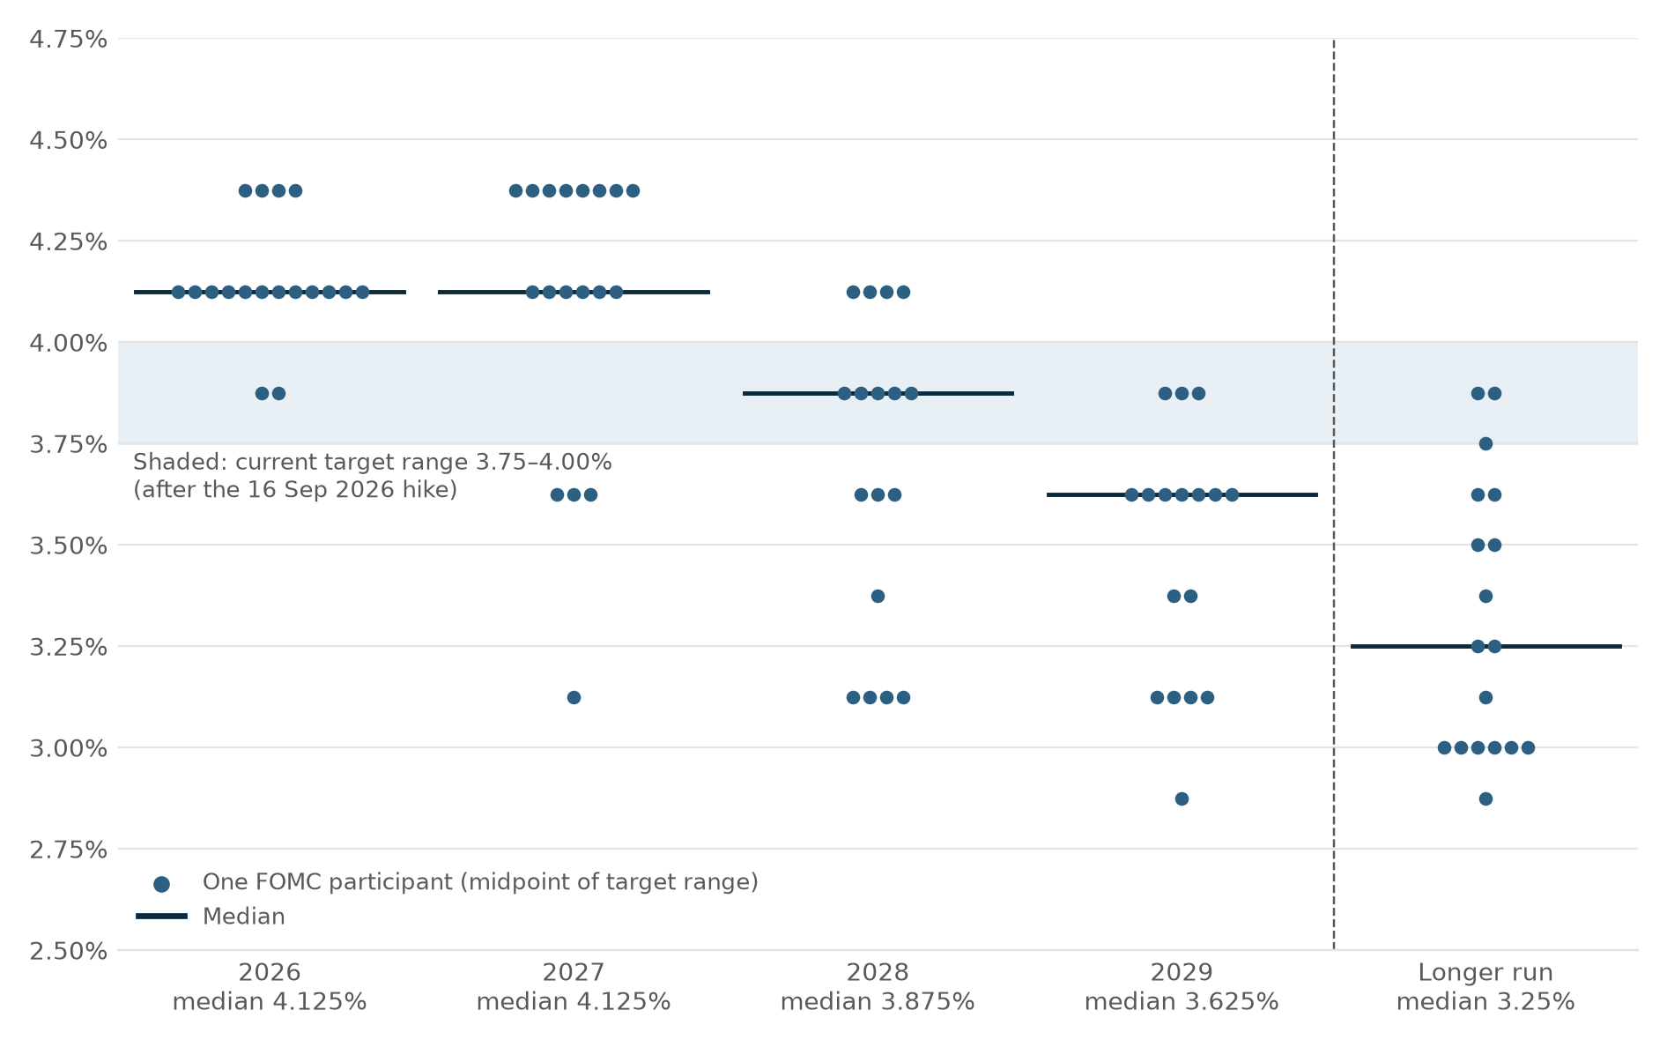
Investment thesis 2 (rates): the Fed's dot plot says higher for longer
4.125%
Rates stay high through 2027: Median 4.125% at end-2026 and 4.125% at end-2027 (one more hike from 3.75–4.00%); cuts only from 2028.
→ USD funding stays high for most of a 5-year note: the principal and a 70% floor are cheap to build
12 dots
Risk of more hikes: 4 participants see 4.375% this year and 8 in 2027, above the median.
→ A 5-year bond loses if rates rise further; an autocall can redeem from year 1 (expected life ~2 years)
125bp
Wide disagreement: 2027 dots span 3.125%–4.375%; longer run 2.875%–3.875%. The rate path is uncertain.
→ Rate uncertainty keeps volatility high, and richer option premium funds the coupon
3.25%
Slow easing later: Median falls to 3.875% in 2028 and 3.625% in 2029, towards 3.25% in the long run.
→ Lower USD rates late in the note's life support Asian equities, helping the basket back to 100% (autocall)
FOMC participants' view of the appropriate fed funds rate (midpoint of target range), Summary of Economic Projections, 16 Sep 2026
Higher-for-longer USD rates make a capital floor cheap and long bonds risky: the setting suits a short-dated, buffered autocall.
Source: Federal Reserve, Summary of Economic Projections, Figure 2 (16 Sep 2026). Dot counts read from the chart (18 participants for 2026–27 and the longer run, 17 for 2028–29): verify against the SEP table.
ANALYSIS
STRATEGY
APPENDIX
Notes:
The dot plot is the Fed's own forecast. Each dot is one FOMC participant's view of the right policy rate at year-end. Three readings: (1) the median sees one more hike this year and no cuts until 2028, so USD rates stay high for most of our 5-year horizon; (2) a hawkish minority sees 4.375%, so long bonds carry real downside; (3) the dots are widely spread, so rate volatility, and with it option premium, stays high. Each reading links to why a short-dated autocall with a 70% floor fits: cheap floor, early redemption, coupon funded by volatility, and supportive easing later in the life of the note.

Slide 5
Investment thesis 2: Traditional strategies fall short; autocallables fit 2026
Long bonds face rising rates; buy-and-hold equity faces record volatility, concentration and stretched valuations
Rates are rising again
Equity paths are violent
Implications
Market proof: Taiwan structured-note issuance +81% in 2025, snowball autocalls the favourite payoff (SRP)
1
Early exit beats duration: Bonds lose ~4.0% per 1% rate rise; autocalls can redeem from year 1
2
Paid on recovery, not timing: −25% in ten weeks (KOSPI 2026): autocall coupons pay once the basket is back at its start
Fed funds upper bound: hikes 2022–23, cuts 2024–25, a hike again on 16 Sep 2026 (median dot 4.1% for end-2026).
Index levels, end-2021 = 100: −10–25% in 2022, then 2–3×. KOSPI fell ~25% from June to late August 2026.
Long bonds carry rate risk
Valuations already price in a lot
3
Diversify the basket: TSMC >40% of TAIEX, ~92% of advanced chips from Taiwan: use a diversified ETF basket, not worst-of
4
Volatility funds the coupon: VKOSPI at a record 91.2: richer option premium means higher autocall coupons
5
Protection is affordable: USD 100 in 5 years costs USD 75.8 at 5.69%: a buffer and a 70% floor fit inside an autocall
Value change of a 5-year USD bond (5.69% coupon) for parallel rate moves of −2% to +2%.
Siblis Research, 1 Jul 2026. Korea's gap assumes earnings roughly triple; Nikkei CAPE 38.6×; Taiwan among the most expensive markets.
Plain bonds and equities leave investors exposed; a buffered autocall with a 70% floor keeps the theme and manages the risks.
Sources: Federal Reserve via Advisor Perspectives; TWSE, KRX/press, Nikkei (index levels); Siblis Research (P/E); Herald / SBS (VKOSPI); TrendForce; J.P. Morgan 2026 Outlook; StructuredRetailProducts.com; case funding grid with standard bond maths.
ANALYSIS
STRATEGY
APPENDIX
Notes:
One-slide thesis 2, modelled on the 'traditional strategies fall short' format, using market evidence only: rising rates (bond duration risk), violent equity paths, concentration, record volatility and a late, richly priced cycle. Implications link each market fact to why an autocallable structure fits; our specific note and its numbers come in the product section.

Slide 6
Appendix: sources for the investment thesis
Fact used | Source
TSMC ~70–73% of global foundry revenue (Q1 2026); HPC 58% of 2025 revenue; 3nm sold out through 2026 | Counterpoint via press; TSMC results (verify in TSMC quarterly reports)
TSMC >40% of TAIEX; TAIEX record 48,476 on 2 Oct 2026 (~+67% vs 2025 close 28,963.6) | Trading Economics (Jul, Oct 2026); TWSE 2025 Market Highlights
HBM revenue share Q2 2026: SK hynix 50%, Samsung 33%, Micron 18% | Counterpoint Research, Global DRAM and HBM Market Share
DRAM contract prices: Q2 2026 +45–50% q/q (consumer), Q3 +13–18%, Q4e +10–15% (conventional) | TrendForce via press (May–Sep 2026)
Advantest ~55–58% of test equipment; TEL ~90% of coater/developers; Advantest 12.2% of Nikkei 225 | Industry research summaries (verify in annual reports); Nikkei Asia
KOSPI forward P/E 7.8x, trailing 23.0x; Nikkei forward 17.2x, CAPE 38.6 (1 Jul 2026) | Siblis Research
Hyperscaler capex ~USD 725bn in 2026, +77% y/y | Company guidance after Q1 2026, via AI Weekly / Yahoo Finance
Chip market ~USD 1.5trn in 2026 (+90%); equipment USD 165.9bn (+23.2%), DRAM equip. +39%, test +31% | WSTS Spring 2026 (2 Jun 2026); SEMI mid-year forecast (14 Jul 2026)
US 25% Section 232 tariff on a narrow set of advanced logic chips from 15 Jan 2026 | White House Proclamation 11002, via Perkins Coie / Mondaq
Fed +0.25% to 3.75–4.00% on 16 Sep 2026, first hike since 2023; median dot 4.1% end-2026 | Federal Reserve decision, via Advisor Perspectives
FOMC dot plot: medians 4.125% (2026), 4.125% (2027), 3.875% (2028), 3.625% (2029), 3.25% longer run | Federal Reserve, Summary of Economic Projections, Figure 2 (16 Sep 2026)
VKOSPI record close 91.23 (9 Jun 2026), above Oct 2008 (89.30); 83.58 on 5 Mar 2026 | Herald Corp; SBS; FN News (Jun 2026)
KOSPI 9,000+ in June (~+110% YTD), 6,789 on 28 Aug 2026 | BIT Research; FN News / Shinhan Securities (31 Aug 2026)
2022: TAIEX −31.6% peak to trough; KOSPI −24.9%; SOX −36% | TWSE 2022 Market Highlights; Korea Times; Bloomberg via BNN
Japan buybacks ¥18.7trn FY2024, ~¥20trn FY2025e; Korea Value-Up Index +30% vs KOSPI 200 | Asset Management One via portfolio institutional; AllianceBernstein
42 AI stocks = 65–75% of S&P 500 returns/profits/capex; ~92% of advanced chips from Taiwan; 10–15% correction in 2026 base case | J.P. Morgan AWM, Eye on the Market 2026 Outlook "Smothering Heights" (1 Jan 2026)
Taiwan structured notes 2025: ~75,900 products, +81%; snowball autocalls favoured | StructuredRetailProducts.com, Taiwan Q4 2025 review
5Y bond value change for −2% to +2% rate moves; 5Y discount factor 75.8% | Standard bond maths on the case USD funding grid (5Y 5.69%)
Several figures are forecasts or third-party estimates; numbers marked 'verify' come from a single secondary source. Full URLs: deck/thesis_sources.md.
ANALYSIS
STRATEGY
APPENDIX

