Slide 1
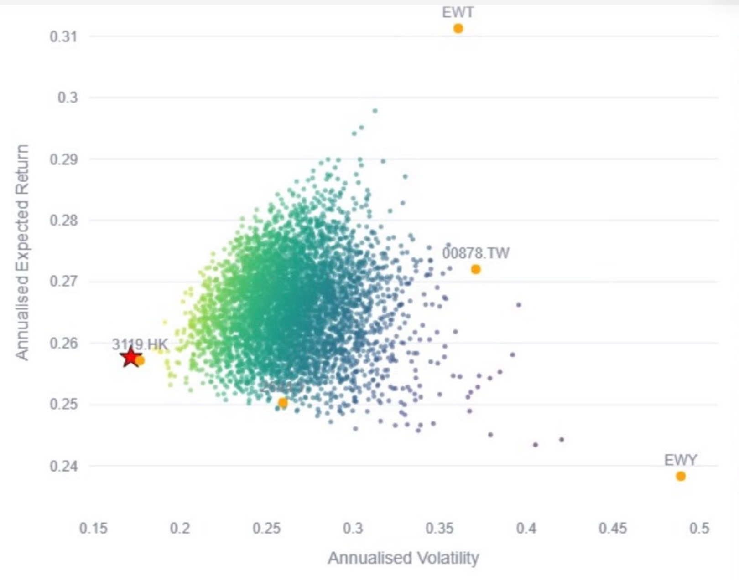
Strategy: five Asian AI-hardware ETFs, combined to cut risk
USD 100mn across five Bloomberg-listed ETFs; mixing them gives most of the return with less volatility than the riskiest funds
Allocation
Risk vs return: single ETFs and random mixes
How to read it
Orange dots: each ETF on its own (2644 is the dot near 0.26, 0.25).
Small dots: thousands of random weightings of the five ETFs; lighter = more return per unit of risk.
Axes: annualised volatility (risk) and expected return.
Half in the semiconductor core
3119 HK + 2644 JP = 50%; Korea adds memory, Taiwan the foundry, 00878 the ESG income.
USD
100mn
Takeaways
Mixing cuts risk: most mixes sit at 22–32% volatility, far below EWY (~49%), while still returning 25–28%.
3119 HK has the best risk/return on its own, so it gets the largest weight (35%).
EWY is the riskiest for its return, so it is held for memory exposure at 20%, not more.
EWT has the highest return (~31%) and 2644 one of the lowest volatilities (~26%): 15% each rounds out the chain.
■ | 3119 HK | Pan-Asian chip leaders | 35%
■ | EWY US | Korea: memory for AI | 20%
■ | EWT US | Taiwan: the AI foundry | 15%
■ | 2644 JP | Japan: chip-making tools | 15%
■ | 00878 TT | ESG dividend anchor | 15%
One theme, five bottlenecks: weighted towards the best risk/return (3119 HK), diversified to keep volatility down
Risk/return chart: team analysis app (annualised from historical data; red star as marked in the app). Liquidity: 3119 HK is borderline against the USD 5M/day rule, verify on Bloomberg.
ANALYSIS
STRATEGY
APPENDIX

Slide 2
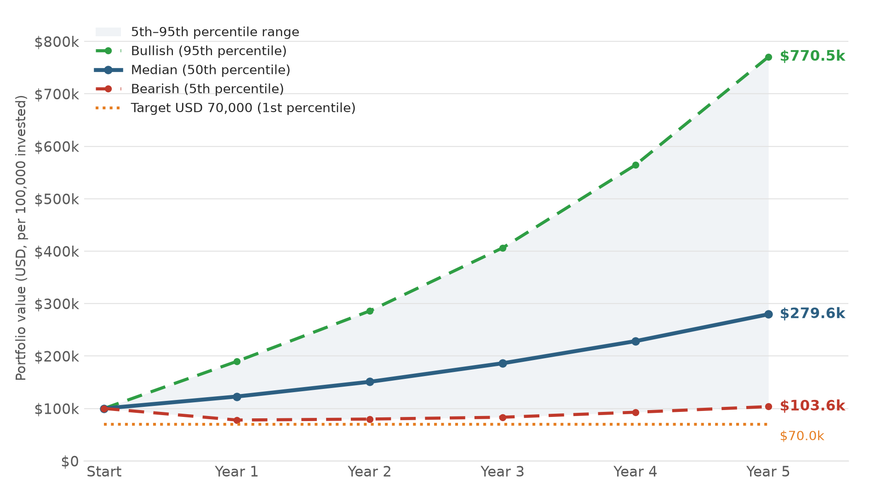
Monte Carlo: the median portfolio grows 2.8× in five years
5-year simulation of the five-ETF portfolio, per USD 100,000 invested (×1,000 for the USD 100mn mandate)
$279.6k
Median at Year 5: 2.8× the start, +22.8% a year
$103.6k
Bearish (5th percentile): still above the start, +0.7% a year
$770.5k
Bullish (95th percentile): 7.7× the start
99.0%
Chance of ending at or above the USD 70,000 target
Even the bearish path ends above the start ($103.6k); the USD 70,000 target is the 1st percentile
Source: team Monte Carlo app (annual checkpoints of the simulated paths). Lines connect the yearly values. Results depend on the app's return and volatility inputs; refresh with Bloomberg data at the 17 Sep 2026 trade date.
ANALYSIS
STRATEGY
APPENDIX

Slide 3
Annual checkpoints: the downside stays above the USD 70,000 target
Simulated portfolio value at each year-end, per USD 100,000 invested
Timeline | Median value (USD) | Bearish 5th percentile (USD) | Bullish 95th percentile (USD) | Probability ≥ target (USD 70,000)
Start | $100,000.00 | $100,000.00 | $100,000.00 | –
Year 1 | $122,798.06 | $77,939.19 | $189,886.46 | 97.72%
Year 2 | $150,858.02 | $79,780.84 | $286,013.81 | 97.46%
Year 3 | $186,215.83 | $83,307.87 | $406,264.32 | 97.76%
Year 4 | $228,430.07 | $92,823.04 | $564,512.06 | 98.28%
Year 5 | $279,609.52 | $103,554.03 | $770,498.81 | 99.00%
Year 1 is the stress point
The 5th percentile falls to $77.9k (−22%) before recovering every year after.
The target holds
At least 97.5% of paths stay at or above USD 70,000 in every year, rising to 99.0% at Year 5.
Upside compounds
Median $279.6k at Year 5 (+22.8% a year); for the mandate, about USD 280mn.
A growth portfolio whose bad years stay above the USD 70,000 line in 97–99% of simulated paths
Source: team Monte Carlo app, Annual Portfolio Checkpoint Table. Probabilities are shares of simulated paths; they are model outputs, not guarantees.
ANALYSIS
STRATEGY
APPENDIX

