Slide 1
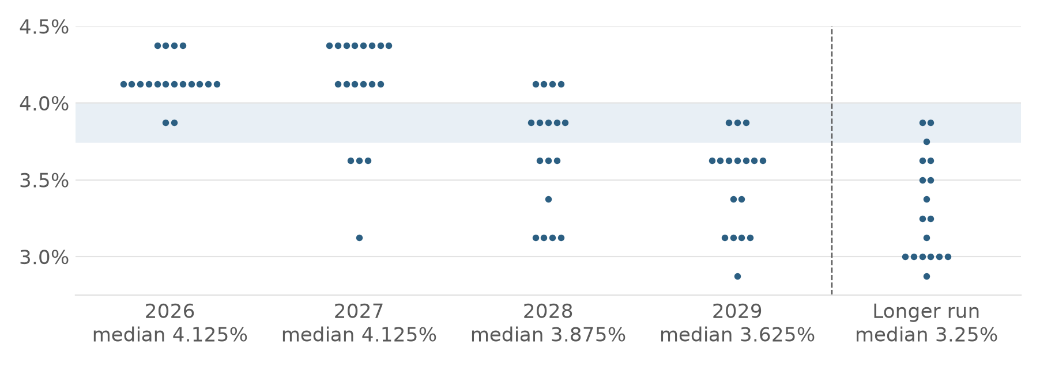
Investment thesis: Monopolizing the AI Supply Chain via Structured Overlays
What we own and why we wrap it: structural demand for Asian chips, memory and tools, held through a market of high rates, record volatility and concentrated, full prices
1 Asia controls AI's hardware bottlenecks
2 2026 punishes bonds and buy-and-hold
Demand is structural
Hyperscaler capex ~US$725bn in 2026 (+77%); the chip market nearly doubles to ~US$1.5trn.
The moat runs through Asia
8 of the world's 10 largest companies depend on TSMC (J.P. Morgan).
…but the cycle is maturing
DRAM price gains slowing: +48% in Q2, ~+13% expected in Q4 2026.
Rates stay high
Fed median 4.125% to end-2027, cuts only from 2028; 12 dots see 4.375%.
FOMC dot plot, 16 Sep 2026 (shaded: today's 3.75–4.00%)
−4.0%
Long bonds carry rate risk: a 5-year bond loses ~4.0% per 1% rise.
→ Redeems from year 1; USD 75.8 today buys USD 100 in 5 years, so a 70% floor fits
~70%
Taiwan makes the chips: TSMC share of global foundry revenue; TSMC >40% of TAIEX
91.2
Volatility is at records: VKOSPI's all-time high; KOSPI fell ~25% from June to August 2026.
→ Coupons pay on recovery, no timing needed; rich option premium funds them
83%
Korea makes the memory: SK hynix + Samsung share of HBM, the memory every AI accelerator needs
~92%
Concentrated and fully priced: of advanced chips come from Taiwan; Nikkei CAPE 38.6×.
→ Diversified five-ETF basket; capping upside at the coupon costs little
~55%
Japan makes the tools: Advantest share of chip test equipment; with Tokyo Electron ≈ 20% of the Nikkei
Whichever AI company wins, it needs Asia's chips, memory and tools. In 2026's market, the way to own them is an autocall with a 30% buffer and a 70% floor.
Sources: WSTS; company capex guidance; Counterpoint (foundry, HBM); TrendForce (DRAM); industry research (test equipment); J.P. Morgan AWM 2026 Outlook; Federal Reserve SEP (16 Sep 2026, dots read from chart); Herald / SBS (VKOSPI); FN News, BIT Research (KOSPI); Siblis (CAPE); case USD funding grid. Full list: deck/thesis_sources.md.
ANALYSIS
STRATEGY
APPENDIX
Notes:
One-page thesis. Left: what we own. AI spending is a hardware boom and Asia holds the three bottlenecks: Taiwan's foundries, Korea's high-bandwidth memory, Japan's chip-making tools. Demand is structural, though the memory cycle is maturing. Right: why we hold it through an autocall now. The Fed's dot plot keeps rates high until 2028, so long bonds carry rate risk and a capital floor is cheap; volatility is at records, so buy-and-hold must sit through violent swings while autocall coupons pay on recovery and are funded by option premium; the theme is concentrated and fully priced, so a diversified basket and a capped upside cost little.

