Slide 1
Built to Spill: An Empirical Examination of Executive Functioning and Work-Family Spillover
Benjamin S. Listyg, M.S.
Dissertation Defense
(Under the Direction of Malissa Clark, Ph.D.)

Slide 2
Overview
Background and Theoretical Framework
Research Aims, Hypotheses, and Research Questions
Method
Results
  Main effects, gender moderation, and social support moderation
  Cross-wave replicability and multiverse analyses
Discussion
  Theoretical and practical implications
  Limitations and future directions

Slide 3
Work and Life in the Modern Workplace
Boundaries between work and personal life increasingly blurred
Work-family spillover predicts employee well-being, job satisfaction, marital quality, and job performance
Managing competing demands requires significant cognitive resources
~7% of working adults have some form of (self-reported) cognitive disability:
  “Because of a physical, mental, or emotional condition, do you have serious difficulty concentrating, remembering, or making decisions?” (Shockey et al., 2023)

Slide 4
Work-Family Spillover
Bi-directional transmission of experiences between work and family domains (Grzywacz & Marks, 2000)
Two types:
  Negative Spillover: Strain and stress impair functioning and role duties in the other domain
  Positive Spillover: Resources and skills enhance functioning in the other domain
Requires significant cognitive effort to manage boundaries

Slide 5
Executive Functioning
Higher-order cognitive processes that facilitate managing competing demands (Diamond, 2013)
Three core components (Friedman & Miyake, 2017):
  Working Memory
  Cognitive Flexibility
  Inhibitory Control
Critical for self-regulation and goal attainment
Exists on a continuum — varies between individuals
Executive dysfunction: common across neurodevelopmental (ADHD, ASD) and mental health (MDD, OCD) conditions

Slide 6
Related Empirical Literature
Executive Dysfunction and Within-Domain Outcomes
Labor Market Outcomes:
  Fletcher (2014): ADHD — lower wages, frequent job changes
  Küpper et al. (2012): Higher job instability and unemployment
  Barkley et al. (2010): Underemployment and career limitations
Family and Relationship Outcomes:
  Murphy & Barkley (1996): Higher marital dissatisfaction and divorce rates
  Eakin et al. (2004): Struggles with household management
  Johnston & Mash (2001): Increased family conflict

Slide 7
An Interdisciplinary Perspective
Despite prevalence of executive dysfunction (~7% of workforce)
Minimal integration between:
  Work-family literature
  Executive function research
No prior direct empirical test of the EF–spillover relationship
Limited understanding of how cognitive differences impact boundary management

Slide 8
Research Aims
Examine how executive functioning influences negative and positive work-family spillover
Explore moderating factors (gender, social support)
Broaden theoretical scope by integrating:
  Cognitive psychology
  Organizational psychology
  Sociology

Slide 9
Main Effects Hypotheses (H1–H4)
Executive functioning enables better management of work-family boundaries
Hypotheses:
  H1: EF negatively related to negative work-to-family spillover
  H2: EF negatively related to negative family-to-work spillover
  H3: EF positively related to positive work-to-family spillover
  H4: EF positively related to positive family-to-work spillover

Slide 10
Gender as a Moderator
Women face disproportionate cognitive load from household management
“Second shift” and invisible labor (Daminger, 2019; Hochschild & Machung, 2012)
Hypotheses:
  H5: Gender moderates EF → negative family-to-work spillover (stronger for women)
  H6: Gender moderates EF → negative work-to-family spillover (stronger for women)
Research Questions:
  RQ1–RQ2: Does gender moderate EF → positive spillover?

Slide 11
Social Support as a Moderator
Support hypothesized to buffer effects of low EF on negative spillover
Three types of support examined:
  Supervisor Support (H7a–H7b; RQ3–RQ4)
  Coworker Support (H8a–H8b; RQ5–RQ6)
  Spousal Support (H9a–H9b; RQ7–RQ8)
Moderation of positive spillover explored as research questions

Slide 12
Method

Slide 13
Sample
Data from MIDUS Study (Waves 2 & 3)
  Wave 2: n = 4,963 (2004–2006)
  Wave 3: n = 3,294 (2012–2014)
Inclusion criteria: currently employed with complete data on all study variables
Final analytic samples:
  MIDUS 2: N = 1,289
  MIDUS 3: N = 729
Both waves analyzed separately to assess replicability

Slide 14
Measures
Executive Functioning: BTACT composite EF score (Lachman et al., 2014)
  Backward Digit Span, Category Fluency, Number Series, 30-SACT, Stop & Go Switch Task
  Mean of z-scores (Tun & Lachman, 2012 scoring)
Spillover: Grzywacz & Marks (2000) scale — 4 subscales (positive/negative × W→F/F→W)
Support: Supervisor, Coworker (Whitehall items), Spousal (Social Support and Strain Scale)
Controls: Job demands, family demands, household income, household size, age, gender, education

Slide 15
Analytic Strategy
Multiple linear regression (change from proposed GEE)
  MIDUS primary sampling unit is the individual (RDD), so observations are independent — household clustering unnecessary
  Change documented in preregistration amendment prior to analysis
Models per wave: 4 main effect + 16 moderation (4 outcomes × 4 moderators)
Continuous predictors mean-centered; α = .05, two-tailed
Significant interactions probed via simple slopes
Replicability assessed with Open Science Collaboration (2015) criteria

Slide 16
Supplemental Analyses
Sensitivity power analysis:
  Minimum detectable effects: β ≈ .10 (MIDUS 2), β ≈ .12 (MIDUS 3)
Multiverse analysis — four arms:
  (a) Alternative covariate specifications
  (b) Covariates as moderators
  (c) Dual-earner couple subsample
  (d) Model-set-specific complete-case samples
CFA + measurement invariance of spillover scales across gender

Slide 17
Results

Slide 18
Descriptive Results
EF weakly correlated with spillover at zero-order level
  MIDUS 2: r = .06–.08 with negative spillover and positive W→F spillover
  MIDUS 3: only negative W→F spillover significant (r = .09)
Spillover measurement model:
  Four-factor structure retained; metric, scalar, and strict invariance across gender supported in both waves (ΔCFI ≤ .01)

Slide 19
Main Effects (H1–H4): Not Supported
No significant EF main effect on any spillover outcome in either wave
  MIDUS 2: β ranged from −.05 to .03 (all p > .07)
  MIDUS 3: β ranged from −.05 to .04 (all p > .16)
All observed effects below minimum detectable effect sizes (β ≈ .10–.12)
  Any true main effect is likely trivially small
Job demands and family demands dominated prediction of negative spillover

Slide 20
Gender Moderation (H5–H6, RQ1–RQ2)
H6: not supported in either wave
H5: partial support
  MIDUS 3: significant EF × Gender interaction for negative F→W spillover (B = −0.14, β = −.09, p = .019)
  Simple slopes: EF negatively related to spillover for women, not men (Figure 1)
  Did NOT replicate in MIDUS 2 (nonsignificant, opposite sign)
RQ1–RQ2: no gender moderation of positive spillover in either wave

Slide 21
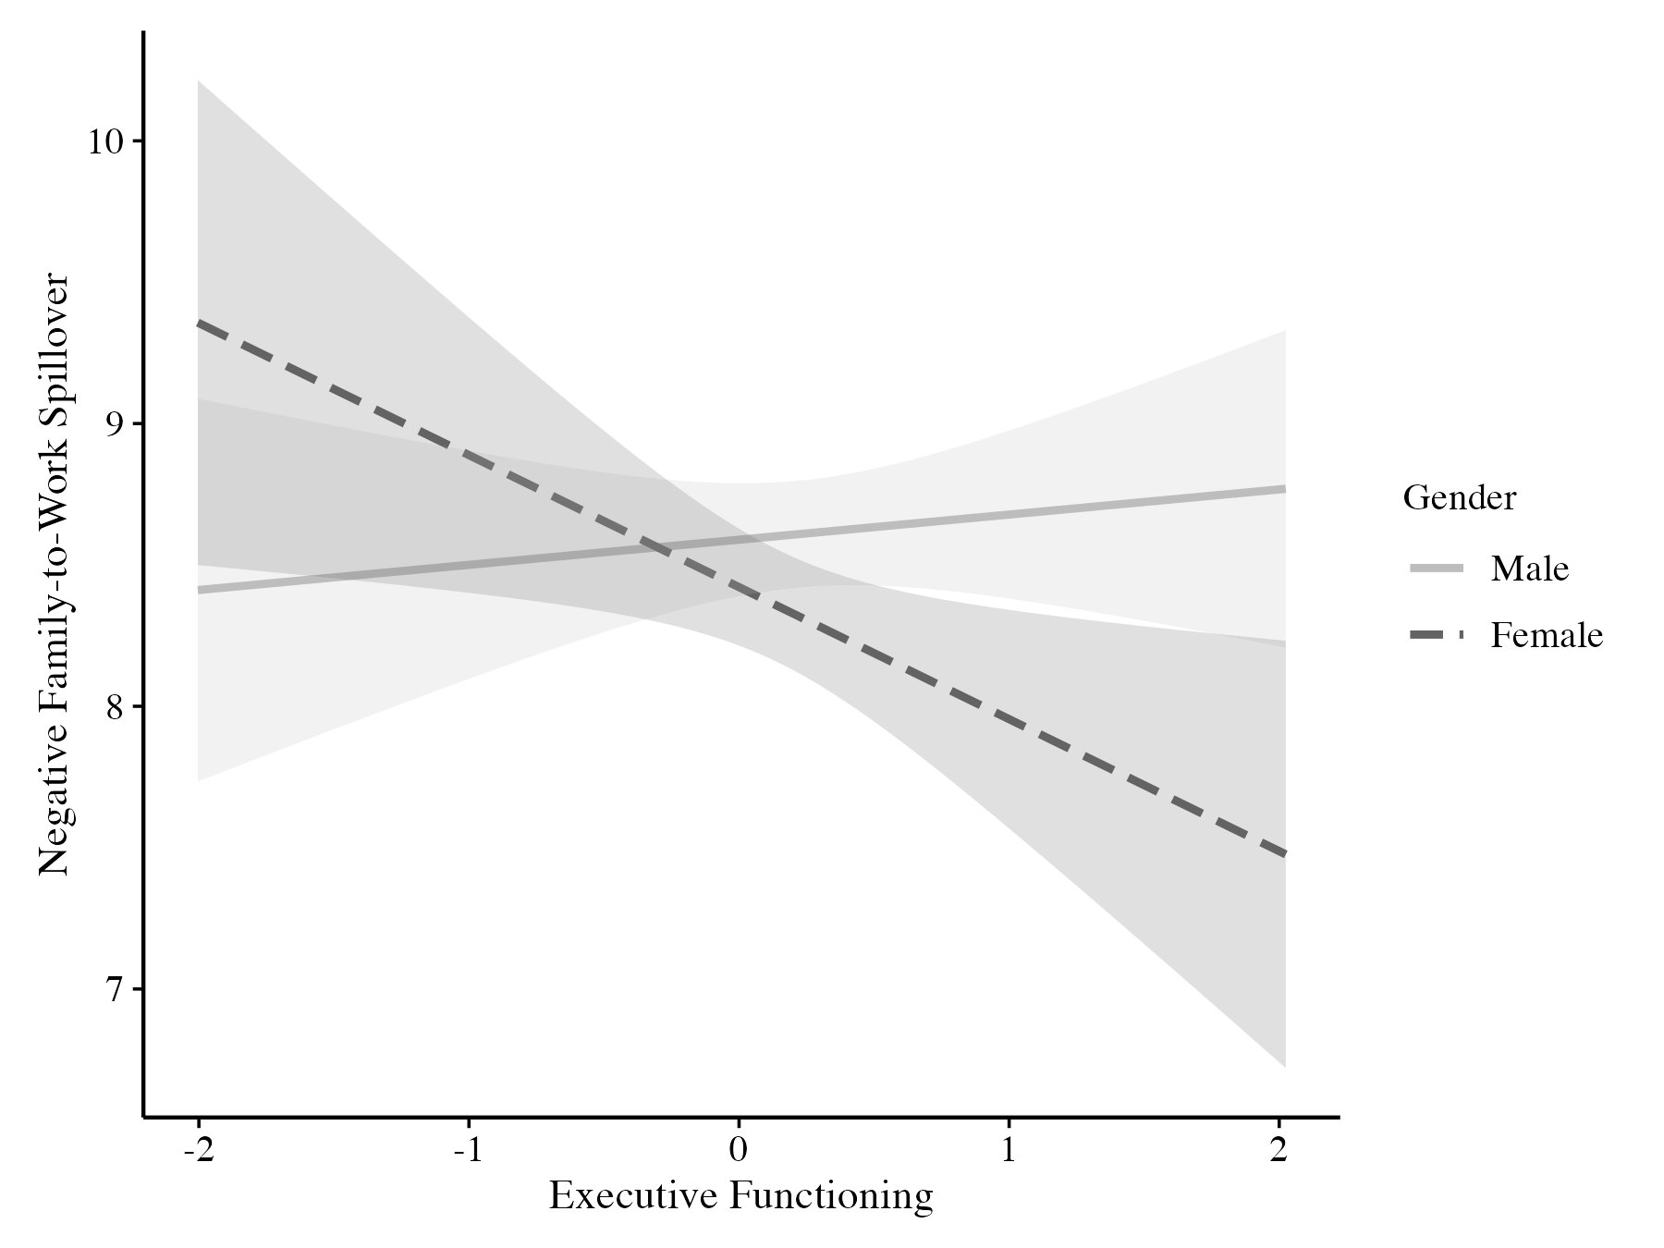
Figure 1. Simple Slopes of EF Predicting Negative Family-to-Work Spillover by Gender (MIDUS 3)

Slide 22
Supervisor Support (H7a–H7b, RQ3–RQ4)
H7a, H7b: not supported in either wave
RQ4: partial support
  MIDUS 3: significant EF × Supervisor Support interaction for positive W→F spillover (B = 0.12, β = .10, p = .007; Figure 2)
  Higher EF associated with lower positive spillover primarily when supervisor support was low
  Did NOT replicate in MIDUS 2
RQ3: no moderation for positive F→W spillover

Slide 23
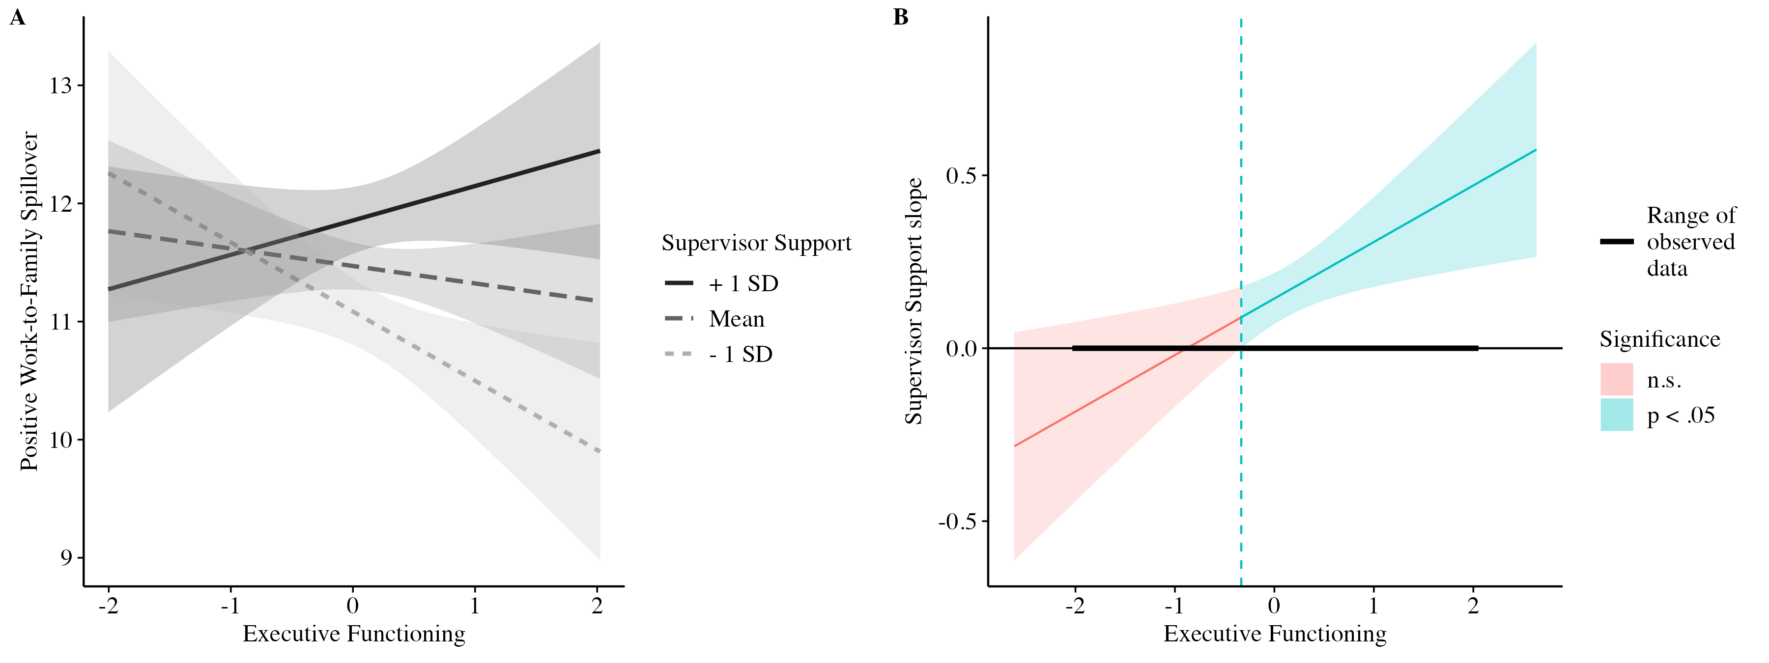
Figure 2. EF × Supervisor Support Predicting Positive Work-to-Family Spillover (MIDUS 3)

Slide 24
Coworker & Spousal Support (H8–H9, RQ5–RQ8)
H8a: partial support
  MIDUS 2: significant EF × Coworker Support interaction for negative W→F spillover (B = 0.06, β = .06, p = .013; Figure 3)
  Did NOT replicate in MIDUS 3 (opposite sign)
H8b, RQ5–RQ6: no other coworker moderation effects
H9a–H9b, RQ7–RQ8: no spousal support moderation in either wave
  But spousal support showed strong positive main effect on positive F→W spillover in both waves

Slide 25
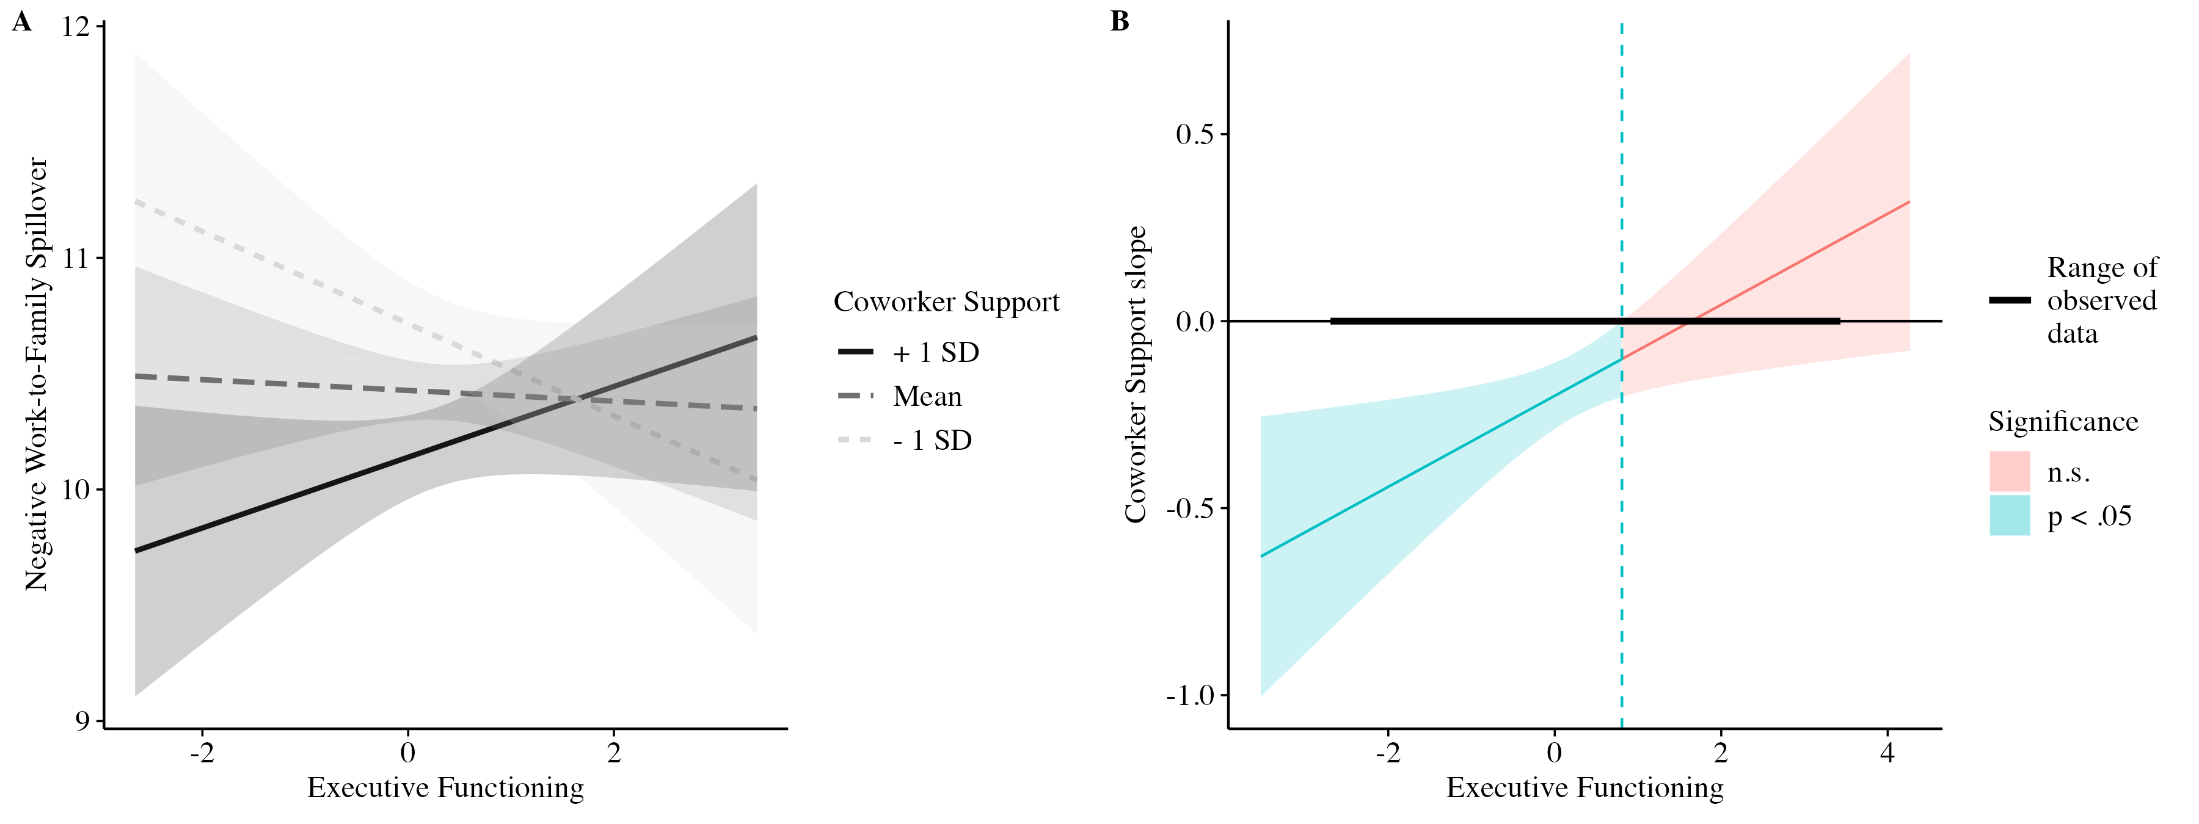
Figure 3. EF × Coworker Support Predicting Negative Work-to-Family Spillover (MIDUS 2)

Slide 26
Replicability & Multiverse
Cross-wave replicability (OSC, 2015 criteria): poor
  Only EF-related term significant in MIDUS 2 (EF × Coworker Support) did not replicate in MIDUS 3
  Significant interactions were each isolated to a single wave and outcome
Multiverse analyses across four arms confirmed the pattern:
  EF coefficient overwhelmingly nonsignificant across alternative specifications
  Substantive conclusions unchanged by analytic choices

Slide 27
Summary of Findings
EF (BTACT composite) showed no robust main or interactive effects on work-family spillover
Of 12 directional hypotheses: 3 partial supports (H5, H8a, RQ4 component), each in a single wave only
Most consistent predictors of spillover:
  Job demands (β = .39–.54 for negative W→F spillover)
  Family demands (β = .35–.43 for negative F→W spillover)
  Social support: consistent main effects in expected directions

Slide 28
Discussion

Slide 29
Theoretical Implications
EF may not operate directly on moment-to-moment spillover management
Situation strength perspective (Meyer et al., 2010; Mischel, 1977):
  Strong situational demands (job/family) constrain influence of individual cognitive differences
Gender: predictors of spillover may be more similar across genders than different (Shockley et al., 2017)
Support operates as a direct resource, not a buffer of EF (French et al., 2018)

Slide 30
Practical Implications
Target workload management, not cognition:
  Realistic workload expectations, adequate staffing, autonomy over task scheduling
Accommodate family responsibilities: flexible scheduling, dependent care support, family leave
Invest in social support: supervisor training, supportive climate
For employees with EF difficulties: environmental/structural supports (flexible arrangements, assistive technologies, mentorship) over cognitive intervention (LeFevre-Levy et al., 2023)

Slide 31
Limitations & Future Directions
BTACT: brief, low-fidelity tasks disconnected from real-world EF demands
Cross-sectional, between-person design; spillover and EF are episodic/within-person
  Future: daily diary and experience-sampling designs
Restriction of range: clinically meaningful executive dysfunction likely underrepresented
Listwise deletion reduced samples — but observed effects below detectable thresholds, so power alone unlikely to explain nulls
Self-report spillover; shared method variance
Future: EF facets, demands as moderators, qualitative/critical incident designs

Slide 32
Conclusion
First direct empirical test of the EF–spillover relationship
Across 2 samples, 40 primary models, and comprehensive multiverse analyses:
  BTACT EF composite does not meaningfully predict spillover
  Isolated moderation effects did not replicate
Spillover is driven by situational demands and social resources
Well-documented null findings guide theory and future measurement

Slide 33
Thank you!
Questions?

Slide 34
APPENDIX SLIDES

Slide 35
Appendix: Sensitivity Power Analysis
Sample size fixed by MIDUS; sensitivity analysis determined minimum detectable effects
  MIDUS 2 (N = 1,289): β ≈ .10
  MIDUS 3 (N = 729): β ≈ .12
Observed EF main effects all |β| ≤ .05

Slide 36
Appendix: CFA & Measurement Invariance
Four-factor spillover model:
  MIDUS 2: CFI = .84, TLI = .80, RMSEA = .09, SRMR = .09
  MIDUS 3: CFI = .86, TLI = .83, RMSEA = .09
  Marginal fit; retained on theoretical grounds and established MIDUS use
Loadings .31–.91, majority > .50
Invariance across gender (both waves): metric, scalar, strict all supported (ΔCFI ≤ .01; Chen, 2007)

Slide 37
Appendix: Multiverse Design
Guards against “garden of forking paths” (Gelman & Loken, 2014)
Arm A: alternative covariate sets (none, demographics only, education-as-SES)
Arm B: covariates as moderators (age, education, income, job demands, family demands × EF)
Arm C: dual-earner couple subsample (20 models per wave re-run)
Arm D: model-set-specific complete-case samples
Summarized by proportion significant, sign consistency, and conclusion stability

Slide 38
Appendix: Measures Detail
BTACT EF tests:
  Backward Digit Span (working memory; Wechsler, 1997)
  Category Fluency (verbal fluency)
  Number Series (inductive reasoning)
  30-SACT (processing speed)
  Stop & Go Switch Task (task switching)
Sample spillover items:
  “Stress at work makes you irritable at home” (negative W→F)
  “Job worries or problems distract you when you are at home”

Slide 39
Selected Key References
Diamond, A. (2013). Executive functions. Annual Review of Psychology
Friedman, N. P., & Miyake, A. (2017). Unity and diversity of executive functions
Grzywacz, J. G., & Marks, N. F. (2000). Work-family spillover measures
Lachman, M. E., et al. (2014). BTACT validation
Open Science Collaboration (2015). Estimating the reproducibility of psychological science
Steegen, S., et al. (2016). Increasing transparency through a multiverse analysis
Additional references available upon request

