Slide 1
Built to Spill: An Empirical Examination of Executive Functioning and Work-Family Spillover
Benjamin S. Listyg, M.S.
Dissertation Proposal Presentation
(Under the Direction of Malissa Clark, Ph.D.)
Notes:
Hi everyone, thank you so much for being here today and for taking the time to serve on my committee. Today I'll be proposing my dissertation titled 'Built to Spill: An Empirical Examination of Executive Functioning and Work-Family Spillover’ under the direction of Dr. Malissa Clark.

Slide 2
Overview
Background and Theoretical Framework
Work-Family Spillover and Executive Functioning
Research Aims and Contributions
Hypotheses and Research Questions
Method
Proposed Analyses
Notes:
Today’s talk will be structured as follows:
I’ll begin by covering relevant background literature and, in the process of discussing prior literature, introduce the constructs of executive functioning and work-family spillover as well as prior
"I'll present my hypotheses and research questions, which examine both main effects and moderating relationships.”
"Finally, I'll walk through the method and proposed analyses using data from the MIDUS study, before opening the floor for your questions and feedback."

Slide 3
Work and Life in the Modern Workplace
Boundaries between work and personal life increasingly blurred
Work-family spillover affects both employee well-being and organizational outcomes
Managing competing demands requires significant cognitive resources
~7% of working adults have some form of (self-reported) cognitive disability:
  “Because of a physical, mental, or emotional condition, do you have serious difficulty concentrating, remembering, or making decisions?” (cognitive)” (Shockey et al., 2023)
Notes:
"Boundaries between one’s work and personal life have become increasingly blurred, particularly as organizations shift to remote and hybrid work schedules and technology enables 24/7 connectivity. One forcing function for a lot of the recent shifts we’ve seen is the COVID-19 pandemic has only accelerated these trends as organizations had to adapt to changes in the way work gets accomplished"
"When work and family demands intersect, individual, familial, and organizational outcomes are affected, with meta-analytic evidence linking these intersections to job satisfaction, mental health, marital quality, and job performance."
"Managing these competing demands requires a significant number of cognitive resources, as individuals must constantly switch between roles, prioritize and delegate tasks, plan and organize across domains, and regulate their emotions when transitioning between work and non-work roles."
”However, for a substantial portion of the U.S. workforce, these very cognitive capabilities are impaired.”
"Approximately 7% of working adults have some form of self-reported cognitive disability, based on a recent CDC survey asking whether individuals have 'serious difficulty concentrating, remembering, or making decisions.’
Despite this substantial portion of the workforce having cognitive impairments and the clear cognitive demands of work-family management, we know remarkably little about how these cognitive differences affect one’s ability to navigate work-family boundaries.

Slide 4
Work-Family Spillover
Bi-directional transmission of experiences between work and family domains
Two types:
  Negative Spillover: Strain and stress impair functioning and role duties in the other domain
  Positive Spillover: Resources and skills enhance functioning in the other domain
Requires significant cognitive effort to manage boundaries
Notes:
"Work-family spillover involves the bi-directional transmission of experiences between work and family domains - what happens in one area of life doesn't stay there."
"There are two types of spillover. Negative spillover occurs when strain and stress impair functioning in the other domain - like when work stress makes you irritable at home, or family worries distract you at work."
"Positive spillover happens when resources and skills enhance functioning in the other domain - such as when leadership skills from work help you manage family activities, or when family support energizes you for the next workday."
"Managing these boundaries requires significant cognitive effort, as theories like the Selection, Optimization, and Compensation model suggest. Individuals must select priorities, optimize resource allocation, and compensate for constraints - all cognitively demanding tasks."

Slide 5
Executive Functioning
[Flesh this slide out with models, pictures, and references]
Definition: Higher-order cognitive processes that facilitate managing competing demands
Three core components:
  Working Memory
  Cognitive Flexibility
  Inhibitory Control
Critical for self-regulation and goal attainment
Exists on a continuum - varies between individuals
Challenges with specific executive functioning show up across of ton different disorders and [], we see different patterns of difficulty with executive functions in learning disabilities, neurodevelopmental disorders, and we also see it in common things like psychological disorders (anxiety depression), prior literature has looked at very specific ways executive dysfunction may manifest (like in ADHD), but nothing has looked at functioning as a whole.
Notes:
"The cognitive difficulties mentioned in the CDC survey - problems with concentration, memory, and decision-making - are key components of the executive functioning construct.”
"Executive functioning refers to higher-order cognitive processes that facilitate managing competing demands, and when you look at the early literature in this area such as Baddeley et al. (1996), authors often evoked the image of an executive in an office setting shifting responsibilities to different cognitive functions
"The three core components include working memory, which is like your mental workspace where you hold and manipulate information - for example, keeping track of your child's school schedule while planning your work meetings." "Cognitive flexibility allows you to shift between different tasks or perspectives - like switching from analytical thinking at work to emotional support at home."
"Inhibitory control helps you resist distractions and override automatic responses - such as not checking work emails during family dinner or not ruminating about family issues during an important presentation." "Executive functioning is critical for self-regulation and goal attainment across life domains, helping us pursue multiple goals without excessive interference." EDIT FROM DIAMOND 2013
"It exists on a continuum and varies between individuals - some people naturally have stronger executive functions, while others struggle more, and this can be affected by various conditions like ADHD, depression, or simply stress and fatigue. When individuals have lower levels of executive functioning, they may struggle to effectively manage their responsibilities within work or within family domains. This inability to manage responsibilities within each domain can establish the conditions for spillover to occur - where experiences, emotions, and stress from one domain transfer to and affect the other.”
In the next slide, I will describe this spillover in more detail.

Slide 6
W-F Models
Action Regulation Theory
SOC Model
???
Cognitive functioning underlies all of these, but

Slide 7
Related Empirical Literature
Executive Dysfunction and Within-Domain Outcomes
Labor Market Outcomes:
  Fletcher (2014): ADHD → lower wages, frequent job changes
  Küpper et al. (2012): Higher job instability and unemployment
  Barkley et al. (2010): Underemployment and career limitations
Family and Relationship Outcomes:
  Murphy & Barkley (1996): Higher marital dissatisfaction and divorce rates
  Eakin et al. (2004): Struggles with household management
  Johnston & Mash (2001): Increased family conflict
  Dawson et al. (2015): Partner-reported lower quality of life
Notes:
In terms of existing empirical literature examining these two constructs, we have related or adjacent work, but nothing directly examining them together. In particular, prior research has examined how executive dysfunction, most often in the form of ADHD, affects work and family - but only within either the work OR family domain
For work outcomes, research in labor economics from Fletcher and Kudder and colleagues, respectively, has shown that ADHD is associated with lower wages, job instability, and unemployment. Corroborated by qualitative evidence from Barkley et al. that show how the executive dysfunction accompanying ADHD limits peoples abilities to progress in their career.
In the family domain, Murphy and Barkley found higher divorce rates. Eakin documented household management struggles, and Dawson et al show an interesting pattern of spillover effects, such that partners of individuals with ADHD report lower quality of life.
Taken together, we have extensive evidence that executive dysfunction impairs functioning at work AND at home - but these outcomes are always studied separately with no one examining how executive dysfunction relates to spillover between domains.
These within-domain studies suggest spillover should occur, but to my knowledge this has never been explicitly tested."

Slide 8
An Interdisciplinary Perspective
Despite prevalence of executive dysfunction (~7% of workforce)
Minimal integration between:
  Work-family literature
  Executive function research
Limited understanding of how cognitive differences impact boundary management
Need for interdisciplinary approach
Notes:
This all leads us to the current work I’m proposing. Reinforcing the points I made earlier, despite the prevalence of executive dysfunction affecting 7% of the workforce, there has been minimal integration between work-family literature and executive function research. These fields have largely developed in silos."
"We have limited understanding of how cognitive differences impact work-family outcomes. Most work-family research assumes all individuals have equal cognitive capacity to manage these boundaries which we know to not be the case"
"This represents a need for an interdisciplinary approach that bridges organizational psychology with cognitive psychology and neuroscience to better understand these phenomena."

Slide 9
Research Aims
Examine how executive functioning influences work-family spillover
Explore moderating factors (gender, social support)
Broaden theoretical scope by integrating:
  Cognitive psychology
  Organizational psychology
  Sociology
Notes:
"My first aim is to examine how executive functioning influences work-family spillover, testing whether individuals with higher executive functioning experience less negative spillover and more positive spillover."
"The second aim explores moderating factors including gender and social support, recognizing that the relationship between executive functioning and spillover may vary based on social context."
"The third aim is to broaden the theoretical scope by integrating cognitive psychology perspectives on executive functioning, organizational psychology theories of work-family dynamics, and sociological insights on gender roles and social support."

Slide 10
Theoretical and Practical Contributions
Expands boundary theory by incorporating executive functioning
Addresses experiences of neurodiverse employees
Integrates cognitive and social factors in work-family dynamics
Provides evidence-based guidance for organizational and familial support
Notes:
"This work expands boundary theory by incorporating executive functioning as a critical individual difference variable, moving beyond purely situational or motivational explanations."
"It addresses experiences of neurodiverse employees who have been largely overlooked in organizational research, despite representing a significant portion of the workforce."
"By integrating cognitive and social factors in work-family dynamics, we can better understand how individual differences and environmental supports interact."
"This research provides evidence-based guidance for organizational support, helping HR professionals and managers design accommodations and support systems that actually address the cognitive challenges employees face."

Slide 11
Main Effects Hypotheses (H1-H4)
[Include Plots]
Executive functioning enables better management of work-family boundaries
Higher EF facilitates resource allocation and role transitions
Cognitive flexibility helps prevent strain from crossing domains
Hypotheses:
  H1: Executive functioning will be negatively related to negative work-to-family spillover
  H2: Executive functioning will be negatively related to negative family-to-work spillover
  H3: Executive functioning will be positively related to positive work-to-family spillover
  H4: Executive functioning will be positively related to positive family-to-work spillover
Notes:
"Executive functioning enables better management of work-family boundaries by providing the cognitive resources needed to maintain separation or integration strategies."
"Higher executive functioning facilitates resource allocation and role transitions, allowing individuals to more effectively switch between work and family roles without carrying over stress or distraction.”
"Based on this reasoning, H1 predicts that executive functioning will be negatively related to negative work-to-family spillover such that those with higher EF will experience less negative work-to-family spillover and H2 predicts that higher EF will experience less negative family to work spillover "
"H3 predicts executive functioning will be positively related to positive work-to-family spillover - those with higher EF can better identify and transfer beneficial resources from work to home."
"H4 predicts executive functioning will be positively related to positive family-to-work spillover - stronger cognitive abilities help individuals leverage family experiences to enhance work performance."

Slide 12
Moderating Effects
Bullet point from Malissa’s previous work explaining why Gender and SS are important moderating variables to look at
Cite previous meta-analyses
Definitions of support variables:
  Spousal
  Co-worker
  Supervisor

Slide 13
Gender as a Moderator
[Include Plots]
Women face disproportionate cognitive load from household management
"Second shift" and invisible labor
Hypotheses:
  H5: Gender moderates the relationship between EF and negative family-to-work spillover
  H6: Gender moderates the relationship between EF and negative work-to-family spillover
Research Questions:
  RQ1-2: How does gender moderate positive spillover?
Notes:
Moving on to boundary conditions of this relationship, I aim to examine the extent to which this relationship varies by gender within household. Evidence from sociological literature namely Daminger 2019, Dean et al. 2022, and Wayne et al. 2023 suggest that
"Women face disproportionate cognitive load from household management, what researchers sometimes call the 'mental load' - the invisible work of planning, organizing, and remembering family needs."
"The 'second shift' and invisible labor create additional cognitive demands beyond physical household tasks, taxing executive functions more heavily for women."
If this additional cognitive burden proves taxing even for women with strong executive functioning capabilities, it is reasonable to hypothesize that women with executive dysfunction may experience disproportionately negative effects on their household and family outcomes.
"H5 predicts that gender moderates the relationship between EF and negative family-to-work spillover, with the negative relationship being stronger for women who face these additional cognitive demands."
"H6 predicts gender moderates the relationship between EF and negative work-to-family spillover, again with stronger effects for women given their greater household management responsibilities."
"RQ1 and RQ2 explore how gender moderates positive spillover, as the theoretical predictions are less clear - women's greater involvement might create more opportunities for positive transfer, or the cognitive load might inhibit it."

Slide 14
Social Support as a Moderator
[Include Plots]
Three types of support examined:
  Supervisor Support (H7-H8, RQ3-RQ4)
  Coworker Support (H9-H10, RQ5-RQ6)
  Spousal Support (H11-H12, RQ7-RQ8)
Each hypothesized to buffer negative effects of low EF on spillover
Notes:
"Support provides additional resources to compensate for EF deficits, acting as external scaffolding for those who struggle with cognitive control."
"Different support sources offer unique benefits - supervisors can adjust work demands, coworkers can help with task organization, and spouses can create structure at home."
"Support can help create structure and reduce cognitive demands by providing reminders, breaking down complex tasks, and offering emotional regulation assistance."
"We examine three types of support. Supervisor support (H7-H8, RQ3-RQ4) may include flexible deadlines, clear instructions, and understanding of cognitive challenges.”
"Coworker support (H9-H10, RQ5-RQ6) might involve helping with prioritization, providing task reminders, or covering during difficult periods."
"Spousal support (H11-H12, RQ7-RQ8) could include managing household schedules, providing emotional stability, and creating predictable routines."
"Each type of support is hypothesized to buffer negative effects of low EF on spillover, with research questions exploring effects on positive spillover."

Slide 15
Method

Slide 16
Sample
Data from MIDUS Study (Waves 2 & 3)
  Wave 2: n = 4,963 (2004-2006)
  Wave 3: n = 3,294 (2012-2014)
Inclusion criteria:
  Dual-earner couples
  Currently employed
  Complete data on all variables
Notes:
"Data for this will come from the MIDUS Study Waves 2 and 3, a nationally representative longitudinal study of midlife development in the United States."
"Wave 2 included 4,963 participants collected between 2004-2006, representing a 75% retention rate from the original sample."
"Wave 3 included 3,294 participants from 2012-2014, with a 66% retention rate between waves."
"Our inclusion criteria require dual-earner couples to ensure both partners face work and family demands, currently employed status to measure work-related variables, and complete data on all study variables for our analyses."

Slide 17
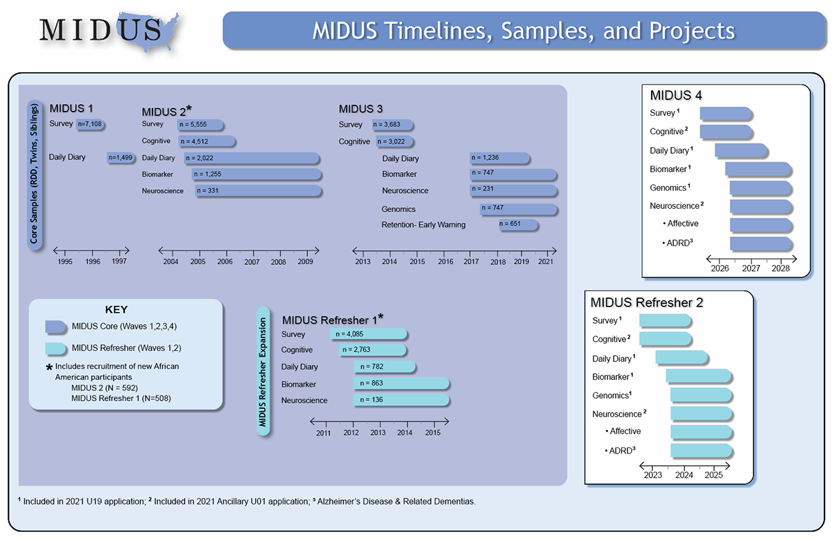

Slide 18
Measures
Include sample items for everything, full scales in appendix]
Executive Functioning:
  BTACT composite EF score
    Backward Digit Span
    Category Fluency
    Number Series
    30-SACT
    Stop & Go Switch Task
    Scoring
      Note that these exercises measure multiple dimensions
Spillover: Grzywacz scale (4 subscales)
Support: Supervisor, Coworker, Spousal measures
Controls: Job demands, family demands, demographics
Notes:
"Executive functioning is measured using the BTACT composite score, a validated telephone-based cognitive assessment that takes about 20 minutes."
"The five components include Backward Digit Span for working memory, Category Fluency for verbal fluency and retrieval, Number Series for inductive reasoning, the 30-Second and Counting Task for processing speed, and the Stop & Go Switch Task for cognitive flexibility."
"Spillover is measured using the Grzywacz scale with 4 subscales measuring negative and positive spillover in both directions."
"Support measures include supervisor, coworker, and spousal support scales, each assessing instrumental and emotional support availability."
"Controls include job demands, family demands, and demographics like age, education, and household income that might influence both executive functioning and spillover."

Slide 19
Proposed Analyses
Generalized Estimating Equations (GEE)
  Follow McNeish (2023) and McNeish et al. (2017)
  Accounts for within-household clustering
    Alternative models can be used for a robustness check (MLM)
Models:
  Main effects (H1-H4)
  Gender moderation (H5-H6, RQ1-RQ2)
  Support moderation (H7-H12, RQ3-RQ8)
12 models total (4 spillover types × 3 support types)
Notes:
"We'll use Generalized Estimating Equations (GEE), which accounts for within-household clustering since partners' experiences are not independent."
"This approach provides population-averaged estimates while handling the non-independence of observations within couples."
"We'll test three sets of models: main effects for H1-H4, gender moderation for H5-H6 and RQ1-RQ2, and support moderation for H7-H12 and RQ3-RQ8."
"This results in 12 models total when we consider 4 spillover types crossed with 3 support types, allowing us to examine each relationship systematically."

Slide 20
Expected Contributions
Theoretical: Expands work-family theory to include cognitive factors
Practical: Informs organizational support for employees with executive dysfunction
Social: Addresses workplace inclusion for neurodiverse populations
Methodological: Demonstrates interdisciplinary approach to work-family research
Notes:
"Theoretically, this work expands work-family theory to include cognitive factors, moving beyond traditional focus on time, strain, and energy to consider cognitive resources.”
"Practically, it informs organizational support for employees with executive dysfunction, providing evidence for specific accommodations and support strategies."
"Socially, it addresses workplace inclusion for neurodiverse populations, contributing to diversity, equity, and inclusion efforts."
"Methodologically, it demonstrates an interdisciplinary approach to work-family research, showing how integrating multiple perspectives can advance our understanding."

Slide 21
References (Selected key references)
Diamond, A. (2013). Executive functions. Annual Review of Psychology
Grzywacz, J. G., & Marks, N. F. (2000). Work-family spillover measures
Lachman, M. E., et al. (2014). BTACT validation
Additional references available upon request

Slide 22


Slide 23
APPENDIX SLIDES

Slide 24
Appendix Slide 1

Slide 25
Appendix Slide 2

Slide 26
Appendix Slide 3

Slide 27
Appendix Slide 4

Slide 28
Appendix Slide 5

Slide 29
Appendix Slide 6

