Slide 1
Capstone Project: A geographical insight into the city of Santiago, Chile

Slide 2
Introduction
Chile is currently in second place of the countries with greatest income inequeality among the OECD's members. This income differences have led to a spatial inequality where there is a physical segregation of people due to their socioeconomic status. The most dramatic effect it is observed in Santiago, the capital of Chile and the biggest and most populated city in the country.
In this project I will try to use machine learning methods in order to analyze how the inequality has affected the local venues and how different are the Santiago's comunes (neighbourhoods) in terms of their venues' diversity.

Slide 3
Data
In order to accomplish the defined goal I will use the following sources of information:
- The list of comunes per region and their spatial coordinates (latitude and longitude) come from a public Github repository called geo_chile from 2x3-la.
- The venues, their category and location will be extracted using the Foursquare API.
- The comunes from the urban part of the Metropolitan region were obtained from the wiki page.

Slide 4
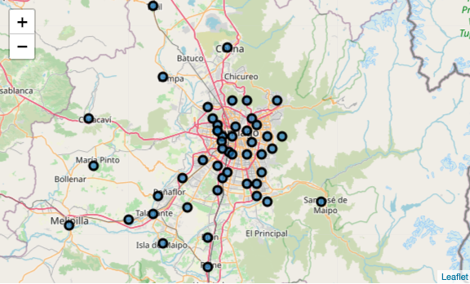
Comunes of RM

Slide 5
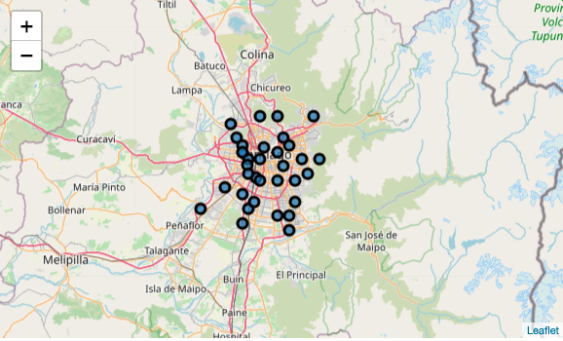
Comunes of Santiago

Slide 6
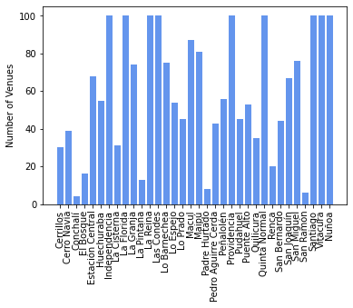
Distribution of venues in comunes

Slide 7
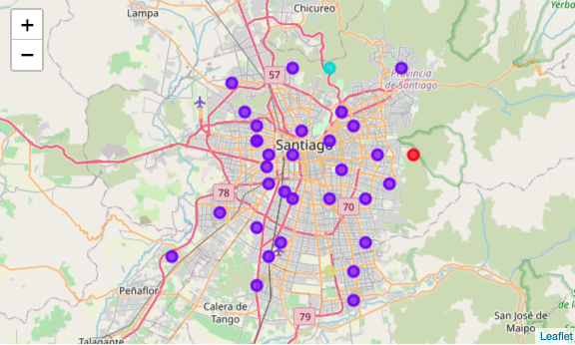
First K-means

Slide 8
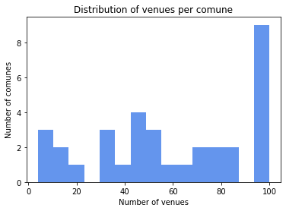
Distribution of the venues per comune

Slide 9
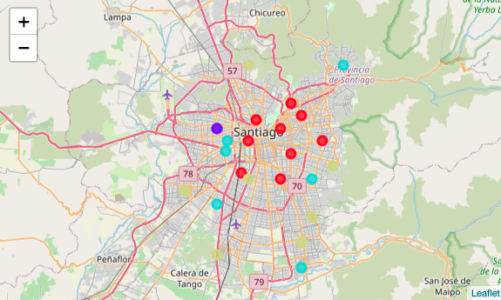
Final K-means clustering

Slide 10
Conclusions
The basic analysis done shows how simmilar and disimilar are the comunes of Santiago. For someone who does not know much about Santiago, will not mean much but the clusters pretty much correlates with the socioeconomic status of the comunes (something that I am planning to further analyze.
Besides, I think is very important to know how the data imputed in a model affects its outcomes. As it can be seen in the two models displayed.

