Slide 1

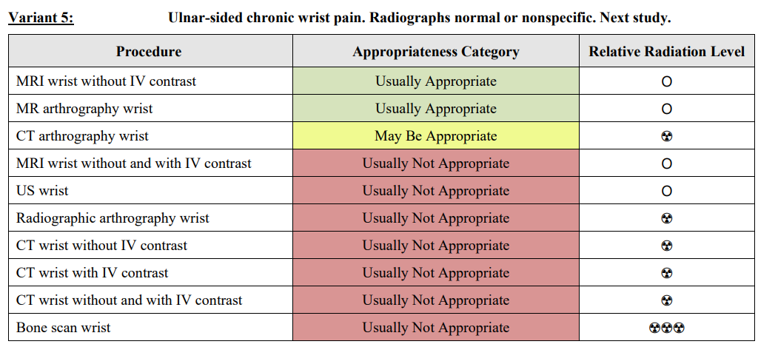
Embedding Content (Table Documents)
Condition: chronic wrist pain
Description: Ulnar-sided chronic wrist pain. Radiographs normal or nonspecific. Next study.
Content:
| Procedure | Appropriateness Category |
|---|---|
| MRI wrist without IV contrast | UA/MBA |
| MR arthrography wrist | UA/MBA |
| CT arthrography wrist | UA/MBA |
| MRI wrist without and with IV contrast | UNA |
| US wrist | UNA |
| Radiographic arthrography wrist | UNA |
| CT wrist without IV contrast | UNA |
| CT wrist with IV contrast | UNA |
| CT wrist without and with IV contrast | UNA |
| Bone scan wrist | UNA |
Markdown texts provided to LLM as retrieved contexts

