Slide 1
Decision Trees
Scott Little

Slide 2
Advantages and Disadvantages
Advantages
Easy to show results
Works on categorical data
Fits nonlinear data well
Disadvantages
Can be computationally intense to train
Overfitting

Slide 3
Grandparents?
Has kids?
> 65 ?
No
No
Yes

Slide 4
Kinds of Decision Trees
• ID3 (Iterative Dichotomiser 3) - Designed for only categorical features - Splits categorical features completely - Uses entropy and information gain to pick the best split
• CART (Classification and Regression Tree) - Handles both categorical and continuous data - Always uses binary splits - Uses gini impurity to pick the best split
• C4.5 - Handles continuous data - Implements pruning to reduce overfiting
• C5.0 - Proprietary, do not have access to the specifics

Slide 5
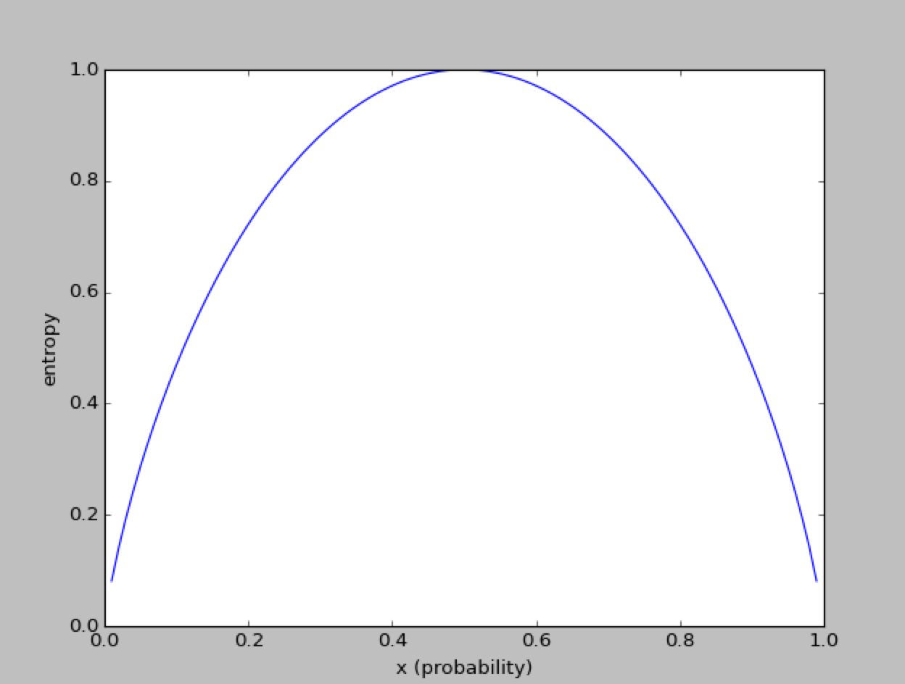
Entropy and Information Gain
plt.plot(x,-x*np.log2(x)-(1-x)*np.log2(1-x))
Notes:
plt.plot(x,-x*np.log2(x)-(1-x)*np.log2(1-x))

Slide 6
Gini Impurity
It is a measure of this probability:
- Take random element from the set
- Label it randomly according to the distribution of labels in the set
- What is the probability that is it labeled incorrectly?

Slide 7
Play Golf?
Outlook | Temperature | Humidity | Windy | Play
 | Nominal | Nominal
overcast | hot | high | FALSE | yes
overcast | cool | normal | TRUE | yes
overcast | mild | high | TRUE | yes
overcast | hot | normal | FALSE | yes
rainy | mild | high | FALSE | yes
rainy | cool | normal | FALSE | yes
rainy | cool | normal | TRUE | no
rainy | mild | normal | FALSE | yes
rainy | mild | high | TRUE | no
sunny | hot | high | FALSE | no
sunny | hot | high | TRUE | no
sunny | mild | high | FALSE | no
sunny | cool | normal | FALSE | yes
sunny | mild | normal | TRUE | yes
Notes:
Whiteboard calculation of entropy

Slide 8
Play Golf?
Outlook
overcast
overcast
overcast
overcast
rainy
rainy
rainy
rainy
rainy
sunny
sunny
sunny
sunny
sunny
Entropy before split:
After split on Outlook
Entropy = 5/14 (0.97) + 5/14 (0.97) + 4/14 (0) = 0.69
Notes:
Whiteboard calculation of entropy

Slide 9
Your turn
Calculate by hand entropy and information gain if we split on “temperature nominal”

Slide 10
Decision Tree Pseudocode
function BuildTree:
If every item in the dataset is in the same class or there is no feature left to split the data:
return a leaf node with the class label
Else:
find the best feature and value to split the data
split the dataset create a node for each split
call BuildTree and add the result as a child of the node
return node

