Slide 1

Geometric data structure From theory to application
By Bao Ngo and Jared Rost

Slide 2





Table of contents
Motivation
Preliminaries
Methodology
Experiments
Results

Slide 3




Table of contents
Motivation
Preliminaries
Methodology
Experiments
Results

Slide 4

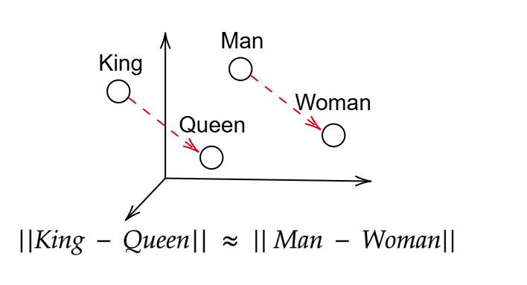
Motivation
Why geometric data structure?
A graph database that combines different “omics” (e.g. genomics, proteomics,…)
Asdasdasadasdasdasdasd
asdasdasd
Tasks

Slide 5


Table of contents
Motivation
Preliminaries
Methodology
Experiments
Results

Slide 6

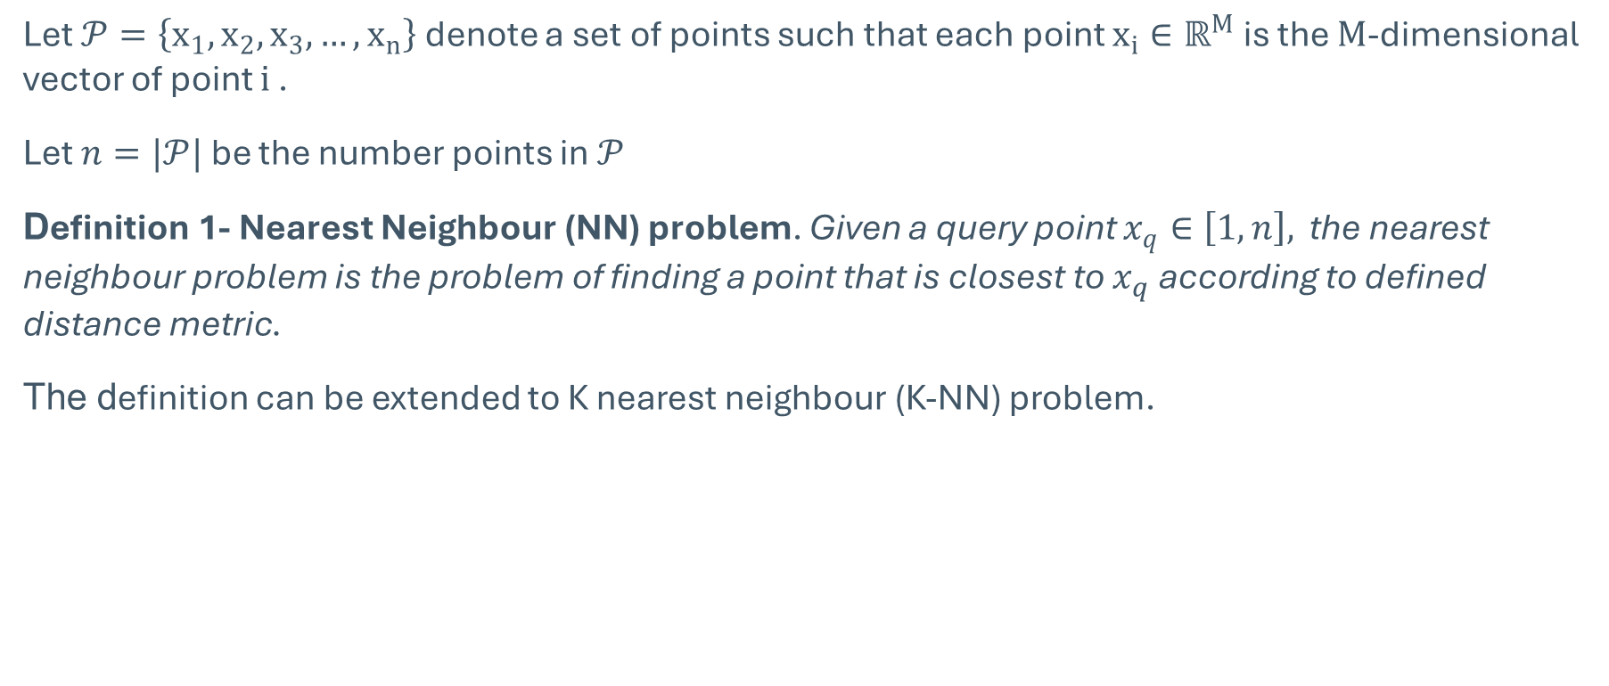
Preliminaries
Let $𝒫=\left\{x_{1},x_{2},x_{3},…, x_{n}\right\}$ denote a set of points such that each point $x_{i}∈ℝ^{M}$ is the $M$-dimensional vector of point $i$ .
Let $n=|𝒫|$ be the number points in $𝒫$
Definition 1- Nearest Neighbour (NN) problem. Given a query point $x_{q}∈\left[1,n\right],$ the nearest neighbour problem is the problem of finding a point that is closest to $x_{q}$ according to defined distance metric.
The definition can be extended to K nearest neighbour (K-NN) problem.

Slide 7
Table of contents
Motivation
Preliminaries
Methodology
Experiments
Results

Slide 8

Methodology
This work focusing on evaluating the performance of geometrics data structures from practical perspectives
Evaluated methods : K-D Tree [1] and Ball* Tree [2]
Focused operations: insert, delete, tree construction, get NN and get KNN
Implement in a unified framework for a fair comparison
Trees are evaluated on large scale real-world datasets with various properties
Number of nodes : 50,000 – 2,000,00
Dimension of each data point : 128 - 4,096

Slide 9
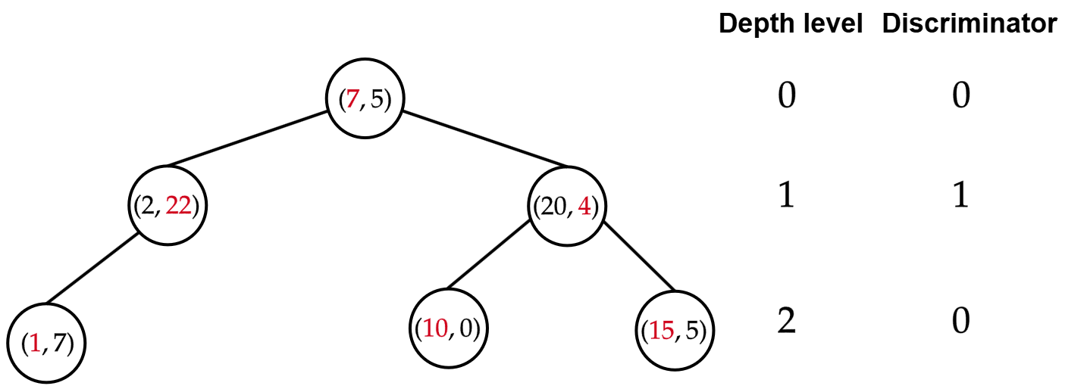
Methodology
K-D Tree
All nodes at the same depth level having the same discriminator
Discriminators between 2 conscutive depth level are different

Slide 10
Methodology
K-D Tree
K-D tree is a binary search tree and each node represents a K-dimensional point
Childs nodes are split into left or right subtree according to the value at a dimension defined by discriminator

Slide 11
Methodology
Ball* Tree

Slide 12
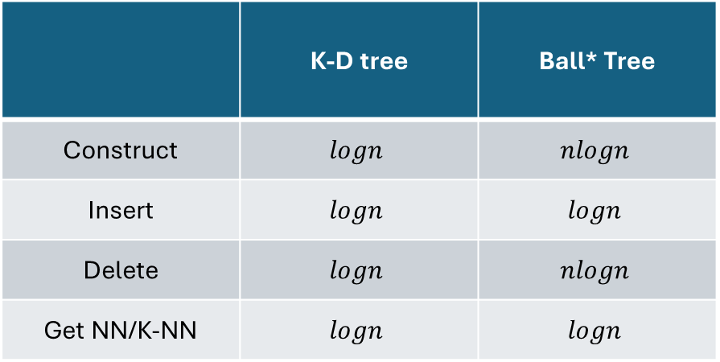
Methodology
Time complexity of all operations
 | K-D tree | Ball* Tree
Construct | $$logn$$ | $$nlogn$$
Insert | $$logn$$ | $$logn$$
Delete | $$logn$$ | $$nlogn$$
Get NN/K-NN | $$logn$$ | $$logn$$

Slide 13
Table of contents
Motivation
Preliminaries
Methodology
Experiments
Results

Slide 14
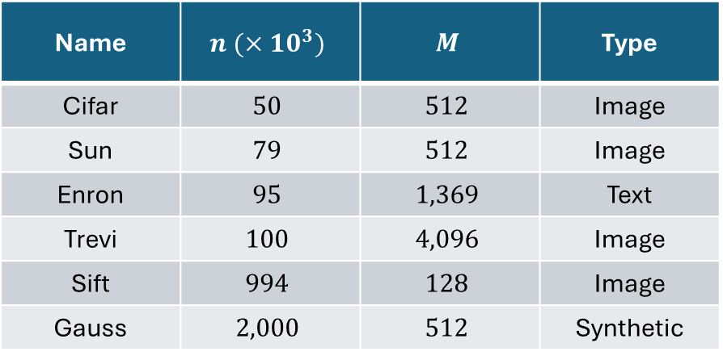

Experiments
Two main experiments setting
Investigate the scalability of two selected geometric data structures when the number of points $n$ inceases
Investigate the impact of the “curse of dimensional” when the number of dimensional $M$ increases
Target operations: insert, delete, construct, get NN and get K-NN
The performance of each operation is evaluate on 200 distinct query point and perform 3 times per point
Experiments are conducted on real-world large-scale datasets:
Name | $$n (×10^{3})$$ | $$M$$ | Type
Cifar | $$50$$ | $$512$$ | Image
Sun | $$79$$ | $$512$$ | Image
Enron | $$95$$ | $$1,369$$ | Text
Trevi | $$100$$ | $$4,096$$ | Image
Sift | $$994$$ | $$128$$ | Image
Gauss | $$2,000$$ | $$512$$ | Synthetic

Slide 15
Table of contents
Motivation
Preliminaries
Methodology
Experiments
Results

Slide 16

Methodology
Multi-omics graph database A graph database that combines different “omics” (e.g. genomics, proteomics,…)
Each entity of an omics (e.g. gene, protein,…) is represented as a node and interactions between entities are represented as edges
A comprehensive analysis of their interactions in a complex biological sample. [1]
18 nodes types & 18 relations types
Tasks Annotating genes
Given a gene, what is related functional annotation(s)?
In graph machine learning, we call this task link prediction

Slide 17

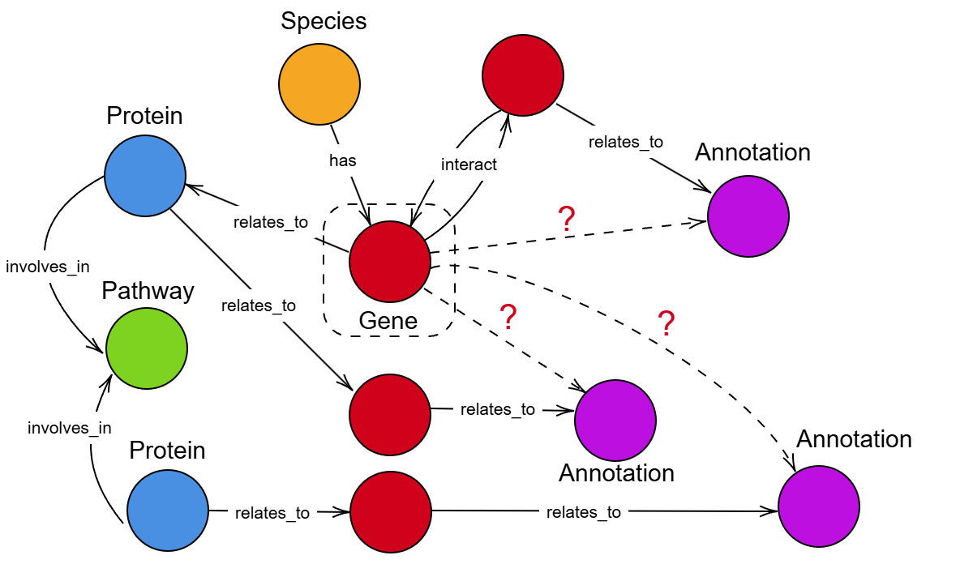
Database
Multi-omics graph database A graph database that combines different “omics” (e.g. genomics, proteomics,…)
Each entity of an omics (e.g. gene, protein,…) is represented as a node and interactions between entities are represented as edges
A comprehensive analysis of their interactions in a complex biological sample. [1]
18 nodes types & 18 relations types
Tasks Annotating genes
Given a gene, what is related functional annotation(s)?
In graph machine learning, we call this task link prediction

