Slide 1
Interface between RTOS target and an Industrial System: Developing USB Digital I/O Module
Benjamin O’Brien
4/29/2013

Slide 2
Motivation
GTA for Real Time Lab
Students need practical experience with Real Time software constructs
Current Fischertechnik systems are aging
Broken and worn parts frustrate students
Configurations are limited
Need to find alternatives

Slide 3
Alternatives
Most alternatives are directed towards PLC training
Physical Process Emulators
Edibon PLCE ($1600)
TII Technical Education Systems PAS Modules ($600)
Designed for standard 24V PLC’s not GPIO
Visual Process Emulators
Bradley PSIM PLC Simulator
Easy Visualized Equipment Emulation Program (EasyVeep)

Slide 4
Alternatives Cont.
PSIM PLC Simulator
No nice way to connect to an external interface
Program so old it won’t run on Windows 7
EasyVeep
Software is free but required EasyPort is expensive
EasyPort is designed for PLC not GPIO logic levels
Could we build our own EasyPort?

Slide 5
Proposed Solution
Create an EasyPort alternative to allow existing Real Time targets to interact with EasyVeep

Slide 6
Creating an EasyPort
Searched the manufacture’s website for technical information related to EasyPort protocol
Dead Links
Buying an EasyPort in order to reverse protocol was too expensive
Disassemble and analyze EasyVeep binaries!

Slide 7
Analyzing EasyVeep
Hex-Rays Interactive Disassembler (freeware)
Analyzed various components of the EasyVeep software distribution to find Serial Protocol
EasyVeep.exe
Main executable, no serial communications code
EasyPort.ocx
ActiveX Control responsible for all communication to EasyPort.
Has format of a Windows COM Object

Slide 8
Analyzing EasyPort.ocx
Looked through the Virtual Method Table
The vtable holds human readable names and pointers to the associated messages
Found many usefully named functions
Connect, SetOutput, GetInputWord
Traced execution of each method of interest and found the format strings being used to build and decode commands

Slide 9
EasyPort Protocol
Command Format | Description
setup0 | Request made by PC to initialize connected EasyPorts.
setup[1-4] | EasyPort response to setup0 command requesting a module number 1-4.
DV | Request by PC to get EasyPort version
V=\d.\d{2} | Response to version request containing the version number of the EasyPort. Must exceed (1.20).
MAW=[1-4].[0248]=[0-F]{4} | Modify the 16 bit output value of EasyPort module [1-4], channel log₂([0248]) to be the value represented by hex number [0-F]{4}.
DEW[1-4].[0248] | Request the current input values from module [1-4], channel log₂([0248])
EW[1-4].[0248]=[0-F]{4} | Response to input value request. The current value of the inputs is represented by a four digit hex number. DAW command is sent in response requesting the current out values the EasyPort has. A response to DAW is not required.
DAW[1-4].[0248] | Request the current output values from module [1-4], channel log₂([0248]) . A response is not required in this application.

Slide 10
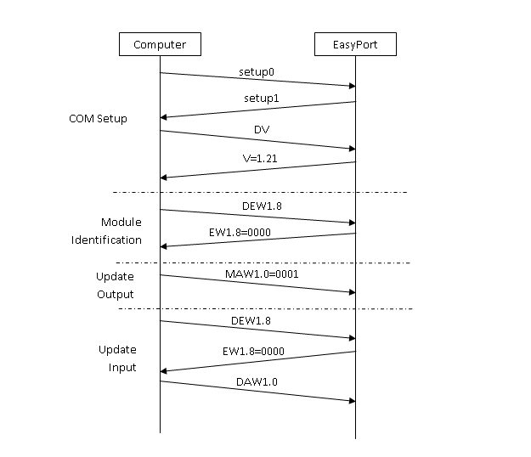
EasyPort Protocol (2)

Slide 11
Making an EasyPort Mark I
Arduino Uno R3
Never meant to be final implementation, but useful as a proof of concept prototype
Fail-duino
Arduino only ever received 0xFF serial characters
AGG Software Advanced Serial Port Monitor
Arduino can’t do the required flow control without modification!

Slide 12
Making an EasyPort Mark II
Write a proof on concept emulator
Desktop application using com0com loopback
com0com allows serial port emulation
Implemented discovered protocol
Able to interact with EasyVeep simulations!

Slide 13
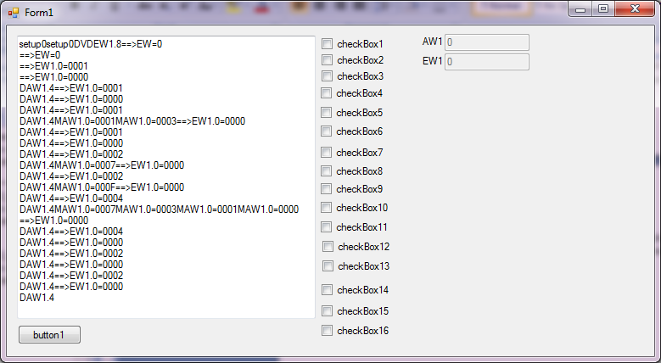
Making an EasyPort Mark II (2)

Slide 14
Making MyEasyPort
Stellaris Launchpad
Overpowered, but available
Supports the flow control EasyVeep desires
Implemented the protocol
Everything talked well at low speed
Updating at more the 5Hz crashed EasyVeep!
Tried debugging EasyVeep and MyEasyPort
Too hard to debug without EasyVeep source

Slide 15
MyEasyVeep
EasyVeep simulations are just flash movies
Copied the flash movies into my own project
Using Flash ActiveX control to load and play
How do I interact with the movie?
Decompile the swf
Sothink Flash Decompiler (trial)
flasm –d
Look through the disassembly to find variable names

Slide 16
MyEasyVeep (2)
Sort through all the variable names to find the useful ones.
Use ActiveX GetVariable and SetVariable methods
Variable Name | Purpose
EprgName | English Program Name
EprgLeirasX | English Program Description ( X = 0..10)
EDigSensX | English Sensor Description ( X = 1..16)
EDigActX | English Actuator Description (X = 1..16)
DAX Digital | Actuator Value ( X =1..16)
DSX Digital | Sensor Value (X=1..16)

Slide 17
MyEasyVeep (3)
Queried simulation at twice the frame rate
If sensor values changed, command would be sent to connected EasyPort
On Update command from MyEasyPort actuator variables would be set in swf
User can also interact with buttons on GUI
Auto – mode shows user how system should work when controlled correctly

Slide 18
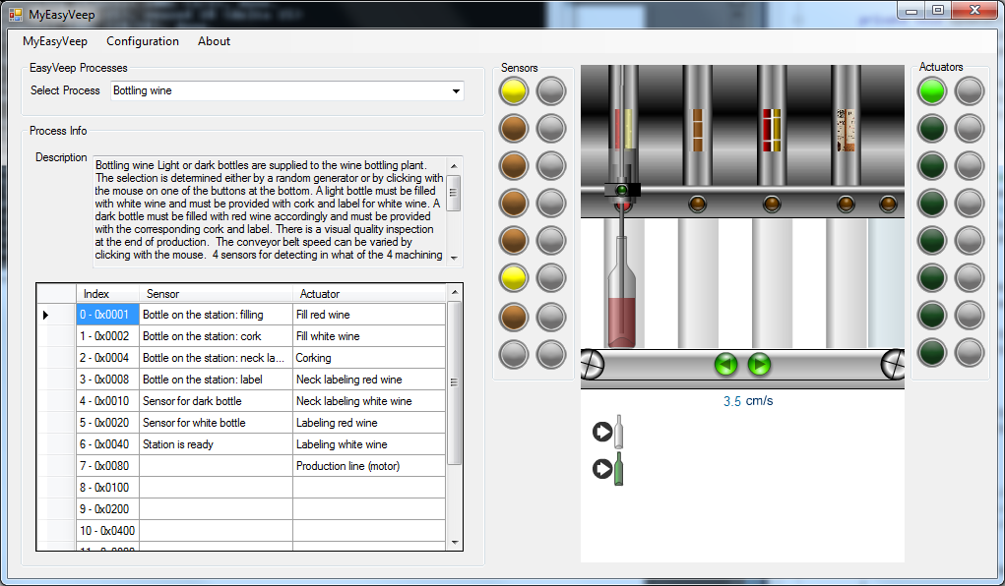
MyEasyVeep (4)

Slide 19
MyEasyPort Design
Connecting MyEasyPort to Arcom is tricky
Logic Levels are different
3.3V MyEasyPort, 5V Arcom
Line Buffers
Arcom I/O card is very low current
Proper Isolation is nice to have
Ground loop, transient voltages
32 channels of I/O need to be routed
4 8-bit channels
Pin-out on Arcom is bizarre

Slide 20
MyEasyPort Design (2)
Silicon Labs Si84XX CMOS isolator
Level shifting, line buffering, isolating package
Everything in one inexpensive IC
It’s only available in SMD packages
4 channels of I/O at up to 150Mbs (using ~15bps)
Chose Si8442
2 Channels each way
Low power consumption so Arcom and USB can power it

Slide 21
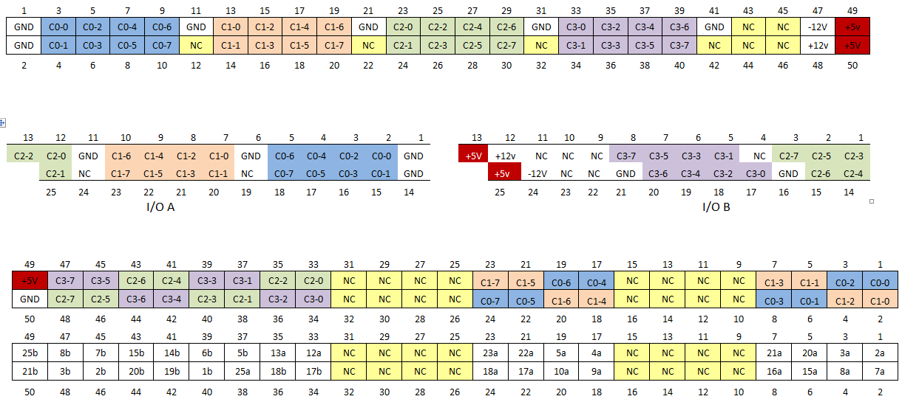
MyEasyPort Design (3)
Used Excel to Experiment with Pin Outs

Slide 22
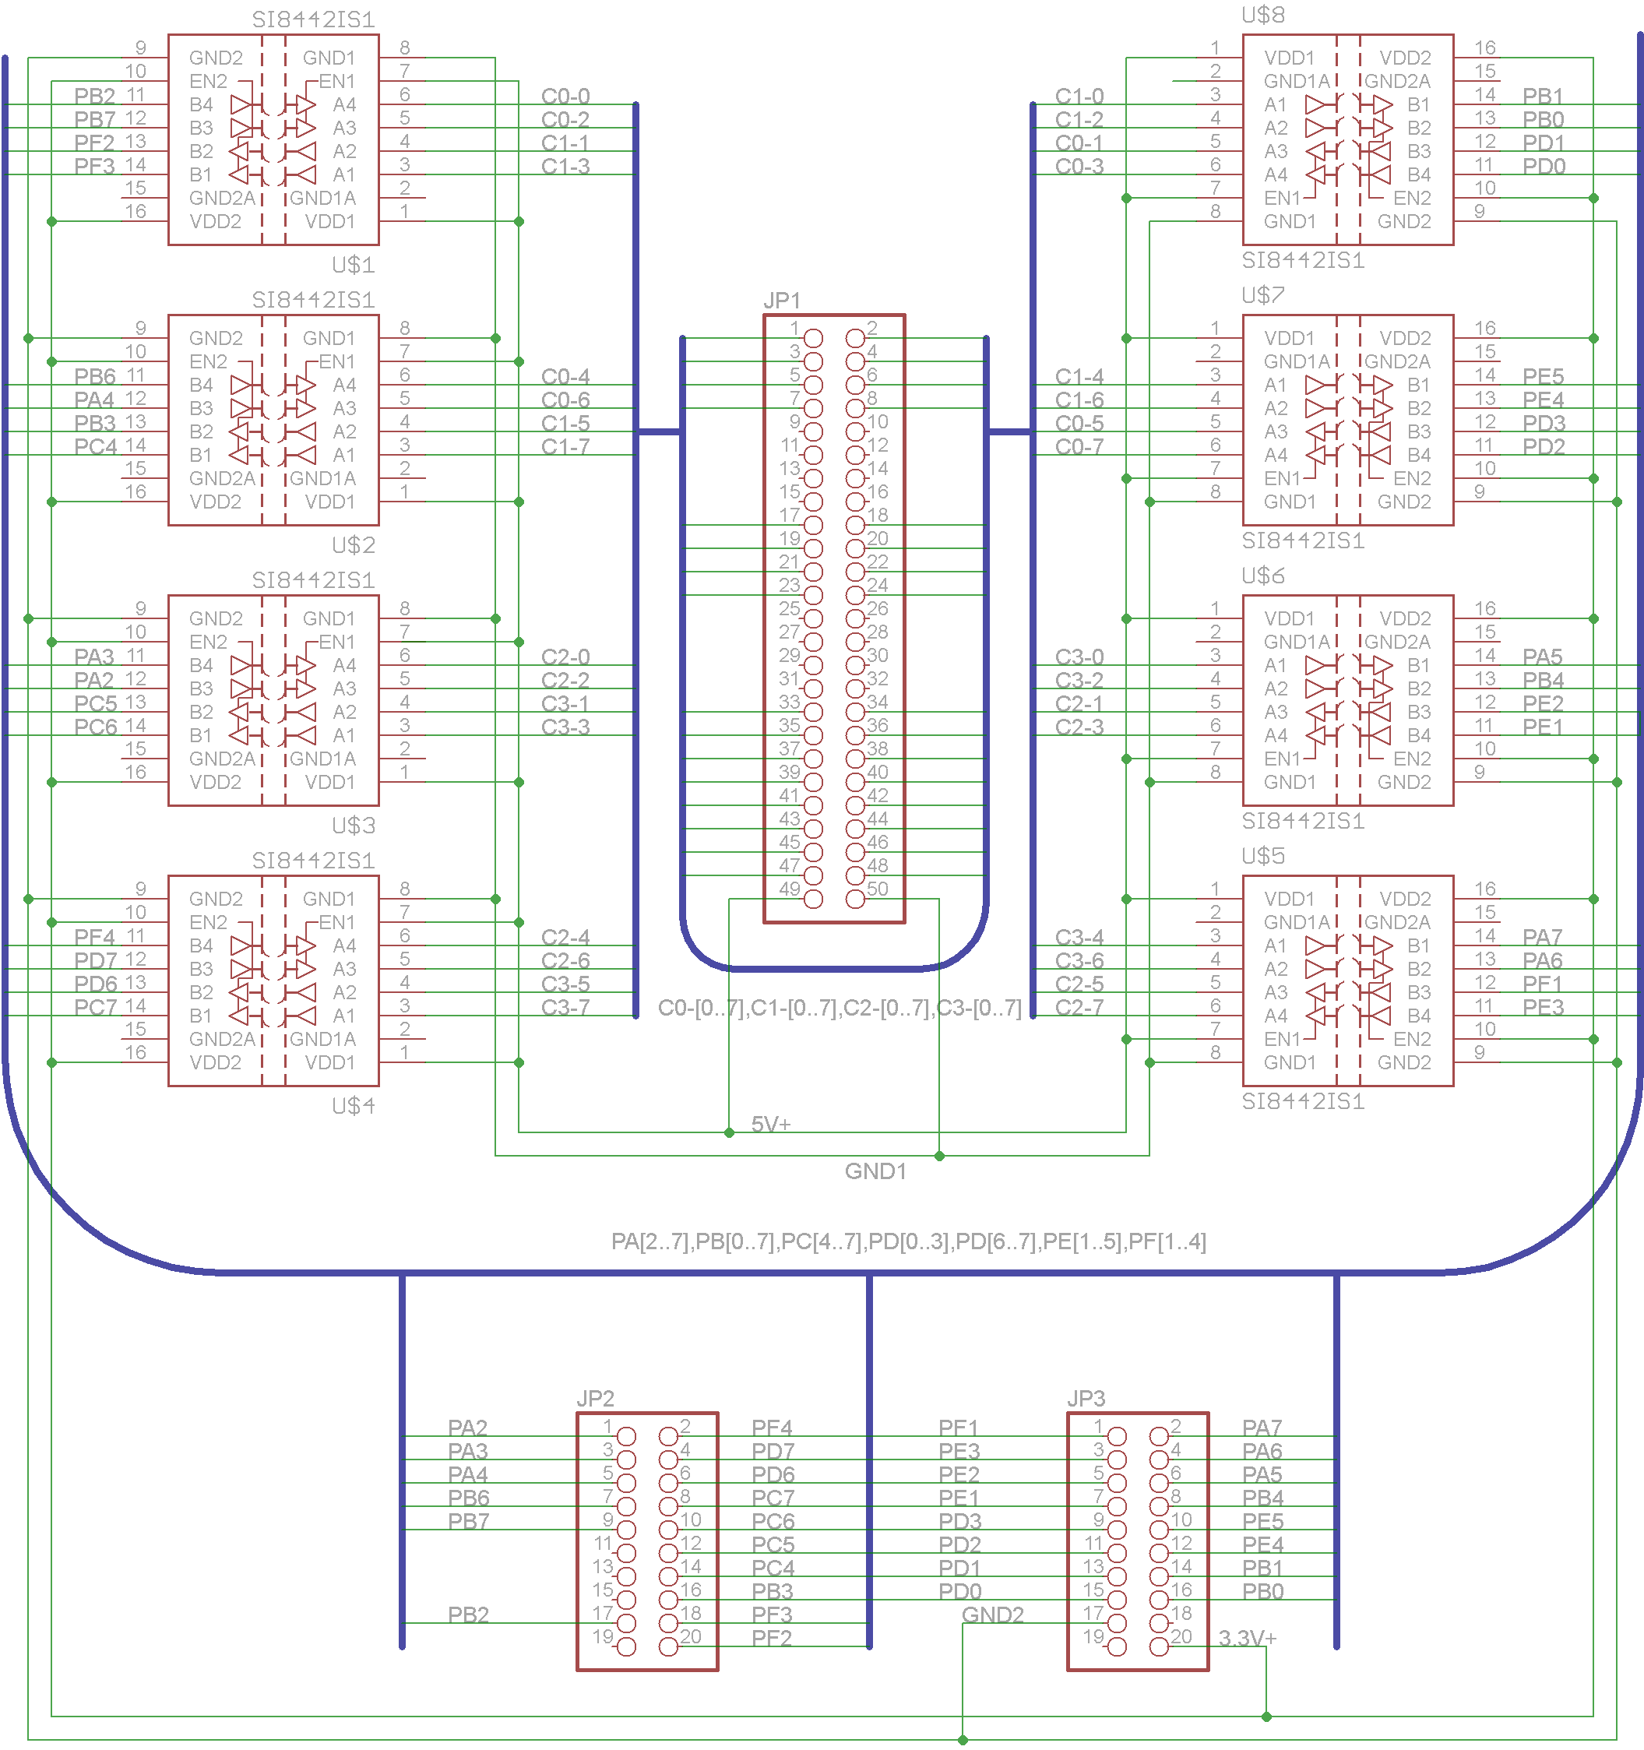
MyEasyPort Design (4)

Slide 23
Using in a VxWorks Program
User must control the I/O mode of the Digital I/O Card
Switching between modes takes some time
about 500 micro seconds
This can lead to an occasional timing glitch
void setActuatorValues(int Actuators){
sysOutByte(0x184,0x01); /* Re enable outputs */
sysOutByte(0x183,(Actuators & 0xFF00) >> 8);
sysOutByte(0x181,(Actuators & 0x00FF));
}
int getSensorValues()
{
int iSensors = 0;
sysOutByte(0x184,0x00); /* Disable outputs */
iSensors = (sysInByte(0x182) << 8) | (sysInByte(0x180));
sysOutByte(0x184,0x01); /* Re enable outputs */
return iSensors;
}

Slide 24
Conclusions and Recommendations
MyEasyPort and MyEasyVeep provide an easy to use interface to many valuable simulations
Students will have access to more systems with which they can interact
Software simulations will not break and fail in the same manner as current systems used
Additional system simulations can be created easily with Adobe Flash or any project the can produce Flash movies

Slide 25
Conclusions and Recommendations (2)
In the future
Create additional simulations
Make a smaller, cleaner MyEasyPort
Resolve the small glitch from switching the I/O card from Input to Output mode
Add features to MyEasyVeep to assists student learning and comprehension further

Slide 26
Demonstration
Demonstration of the MyEasyPort and MyEasyVeep software will take place in LB161.

Slide 27
References
[1] | L.-X. Li, H. M. Lu, L. ZhiPing and M. XiangYang, "Design and Application of Automatic Control System Program Based on FESTO Training System," in Control, Automation and Systems Engineering (CASE), 2011 International Conference o, 2011.
[2] | A. R. Izaguirre and M. E. Macias, "Virtual Reality Machines to improve training in Control and Automation," in Conference for Industry and Education Collaboration, San Antonio, 2011.
[3] | D. Wolowicz and J. Knoll, "Proposal For USB I/O Board," 13 May 2002. [Online]. Available: http://www.ece.uvic.ca/~elec499/2002a/group04/Proposal.pdf. [Accessed 10 12 2012].
[4] | L. Ngalamou and L. Myers, "A Software Approach for the Design of a Virtual Plant," International Journal of Computer Science and Network Security, vol. 10, no. 9, pp. 48-56, 2010.
[5] | C.-G. Haba, "Extending the Use of PLC Simulator Software in Student Laboratory Works," Advances in Electrical and Computer Engineering, vol. 10, no. 1, pp. 84-89, 2010.
[6] | Sealevel, "The Digital I/O Handbook | Sealevel Support," 08 05 2012. [Online]. Available: http://www.sealevel.com/support/article/AA-00391/155/Resource-Center/Digital-IO-Interfaces/The-Digital-IO-Handbook.html#CL. [Accessed 19 12 2012].
[7] | "PSIM PLC Training Simulator," The Learning Pit, [Online]. Available: http://www.thelearningpit.com/plc/psim/psim.html. [Accessed 23 January 2013].
[8] | Festo Didactic GmbH & Co., "Manual EasyPort USB," 1 11 2008. [Online]. Available: http://www.festo-didactic.com/ov3/media/customers/1100/721876_deenesfr_mit_lesezeichen_4.pdf. [Accessed 19 11 2012].
[9] | Hex-Rays, "Freeware Download Page," [Online]. Available: http://www.hex-rays.com/products/ida/support/download_freeware.shtml. [Accessed 11 29 2012].
[10] | "Null-modem emulator," [Online]. Available: http://com0com.sourceforge.net/. [Accessed 12 Dec 2012].
[11] | Silicon Labs, "HIGH-SPEED LEVEL SHIFTING USING Si8XXX ISOLATORS," [Online]. Available: http://www.silabs.com/Support%20Documents/TechnicalDocs/AN598.pdf. [Accessed 5 March 2013].
[12] | Sealevel, "USB to 16 Isolated Inputs / 16 Reed Relay Outputs Digital Interface Adapter (8221)," [Online]. Available: http://www.sealevel.com/store/i-o/digital-i-o/usb/8221-usb-to-16-isolated-inputs-16-reed-relay-outputs-digital-interface-adapter.html. [Accessed 19 12 2012].
[13] | Festo Didactic GmbH & Co., "ActiveX Control for EasyPort USB," [Online]. Available: http://www.festo-didactic.com/int-en/services/software/software-licences/activex-control-for-easyport-usb.htm?fbid=aW50LmVuLjU1Ny4xNy4zMi44MjUuNjk0NQ. [Accessed 28 11 2012].

Slide 28
Questions?

