Slide 1


A/B Testing for Revenue Increase
To increase revenue, Globox conducted an A/B test on their home page. Average spend per user for A and B were close, but what did the results reveal?
by BENJAMIN ODAME

Slide 2

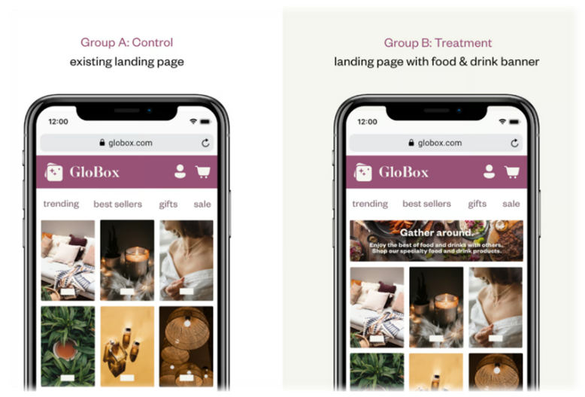
Purpose of A/B Testing
By performing A/B testing, we aimed to identify the most effective version of our home page in terms of increasing revenue. Our objective was to optimize the user experience and encourage higher conversion rates.

Slide 3

Key Performance Indicators
Average Spent
Conversion Rate
Data Properties
Device type, Gender, Country
User Group
A – Control
B- Treatment

Slide 4
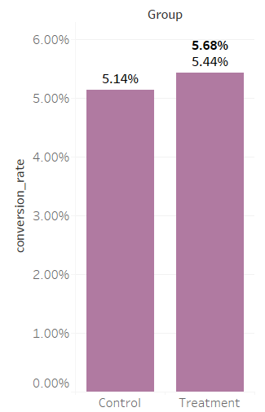
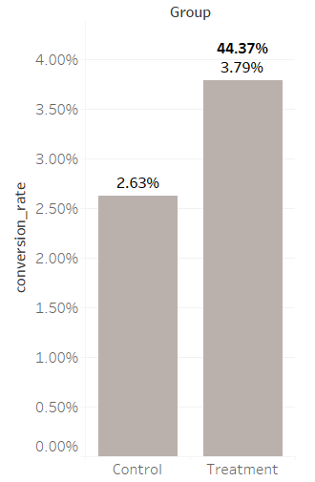
Conversion Rate Analysis (Gender)
Female Users
Male Users
Generally Females have higher
Conversion rate.
Male users have conversion rate of
44.37% in treatment than the
Control group.

Slide 5
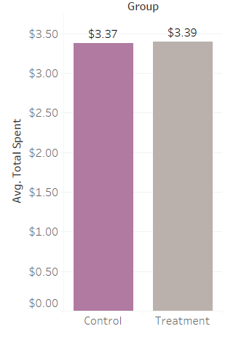
Average Spent By Groups
Amount Spent not based on category ( Food,
Drinks)
No Significant Difference between the
revenue for the two groups
Users Spent averagely between $2- $4
In both groups

Slide 6
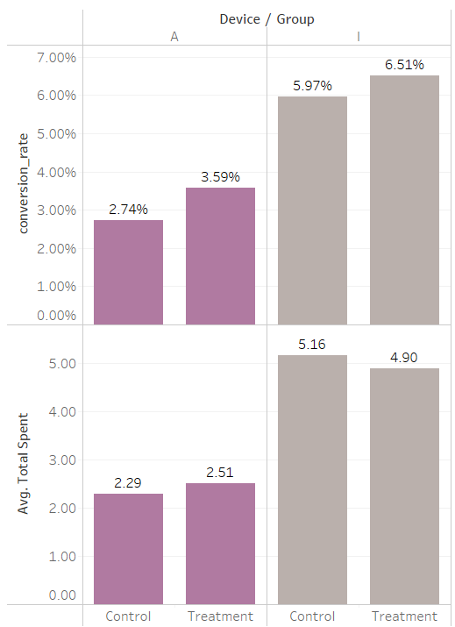
Device Analysis
Generally iOS users have
Higher conversion rate.
Conversion rate based on the new
Feature is higher in android than in iOS.
31% increase in conversion for
android for the new feature.
Spending is less in the new feature for
iOS users.

Slide 7
Testing Results
Average Spend
Average Spend
Total Users
A: $3.37 per user
B: $3.39 per user
4.8k users
Conversion Rate
Conversion Rate
A: 3.92%
B: 4.63%

Slide 8

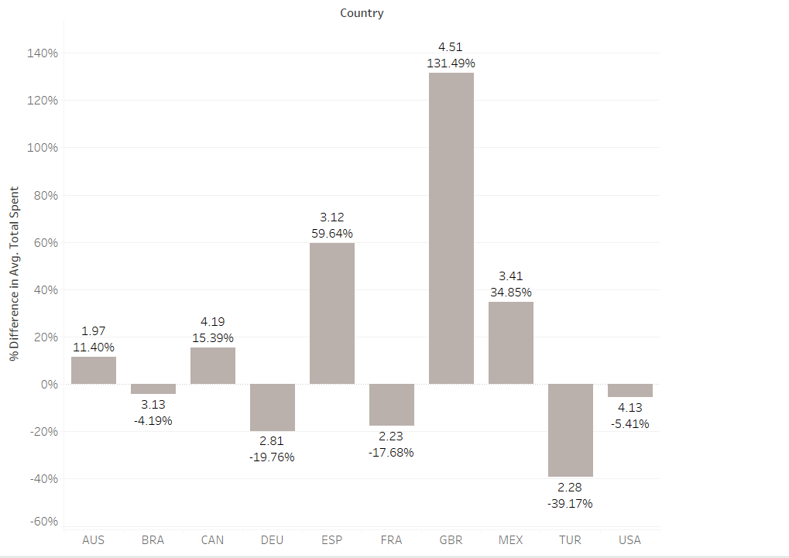
% Difference in Spending (Country)
The UK had the highest amount spent with an increase of about 131% for the treatment group compared to the control group.
Brazil, Turkey, France, USA and Germany which had a drop in the amount spent.

Slide 9
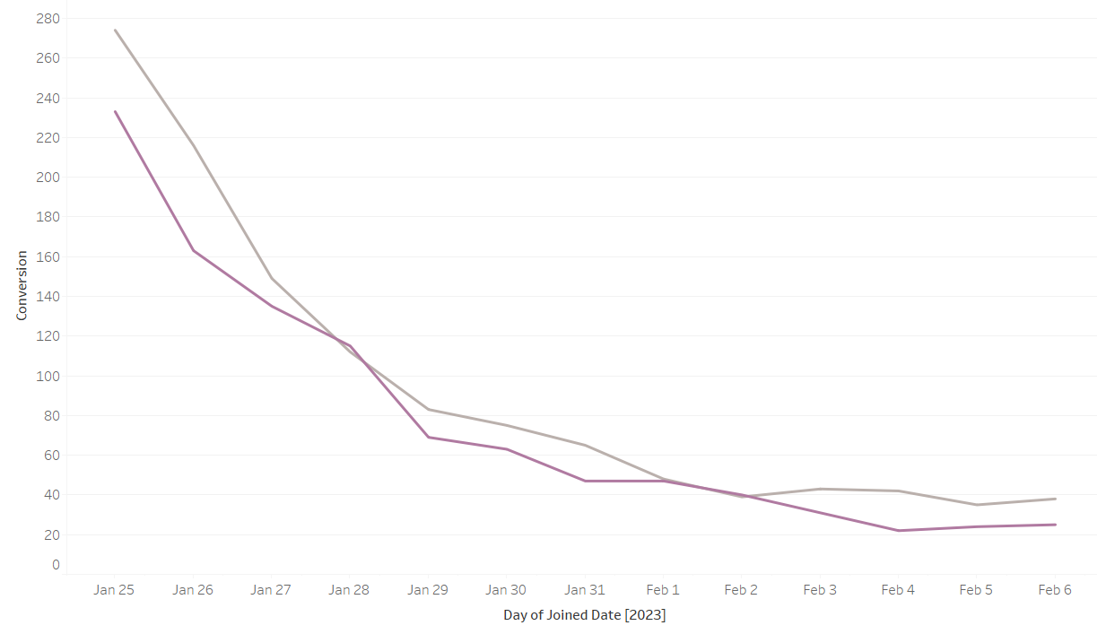
Novelty Effect(Conversion rate)
Conversion rate for both control and treatment dropped.
The number of persons joined also declined over the period.
Based on the findings there was no novelty effect.

Slide 10
Analysis of Results
1
Small Difference in Average Spend
The average spend difference between control and treatment was only 2 cents. This indicates a significant similarity in user behavior and purchase patterns.
2
Higher Conversion Rate for Treatment Group
Treatment group showed an 18% higher conversion rate compared to control. This suggests that the new feature had a positive impact on user engagement and purchasing decisions.
3
Strong User Engagement
With close to 5,000 users participating in the test, we obtained a substantial dataset to draw meaningful conclusions, however increasing the number of users would have provided an accurate measure of the KPI.

Slide 11

Recommendation
Based on the A/B test results, we recommend implementing test(New variant) as the default home page design. The slightly higher conversion rate and positive engagement indicate that the new feature resonates well with our users. This change has the potential to drive increased revenue and provide an improved user experience.
Providing the category of Spent in future study data can help in getting a true reflection of the revenue generated on the new feature.

Slide 12
Conclusion
Through rigorous A/B testing, Globox has gained valuable insights about user behavior and preferences. The introduction of the new feature in variant B has demonstrated its potential to positively impact revenue and enhance user engagement. This experiment exemplifies our commitment to continuous innovation and customer-centricity.

