Slide 1
Story Boards

Slide 2
Conductor’s scanner

Slide 3
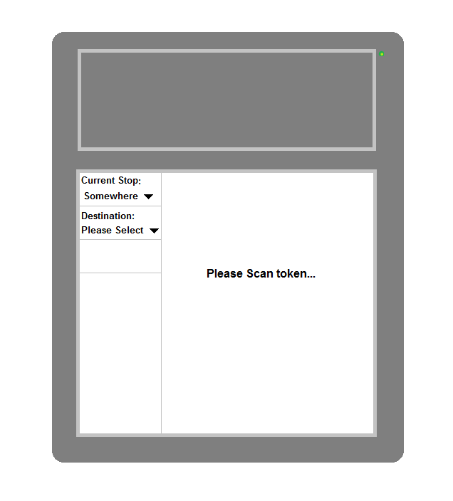
This is the basic scanner at idle, the conductor could keep updating the current stop as they go along by using the drop down.
But they have the option to change it back to a previous stop if the conductor didn’t have chance to see some of the passengers that got on at previous stops.
Also it indicates to the conductor that the passengers token needs to be scanned and it will not continue until it has been scanned, it indicates to the passenger by a green LED that the scanner is ready.
Scanner Image 1
Notes:
This is the basic scanner at idle, the conductor could keep updating the current stop as they go along by using the drop down.
But they have the option to change it back to a previous stop if the conductor didn’t have chance to see some of the passengers that got on at previous stops.
Also it indicates to the conductor that the passengers token needs to be scanned and it will not continue until it has been scanned, it indicates to the passenger by a green LED that the scanner is ready.

Slide 4
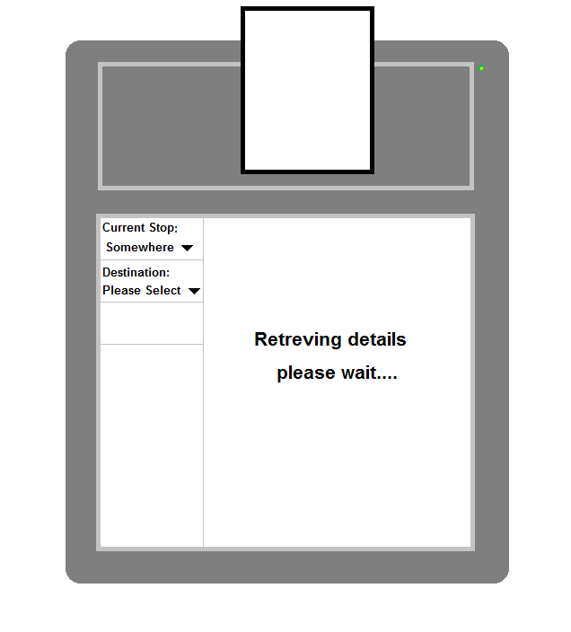
When the passenger scans the token it will then go and retrieve the account details and determines if the token is valid or not and will output the relevant messages in Scanner Image 3 and Scanner Image 3 alternative.
This gives an indication that the scanner is processing the token and finding the token by outputting the message retrieving details.
Scanner Image 2
Notes:
When the passenger scans the token it will then go and retrieve the account details and determines if the token is valid or not and will output the relevant messages in Scanner Image 3 and Scanner Image 3 alternative.
This gives an indication that the scanner is processing the token and finding the token by outputting the message retrieving details.

Slide 5
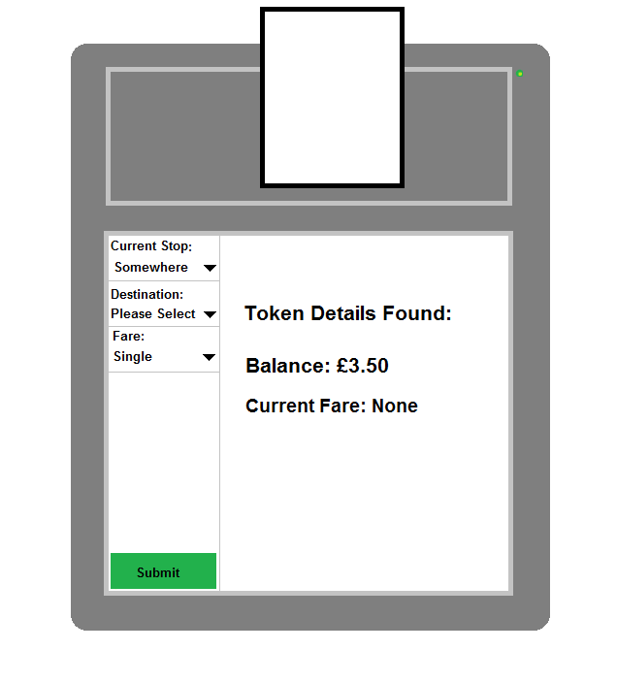
Once the scanner has received the details it will output the balance of the account and the current fare to let the conductor know.
If there is no fare found it will then allow the conductor to input the stop they got on and their destination, and the fare type the passenger requires.
Scanner Image 3
Notes:
Once the scanner has received the details it will output the balance of the account and the current fare to let the conductor know.
If there is no fare found it will then allow the conductor to input the stop they got on and their destination, and the fare type the passenger requires.

Slide 6
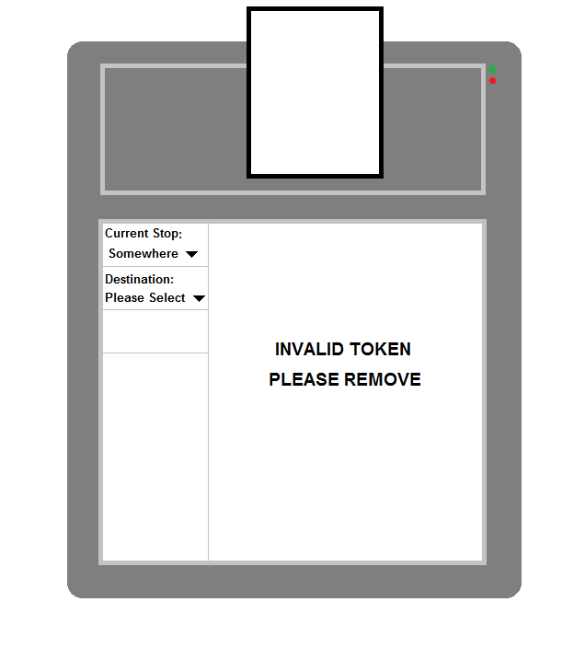
If the token is invalid it will output an error to the conductor and it will inform the passenger by showing a red LED.
The passenger will then need to remove the token and the process can be tried again.
Alternative payment may be used (e.g. cash and a ticket may be printed rather than using a card or token alternative)
Scanner Image 3 alternative
Notes:
If the token is invalid it will output an error to the conductor and it will inform the passenger by showing a red LED.
The passenger will then need to remove the token and the process can be tried again.
Alternative payment may be used (e.g. cash and a ticket may be printed rather than using a card or token alternative)

Slide 7
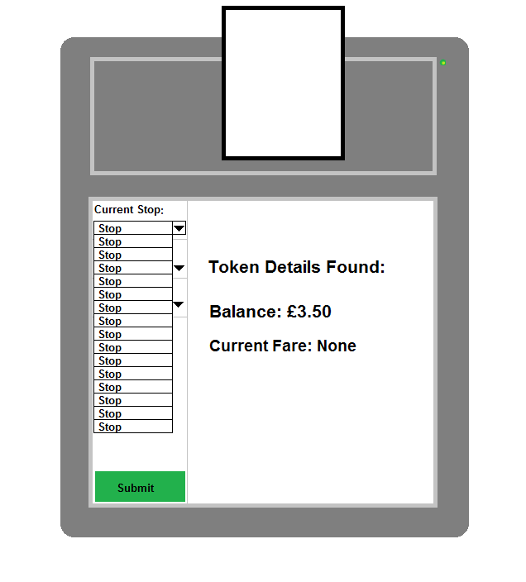
This show that the current stop can be selected from the drop down of available stops to that scanner on the specific route.
Scanner Image 4
Notes:
This show that the current stop can be selected from the drop down of available stops to that scanner on the specific route.

Slide 8
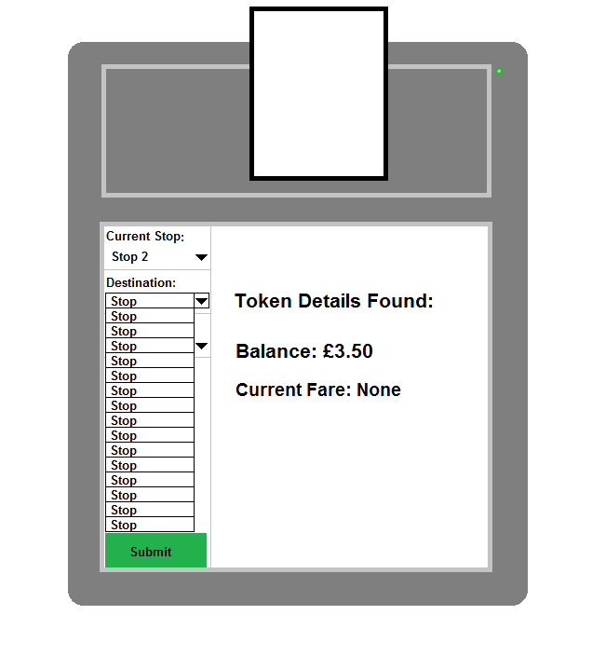
This show that the destination can be selected from the drop down of available stops to that scanner on the specific route.
Scanner Image 5
Notes:
This show that the destination can be selected from the drop down of available stops to that scanner on the specific route.

Slide 9
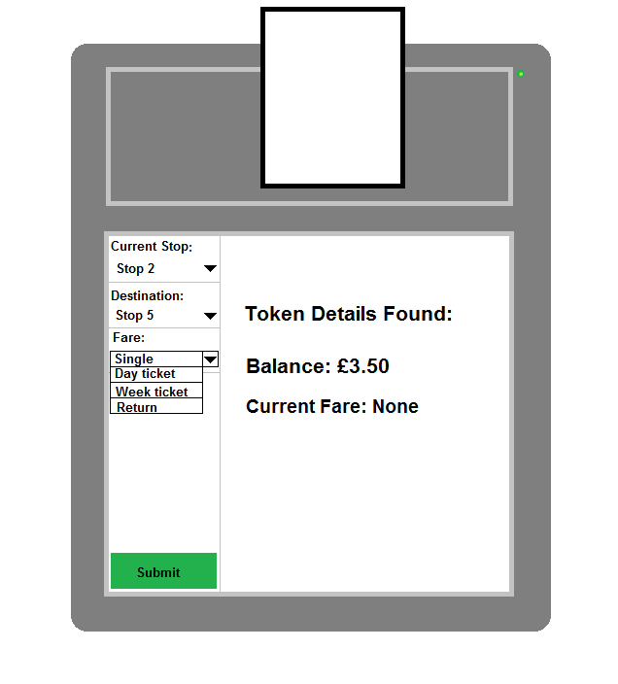
This will allow them to select what type of fare the passenger wants.
Scanner Image 6
Notes:
This will allow them to select what type of fare the passenger wants.

Slide 10
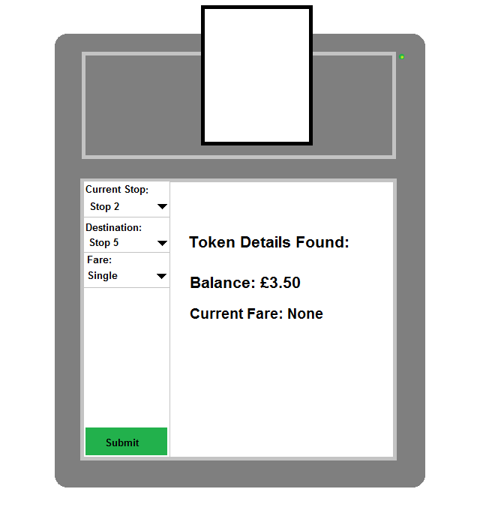
With all the options selected they can now press submit, it will then determine if the passenger can afford the journey.
Scanner Image 7
Notes:
With all the options selected they can now press submit, it will then determine if the passenger can afford the journey.

Slide 11
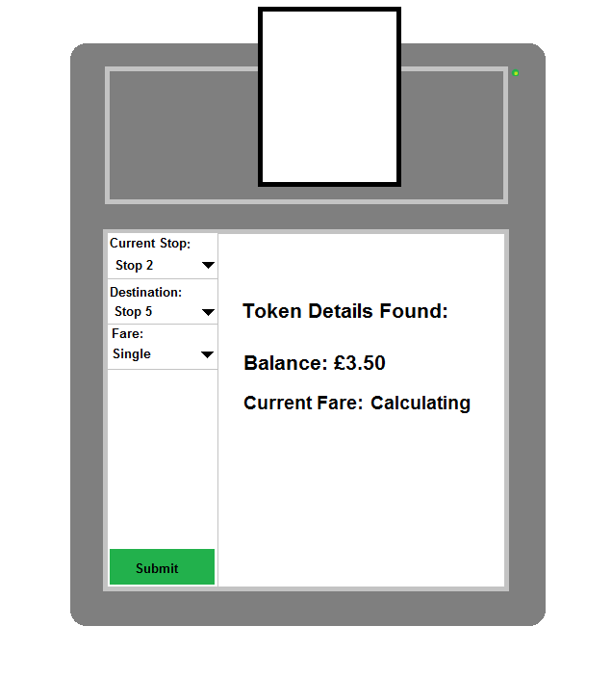
This is the output it will say when it has calculating the journey.
Scanner Image 8
Notes:
This is the output it will say when it has calculating the journey.

Slide 12
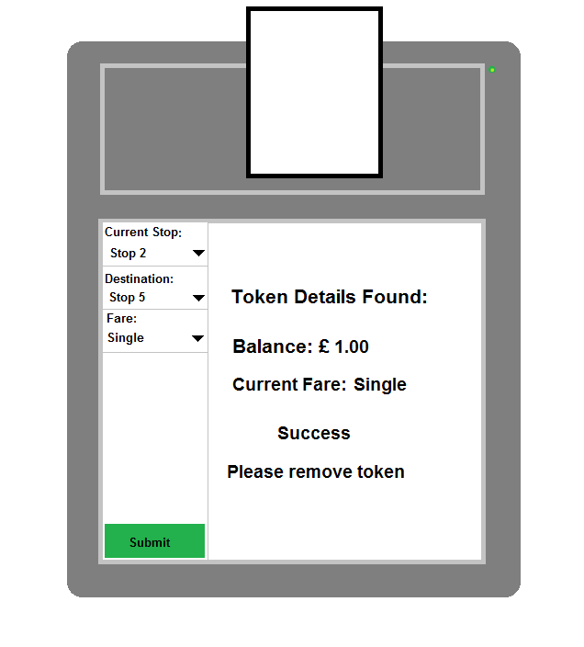
It will return either a success or an error message saying the journey can or cannot be made, an error as shown in Scanner Image 9 alternative
Scanner Image 9
Notes:
It will return either a success or an error message saying the journey can or cannot be made, an error as shown in Scanner Image 9 alternative

Slide 13
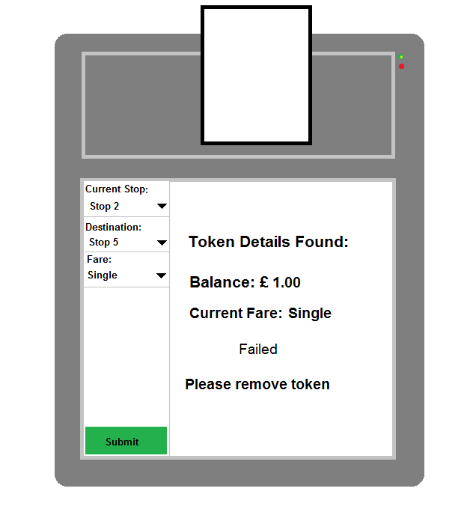
Shows that there was an error with the current journey.
Scanner Image 9 alternative
Notes:
Shows that there was an error with the current journey.

Slide 14
Terminal

Slide 15
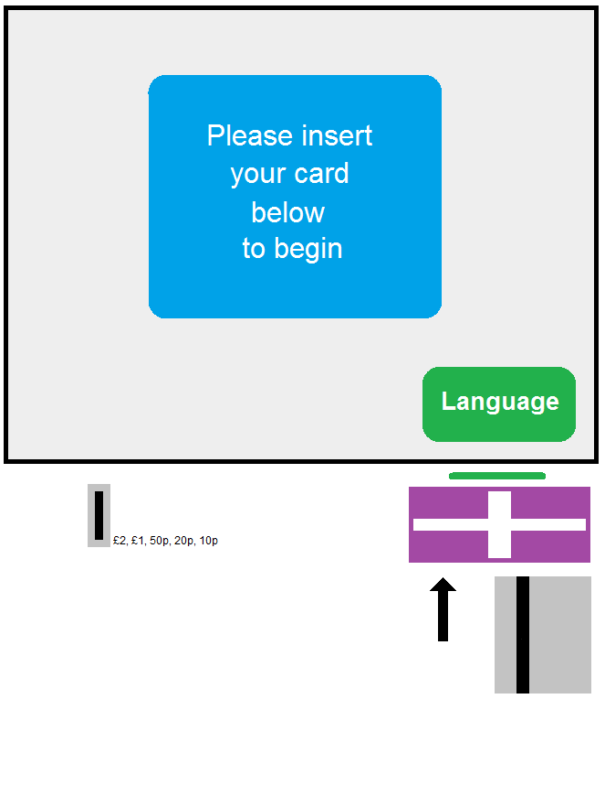
This is the waiting screen of the terminal. It will wait for an token to be inserted/scanned. Nothing will happen without the token present.
Terminal Image 1
Notes:
This is the waiting screen of the terminal. It will wait for an token to be inserted/scanned. Nothing will happen without the token present.

Slide 16
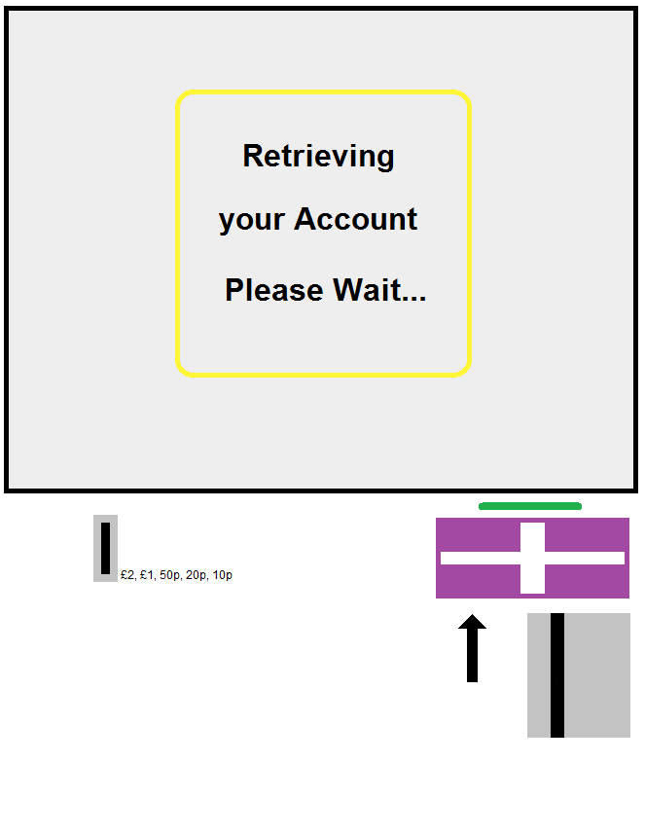
This will appear when an token has been inserted. Letting the user know that there account is being retrieved by the terminal.
Once it has been verified it will show the options for the account in Terminal, Image 3. If it is an invalid token it will show the error in Terminal Image 3 alternative.
Terminal Image 2
Notes:
This will appear when an token has been inserted. Letting the user know that there account is being retrieved by the terminal.
Once it has been verified it will show the options for the account in Terminal, Image 3. If it is an invalid token it will show the error in Terminal Image 3 alternative.

Slide 17
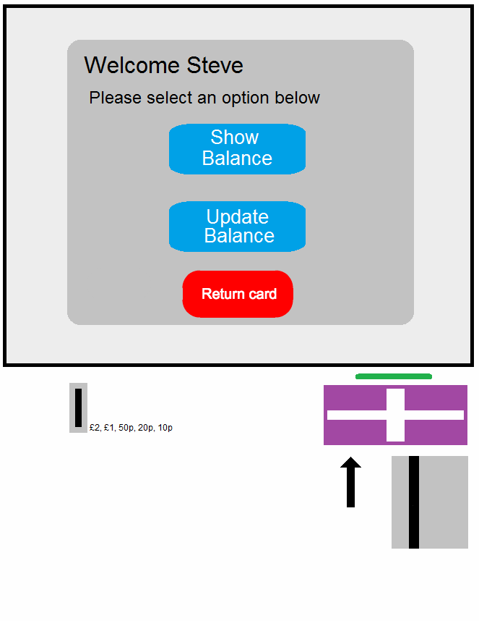
This is the options page, it shows the options to allow the user to see their balance, and to add money to their account.
The profile name is displayed which can be different for the Account Name for privacy preferences.
If they have inserted there card and changed their mind they can press the return card button to sign out of the terminal and it will return their card.
Terminal Image 3
Notes:
This is the options page, it shows the options to allow the user to see their balance, and to add money to their account.
The profile name is displayed which can be different for the Account Name for privacy preferences.
If they have inserted there card and changed their mind they can press the return card button to sign out of the terminal and it will return their card.

Slide 18
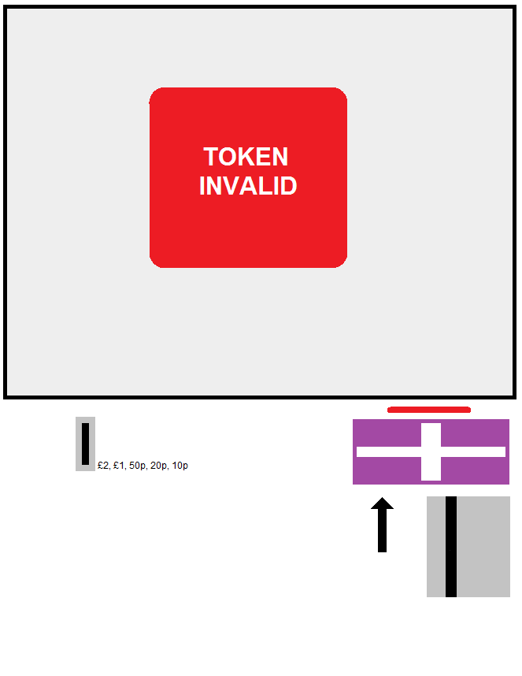
This is the error message that will show if the token is invalid for any reason. It will then allow the user to remove their token, and they can then try again.
This may be accompanied by a prompt message saying “Please try again or contact a member of staff”
Terminal Image 3 Alternative
Notes:
This is the error message that will show if the token is invalid for any reason. It will then allow the user to remove their token, and they can then try again.
This may be accompanied by a prompt message saying “Please try again or contact a member of staff”

Slide 19
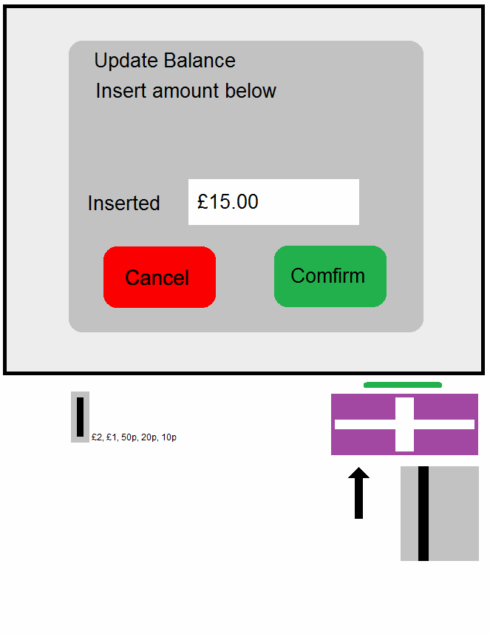
This is the update balance page, this will allow the user to insert coins into the coin slot and add money to the account. The number of coins inserted on screen will update every time an coin is entered.
The terminal may also be fitted with a note slot and an visa/credit card reader so that it can accept any method of payments.
Once, to let the terminal to update their balance. the user has finished entering the amount required they will then click confirm.
If the user doesn't want to update their balance they can click cancel at anytime and it will take them back to the home page, and it will refund the money inserterted.
Terminal Image 4
Notes:
This is the update balance page, this will allow the user to insert coins into the coin slot and add money to the account. The number of coins inserted on screen will update every time an coin is entered.
The terminal may also be fitted with a note slot and an visa/credit card reader so that it can accept any method of payments.
Once, to let the terminal to update their balance. the user has finished entering the amount required they will then click confirm.
If the user doesn't want to update their balance they can click cancel at anytime and it will take them back to the home page, and it will refund the money inserterted.

Slide 20
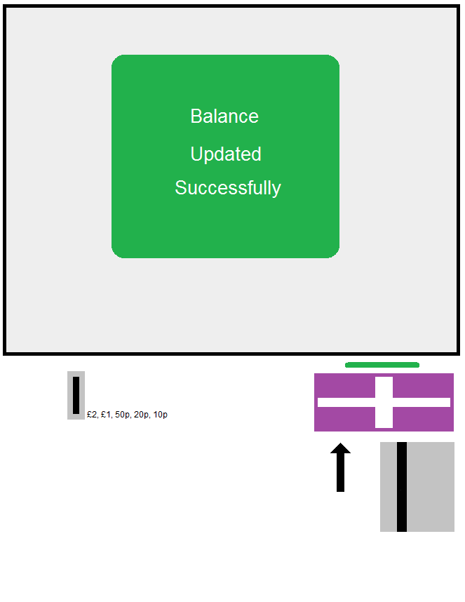
This screen will appear when the transaction has completed, it will then go back to the menu screen shown in terminal image 3.
If they don't want to use any more of the options they can select the return card on image 3 to signout and return their card.
Terminal Image 5
Notes:
This screen will appear when the transaction has completed, it will then go back to the menu screen shown in terminal image 3.
If they don't want to use any more of the options they can select the return card on image 3 to signout and return their card.

Slide 21
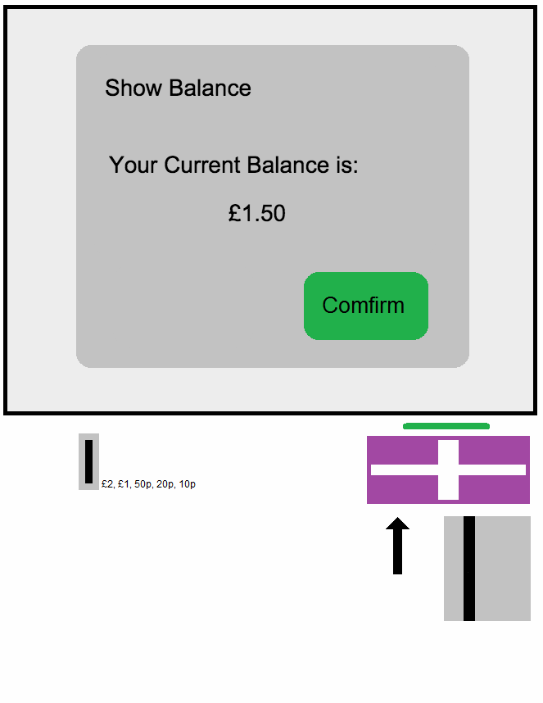
This screen will appear when the user selects the show balance screen, it will then retrieve the users balance and output it onto the screen.
Terminal Image 6
Notes:
This screen will appear when the user selects the show balance screen, it will then retrieve the users balance and output it onto the screen.

Slide 22
Mobile App

Slide 23
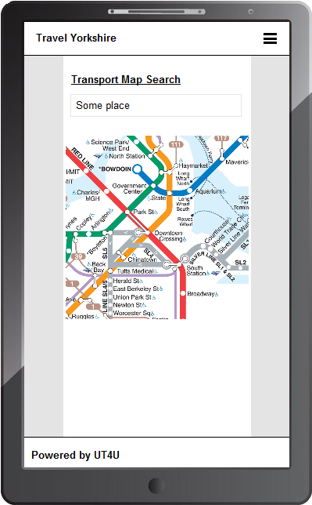
This app will allow any users of the transport system to gain access to their account, and to find any information about routes, fares etc.
This is an example page where an user may find the desired route in a given location.
Mobile App Image 1
Notes:
This app will allow any users of the transport system to gain access to their account, and to find any information about routes, fares etc.
This is an example page where an user may find the desired route in a given location.

Slide 24
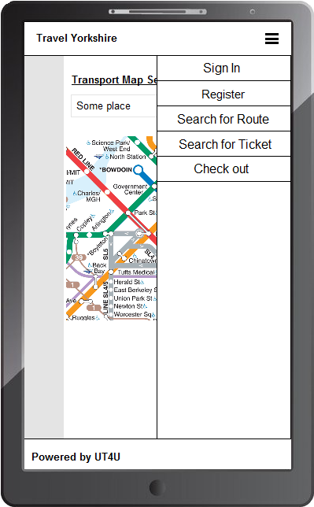
This is the navigation for the app this will allow them to navigate to any part of the app, and even allow them to log into their account or to register.
Mobile App Image 2
Notes:
This is the navigation for the app this will allow them to navigate to any part of the app, and even allow them to log into their account or to register.

Slide 25
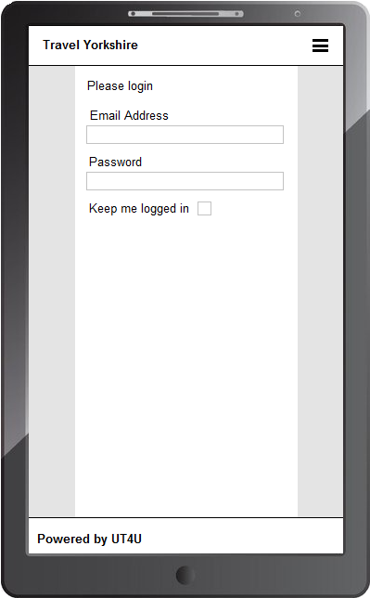
This is the login page. If the username and password is incorrect it will, notify the user by appropriate error messages and highlighting the boxes and labels red.
Mobile App Image 3
Notes:
This is the login page. If the username and password is incorrect it will, notify the user by appropriate error messages and highlighting the boxes and labels red.

Slide 26
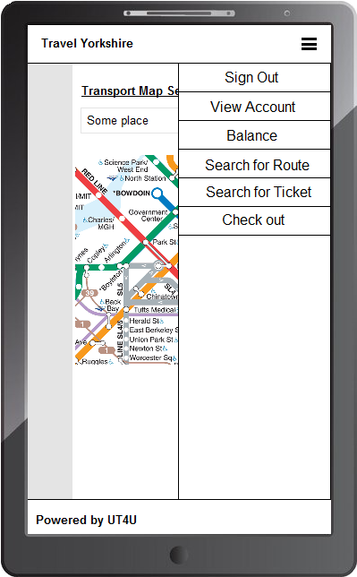
Once logged in they will be given more options on the navigation bar, such as view account, balance, and sign out.
They will they be able to update their address, profile name and password using this app and these options will also be available once logged in or when the user requests to change their password after not being able to sign in and it being verified in some way e.g. email, text etc.
Mobile App Image 4
Notes:
Once logged in they will be given more options on the navigation bar, such as view account, balance, and sign out.
They will they be able to update their address, profile name and password using this app and these options will also be available once logged in or when the user requests to change their password after not being able to sign in and it being verified in some way e.g. email, text etc.

Slide 27
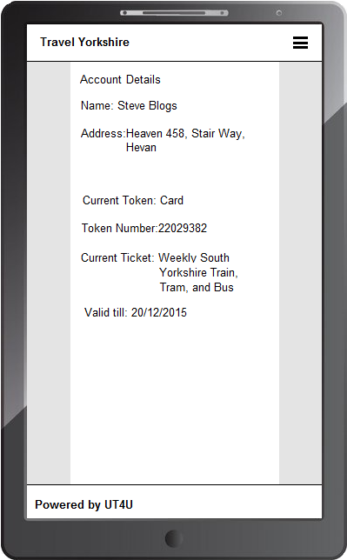
This is the account page. This will allow the user to look at their personal information, and information about their current token and their current ticket.
This page will show all the Account details:
Account ID
Account Name
Profile Name
Occupation
Current Balance
Additional information will be hidden until “show additional information” is pressed.
Additional Information:
Account Activation Date
Date of Birth
Mobile App Image 5
Notes:
This is the account page. This will allow the user to look at their personal information, and information about their current token and their current ticket.
This page will show all the Account details:
Account ID
Account Name
Profile Name
Occupation
Current Balance
Additional information will be hidden until “show additional information” is pressed.
Additional Information:
Account Activation Date
Date of Birth

Slide 28
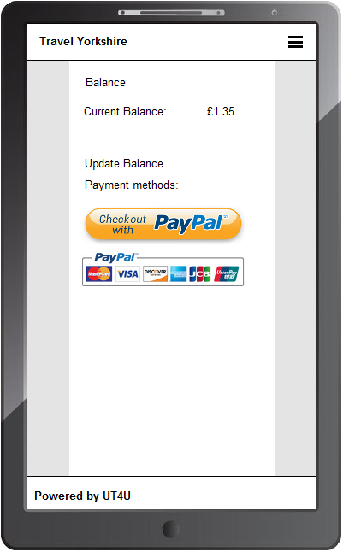
This page will allow the user to update their balance with any online payment methods e.g. PayPal, this will give them the chance to update it on the go or when they are in a sticky situation. Such as not been able to get to the transport interchange to update their balance.
Mobile App Image 6
Notes:
This page will allow the user to update their balance with any online payment methods e.g. PayPal, this will give them the chance to update it on the go or when they are in a sticky situation. Such as not been able to get to the transport interchange to update their balance.

