Slide 1
Meal Planner on Dash
V1.0 - 2021.01.04

Slide 2
Objectives of the Guide
Installation and Setup of the Application
Usage of the Application to aid meal planning
Basic Customisation of the Application (U/C)

Slide 3
Installation & SetUp

Slide 4
Installation Steps
Download all files in directory
Install python packages (pandas, dash, dash-table, dash bootstrap components)
Edit recipe database
Run main_app.py and open in browser (see python terminal for URL)

Slide 5
User Guide

Slide 6
Weekly Meal Plan
Weekly Grocery List
Cross reference ingredients and occurrences and generate shopping list
Store Meal Plan
Auto-saved, once complete. Stored for future reference.

Slide 7
Weekly Meal Plan
Step 1: Select the week
Step 2: Select recipes planned for the week
Step 3: Drop down select into slots for the week
Step 4: Inspect & Modify auto-generated shopping list
Step 5: Copy to clipboard

Slide 8
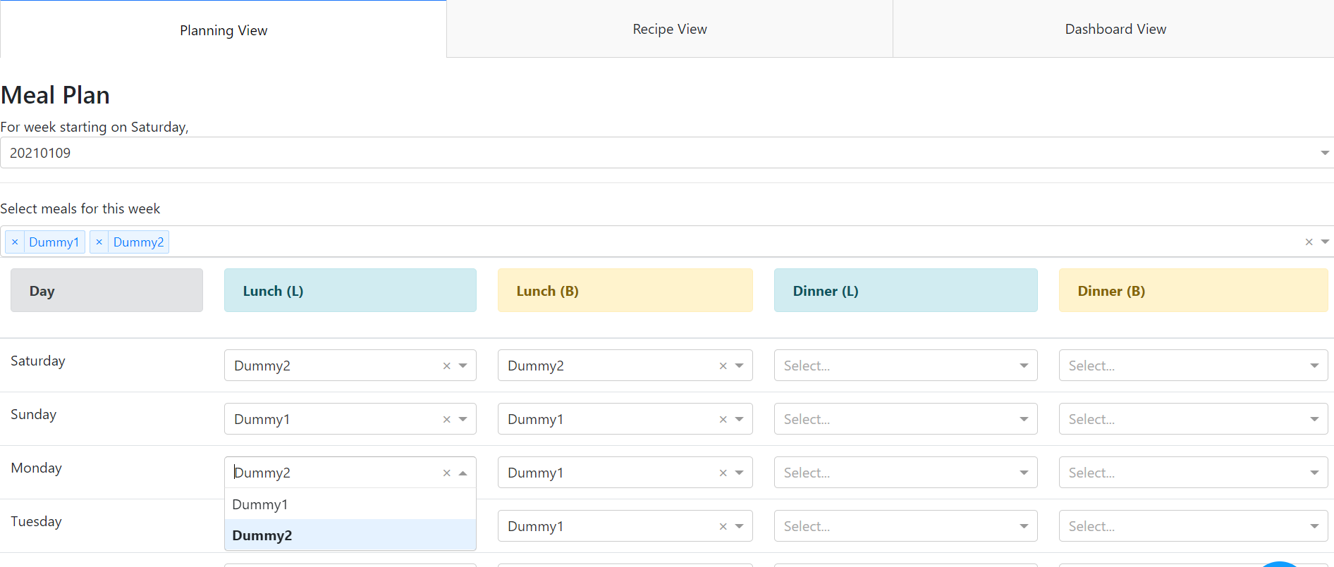
1. Specify Week Start
2. Add recipes via drop-down
3. Fill meal slots

Slide 9
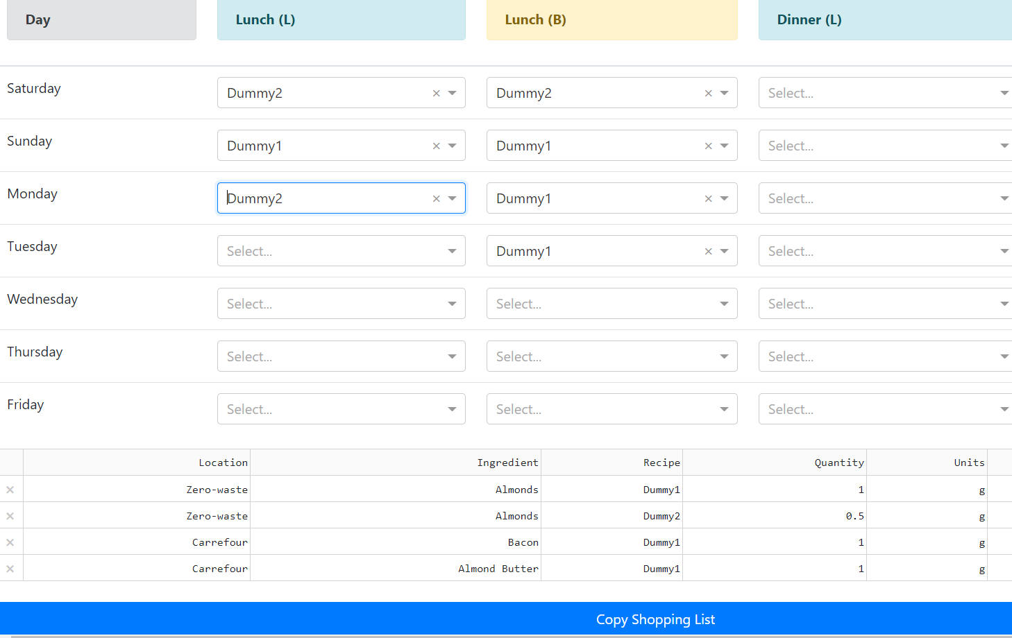
4. Remove as applicable
5. Copy Grocery List to Clipboard

Slide 10
Recipe Editor
Add Recipes
Recipes Database is what powers the grocery-list generation capabilities of the application

Slide 11
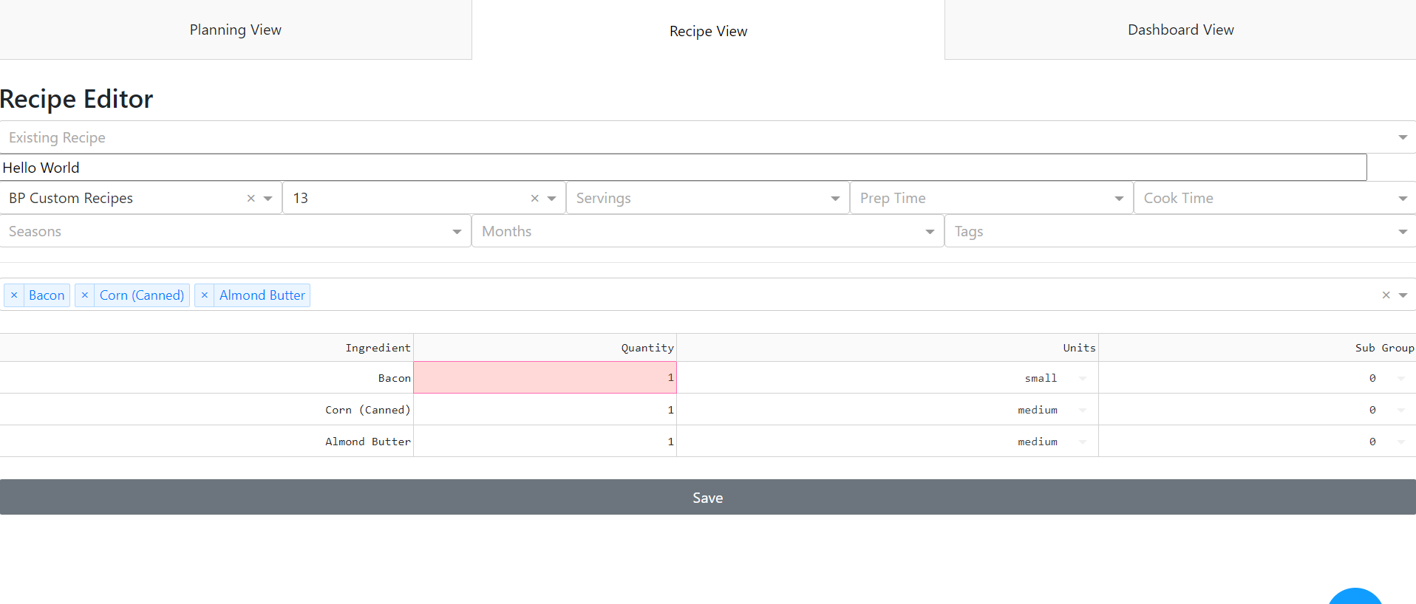
1. Recipe Meta-data (e.g. Name, Source, Page/Idx, …)
2. Select Ingredients
3. Modify Quantities etc
4. Save Recipe
Note, Sub Group refers to if we have a choice between various ingredients
Note, all recipes can also be manually adjusted via direct access to CSV files

