Slide 1
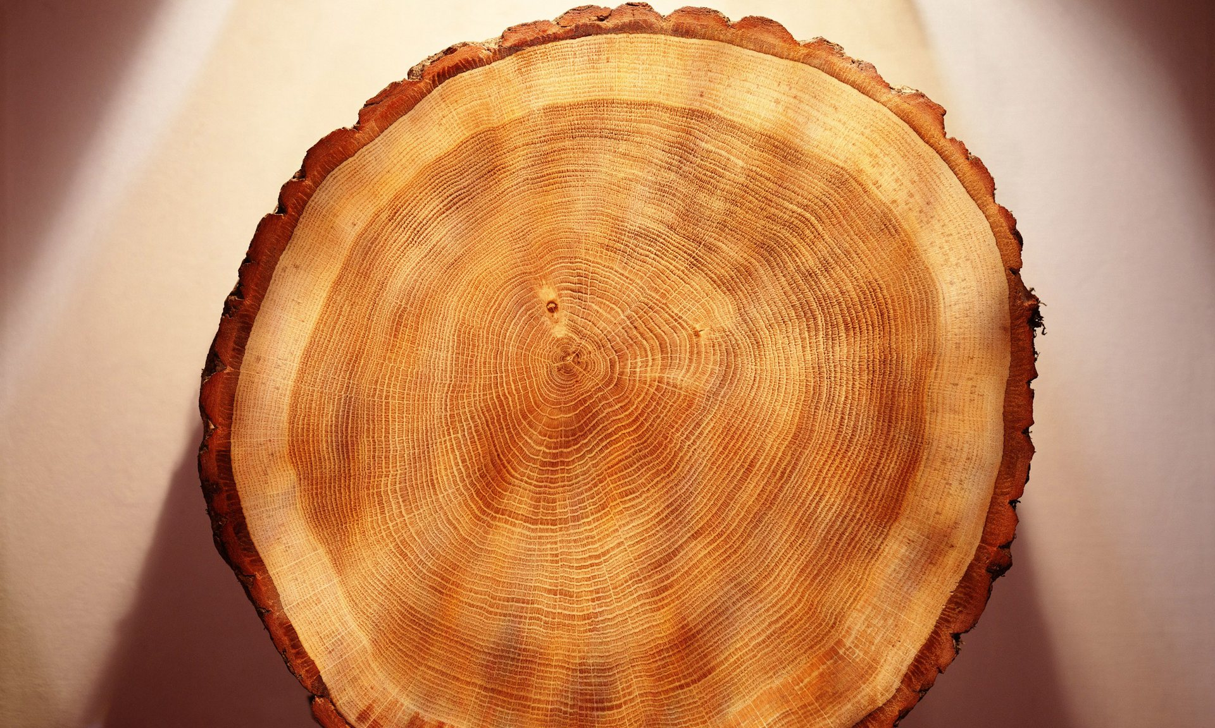


Extreme Solar Events
in the tree-ring Radiocarbon Record
Benjamin Pope
SPI-MAX Seminar Hilary 2017
github.com/benjaminpope
@fringetracker

Slide 2
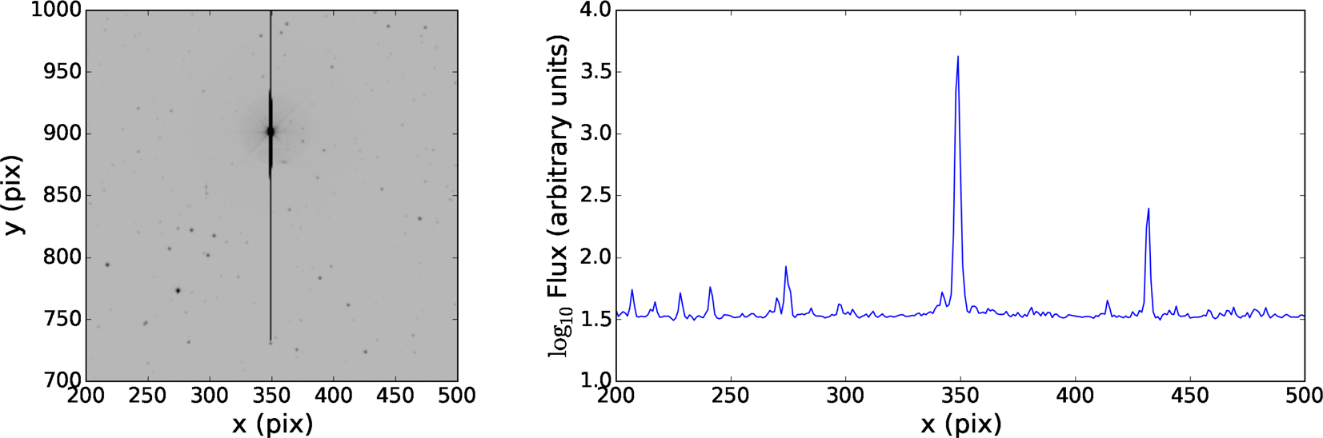
Smear Photometry
Red giant HR 8500 in a Kepler Full Frame Image, and its accompanying smear profile

Slide 3
Conclusions

