Slide 1

Adapting Tempo Analysis
for Your Data
A practical guide to tuning librosa for non-standard audio
Benjamin D. Rieger
TU Dresden | CeTI Excellence Cluster

Slide 2
What is algorithmic tempo analysis?
Using mathematical functions to predict the beat and tempo of a piece of music
Autocorrelation, Beattracking, Dynamic Programming are the most common forms
The shape and regularity of audio is measured in reference to the whole track and simulated or projected with multiple hypothetical grids

Slide 3
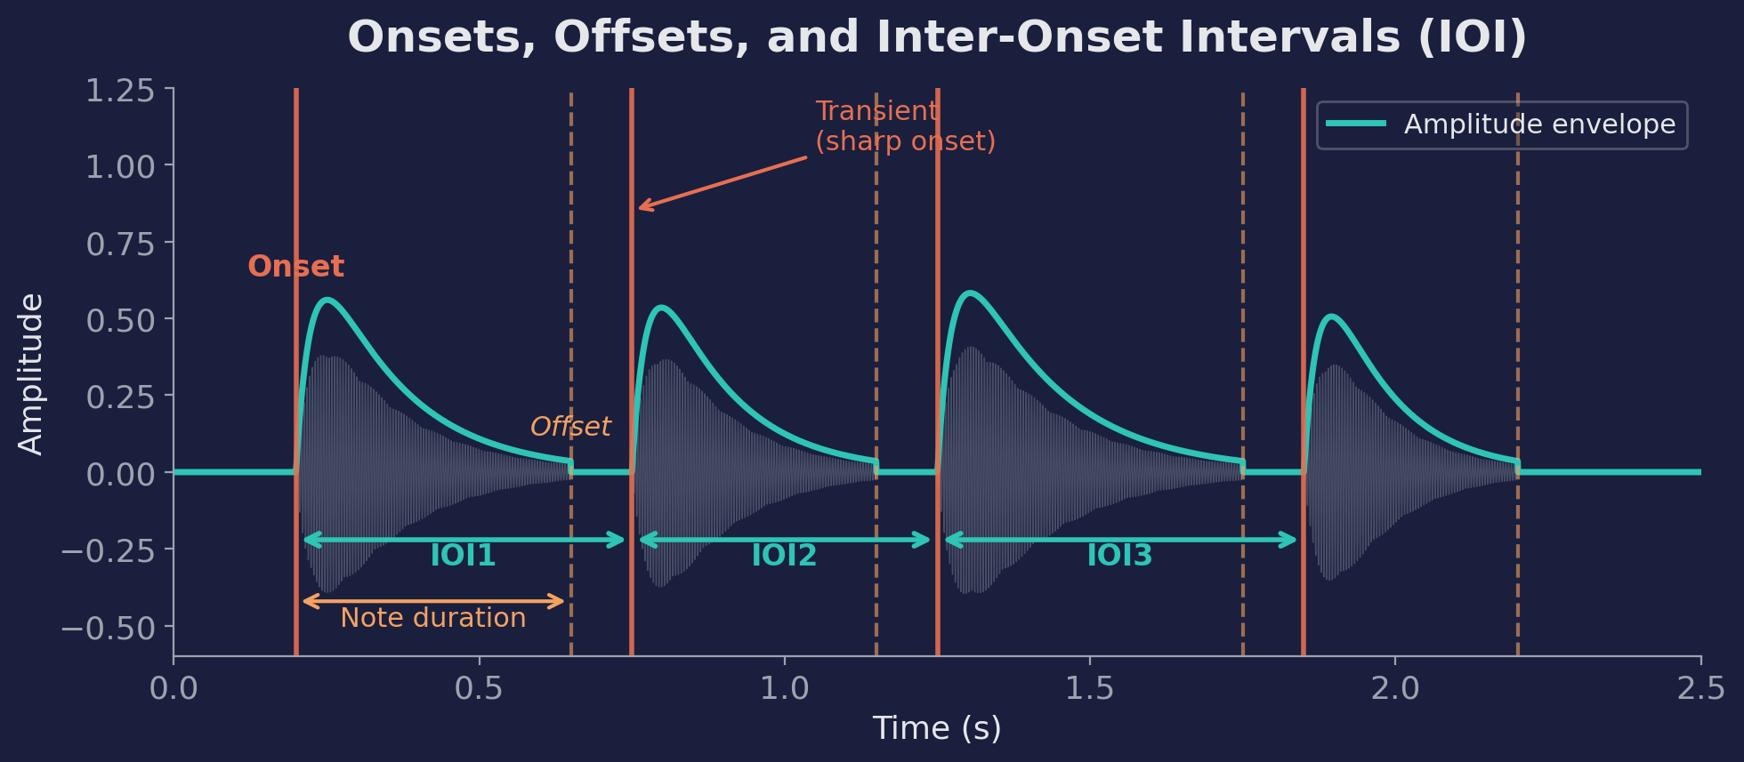
Anatomy of a Beat
IOI is the raw material for tempo: BPM = 60 / median(IOI)

Slide 4
When Defaults Fail
librosa's beat tracker is optimised for produced music with clear percussion.
A cappella singing
Soft onsets, no percussion, tempo drift
Field recordings
Background noise, variable dynamics
Speech / spoken word
Irregular rhythm, no clear beat
Ambient / drone
No transients, very slow or no pulse
Non-Western music
Unfamiliar meter, microtiming
If your audio doesn't sound like a pop song, you need to adapt.

Slide 5
What librosa Gives You
import librosa
y, sr = librosa.load('audio.wav', sr=None, mono=True)
env = librosa.onset.onset_strength(y=y, sr=sr, hop_length=512)
bpm, beats = librosa.beat.beat_track(onset_envelope=env, sr=sr,
hop_length=512, start_bpm=120)
Two core functions with tunable parameters:
onset_strength()
Spectral flux across mel bands. Params: sr, hop_length, n_fft, aggregate, n_mels
beat_track()
Dynamic-programming beat sequence. Params: start_bpm, tightness, trim, units

Slide 6
Knob 1: Pre-emphasis Filtering
Not a librosa parameter — you apply it to your audio before feeding it in.
y = librosa.effects.preemphasis(y, coef=0.97)
What it does
When & how much
Boosts high frequencies relative to low
Makes consonants ('t', 'k', 's') louder relative to vowels
Syllable boundaries become visible as amplitude peaks
coef = 0.95–0.97
for singing with clear consonants
coef = 0.85–0.90
for humming or vowel-heavy audio
Skip entirely
for percussive audio (already sharp)
Notes:
Pre-emphasis is the single most impactful adaptation for vocal audio. Demo idea: play the same lullaby with and without pre-emphasis and show the onset envelope difference.

Slide 7
The Octave Problem
The single most common failure mode in tempo estimation:
Is this song at 60 BPM or 120 BPM?
Both are mathematically valid. Every beat at 60 BPM is also a beat at 120 BPM — you just skip every other one. Autocorrelation finds both.
Three strategies to resolve it:
1
Tempo prior (soft bias)
Multiply ACF by a Gaussian centred on your expected tempo. Gently discourages the wrong octave without forcing a result.
2
Tactus correction (post-hoc)
After estimation, check: is the result closer to 2× the expected? If yes, halve it. Simple and effective as a safety net.
3
Grid-fit comparison
Place a beat grid at BPM and BPM/2. Measure which grid aligns better with actual onset peaks. The better fit wins.
Notes:
The octave problem is universal. Even professional MIR tools struggle with it. These three strategies can be combined. In my lullaby work I use all three. For student projects, at minimum use a tempo prior if you know roughly what range to expect.

Slide 8
Knob 3: start_bpm & tightness
bpm, beats = librosa.beat.beat_track(onset_envelope=env, sr=sr,
hop_length=512, start_bpm=120, tightness=100)
start_bpm
tightness
Initial tempo estimate for dynamic programming.
Default: 120 BPM (pop music)
Slow audio: 50–80
Fast audio: 140–180
Wrong start_bpm = garbage.
Controls beat rigidity. Higher = stricter; lower = flexible.
Default: 100
Steady music: 100–400
Rubato/expressive: 20–50
Too low = chases noise.

Slide 9
Knob 2: Onset Envelope Tuning
env = librosa.onset.onset_strength(y=y, sr=sr, hop_length=512)
env = librosa.util.normalize(env) # scale to [0, 1]
hop_length
smoothing
normalize
~12 ms at 44.1 kHz.
Time resolution.
Moving average over N frames
suppresses noise.
Puts all recordings on
same amplitude scale.
Tuning:
Tuning:
Tuning:
Smaller = finer but noisier.
256 fast, 512–1024 slow.
5–10 for singing.
Less percussive, more ambient.
Almost always do this.
Prevents loud domination.

Slide 10
Building an ACF Estimator with Prior
def acf_tempo(onset_env, sr, hop, tempo_min, tempo_max, mu, sigma=5):
"""Pick tempo from ACF, biased toward expected range."""
N = len(onset_env)
acf = [np.dot(onset_env[:N-k], onset_env[k:]) / (N-k)
for k in range(1, N//2)]
bpms = 60 * sr / (hop * np.arange(1, len(acf)+1))
mask = (bpms >= tempo_min) & (bpms <= tempo_max)
# Gaussian prior — the key adaptation
prior = np.exp(-0.5 * ((bpms[mask] - mu) / sigma)**2)
score = acf[mask] * prior
return bpms[mask][np.argmax(score)]
Copy-paste this. The two red lines are the entire prior mechanism.

Slide 11
Knob 3: start_bpm & tightness
bpm, beats = librosa.beat.beat_track(onset_envelope=env, sr=sr,
hop_length=512, start_bpm=120, tightness=100)
start_bpm
tightness
The initial tempo estimate for the dynamic programming. The algorithm builds a beat sequence anchored around this value.
Default: 120 BPM (pop music)
If your audio is slow (lullabies, ambient), set this lower (50–80). If fast (EDM, punk), set higher (140–180). A wrong start_bpm can make the tracker drift entirely.
Controls how rigidly beats must follow the expected tempo. Higher = stricter metronome; lower = more flexible.
Default: 100
For steady music: 100–400 works well. For rubato / expressive performance: lower to 20–50 so the tracker can follow tempo changes. Too low and it chases noise.
Notes:
These are the two most important beat_track parameters. start_bpm is where most people go wrong — they leave it at 120 for everything. tightness controls flexibility vs stability. Show examples: same audio, different start_bpm values, see how the beat sequence changes.

Slide 12
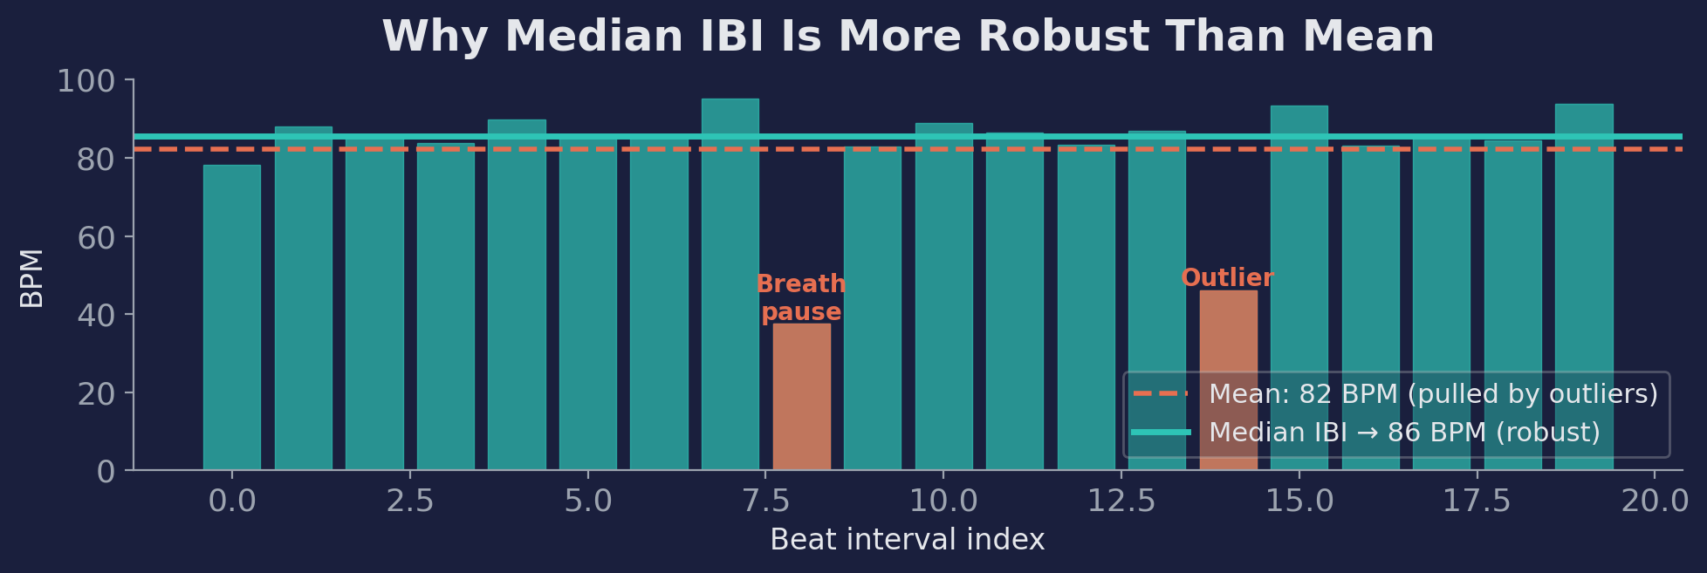
Knob 4: Robust BPM from Beat Positions
beat_times = librosa.frames_to_time(beat_frames, sr=sr, hop_length=512)
ibis = np.diff(beat_times) # inter-beat intervals
robust_bpm = 60.0 / np.median(ibis) # median, not mean
Two lines. Dramatically better for anything with natural tempo variation.

Slide 13
Parameter Reference Card
Parameter | Default | Slow / soft audio | Fast / percussive
pre-emphasis coef | none | 0.90 – 0.97 | skip
hop_length | 512 | 512 – 1024 | 256 – 512
smoothing (frames) | none | 5 – 15 | 1 – 3
start_bpm | 120 | 50 – 80 | 120 – 180
tightness | 100 | 20 – 50 (rubato) | 100 – 400
ACF prior sigma | n/a | 5 – 10 (narrow) | 15 – 30 (broad)
BPM summary | global | median IBI | global or median
Coral = changes that matter most.

Slide 14
Validation: How to Know It Works
You've tuned the parameters. How do you know the output is correct?
1
Run multiple methods
Use 2–3 estimators on same audio. If they agree, trust it.
2
Report agreement
Pearson r, ICC, MAD. ICC > .85 = good. Show in your paper.
3
Spot-check by ear
Listen with metronome overlay. Low-tech but catches systematic errors.
4
Check your key effect
Does your finding hold across all methods? If not, it may be an artefact.

Slide 15
Key Takeaways
1
librosa is a foundation, not a finished product. Adapt it.
2
Pre-emphasis is your best friend for vocal audio.
3
start_bpm and tightness matter most. Don't leave defaults.
4
The octave problem is real. Use priors, correction, or both.
5
Median IBI > global BPM for natural tempo variation.
6
Always validate. Multiple methods + listen.

