Slide 1
.NET ASPIRE
Supercharged Cloud-First Development

Slide 2
What is .NET Aspire
Not related to the contracting company Aspire
An Orchestrator tool – mostly for local development
Requires .NET 8
A new project type that can be added onto existing projects to help running distributed applications locally.
Brings opinionated, pre-tooled NuGet packages that build off existing framework packages like Entity Framework, Azure SDK, etc. that automatically configure health checks, logging, metrics, tracing, resiliency, etc.
Infrastructure from code

Slide 3
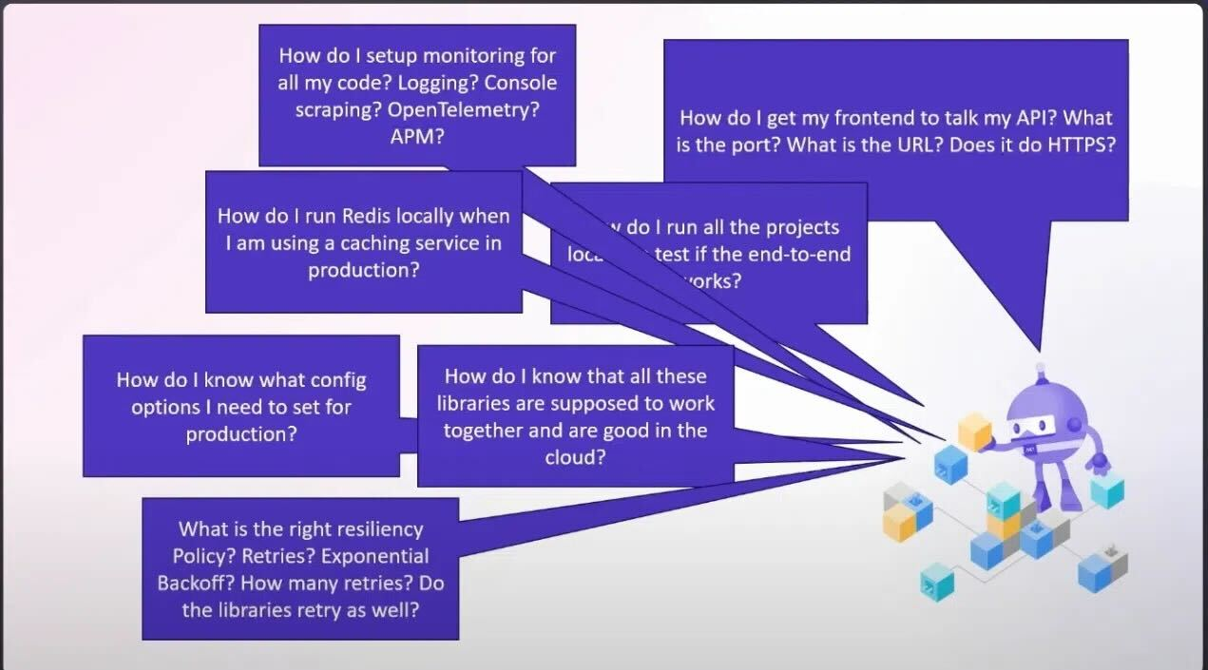
Distributed Systems are hard

Slide 4
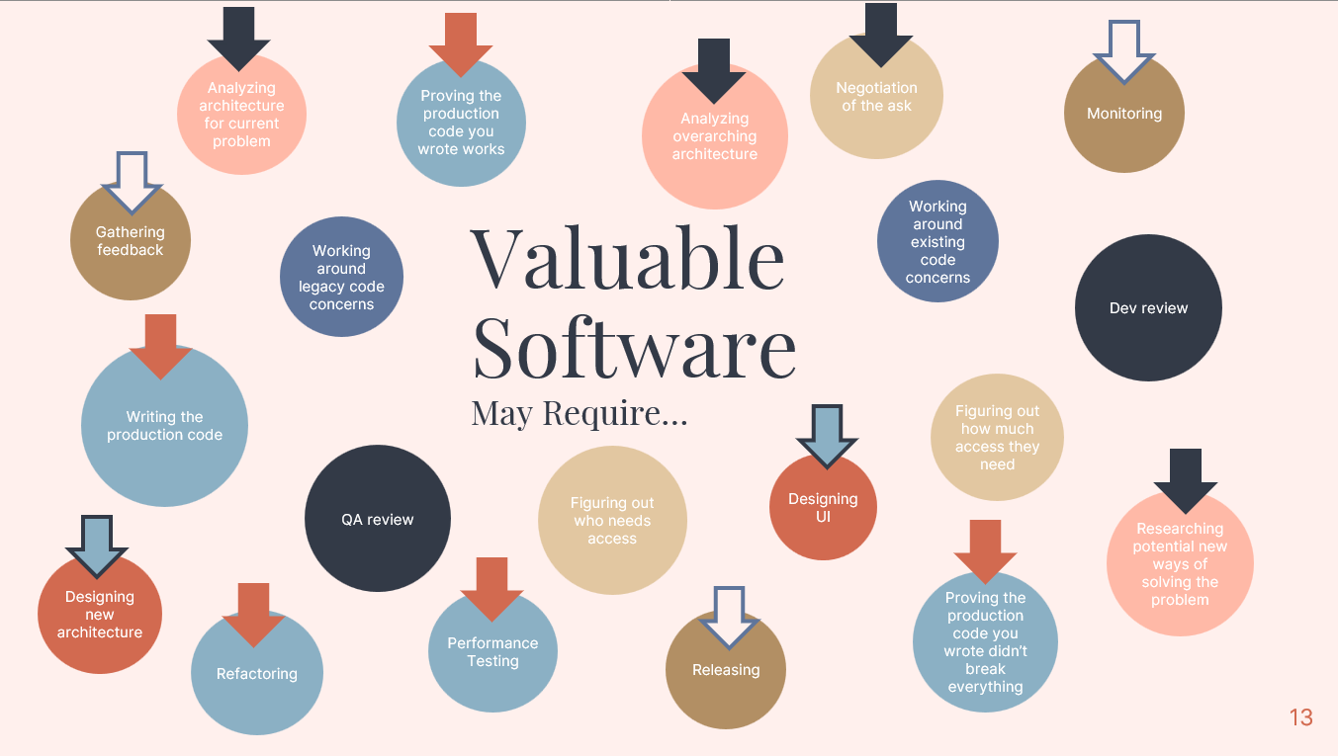

Slide 5
A Refresher on Distributed Tracing

Slide 6
Observability
Logging
Tracing
Metrics
Debugging, understanding user behavior, reactive monitoring
Correlation, performance analysis across entire system
Performance of specific things, at specific times

Slide 7
Web Application
Database
Traceparent (2019)
Built into .NET since 3.1
Open Telemetry (OTEL)
Backend Api
Database

Slide 8
Trace Id - 444
Example - https://onenr.io/0MR2aB70GwY
Invoice Processing
Invoice Validation
Invoice Reconciliation
Event
Event
Span Id - 111
Span Id - 222
Span Id - 333

Slide 9
DEMO
The Project Template, Embedding into an existing project, and the Azure Developer CLI

