Slide 1

.NET Local & Dev Testing
Without a Dockerfile or Docker-Compose

Slide 2
Why Containers?
Pull dependencies for dev & testing
SQL Server
Your own APIs
Utilities / Shared Infrastructure
Common deployment targets allow simpler pipelines
Hide complexity of infrastructure from application
Azure Function -> Worker Services
Notes:
4) Monitoring services like health checks
5) Always deploy to a container app rather than a bespoke resource type
7) Azure Functions (triggers, host runtime, etc)

Slide 3

Why no Dockerfile?
Notes:
- Need to learn a new DSL, versus using a GPL you’re already familiar with.
- Additional complexity with private feeds
- Casey’s self-signed certificate
Command does some optional but nice things at the docker level
Doesn’t absolve us from learning how it works – but learning is layered and is easiest from a familiar place.

Slide 4

Building Our Own Image Locally
.NET 8+
.NET 7- requires Microsoft.NET.Build.Containers
No Dockerfile
Do not need to import self-signed certificate
Do not need to import a AzDo token for NuGet restores to our private feed
Configured through properties in .csproj

Slide 5

Demo

Slide 6

Tools For Local Dev & Testing
TestContainers.NET
SQL Server
Azurite
Postgres
Etc.
.NET Aspire
Some pitfalls
Hardening a lot in .NET 10
High investment by .NET Team

Slide 7

Problems We Have During Testing
Database
Creating a database
Seeding Initial Data required by the domain
Inserting data atomically
Cleaning up between each test
Azure Storage
Creating a container
Placing files atomically
Cleaning up between each test
More generally, orchestration

Slide 8
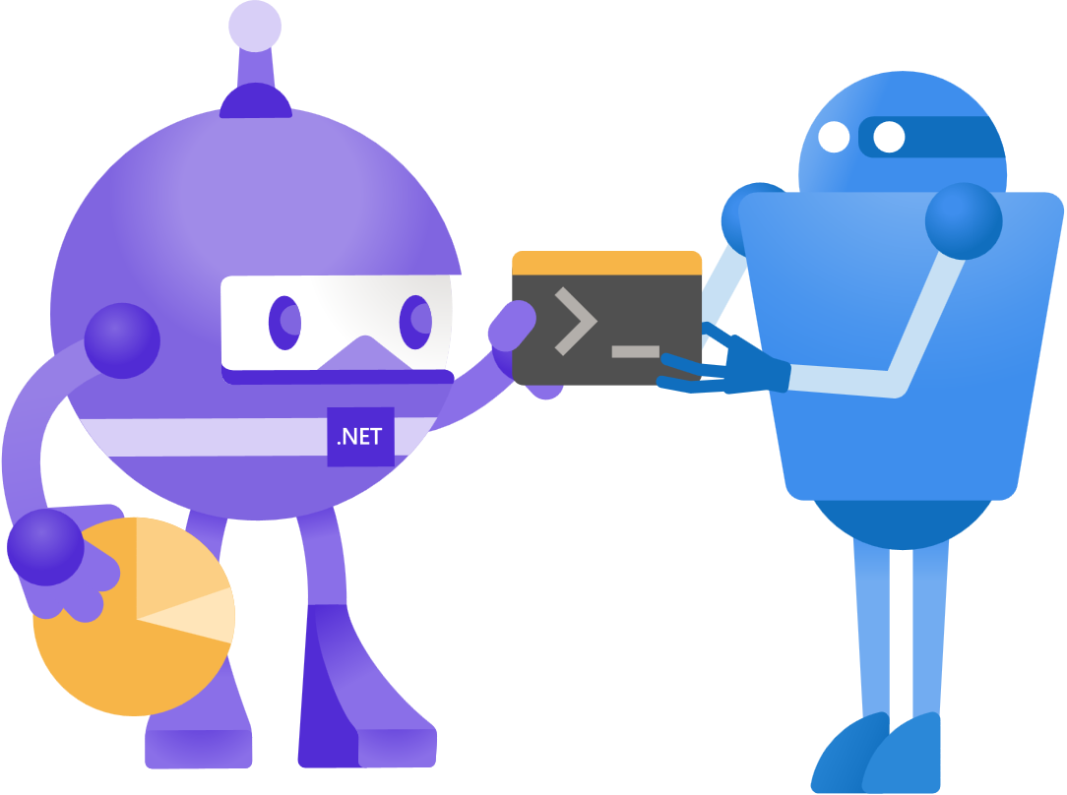
Problems We Have During Local Dev
The same as testing
Container re-use
Speed
Sanity

Slide 9

Demo

Slide 10

Questions?

