Slide 1
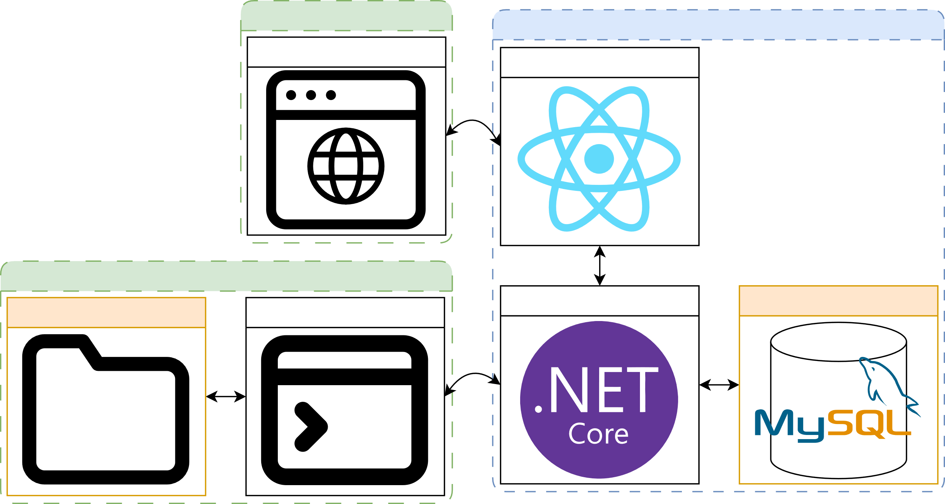
- -
User 1s Machine
- -
Background
Docker
Objective
Browser
Frontend (React, JS)
System Architecture
Janus is a secure distributed version control system (DVCS) tailored for enterprises to manage their codebases internally. It eliminates reliance on external cloud services, ensuring that sensitive data remains under strict organisational control.
Version control systems are crucial in managing code and facilitating effective collaboration.
Early centralised systems offered a simple solution but required constant network access and were inflexible. In contrast, public distributed systems cater to general use.
However, this one-size-fits-all approach frequently falls short of addressing modern organisations' stringent requirements regarding data sovereignty, internal compliance, and legal obligations.
- -
User 2s Machine
Backend (.NET 8, C#)
Database (MySQL)
Local Repository
CLI (.NET 8, C#)
- Features -
Local Version Control: With binary file support
Standalone Command Line Interface (CLI)
Cross Platform Compatibility: Operates seamlessly on MacOS, Linux & Windows
Plugin Architecture: Extendable CLI functionality through custom plugins
Web Interface: A React web app for remote repository management
Granular Access Control: Per repository permissions for collaborative projects
Data Fortress: Operates entirely within internal networks, with no external exposure
Activity Logging: Track all operations to the remote repository
- -
Future
Plugin Marketplace: Create space for plugins to be shared within the community
Advanced Encryption: Integrate encryption protocols for data in transit and at rest
Pilot Testing: Collaborate with DevOps teams to collect real world usage data for improvements to the system
Scalability: Incorporate Kubernetes for scaling and load balancing

