Slide 1
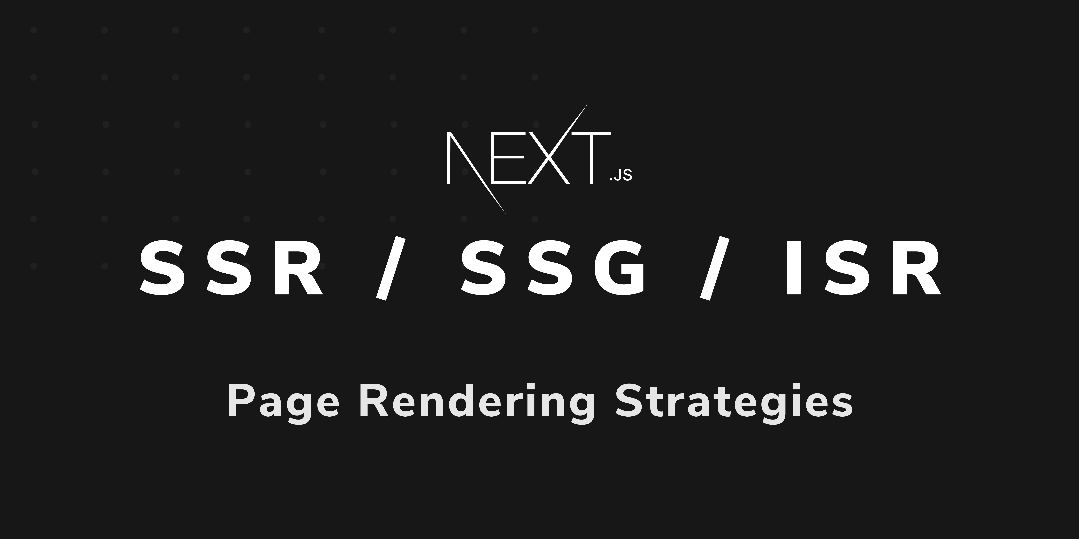

Slide 2


Slide 3
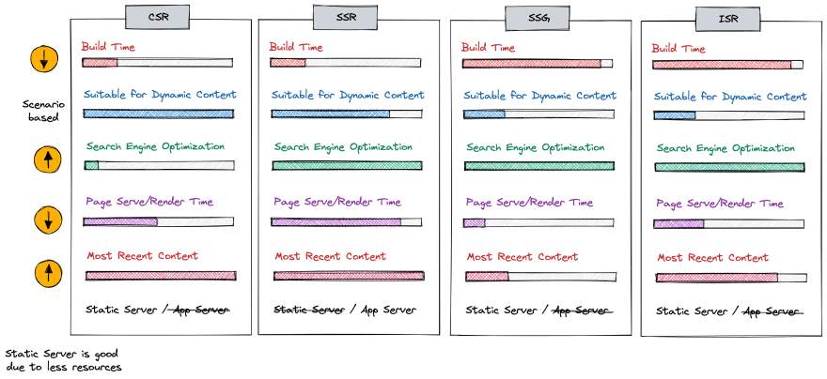
CSR - Client Side Rendering

Slide 4
SSR - Server Side Rendering

Slide 5
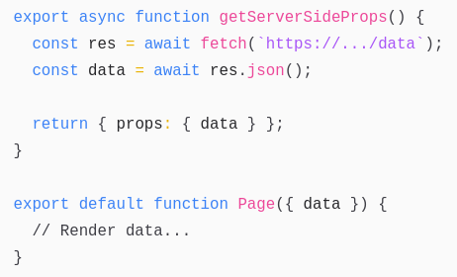
SSR - Server Side Rendering

Slide 6
SSG - Static Site Generation

Slide 7
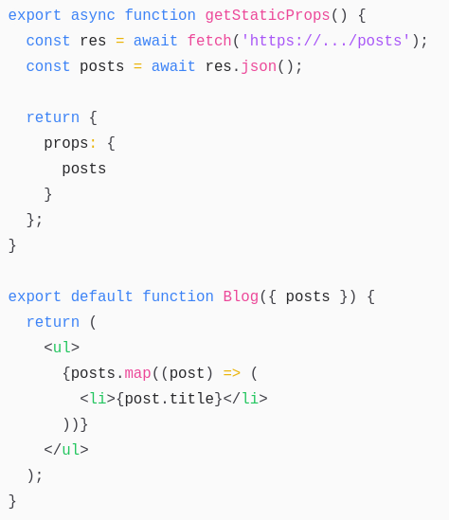
SSG - Static Site Generation

Slide 8
ISR - Incremental Static Regeneration

Slide 9
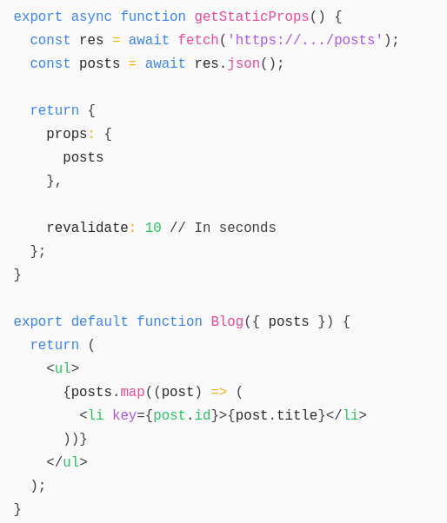
ISR - Incremental Static Regeneration

Slide 10


