Slide 1
Hardware Programming HWP01
capturing a
FPGA
design with
VHDL

Slide 2
Planning: theory
First week
Introduction digital systems
Structured digital Design
RTL
Second week
Introduction VHDL
Code structure and data types
Design verification
Third week
Combinational versus sequential design
Concurrent and sequential code
Signals and variables
Fourth week
Introduction to state machines
Fifth week
Designing state machines
Advanced VHDL design

Slide 3
Agenda
Discussion of previous week
Combinational versus sequential design
Concurrent and sequential code
Signals versus variables

Slide 4
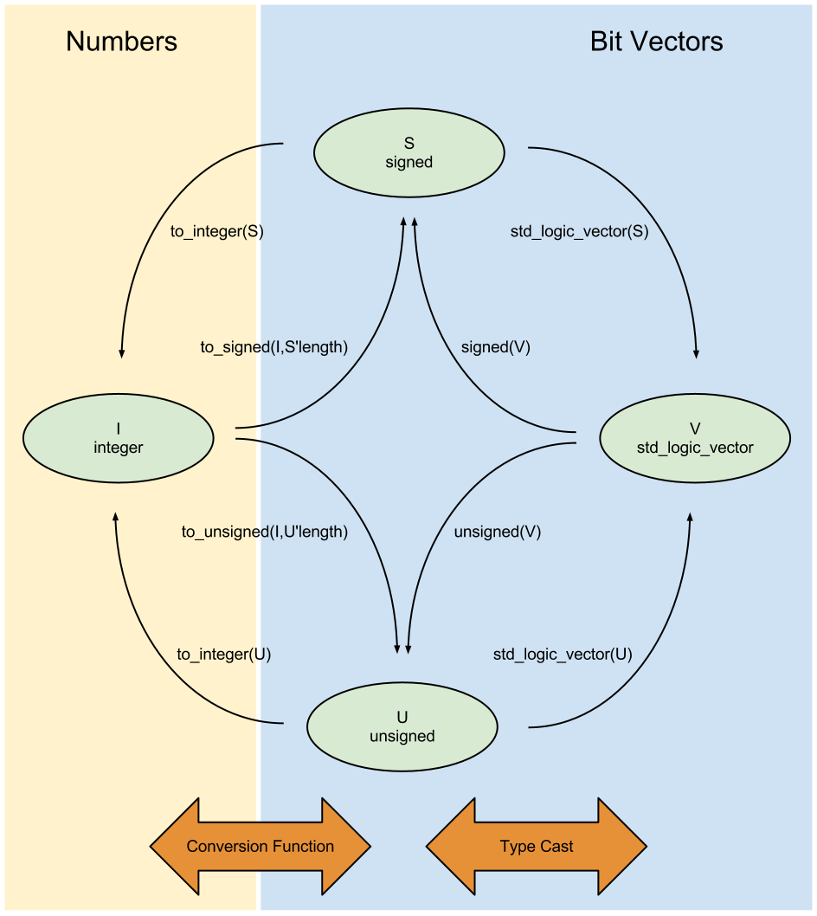
Zie ook:
TABEL:
H.3 ; blz 76

Slide 5
Agenda
Discussion of previous week
Combinational versus sequential design
Concurrent and sequential code
Signals versus variables

Slide 6
Combinational and sequential logic (1/2)
Combinational: no memory
The output is a function only of the current inputs.
In any implementation there is a propagation delay
For this course, we don’t consider the propagation delay.

Slide 7
Combinational and sequential logic (2/2)
Sequential logic:
The output of sequential logic, is ...
... a function of a sequence of operations ..
... on current and/or previous inputs.
Advantages?
Notes:
geheugen
Complexere systemen

Slide 8
Combinational vs. sequential logic example
Combinational
Sequential
A
B
Y
Updates instantly as input changes (in theory).
A
B
Y
Updates only when CLK goes high. Until then it remembers the previous input (memory)
D
Q
R
CLK
D
Q
R

Slide 9
Combinational or sequential?
Multiplexer vs. Synchronized Multiplexer?
Timer?
Encoder (for example binary to 7-seg display)?
Comparators?
Adder?
Multiplier?
ALU?
CPU?
Register?
Notes:
Multiplexer vs. Gated-Multiplexer -> wat is gated multiplexer? (Combinational)
Timer? (Sequential)
Encoder (for example binary to 7-seg display)? (Combinational)
Comparators? (Combinational)
Adder? (C)
Multiplier? (Combinational)
ALU? (C)
CPU? (Sequential)

Slide 10
Agenda
Discussion of previous week
Combinational versus sequential design
Concurrent and sequential code
Signals versus variables

Slide 11
Concurrent Code
concurrent code is intended only for combinational circuits.
often used for structural descriptions of a circuit.
outputs activated asynchronously, at any time.
statements for concurrent code:
when ... else
with ... select
generate
can be placed outside process, function and procedure

Slide 12
WITH/SELECT
with ... select is used very often
read: depending on sel, y becomes a when sel is 00, y becomes b when sel is 01, etc…
note the usage of the others keyword here to cover all possibilities
architecture mux2 of mux is
begin
with sel select
y <= a when "00", -- use "," not ";"
b when "01",
c when "10",
d when others;
end mux2;
abcd
MUX
Y
sel(1..0)

Slide 13
WHEN/ELSE
abcd
architecture mux1 of mux is
begin
y <= a when sel="00" else
b when sel="01" else
c when sel="10" else
d;
end mux1;
MUX
Y
sel(1..0)
Read: when sel is equal to “00”, y obtains the value of a, else when sel is equal to “01”, y obtains the value of b, etc…
Cover all combinations
Let the synthesizer do the K-map for us!
Lijkt op een priority encoder
Notes:
Priority encoder -> Interrupt controller bijvoorbeeld.

Slide 14
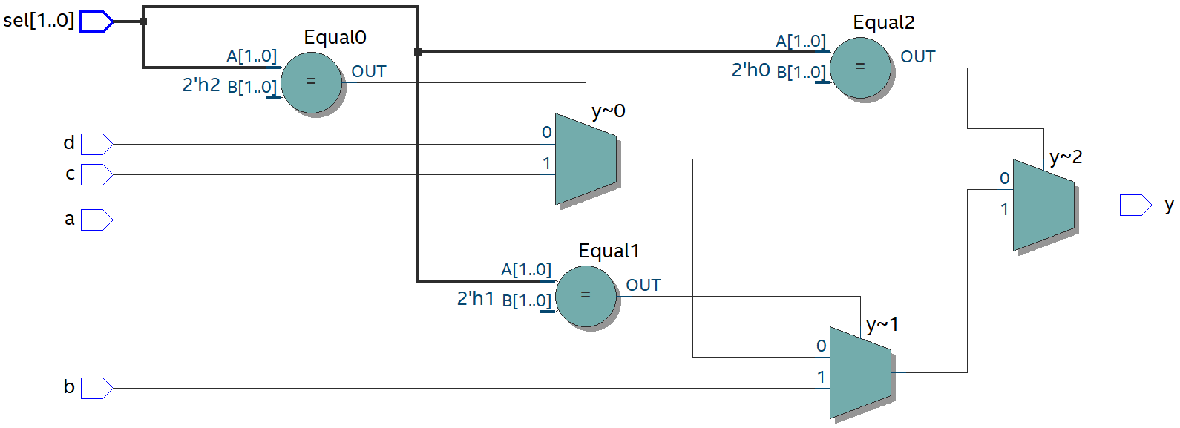
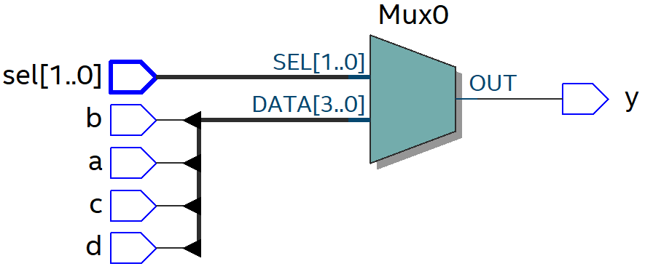
Difference
When/Else
With/Select

Slide 15
Synchronized Multiplexer
library ieee;
use ieee.std_logic_1164.all;
---------------------------------------------
entity synced_mux is
port (a, b, c, d, clk: in std_logic;
sel : in std_logic_vector (1 downto 0);
y : out std_logic);
end gated_mux;
--------------------------------------------
architecture behavioral of synced_mux is
signal x: std_logic;
begin
with sel select
x <= a when "00", -- use "," not ";"
b when "01",
c when "10",
d when others;
process (clk)
begin
if rising_edge(clk) then
y <= x;
end process
end architecture
DFF
abcd
x
Q
y
MUX
D
clk
sel(1..0)

Slide 16
Sequential Code
statements for sequential code:
if
wait
loop
case
sequential code can be used to design both sequential and combinational circuits
code within a process, function or procedure is sequential.

Slide 17
Sequential Code
process is a sequential section, located in the architecture
note that multiple processes are allowed. they are concurrent to each other.
support for the following sequential statements:
if
wait
loop
case
with (since 2008)
when (since 2008)

Slide 18
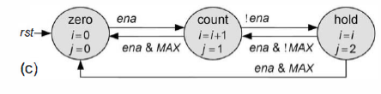
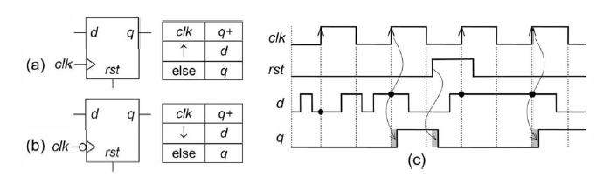
Sequential Code Circuit Examples
A
B
C
D
MUX
Y
SEL(1..0)

Slide 19
Multiplexer with sequential code
A
B
C
D
library ieee;
use ieee.std_logic_1164.all;
---------------------------------------------
entity seq_code_mux is
port (a, b, c, d: in std_logic;
sel : in std_logic_vector (1 downto 0);
y : out std_logic);
end seq_code_mux;
---------------------------------------------
architecture seq_code_impl of seq_code_mux is
begin
process(sel,a,b,c,d)
begin
if sel = "00" then
y <= a;
elsif sel = "01" then
y <= b;
elsif sel = "10" then
y <= c;
else
y <= d;
end if;
end process;
end seq_code_impl;
MUX
Y
SEL(1..0)
A process has a sensitivity list
The outputs of the process get updated if the value of an object in the list changes

Slide 20
Multiplexer with CASE
library ieee;
use ieee.std_logic_1164.all;
---------------------------------------------
entity seq_code_mux is
port (a, b, c, d: in std_logic;
sel : in std_logic_vector (1 downto 0);
y : out std_logic);
end seq_code_mux;
---------------------------------------------
architecture seq_code_impl of seq_code_mux is
begin
process(sel,a,b,c,d)
begin
case sel is
when "00" =>
y <= a;
when "01" =>
y <= b;
when "10" =>
y <= c;
when others =>
y <= d;
end case;
end process;
end seq_code_impl;

Slide 21
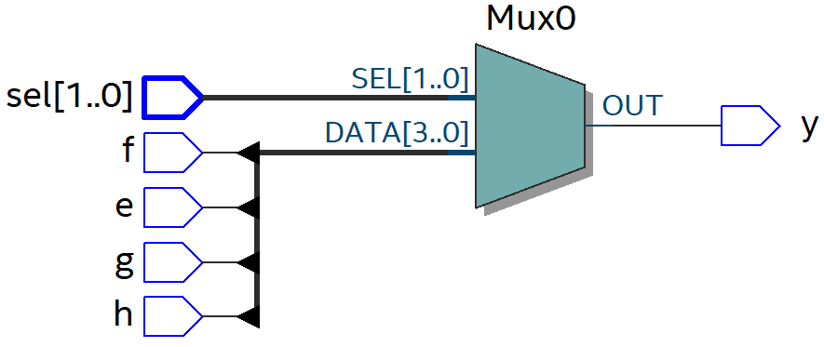
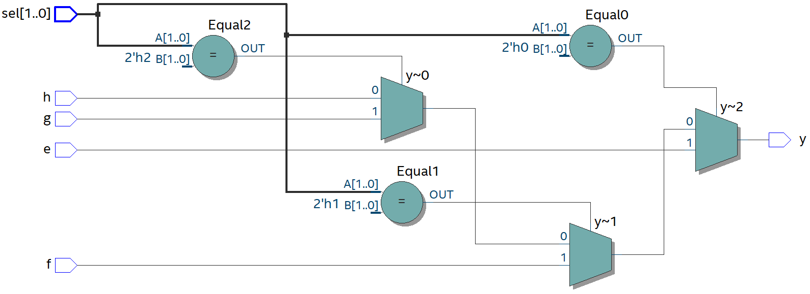
Difference
Case
If/Else

Slide 22
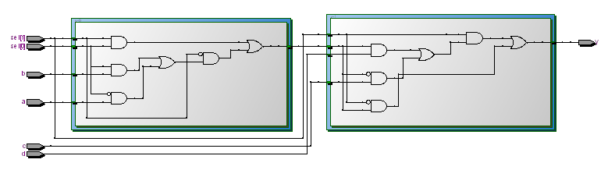
Tech. map of mux with sequential code
Sequential Code can make Combinational Circuits
Notes:
Uitbreiden.

Slide 23
D Flip-Flop
library ieee;
use ieee.std_logic_1164.all;
---------------------------------------------
entity dff_example is
port (
clk: in std_logic;
d,r: in std_logic;
q : out std_logic
);
end dff_example;
---------------------------------------------
architecture dff_implementation of dff_example is
begin
process(clk, r )
begin
if r = '1' then
q <= '0';
elsif rising_edge(clk) then
q <= d;
end if;
end process;
end dff_implementation;
D
DFF
Q
R
We only want to update Q when the CLK goes high, so only the CLK & R are in the sensitivity list
Notes:
Asynchroon zit onderop: Nieuw Plaatje. Boek
Check de code. Boek p. 287

Slide 24
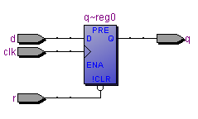
Technology Map of DFF
Sequential circuits can only be written with sequential code

Slide 25
Up/down counter
library ieee;
use ieee.std_logic_1164.all;
use ieee.numeric_std.all;
entity updown is
generic (
counter_width : integer := 31
);
port (
clk : in std_ulogic;
rst : in std_ulogic;
up_ndown : in std_ulogic;
count_out : out std_ulogic_vector(counter_width downto 0)
);
end updown;

Slide 26

Up/down counter
architecture arch of updown is
variable count : unsigned(counter_width downto 0);
begin
process(clk)
begin
if rising_edge(clk) then
if rst = '1' then
count <= (others => '0');
else
if up_ndown = '1' then
count <= count + 1;
else
count <= count - 1;
end if;
end if;
end if;
end process;
count_out <= std_ulogic_vector(count);
end arch;
Notes:
Code klopt niet.

Slide 27
WAIT
In a process you can use the wait keyword
A process CANNOT have both a sensitivity list and wait statements
Three types:
wait until condition
wait on sig1, sig2, ..., sign (sensitivity list)
wait for time
wait for cannot be synthesized; only for simulation and test benches

Slide 28
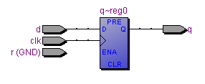
D Flip-Flop with WAIT
LIBRARY ieee;
USE ieee.std_logic_1164.all;
---------------------------------------------
ENTITY dff_example IS
PORT (
clk: IN STD_LOGIC;
d,r: IN STD_LOGIC;
q : OUT STD_LOGIC
);
END dff_example;
---------------------------------------------
ARCHITECTURE dff_implementation OF dff_example IS
BEGIN
PROCESS
BEGIN
WAIT UNTIL RISING_EDGE(clk);
q <= d;
END PROCESS;
END dff_implementation;
Not very handy without a reset ☹
Notes:
Niet per se nuttig of nodig, sensitivity list is beter.

Slide 29
Loops in VHDL
for and while loops
for ... loop repeats until the upperbound is reached
static bounds; use constants to specify the upper bound of your loop
process(sel)
..
begin
for i in 0 to 5 loop
x <= i;
end loop;
end process;

Slide 30
Loops in VHDL
while ... loop is similar in structure as the for ... loop
see page 161 of your book for some examples with loops
process(sel)
..
begin
while i<10 loop
...do something...
end loop;
end process;

Slide 31
Agenda
Discussion of previous week
Combinational versus sequential design
Concurrent and sequential code
Signals versus variables

Slide 32
Signals versus variables
SIGNAL
Is eigenlijk een verbinding of draadje
Bedoeld om data over te brengen tussen verschillende blokken zoals concurrent statements en processen
VARIABLE
Is meer een abstracte waarde
Het wordt gebruikt om iets te onthouden binnen een process

Slide 33
Signals versus variables
SIGNAL properties:
Can ONLY be declared outside a process but can be used within a process
Within sequential code the signal is not ‘updated immediately’ (at the end of the process)
Only a single assignment is allowed to a signal in the whole code (multiple assignments in processes are fine, but only the last one will be effective!)
VARIABLE properties:
Can ONLY be declared inside a process
Is ‘updated immediately’ and can be used in the next line of code
Multiple assignments are not a problem

Slide 34
Signals and Variables in VHDL (1/2)
library ieee;
use ieee.std_logic_1164.all;
use ieee.numeric_std.all;
entity example is
port (
clk: in std_logic;
x: in std_logic;
counter_a: out integer range 0 to 15;
counter_b: out integer range 0 to 15;
);
end example;
Notes:
Geen integer in output

Slide 35
Signals and Variables in VHDL (2/2)
architecture example of example is
signal a: integer range 0 to 15 := 0;
begin
process (clk)
variable b: integer range 0 to 15 := 0;
begin
if rising_edge(clk) then
a <= a + 1;
b := b + 1;
if x = '1' then
a <= a + 1;
b := b + 1;
end if;
end if;
counter_b <= b;
end process;
counter_a <= a;
end example;
Variable can only be used inside the process!

Slide 36

Example
When x is high
The variable counter is counted up twice
The signal counter is counted up only once
Only the last assignment is effective for a signal

Slide 37

Last signal assignment is only used
Proof:
change a <= a + 1
to a <= a + 3
Conclusion
Variables are useful when you have to do multiple assignments inside a process
if rising_edge(clk) then
a <= a + 1;
b := b + 1;
if x = '1' then
a <= a + 3;
b := b + 1;
end if;
end if;
Formally:
<= is a concurrent statement!
:= is a sequential statement!

Slide 38
Summary
Combinational versus sequential design: no memory versus memory.
In VHDL we can model combinational circuits with sequential statements
Remember the differences between signals and variables

Slide 39
Homework
Covered today:
Discussion of previous week
Combinatorial versus sequential design
Concurrent and sequential design
Signals versus variables
Next week:
Chapter 12 (13) ‘Sequential Code’
! Chapter 12.9 ‘SIGNAL and VARIABLE’
Chapter 14.3 – 14.5 ‘FUNCTION and PROCEDURE’

