Slide 1
Hardware Programming HWP01
capturing a
FPGA
design with
VHDL

Slide 2
Planning: theory
First week
Introduction digital systems
Structured digital Design
RTL
Second week
Introduction VHDL
Code structure and data types
Design verification
Third week
Combinational versus sequential design
Concurrent and sequential code
Fourth week
Components
Generics
Fifth week
Introduction to state machines
Designing state machines
Advanced VHDL design

Slide 3
Agenda
Discussion of previous week
Component instantiating
Generics

Slide 4
Signals versus variables
SIGNAL properties:
Can ONLY be declared outside a PROCESS but can be used within a PROCESS
Within sequential code the signal is not ‘updated immediately’ (at the end of the PROCESS)
Only a single assignment is allowed to a signal in the whole code (multiple assignments in PROCESSES are fine, but only the last one will be effective!)
VARIABLE properties:
Can ONLY be declared inside a PROCESS
Is ‘updated immediately’ and can be used in the next line of code
Multiple assignments are not a problem

Slide 5
Agenda
Discussion of previous week
Component instantiating
Generics

Slide 6
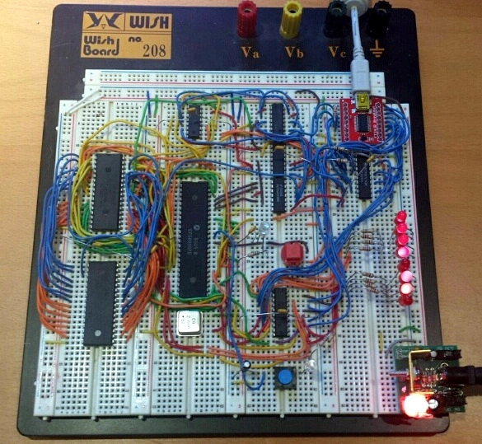
Putting it together

Slide 7
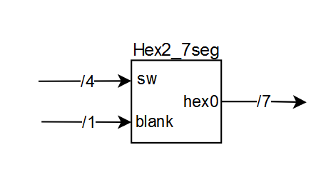
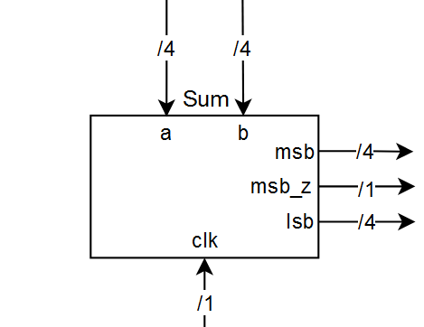
Create (separately) validated components
Entity
Architecture
Entity
Architecture

Slide 8
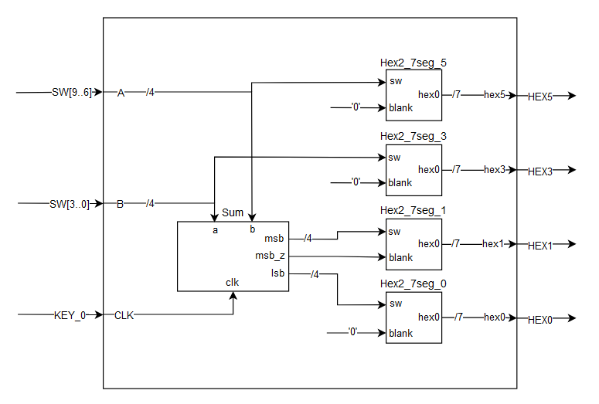
Add components to your top level design
“ Top Level Design: multiply_2hexandDisplay.vhd”
Notes:
Generate
Packages -> demo
Clock toevoegen

Slide 9
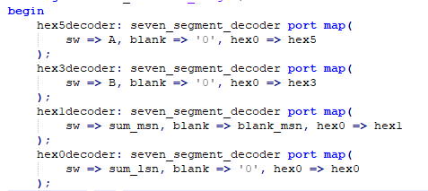
Instantiating components

Slide 10
Agenda
Discussion of previous week
Component instantiating
Generics

Slide 11
Generic statements
Generic values are used for declaring global constants in a component
What is the use of generics?
For more information on generics and what else they are capable of, see CH 6.7

Slide 12
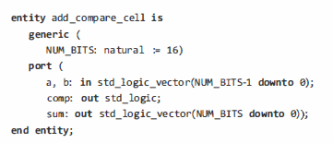

Voorbeeld Generics
With value
Without value
Notes:
Dit moet aangepast. Laat ook zien hoe generic map gebruikt wordt.

Slide 13
Summary
Remember the differences between signals and variables
Components are pre-validated VHDL library elements used to reduce development time of new products.

