Slide 1
Hardware Programming HWP01
capturing a
FPGA
design with
VHDL

Slide 2
Fifth Week: Theory
Theory:
Ch15+16: State Machines
Goals:
Learn how to design and implement a Finite State Machine in a digital circuit using VHDL

Slide 3
Agenda
Finite State Machines
Example
Example in VHDL
Template in VHDL

Slide 4
Finite State Machines Design
FSM diagrams consist of:
States
Transitions
Conditions
Inputs
Outputs
Reset
0
X=1
Y=0
1
A=0
B=0
A=0
B=1
reset
X=1
Y=1
X=0
Y=1
3
X=0
Y=0
2
A=1
B=Y
A=X
B=1
clk
x
y
FSM
A
B
Reset
Notes:
Dit is een Moore SM
Er moet wel een clock bij

Slide 5
Finite State Machines in Digital Circuits
Combinational Part
INPUTS
Combinational Logic
OUTPUTS
PRESENT STATE
NEXT STATE
Q
D
R
Sequential Part
Notes:
Reset onderop

Slide 6
The Sequential Part
Combinational Part
The sequential part consists only of dffs, a clock and a reset.
The flip-flops hold the present state
They switch to the next state on the clock-edge
The reset makes the present state 0000 (initial state).
The combinational part determines the next state by the inputs and present state
INPUTS
Combinational Logic
OUTPUTS
PRESENT STATE
NEXT STATE
Q
D
R
Sequential Part

Slide 7
Encoding the State Bus
Combinational Part
The states are represented by bits (of course)
Encoding states can be done in a few ways:
State BINARY GRAY ONE-HOT
0 00 00 0001
1 01 01 0010
2 10 11 0100
3 11 10 1000
Why? (See Ch. 2.6.5)
Keep it easy, let Quartus decide the encoding.
See Ch. 15.2 how to do this.
INPUTS
Combinational Logic
OUTPUTS
PRESENT STATE
NEXT STATE
Q
D
R
Sequential Part

Slide 8
The Combinational Part
Combinational Part
INPUTS
Combinational Logic
OUTPUTS
the combinational part determines the next state
it is a function of the inputs and present state
the combinational part determines the outputs
Moore: it is a function of the present state
Mealy: it is a function of the present state combined with the inputs
Always design as Moore and change to Mealy if output needs to react instantly
PRESENT STATE
NEXT STATE
Q
D
R
Sequential Part
Template M1 on page 382
Listing
Notes:
Always design Moore. Alleen als output meteen moet reageren op input dan moore omzetten naar mealy zie boek.

Slide 9
The Combinational Part
Combinational Part
INPUTS
Combinational Logic
OUTPUTS
The Combinational Part is Combinational Logic
It is a (simple) Boolean Function
We can draw a truth-table for this
We can use K-maps to minimize the logic
PRESENT STATE
NEXT STATE
Q
D
R
Sequential Part

Slide 10
Agenda
Finite State Machines
Example
Example in VHDL
Template in VHDL

Slide 11
Egg Timer: FSM Context
cnt_done
State Machine
cnt_enable
cnt_done
Counter
cnt_reset
button
reset
led

Slide 12
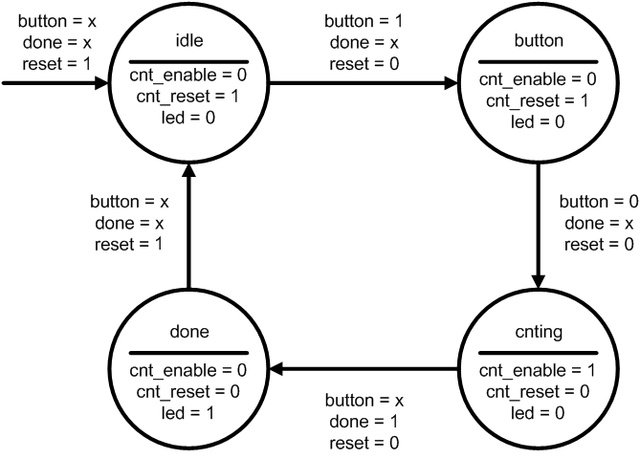
Egg Timer: State Diagram

Slide 13
Example in VHDL
Same Egg Timer: the entity
library ieee;
use ieee.std_logic_1164.all;
entity fsm_hard is
port(
clk : in std_logic;
reset : in std_logic;
button : in std_logic;
cnt_done : in std_logic;
cnt_enable : out std_logic;
cnt_reset : out std_logic;
led : out std_logic
);
end entity;

Slide 14
Example in VHDL
We can do it the hard way (previous example) and then write the code:
architecture rtl of fsm_hard is
signal s: std_logic_vector(1 downto 0) := "00";
signal n: std_logic_vector(1 downto 0) := "00";
Begin
-- The flip-flops to hold the current state and switch to next state
process(clk)
begin
if reset = '1' then
s <= "00";
elsif rising_edge(clk) then
s <= n;
end if;
end process;
-- The combinational part
cnt_enable <= s(1) and not(s(0));
cnt_reset <= not( s(1) and not(s(0)));
led <= s(1) and s(0);
n(1) <= s(1) or (not(button) and s(0));
n(0) <= (s(0) and s(1)) or (not(s(1)) and button) or (s(1) and cnt_done);
end rtl;
Disadvantages?
Time efficiency
Readability
Reusability

Slide 15
Agenda
Finite State Machines
Example
Example in VHDL
Template in VHDL
Notes:
Onderwerp synchronizers toevoegen: Om problemen te voorkomen bij synchrone systemen zoals statemachines moeten asynchrone inputs (b.v. signalen afkomstig van externe inputs) gesynchroniseerd worden met een synchronizer. Een en ander wordt uitgelegd op pagina 32. Voor degene die er meer van wilt weten is deze White Paper interessant: https://www.altera.com/en_US/pdfs/literature/wp/wp-01082-quartus-ii-metastability.pdf

Slide 16
Example in VHDL
To write the circuit in such a low-level way is not recommended.
Use the power of abstraction!
A state machine template in VHDL can be found in the course folder.

Slide 17
Example in VHDL
Same Egg Timer: the entity
library ieee;
use ieee.std_logic_1164.all;
entity fsm_egg_timer is
port(
clk, reset, btn, cnt_done : in std_ulogic;
cnt_enable, cnt_reset, led : out std_ulogic
);
end entity;

Slide 18
State Bus Encoding in VHDL
We need to define the states inside our architecture.
We can use the “TYPE” keyword, it’s like “ENUM” in C. The synthesizer will define what idle, button, cnting, etc… is.
We need to define signals for the present and next state.
architecture rtl of fsm_egg_timer is
-- Define an enumerated type for the state machine
type state_type is (idle, button, cnting, done);
-- Register to hold the current state
signal present_state, next_state : state_type;
begin

Slide 19
Manual Encoding
We can also encode the state bus manually using constants
It’s not necessary most of the time, since the synthesizer can also be configured to use gray, one-hot, two-hot, binary, etc…
architecture rtl of fsm_easy is
-- Build an enumerated type for the state machine
constant idle : std_logic_vector(1 downto 0) := "00";
constant button: std_logic_vector(1 downto 0) := "01";
constant cnting: std_logic_vector(1 downto 0) := "11";
constant done : std_logic_vector(1 downto 0) := "10";
-- Register to hold the current state
signal present_state,next_state : std_logic_vector(1 downto 0);
begin

Slide 20
Define the flip-flops
-- state register
pr_flipflops : process (clk, reset)
begin
if reset then
present_state <= idle;
elsif rising_edge(clk) then
present_state <= next_state;
end if;
end process;

Slide 21
Write the transitions
-- logic to determine the next state
pr_next_state : process (present_state, btn, cnt_done)
begin
case present_state is
when idle =>
if btn then
next_state <= btn;
else
next_state <= idle;
end if;
when btn =>
if not btn then
next_state <= cnting;
else
next_state <= btn;
end if;
when cnting =>
if cnt_done then
next_state <= done;
else
next_state <= cnting;
end if;
when done =>
next_state <= done;
end case;
end process;

Slide 22
Write the outputs (Moore)
-- Logic to determine the outputs
pr_outputs: process (present_state)
begin
case present_state is
when idle =>
cnt_enable <= '0';
cnt_reset <= '1';
led <= '0';
when btn =>
cnt_enable <= '0';
cnt_reset <= '1';
led <= '0';
when cnting =>
cnt_enable <= '0';
cnt_reset <= '0';
led <= ‘0';
when done =>
cnt_enable <= '1';
cnt_reset <= '0';
led <= ‘1';
end case;
end process;
end architecture;

Slide 23
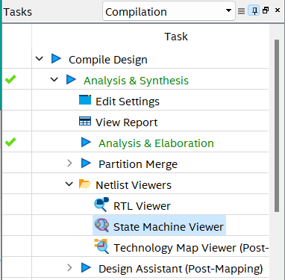
State Machine Viewer
Quartus can detect a state machine in your code!

Slide 24
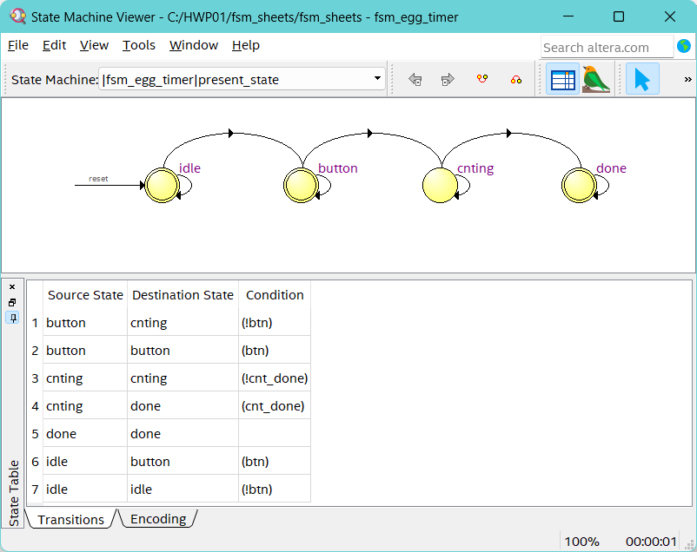
State Machine Viewer

Slide 25
Agenda
Finite State Machines
Example
Example in VHDL
Template in VHDL

Slide 26
Write the outputs (Moore)
library ieee;
use ieee.std_logic_1164.all;
entity fsm is
port (
clk, rst: in std_ulogic;
input1, input2, ...: in std_ulogic;
output1, output2, ...: out std_ulogic
);
end fsm;
architecture behavior of fsm is
type state_type is (idle, state1, state2, ...);
signal pr_state, nx_state: state_type;
begin
process(clk, rst)
begin
if rst then
pr_state <= idle;
elsif rising_edge(clk) then
pr_state <= nx_state;
end if;
end process;
process(pr_state, input1, input2, ...)
begin
case pr_state is
when idle =>
if input1 then
nx_state <= state1;
else
nx_state <= state2;
end if;
when state1 =>
nx_state <= state2;
when state2 =>
...;
when ... =>
...;
end case;
end process;
process(pr_state)
begin
case pr_state is
when idle =>
output1 <= '0';
output2 <= '0';
...
when state1 =>
output1 <= '0';
output2 <= '1';
...
when state2 =>
...;
when ... =>
...;
end case;
end process;
end architecture;
Template M1 on page 382
Listing

Slide 27
Advantages of using the template
Readability
Reusability
Adaptability
Quicker (especially for bigger designs)
Quartus also has built-in templates (right-click in the editor)

