Slide 1
Mitigati0n h4x for the IRL
Focus on Prevention with Real Time data analytics

Slide 2
Team
Benjamin Spak – Front End, UI Brian Balboa – Research, UX & Innovation Dakarai Simmons – Back/Front End Michael Reynolds – Research & Front End
Mission: Help manage & prioritize resources for IRL through big data.

Slide 3
What’s what?
The US National Estuary Program (NEP) identifies estuaries of national significance that are threatened by the risk of pollution, developmental disruption and overuse. The 156 mile Indian River Lagoon (IRL) is one of 28 estuaries identified by the NEP currently impacted by said issues. Plagued by heavy nutrient pollution and land disruption issues, the lagoon has become overwhelmed by algae blooms, brown tides, fish kills, muck propagation and habitat loss. The decline of the lagoon can be largely attributed to nonpoint source pollution transported via stormwater runoff causing eutrophication. Trash and fertilizer washouts, hydrocarbon infiltration, septic tank leakage, and pet waste buildup are among the top factors contributing to the decline of native species within this fragile ecosystem.

Slide 4

Using Resources
HydroCycle PO4 & LOBO
Baffle Boxes & Storm Drains
Real Time data
Dashboard Reporting
Alerting System

Slide 5
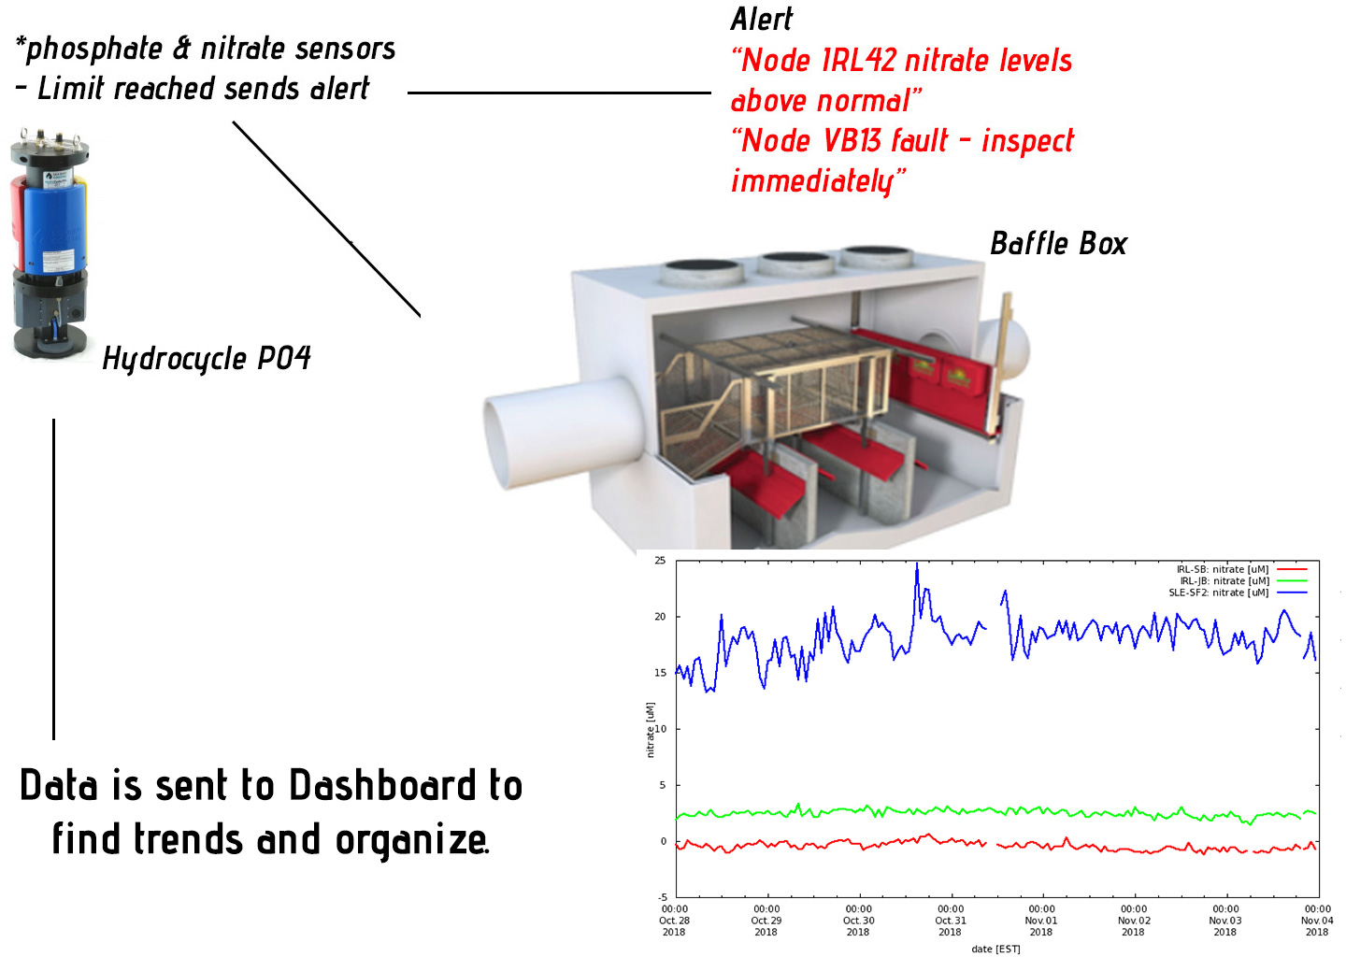
DEMO!

Slide 6
Possibilities
Find Trends
Add more algorithms for following data (bloom nutrients)
Prioritize resources & funding for current initiatives

Slide 7

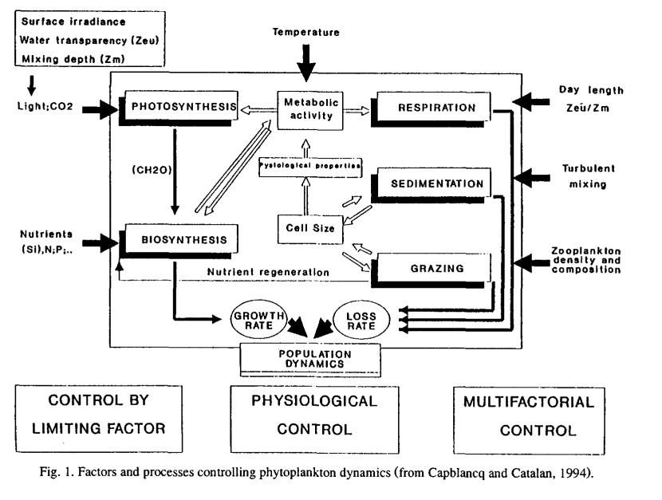
Future Possibilities
Baffle Boxes Efficiency
Equipment failure
Prediction methodologies
Bold & Gold

Slide 8
Questions & References
http://fau.loboviz.com/loboviz/
https://www.ott.com/products/water-quality-2/sea-bird-scientific-hydrocycle-po4-phosphate-sensor-1528/
HACKTHEIRL Mentors
https://www.youtube.com/watch?v=vHDMbWkQup8

