Slide 1
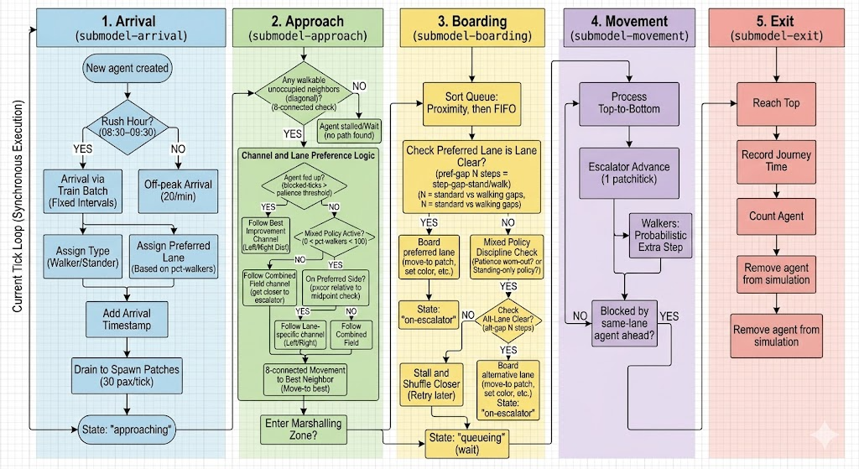

Slide 2
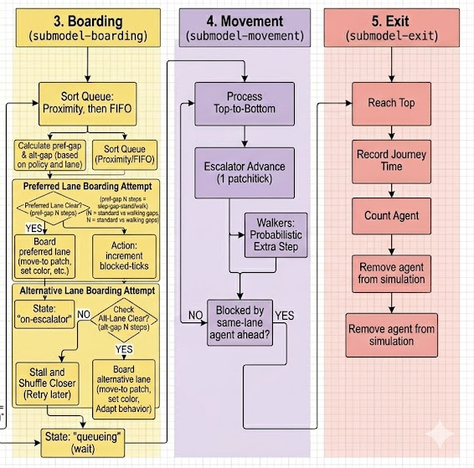
1. Arrival
(submodel-arrival)
2. Approach
(submodel-arrival)
3. Boarding
(submodel-boarding)
4. Movement
(submodel-movement)
5. Exit
(submodel-exit)
Sort queue proximity, then FIFO
Process agents
(Top-to-Bottom)
Reach top
New agent created
Any walkable
unoccupied neighbours?
(8-connected check)
NO
Calculate pref-gap & alt-gap based on policy & lane
Rush Hour?
(08:30-09:30)
YES
Agent stalled
(Wait until path found)
Escalator Advance
(1 patch per tick)
Record Journey Time
Preferred Lane Boarding Attempt
YES
NO
Pref Lane Clear?
(pref-gap N steps)
Channel and Lane Preference Logic
NO
Arrival via
Train Batch
(Fixed Intervals)
Off-peak arrival (20pax/min)
Walkers:
Probabilistic extra step
Count agent as part of throughput
Agent fed up?
(blocked-ticks >
lane-discipline?)
YES
NO
Increment blocked-ticks
Move-to-patch,
set colour
Current Tick Loop (Synchronous Execution)
Follow best improvement channel
Mixed Policy
Active?
(0<pct-walkers<100)
Remove agent from simulation
Assign Type
(Walker / Stander)
Assign Lane Preference (Based on pct-walkers)
YES
NO
YES
Alternative Lane Boarding Attempt
Blocked by same-lane agent ahead?
Follow best improvement channel
Alt-Lane Clear?
(pref-gap N steps)
NO
Update all other metrics
On
preferred
side?
YES
NO
YES
Increment blocked-ticks
NO
Add Arrival Timestamp
Follow Lane Specific Channel
Follow Combined Field
Move-to-patch, adapt behaviour, set colour
Stall and shuffle closer
(wait)
Advance total steps
If tick = sim-end-tick?
(END)
Drain to Spawn Patches (30pax/tick)
8-connected movement to best neighbour
(move-to-best)
Board alt lane;
Record wait time
Board pref lane;
Record wait time
NO
Enter Marshalling Zone?
State: “approaching”
YES
State: “on escalator”
State: “queuing”
Figure 1: Summary of submodels and decision process flow

