Slide 1
Online Analytical Processing Stream Data: Is It Feasible?
Yixin Chen, Guozhu Dong, Jiawei Han, Jian Pei, Benjamin W. Wah, Jiayong Wang
Univ. of Illinois at Urbana-Champaign
Wright State Univ.
Simon Fraser Univ.
Peking Univ.
June 2, 2002

Slide 2
Outline
Characteristics of stream data
Why on-line analytical processing and mining of stream data?
A stream cube architecture
Stream cube computation
Discussion
Conclusions

Slide 3
What Is a Data Stream?
Data Stream
  Ordered sequence of points, x₁,…, x_{i}, …, x_{n}, that can be read only once or a small number of times in a fixed order
Characteristics
  Huge volumes of data, possibly infinite
  Fast changing and requires fast response
  Data stream is more suited to our data processing needs of today
  Single linear scan algorithm: can only have one look
    random access is expensive
  Store only the summary of the data seen thus far
  Most stream data are at pretty low-level or multi-dimensional in nature, needs ML/MD processing

Slide 4
Stream Data Applications
Business: credit card transactions
Telecommunication: phone calls
Financial market: stock exchange
Engineering & industrial processes: power supply
Monitoring & surveillance: video streams
Web page click streams

Slide 5
Previous Research
Stream data model
  STanford stREam datA Manager (STREAM)
  Data Stream Management System (DSMS)
Stream query model
  Continuous Queries
  Sliding windows
Stream data mining
  Clustering & summarization (Guha, Motwani et al.)
  Correlation of data streams (Gehrke et al.)
  Classification of stream data (Domingos et al.)

Slide 6
Why Stream Cube and Stream OLAP?
Most stream data are at pretty low-level or multi-dimensional in nature: needs ML/MD processing
Analysis requirements
  Multi-dimensional trends and unusual patterns
  Capturing important changes at multi-dimensions/levels
  Fast, real-time detection and response
  Comparing with data cube: Similarity and differences
Stream (data) cube or stream OLAP
  Is it feasible? How to implement it efficiently?

Slide 7
An Example
Analysis of Web click streams
  Raw data at low levels: seconds, web page addresses, user ip addresses, …
  Analysts want: changes, trends, unusual patterns, at reasonable levels of details
A typical data stream OLAP query
  Can we find patterns like
  “Average web clicking traffic in North America on sports in the last 15 minutes is 40% higher than that in the last 24 hours.”

Slide 8
A Stream Cube Architecture
A tilt time frame
  Different time granularities
  second, minute, quarter, hour, day, week, …
Critical layers
  Minimum interest layer (m-layer)
  Observation layer (o-layer)
  User: watches at o-layer and occasionally needs to drill-down down to m-layer
Partial materialization of stream cubes
  Full materialization: too space and time consuming
  No materialization: slow response at query time
  Partial materialization: what do you mean “partial”?

Slide 9
A Tilt Time-Frame Model
Up to 7 days
7 days
24hrs
4qtrs
15minutes
25sec.
Time
Now
Up to a year
12 months
31 days
24 hours
4 qtrs
Time
Now

Slide 10
Two Critical Layers in the Stream Cube
(*, theme, quarter)
o-layer (observation)
(user-group, URL-group, minute)
m-layer (minimal interest)
(individual-user, URL, second)
(primitive) stream data layer

Slide 11
What Are the Issues?
Materialization problem
  Only materialize cuboids of the critical layers?
  Popular path approach vs. exception cell approach
Computation problem
  How to compute and store stream cubes efficiently?
  How to discover unusual cells and patterns between the critical layer?

Slide 12
Stream Cube Structure from the m-layer to the o-layer
(A1, *, C1)
(A1, *, C2)
(A1, *, C2)
(A1, *, C2)
(A1, B1, C2)
(A1, B2, C1)
(A2, B1, C1)
(A2, *, C2)
(A2, B1, C2)
(A1, B2, C2)
A2, B2, C1)
(A2, B2, C2)

Slide 13
Stream Cube Computation
Cube structure from m-layer to o-layer
Three approaches
  All cuboids approach:
    materializing all cells
  Exceptional cells approach
    materializing only exceptional cells
  Popular path approach
    computing and materializing cells only along a popular path

Slide 14
An H-Cube Structure
root
Observation layer
enter.
sports
politics
uic
uiuc
uic
uiuc
Minimal int. layer
jeff
mary
jeff
mary
Quant-Info
Q.I.
Q.I.
Q.I.
Sum: xxxx
Cnt: yyyy
Regression:

Slide 15
Feasibility analysis
Popular path
  Computing layers along the popular path
  Other planes/cells will be computed when requested
  Using H-cube structure to store computed cells (which form the stream cube)
  Tradeoff for time/space between cube materialization and online query computation
Exception cells approach
  How to set up an appropriate thresholds for all the applications?

Slide 16
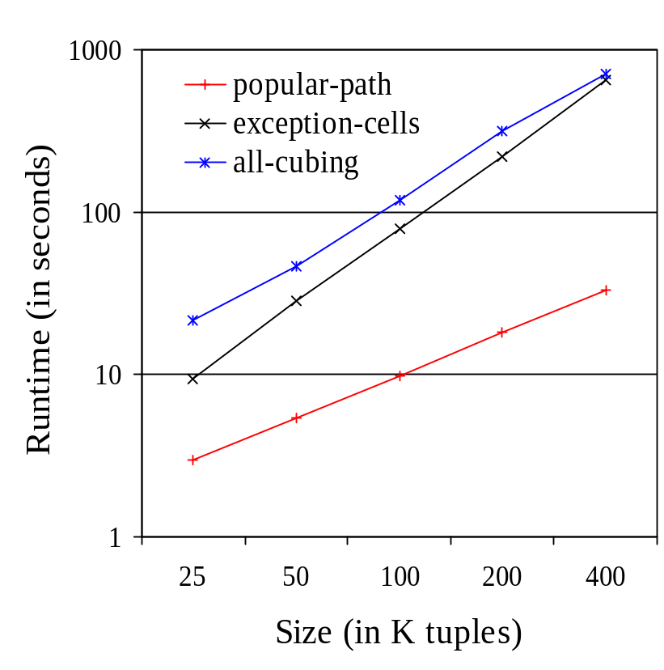
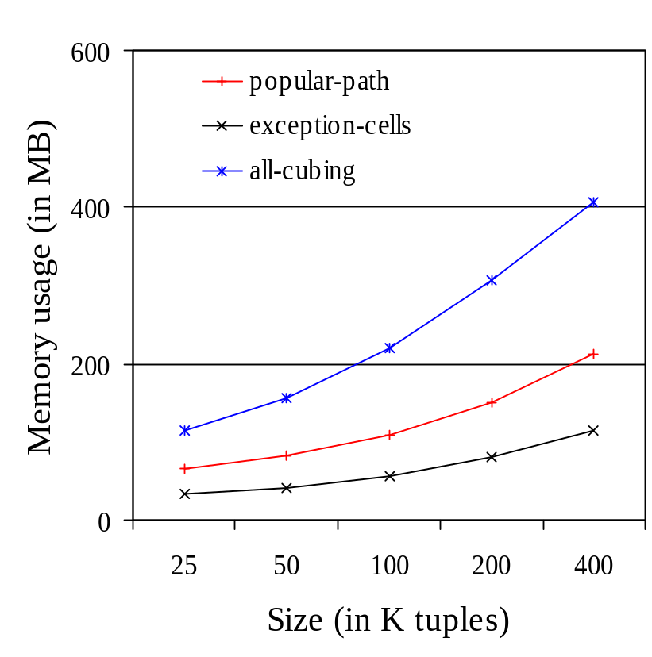
a) Time vs. m-layer size
b) Space vs. m-layer size
Feasibility study: Time and space vs. # tuples at the m-layer for dataset D3L3C10T400K

Slide 17
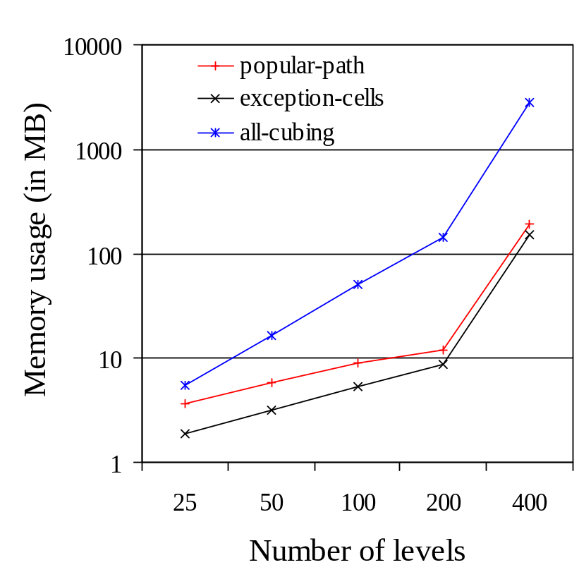
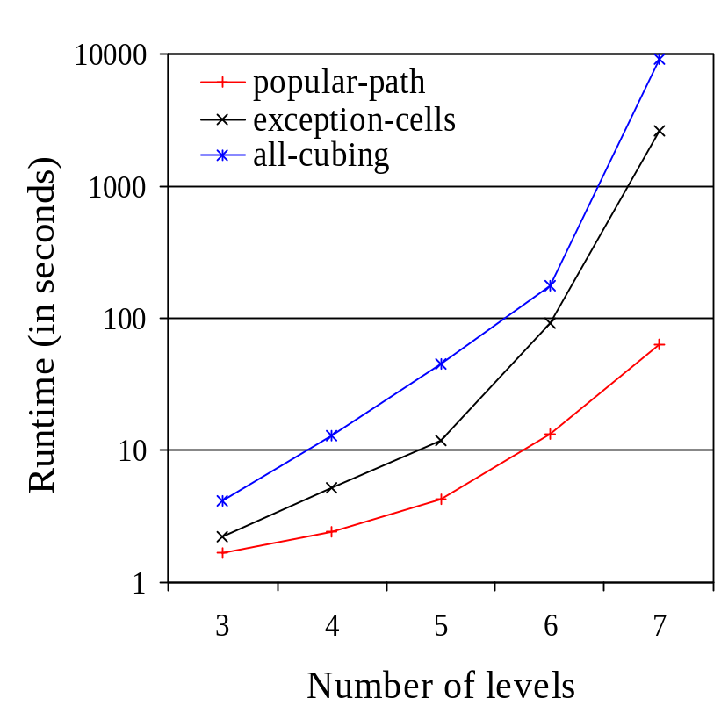
b) Space vs. # levels
a) Time vs. # levels
Time and space vs. # of levels

Slide 18
Conclusions
Stream data analysis
  Besides query and mining, stream cube and OLAP are powerful tools for finding general and unusual patterns
A multi-dimensional stream cube framework
  Tilt time frame
  Critical layers
  Popular path approach
An important issues for further study
  Mining stream data at high-level, multiple-levels, or in multiple dimensions

Slide 19
References
A previous study on H-cubing
  J. Han, J. Pei, G. Dong, and K. Wang, “Computing Iceberg Data Cubes with Complex Measures”, SIGMOD’2001
A further study: regression cubes and stream data regression analysis
  Y. Chen, G. Dong, J. Han, B. Wah & J. Wang, “Multi-dimensional Regression Analysis of Time-series Data Streams,” VLDB 2002

Slide 20

www.cs.uiuc.edu/~hanj
Thank you !!!

