Slide 1

Constraint Partitioning for Solving Planning Problems with Trajectory Constraints and Goal Preferences
Chih-Wei Hsu, Benjamin W. Wah, Ruoyun Huang, Yixin Chen
Department of Electrical and Computer Engineering
and the Coordinated Science Laboratory
University of Illinois at Urbana-Champaign
URL: http://manip.crhc.uiuc.edu
IJCAI-07

Slide 2

Outline
Observation on constraint locality
Partition-and-resolve approach
  Partition a problem by its constraints into subproblems
Observation in PDDL3 domains
Architectures of SGPlan₅
  Handling soft goals
  Handling trajectory constraints
  Subproblem-level planning
Conclusions

Slide 3
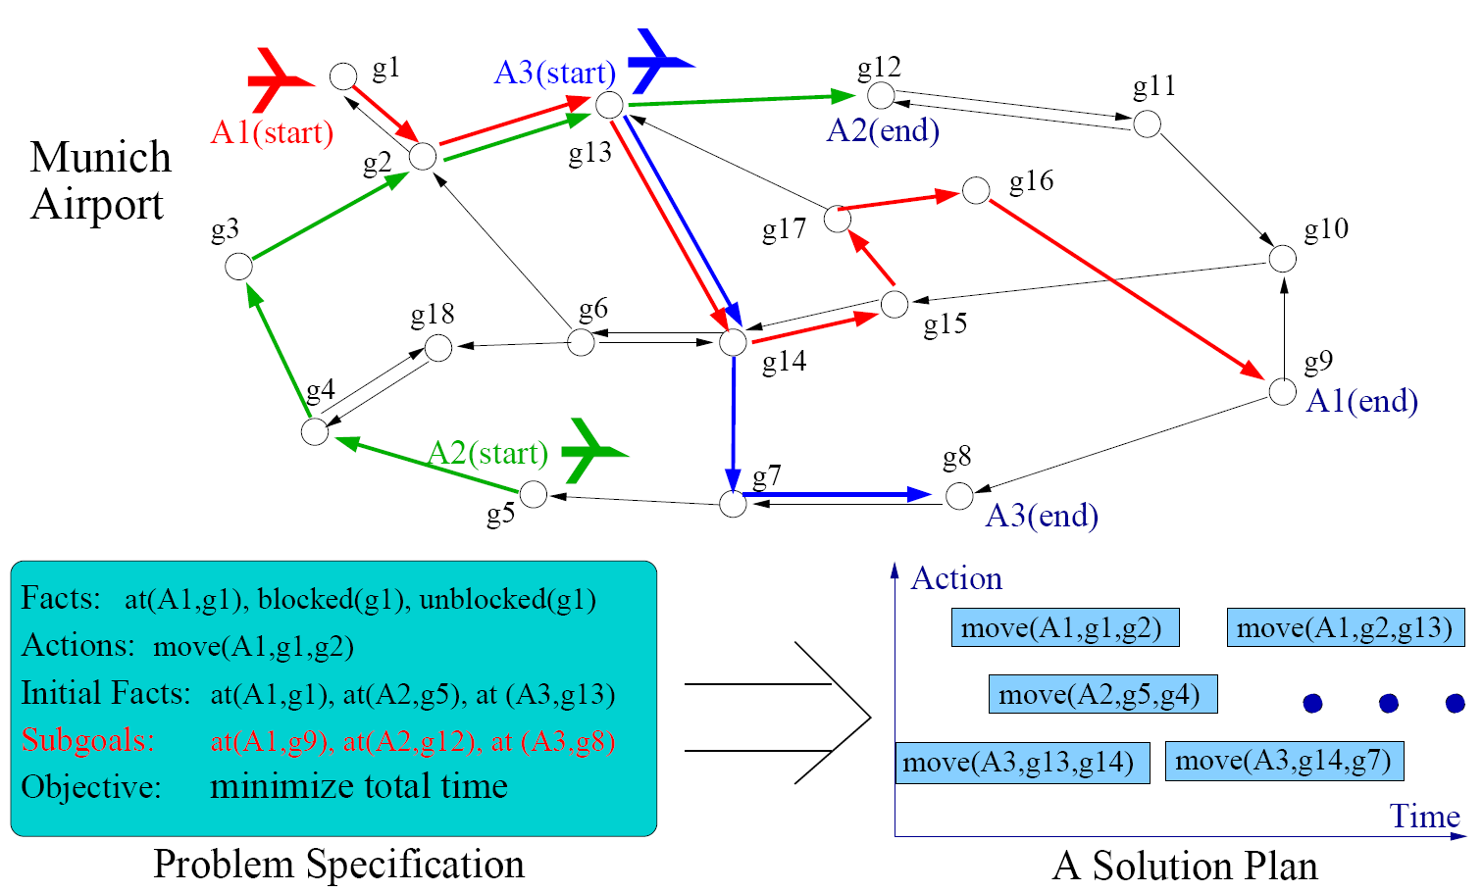
An Airport Planning Example

Slide 4
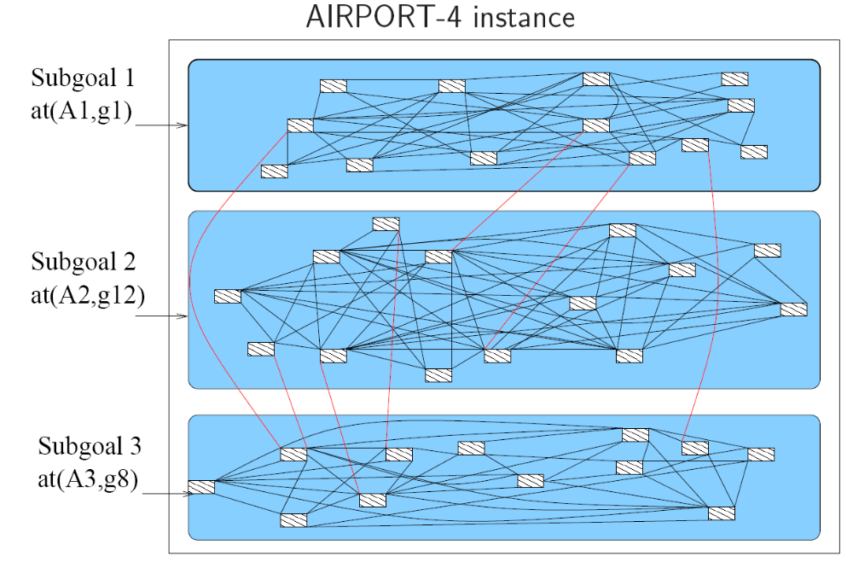
Spatial Constraint Locality in AIRPORT
Mutual exclusion between 2 subgoals:
2 planes cannot be on the same runway at the same time

Slide 5
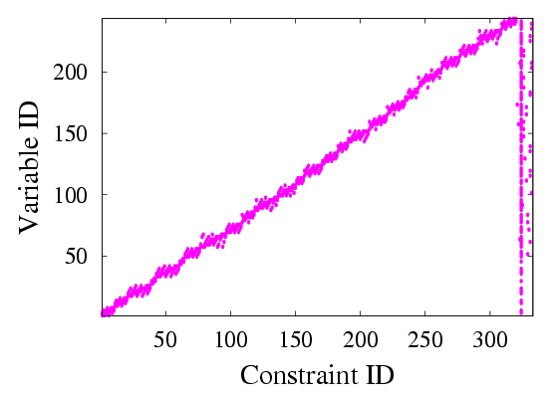
Depicting Constraint Localities
Problem Formulation
Rovers-Propositional-P30
Constraints: mutual exclusions, trajectory constraints and goals
Variables: initial solution plan
Global constraints: constraints span across multiple subproblems
Attribute used for partitioning: subgoals

Slide 6
Outline
Observation on constraint locality
Partition-and-resolve approach
  Partition a problem by its constraints into subproblems
Observation in PDDL3 domains
Architectures of SGPlan₅
  Handling soft goals
  Handling trajectory constraints
  Subproblem-level planning
Conclusions

Slide 7
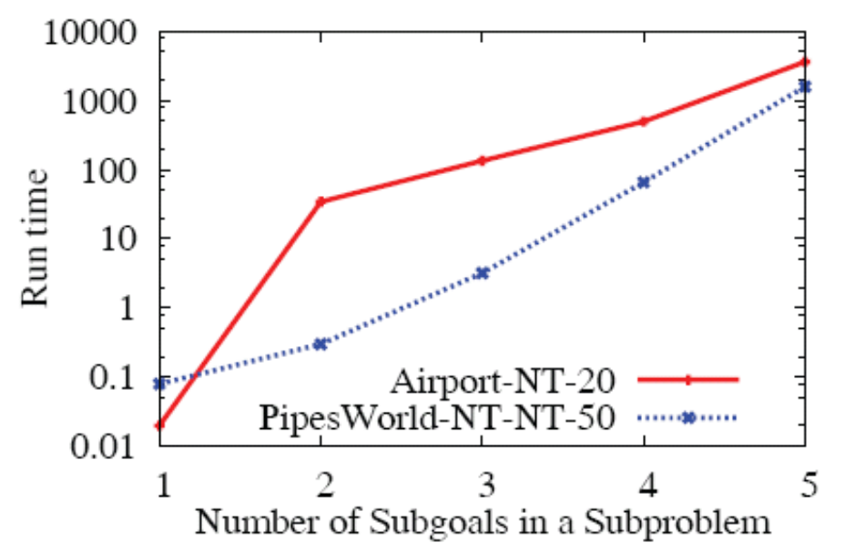
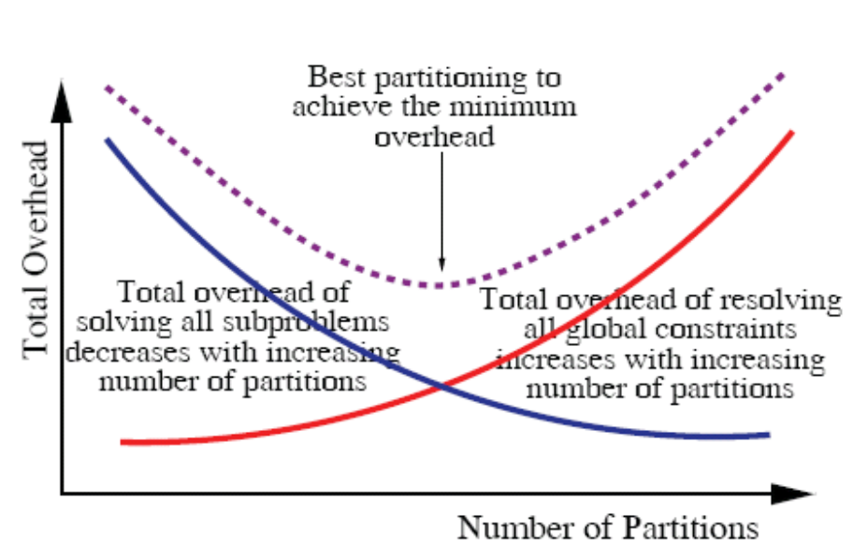
Motivations of Approach
Significantly smaller aggregate complexity of solving all subproblems
Large reduction in solution time if global constraints can be resolved quickly
Study of constraint locality and partitioning granularity to reduce the number of global constraints
Exponential growth in solution time
Convex relationship between no.
of partitions and total time

Slide 8
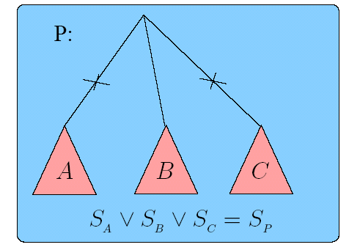
Subspace Partitioning
Partition P by branching on the values of a variable
Solve P by choosing the correct path and by solving the subproblem
Overhead for solving each subproblem is similar to that of P
X=1
X=2
X=3
Subspace
Partitioning
Notes:
The complexity of the space for resolving the global constraints actually grows exponentially, as a Cartesian product of the subspaces across the subproblems.
A more general approach is to study the hierarchical organization of global constraints, as recommended by Rina Dietech. She talked about AND-OR representation of global constraints, although it is doubtful that the AND-OR representation will allow overlapped variables across the partitions.
Subspace partitioning
Branch on discrete variables into subproblems
Prune inferior subproblems
Subproblems must be solvable efficiently
Examples: GBD, OA, GCD, B&R, B&B

Slide 9
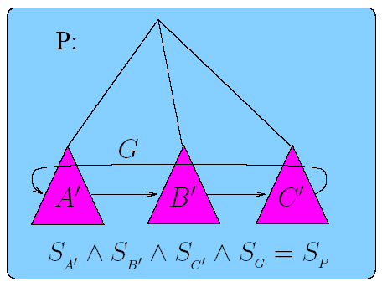
Constraint Partitioning
Partition P by its constraints into subproblems
Solve P by solving all the subproblems and by resolving those violated (active) global constraints
Overhead of each subproblem is substantially smaller
Constraint Partitioning
Each subproblem is significantly
relaxed with a much larger solution
space
Notes:
The complexity of the space for resolving the global constraints actually grows exponentially, as a Cartesian product of the subspaces across the subproblems.
A more general approach is to study the hierarchical organization of global constraints, as recommended by Rina Dietech. She talked about AND-OR representation of global constraints, although it is doubtful that the AND-OR representation will allow overlapped variables across the partitions.

Slide 10
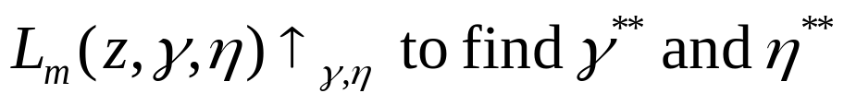
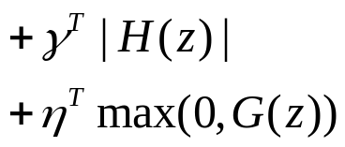
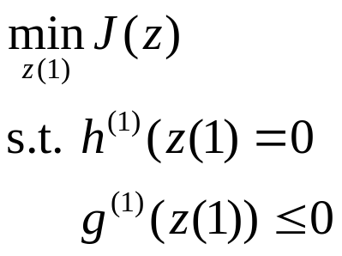
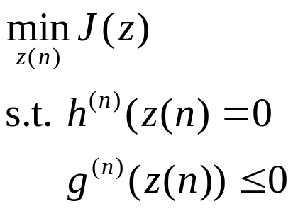
Our Partition-and-Resolve Framework
Solving a subproblem
  Satisfy local constraints
  Minimize global objective
  Satisfy (soft) global constraints
Increasing penalties on violated global constraints
Weighted active global constraints
provide guidance in
local subproblems
Similar solver as original problem

Slide 11
Outline
Observation on constraint locality
Partition-and-resolve approach
  Partition a problem by its constraints into subproblems
Observation in PDDL3 domains
Architectures of SGPlan₅
  Handling soft goals
  Handling trajectory constraints
  Subproblem-level planning
Conclusions

Slide 12
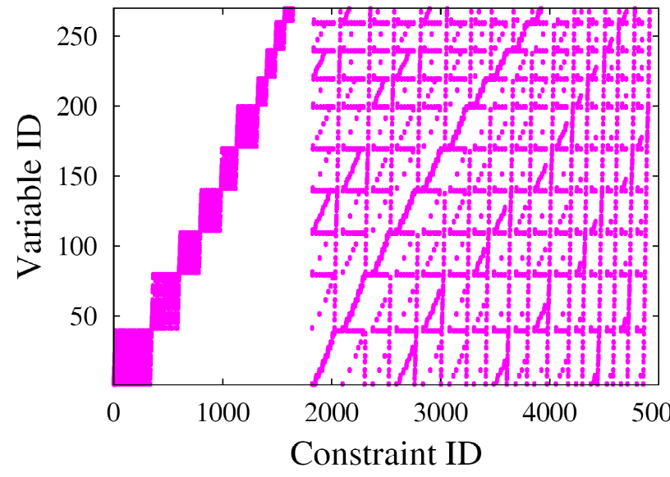
Constraint Locality in PDDL3
Planning benchmarks in PDDL 3.0
  New features over PDDL 2.2
    Soft goals or preferences on action preconditions
    Hard and soft constraints on plan trajectory
Different locality of constraints caused by new features
TPP-QualitativePreferences-P05
Poor locality by subgoal partitioning
  Many global constraints due to implicit mutual exclusions
  Trajectory constraints not considered in partitioning

Slide 13
Multi-Valued Domain Formulation
Multi-valued state variables
  Traditionally encoded in multiple binary facts
  Now encode in one variable that can take multiple values
Example
  AT(TRUCK1, LOCATION1), …, AT(TRUCK1, LOCATION8) → LOC(TRUCK1) = LOC1, …, LOC(TRUCK1) = LOC8
More compact representation than STRIPS
New problem representation for reducing the number of global constraints

Slide 14
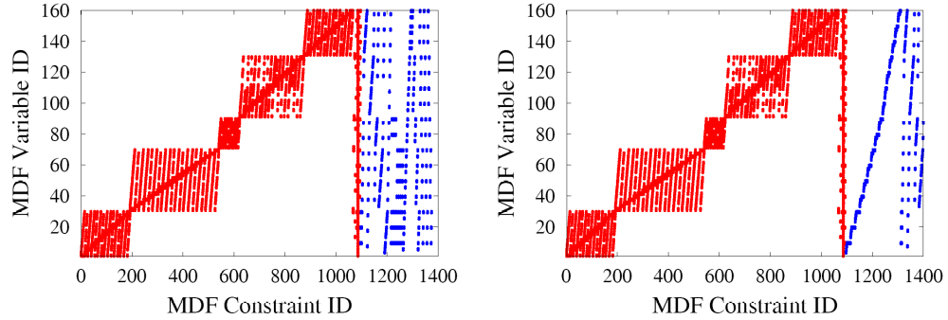
Constraint Locality by Other Variables
Guidance variable: variable in goal-state constraint
  Ex: Stored quantity of a product
Cluster constraints by guidance variables
TPP-QualitativePreferences-P05
Clustering by hard constraints
Clustering by hard/soft constraints

Slide 15
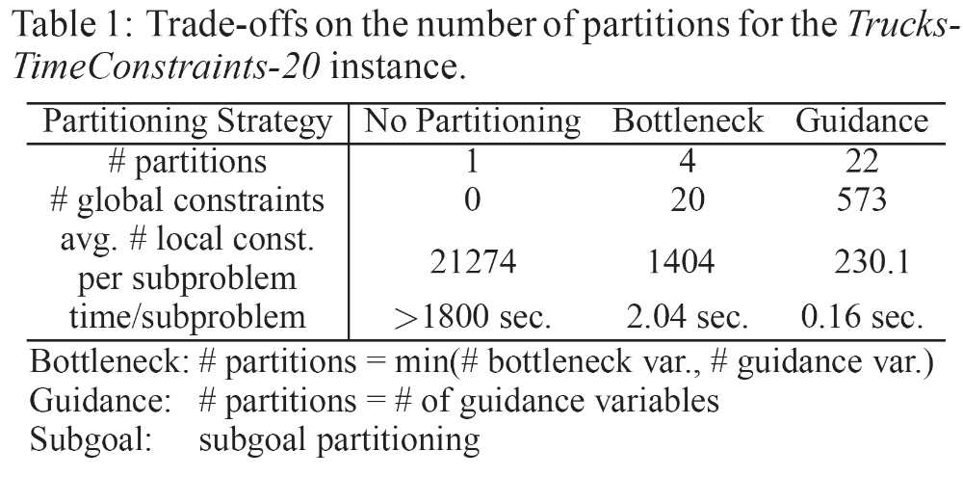
Granularity in Partitioning
Bottleneck variable: variable in a group that other variables depend on
  Ex: Position of Truck in TPP; Position of Hoist in Storage

Slide 16
Summary of Partitioning Approach
Problem representation: MDF
Partitioning attributes: guidance variables
# partitions = min(# guidance var., # bottleneck var.)
Cluster guidance variables using information of constraints/preferences

Slide 17
Outline
Observation on constraint locality
Partition-and-resolve approach
  Partition a problem by its constraints into subproblems
Observation in PDDL3 domains
Architectures of SGPlan₅
  Handling soft goals
  Handling trajectory constraints
  Subproblem-level planning
Conclusions

Slide 18
Architecture of SGPlan₅
Preprocessing
Handling
Trajectory Constraints
Penalty Update
Strategy
Partitioning
Strategy
Global Constraints on Subproblems
Plan
Evaluation
P_1
P_2
P_N
Handling
Soft Goals
Granularity
Control
Temporal Engine
Trajectory Constraint Engine
Search Space Reduction
G_11
G_12
Basic
Planner

Slide 19
Partitioning of Problems with Soft Goals
State is a conjunctive list of state variables
Naïve approach
  Enumerate all reachable values of state variables in (soft and hard) goals
  Choose assignment that optimizes plan metric
To overcome high complexity of enumeration
  Decompose enumeration according to locality of constraints in subgoals
  Conduct heuristic search for large space

Slide 20




Handling Soft Goals
If enumeration cost is small and metric has only soft-goal violations (on final state)
  Enumerate and plan to optimal assignment
Otherwise
  Perform DFS with backtracking
    Use plan metric value as heuristic value
    Plan for each explored node
Soft Const
Penalty
 | 2
 | 3
 | 4
 | 5
(X1,X2,X3)=(0,0,0)
(X1,X2,X3)=(2,0,0)
(X1,X2,X3)=(1,0,0)
Do planning
(X1,X2,X3)=(1,1,0)
(X1,X2,X3)=(1,2,0)
(X1,X2,X3)=(1,3,0)
Do planning

Slide 21
Handling Trajectory Constraints
General difficulties
  Huge complexity to enumerate over intermediate states
  Difficult to detect violation of constraints beforehand
  Need support from basic planner
Approach
  Adapt partition-and-resolve strategy and basic solver for trajectory constraints

Slide 22
Handling Soft Trajectory Constraints
Approach: relax-and-tighten
  Assign a penalty to each soft constraint
  Initially set all penalties to zero
  Call solver with modified heuristic function
  Augment penalties of violated constraints
Update Penalties
Modified heuristic function
Call basic planner
Preference Weights
Solution plan
Compute plan metric
Best solution

Slide 23
Subgoal-level planning
Modified Metric-FF for PDDL3
  Support temporal features and partitioned approach (done in IPC4)
  New search heuristic MCDC, similar to that in Fast Downward
  Penalize actions whose relaxed plan violates trajectory constraints
Search-space reduction
  Eliminate irrelevant actions that only relate to facts or subgoals in other subproblems (done in IPC4)
  Prioritize actions that do not cause inconsistencies of bottleneck state variables (variable ordering)
Subgoal-level decomposition techniques
  Necessary if subproblem is too complicated
  Incremental planning on subproblems with multiple subgoals

Slide 24
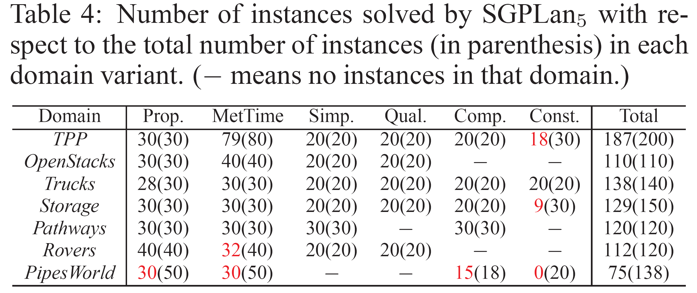
IPC5 Results (2006)
SGPlan₅ solved 871/978 (89%) of the benchmarks
  1st prize in satisficing planners

Slide 25
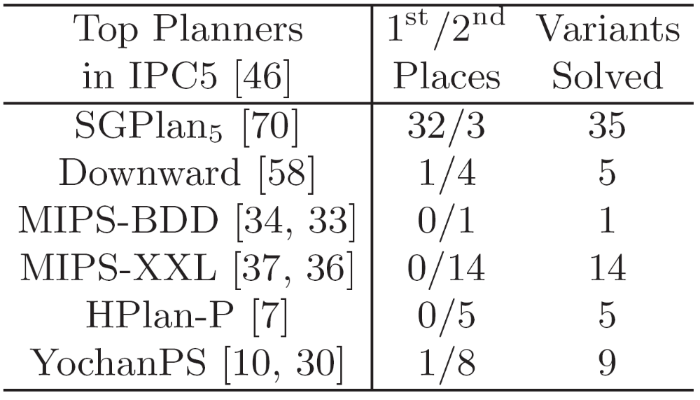
Comparison with Other IPC5 Planners

Slide 26
Conclusions
Constraint partitioning is a powerful approach for exploiting constraint structure and for reducing complexity
  Bottom-up resolution with guidance provided by top-level active global constraints
  Using existing solvers to solve partitioned subproblems
Planning with trajectory constraints and goal preferences
  New partitioning strategy from MDF analysis:
  partitioning attributes and granularity control
  Handling soft goals: enumeration or DFS
  Heuristics for trajectory constraints
  Integration of techniques

Slide 27
Questions?

