Slide 1
New Piggybacking Algorithm In VoIP Using Enhanced G.722.2 Codec With Larger Frames
Wee Hong Yeo, Batu Sat,
and Benjamin W. Wah
University of Illinois, Urbana-Champaign
MMSP’2009

Slide 2
Outline
Introduction
  G.722.2 Codec
  Piggybacking
  Problem Statement
Combining 20ms frames into Larger Frames
Proposed Piggybacking Algorithm
Estimating MED for Piggybacking
Conclusions
MMSP’2009
Yeo, Sat, and Wah

Slide 3
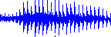
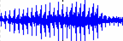
Introduction
Speech Codec
ENCODER
100111100011…..
NETWORK
DECODER
MMSP’2009
Yeo, Sat, and Wah

Slide 4
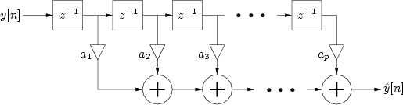
G.722.2 Codec
20-ms frame size, 5-ms sub-frame size
16,000 samples per sec
Algebraic Code Excited Linear Prediction (ACELP)
9 possible bit rates 6.60 – 23.85kbps
Block Diagram of Linear Predictor
*diagram taken from http://www.music.mcgill.ca/~gary/307/week9/node20.html
MMSP’2009
Yeo, Sat, and Wah

Slide 5
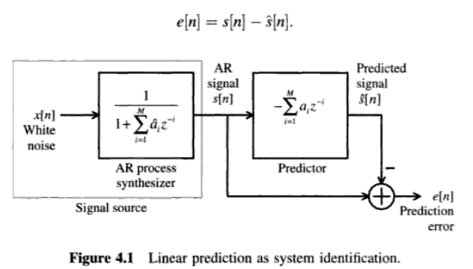
Linear Prediction
Speech
*diagram taken from Speech Coding Algorithms, Wai C. Chu
MMSP’2009
Yeo, Sat, and Wah

Slide 6
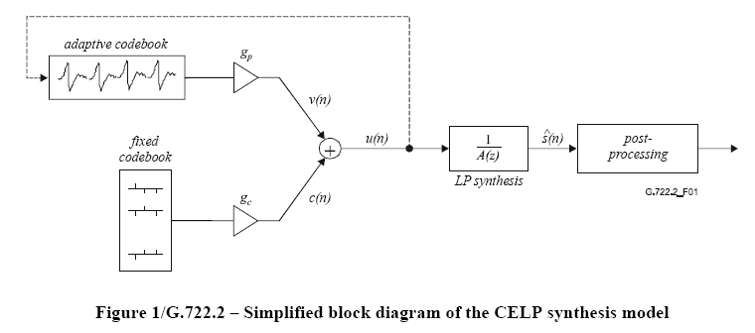
ACELP
*diagram taken from ITU-T G.722.2 Recommendation
MMSP’2009
Yeo, Sat, and Wah

Slide 7
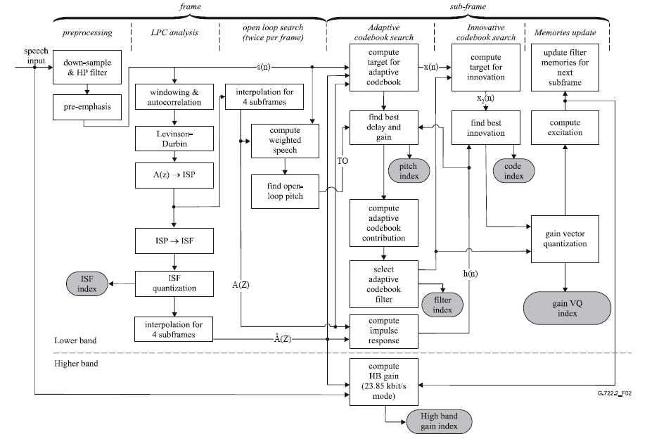
*diagram taken from ITU-T G.722.2 Recommendation
MMSP’2009
Yeo, Sat, and Wah

Slide 8
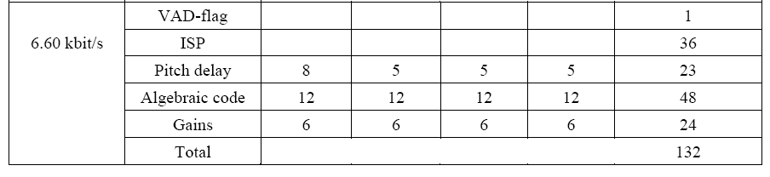
G.722.2 Frame Structure
*table taken from ITU-T G.722.2 Recommendation
MMSP’2009
Yeo, Sat, and Wah

Slide 9
Piggybacking
ISP
ISP
ISP
ISP
ISP
X-4
X-3
X-2
X-1
X
PACKET
ISP
FRAME
144 / 660 = 21.8%
MMSP’2009
Yeo, Sat, and Wah

Slide 10
Problem Statement
Design a new piggybacking algorithm utilizing various frames sizes to achieve high savings in bit rate while incurring little degradation in speech quality
MMSP’2009
Yeo, Sat, and Wah

Slide 11
Outline
Introduction
  G.722.2 Codec
  Piggybacking
  Problem Statement
Combining 20ms frames into Larger Frames
Proposed Piggybacking Algorithm
Estimating MED for Piggybacking
Conclusions
MMSP’2009
Yeo, Sat, and Wah

Slide 12
Combining 20-ms frames into Larger frames
Motivation
  IP network vary from time-division multiplexed network
    Delay is not constant
    Packet rate may be too high
  Redundancy
MMSP’2009
Yeo, Sat, and Wah

Slide 13
Mouth-to-Ear Delay
MED = end-to-end transmission time of first packet
+ frame size * frames/packet + processing time
+ jitter-buffer delay + playout delay
ENCODER
100111100011…..
NETWORK
DECODER
MMSP’2009
Yeo, Sat, and Wah

Slide 14
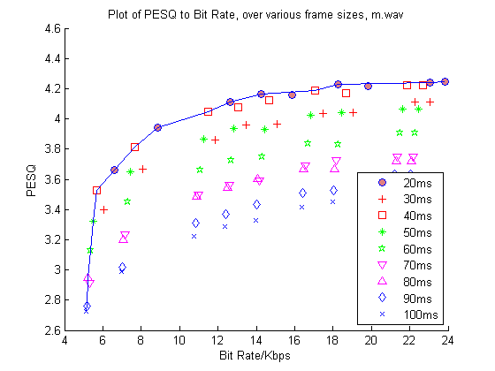
New Configurations
MMSP’2009
Yeo, Sat, and Wah

Slide 15
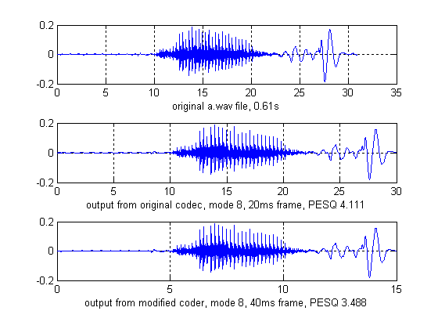
MMSP’2009
Yeo, Sat, and Wah

Slide 16
Outline
Introduction
  G.722.2 Codec
  Piggybacking
  Problem Statement
Combining 20ms frames into Larger Frames
Proposed Piggybacking Algorithm
Estimating MED for Piggybacking
Conclusions
MMSP’2009
Yeo, Sat, and Wah

Slide 17
Proposed Piggybacking Algorithm
Encoder
  Assume 20-ms frame size with piggybacking degree 3
  Single Output Stream
  (− − 1), (− 1 2), (1 2 3), (2 3 4), (3 4 5),
  (4 5 6), (5 6 7), (6 7 8), (7 8 9), (8 9 A),
  (9 A B), (A B C), (B C D), (C D E), (D E F), . . .
MMSP’2009
Yeo, Sat, and Wah

Slide 18
Proposed Piggybacking Algorithm
  3 Coder streams
1) − − 1, 2 3 4, 5 6 7, 8 9 A, B C D . . .
2) − 1 2, 3 4 5, 6 7 8, 9 A B, C D E . . .
3) 1 2 3, 4 5 6, 7 8 9, A B C, D E F . . .
  Number of Coder streams
  = piggybacking degree
MMSP’2009
Yeo, Sat, and Wah

Slide 19
Proposed Piggybacking Algorithm
Decoder
  Split back into 3 decoder streams
Decoder algorithm for piggybacked packets
1: if packet is lost then 2: try to recover the current frame from later packets 3: if unrecoverable then 4: output estimated speech frame 5: end if 6: else 7: output current speech frame 8: plus any other frames that need to be recovered 9: end if
MMSP’2009
Yeo, Sat, and Wah

Slide 20
Quality vs Bit-Rate Tradeoffs under Random Losses
Tested following configurations
    20ms, pd 2,3,4,5
    30ms, pd 2,3
    40ms, pd 2,3
    50ms, pd 2,3
5 – 30% Random Losses
2 Benchmarks, male and female voice
MMSP’2009
Yeo, Sat, and Wah

Slide 21
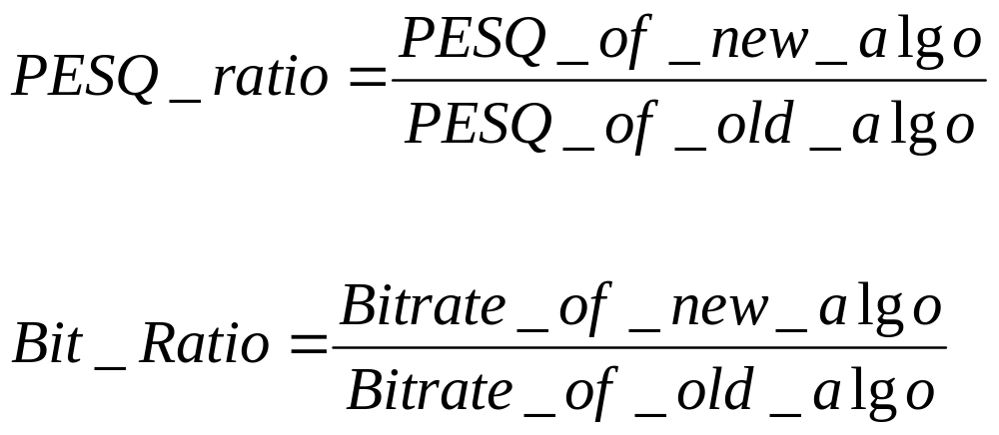
Quality vs Bit-Rate Tradeoffs under Random Losses
MMSP’2009
Yeo, Sat, and Wah

Slide 22
Perceptual Quality
Label PESQ Range Color
No Difference > 3.8 Not Applicable
Just Noticeable Diff. 3.8 – 3.2 Blue
Acceptable 3.2 – 2.5 Green
Tolerable 2.5 – 1.7 Magenta
Intolerable < 1.7 Red
MMSP’2009
Yeo, Sat, and Wah

Slide 23
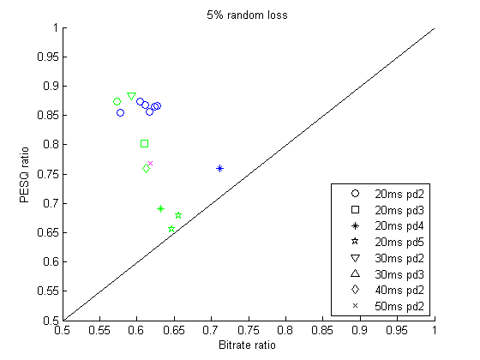
5% Random Loss
MMSP’2009
Yeo, Sat, and Wah

Slide 24
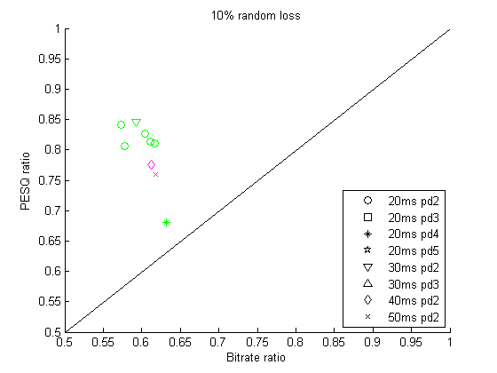
10% Random Loss
MMSP’2009
Yeo, Sat, and Wah

Slide 25
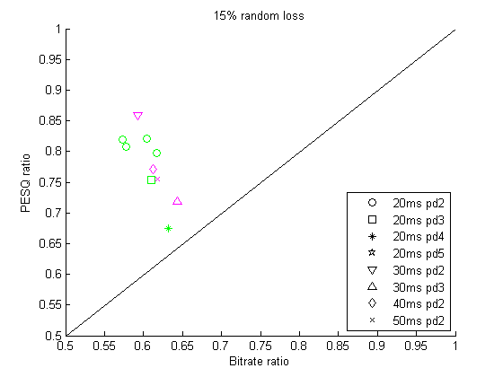
15% Random Loss
MMSP’2009
Yeo, Sat, and Wah

Slide 26
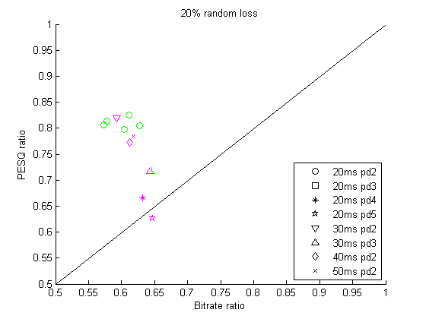
20% Random Loss
MMSP’2009
Yeo, Sat, and Wah

Slide 27
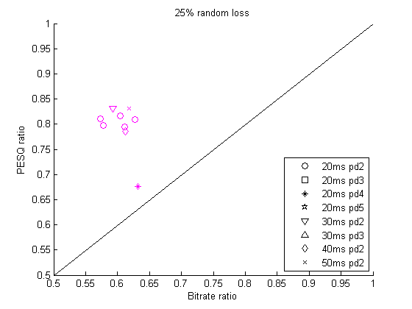
25% Random Loss
MMSP’2009
Yeo, Sat, and Wah

Slide 28
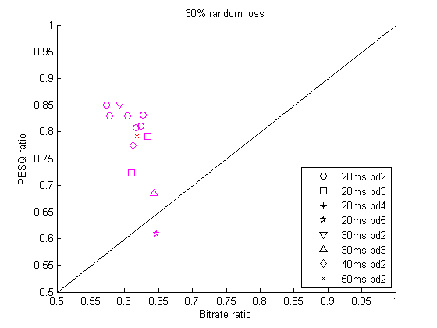
30% Random Loss
MMSP’2009
Yeo, Sat, and Wah

Slide 29
Outline
Introduction
  G.722.2 Codec
  Piggybacking
  Problem Statement
Combining 20ms frames into Larger Frames
Proposed Piggybacking Algorithm
Estimating MED for Piggybacking
Conclusions
MMSP’2009
Yeo, Sat, and Wah

Slide 30
Estimating MED for Piggybacking
MED = end-to-end transmission time of first packet
+ frame size * frames/packet + processing time
+ jitter-buffer delay + playout delay
ENCODER
100111100011…..
NETWORK
DECODER
MMSP’2009
Yeo, Sat, and Wah

Slide 31
Estimating MED for Piggybacking
Jitter-buffer delay = average variation of arrival times
of the first x packets with respect
to the first packet + jitter tolerance
set x = 10
Vary jitter-tolerance from 25ms to 275ms in 50-ms intervals
MMSP’2009
Yeo, Sat, and Wah

Slide 32

PlanetLab Traces Simulation
Over 100 traces
China, Taiwan, US and UK
duration: 5 ~ 10 mins
packet period: 30ms or 60ms
*diagram taken from http://www.planet-lab.org/
MMSP’2009
Yeo, Sat, and Wah

Slide 33
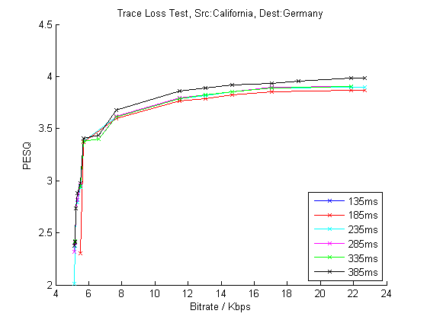
Trace Test Result
MMSP’2009
Yeo, Sat, and Wah

Slide 34
Conclusions
Modified G.722.2 to work with new frame sizes
Effective piggybacking algorithm offering good tradeoffs over various loss rates
Demonstrated effectiveness using random losses and PlanetLab traces
Simple Algorithm for estimating MED
MMSP’2009
Yeo, Sat, and Wah

Slide 35
Recommended Configs
Frame Size/ms | Piggybacking Degree | Bitrate/kbps
20 | 2 | 11.35, 15.35, 22.95
30 | 2 | 10.733
40 | 2 | 10.425
50 | 2 | 10.240
MMSP’2009
Yeo, Sat, and Wah

Slide 36
Questions?
MMSP’2009
Yeo, Sat, and Wah

