Slide 1
Wildfire-lab
Benjamin Rio

Slide 2
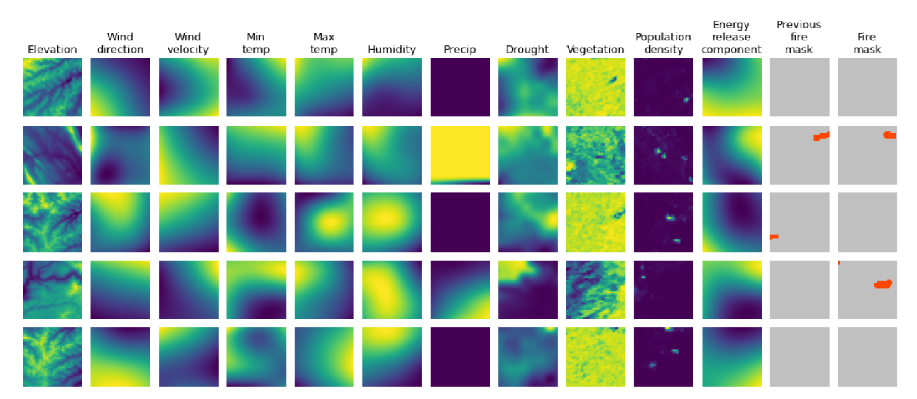
Google: predicting next-day fire masks
Multivariate data set of historical wildfires aggregating nearly a decade of remote sensing data across the United States
Lead time = 1 day

Slide 3

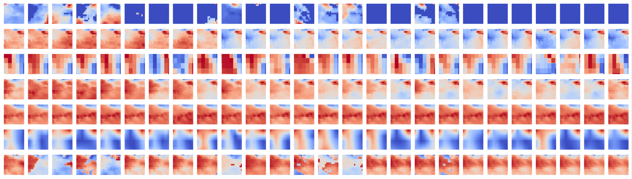
Satellite Weather Data Extraction
For each fire, get 26 days of data
Precipitation (mm)
Specific humidity
(mass fraction)
Wind direction
Max temp (K)
Min temp (K)
Wind velocity (ms)
Energy release
component
day
-5
0
20
First operational
report (in SIT209)
3-weeks lead (current day + 20 days after)
5-day lag

Slide 4







Mutlimodal Dataset
Precipitation
Specific humidity
Wind direction
Satellite images
from GEE, stored
in Google Cloud
Storage
Max temp
Shape: (7, 64, 64)
Min temp
Wind velocity
X = fire report
Query: (report, day)
Energy release
component
Tabular features
SIT 209
Shape: (51,)
Reports
Fire behaviour (1-hot)
Fuel type (1-hot)
Suppression method (1-hot)
Fire spread
Y = next-day
fire area
value reported in SIT
Shape: (1,)
Next-day fire spread

Slide 5
Multimodal model
Precipitation
(7, 64, 64)
Specific humidity
(128)
Wind direction
Max temp
efficientNet
Min temp
(128+8)
Wind velocity
(1)
Energy release
component
FFN
L=1
(49)
(8)
FFN
L=2
Fire behaviour (1-hot)
Fuel type (1-hot)
Suppression method (1-hot)
Fire spread

Slide 6
Problems
Target: skewed, biased, noisy
Features:
1. Tabular data: biased
2. Satellite images: missing images, no interpolation, noise
Model:
How many layers to freeze? (0 -> fully-retrained)

Slide 7
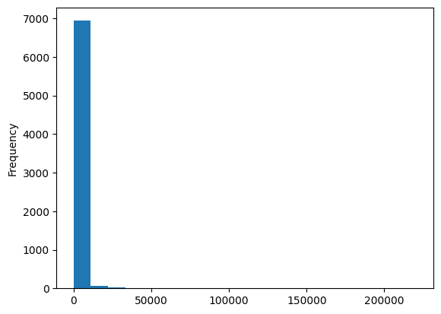
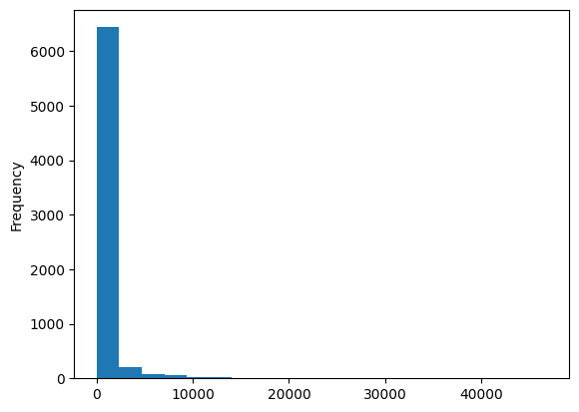
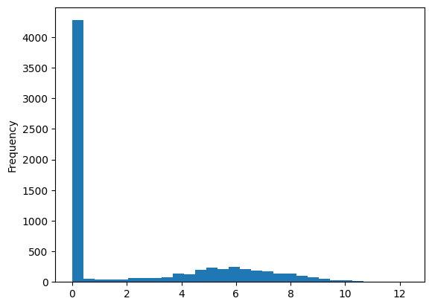
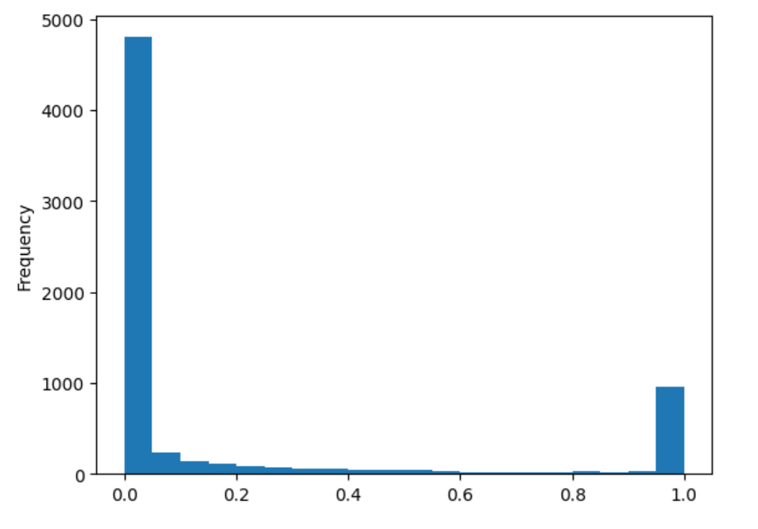
Appendix: Target
Difference
Log(1+diff)
Ratio : day/day before

Slide 8
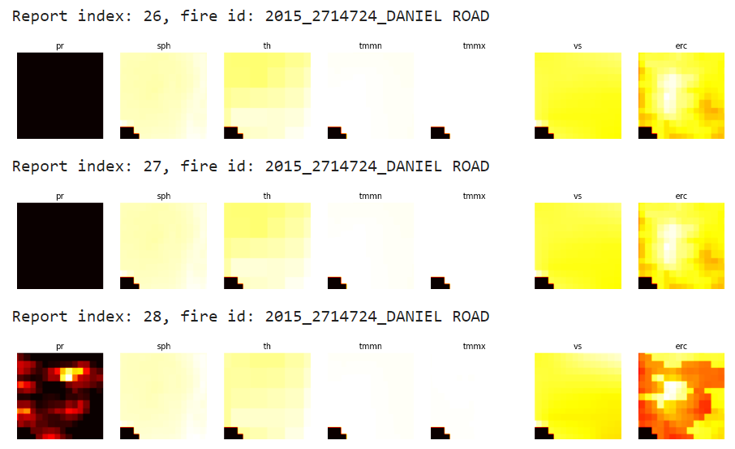
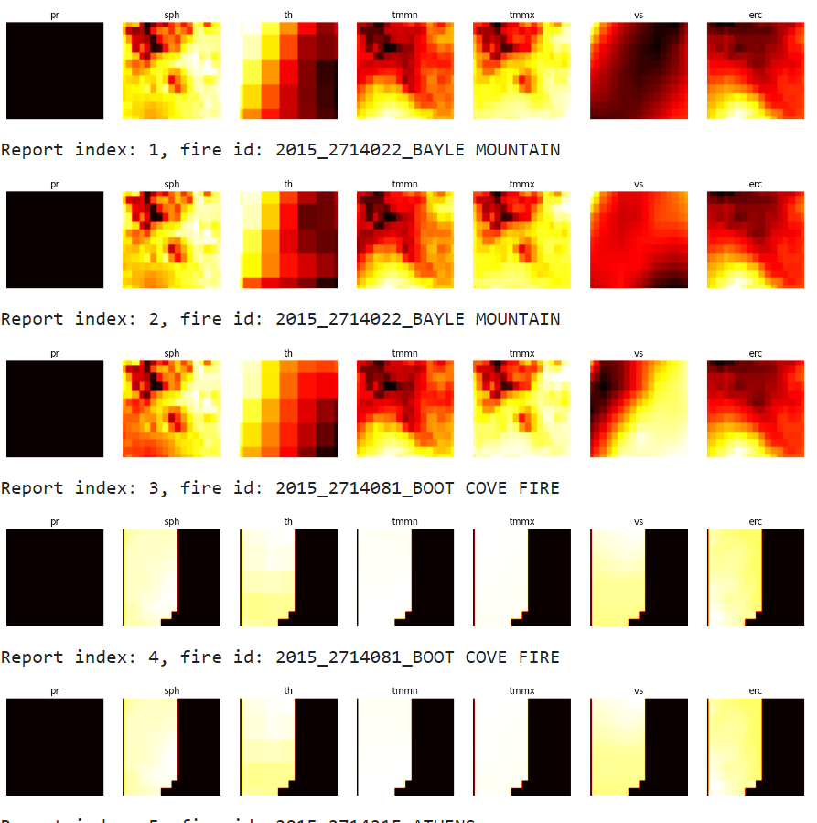
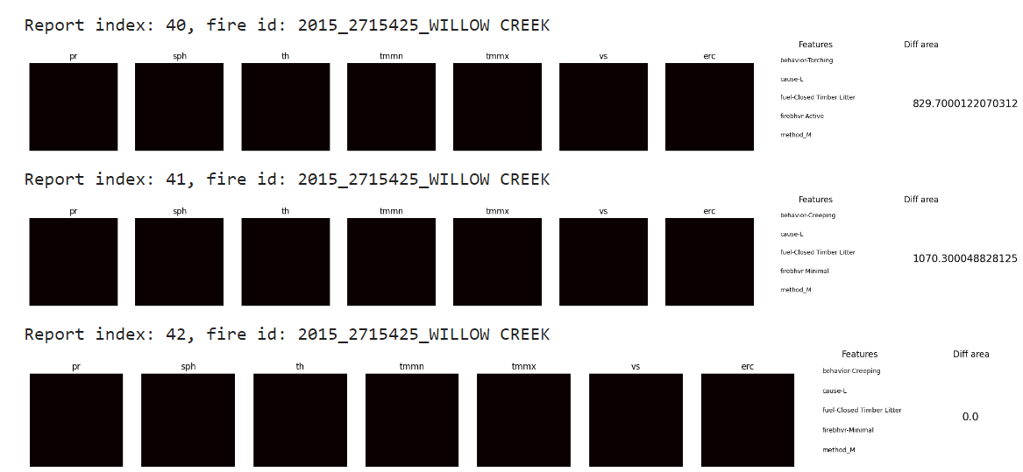
Satelite images

Slide 9
Notes
Model
Ablation study: just features => test relative:
Create exp class: use args for rel/abs growth, multimodal, log distribution
2. Model with 2 unfreezed layers, Lr=3e-4, 5e-5
Log distribution-> create 3-5 classes
3. Relative vs absolute growth
4. Only train with non-zeros reports
Data
Download 1000 ->n
2. Target
3. interpolation

