Slide 1




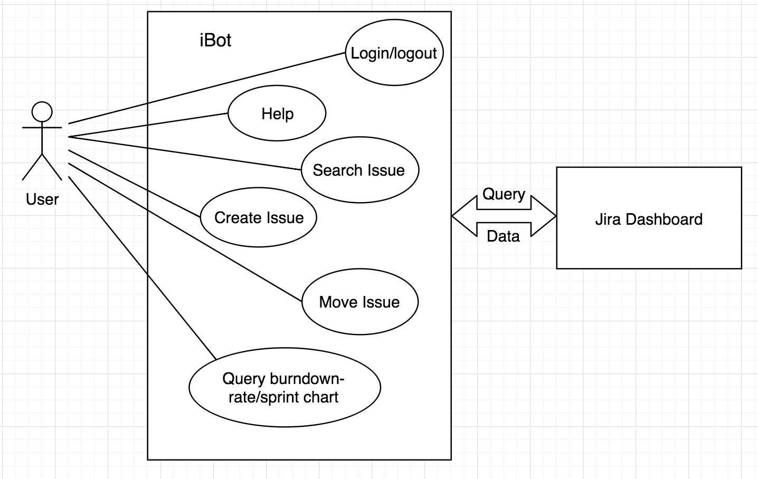
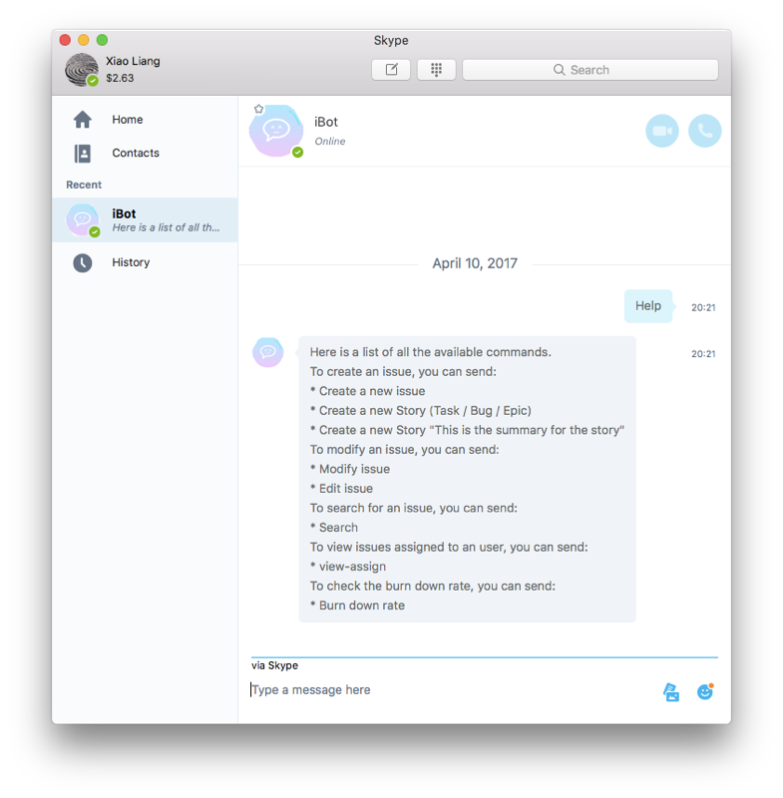
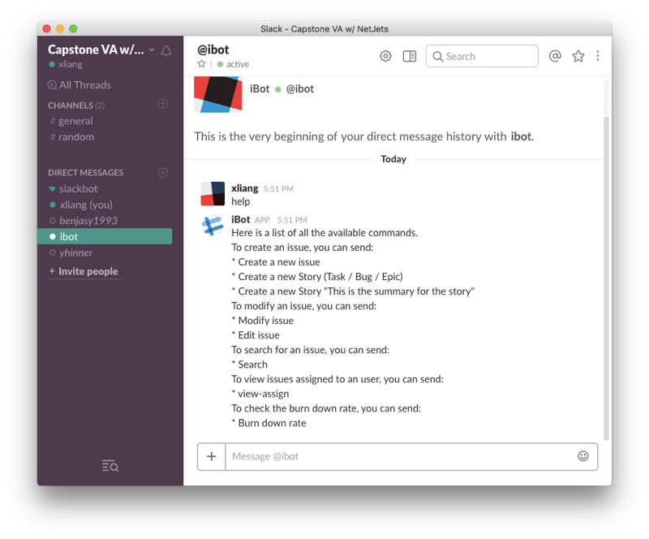

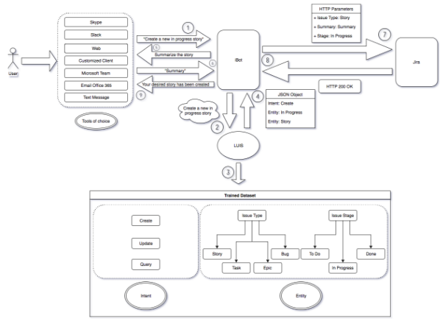

Xiao Liang
Yun Ma
Xuzhou Yin
Young Liu
iBot
Introduction
Software Analysis & Design
Facts
Some tasks that IT staffs are doing everyday have cumbersome steps and unnecessary complexity.
Time is money, simplifying the workflow is urgent.
Problem
There is a need of a simple virtual assistant tool that can simplify the steps of daily IT works and improve the efficiency of IT employees.
This tool
Project Goal
Developing a user-oriented chatting bot that can understand human language accurately and reply messages.
This bot should be able to interact with project management platforms.
This bot should be able to support multiply mainstream communication channels such as Skype, Slack and Emulators.
This bot should be able to identify users and provide customized features.
Current Methods
At this time, employees can only type commands to finish simple works. But more complex customized features are not available now and need further development.
Open sources like APIs for bot are limited in the related software area. Therefore, useful functionalities cannot be integrated.
Approach
Agile
Use Jira to track progress and issues
Iterative development
Gather feedback from user in order to continously improve our product
Test driven development
Doing testing along with developing to ensure product quality
Figure 2: User Case Diagram
Functional Requirements
Respond when user joins
Create cards/issues in Jira
Search cards/issues in Jira
Assign issue to user
Change issue status
Set priority for each task
Cancel issue creation
Help command
Sign in/ sign out
Other features
Burn down rate
Sprint report
Figure 3: iBot on Skype and Slack
Significance
The group creates a workable prototype with many useful features.
Well-documented system design and architecture help better understanding on current features and future extensions.
Organized code design provides space for further developments on customized features.
iBot
System Architecture
Future Work
Enhancements and Extensions
Integrating with more DevOps tools
Customized features such as calendar, emails and summary
Voice input
Group chat with multiple users
Acknowledgement
Figure 1: Software Architecture
A special thank to our professor Ramasamy. And we would also like to thank our classmate in CSE5911 for their support.
User-iBot: input human language and output result
User-LUIS: analyze words into intent and entity with machine learning
User-Jira/Jenkins: RESTful API calls

